Slide 1
English II Pre-AP
Outside Reading Book Clubs!

Slide 2
Why Outside Reading? Why Student Choice Clubs?
develops learner autonomy- self direction.
offers comprehensible input- to apply and make connections
helps develop general, world knowledge- to make connections
consolidates and sustains vocabulary growth
helps improve writing
creates and sustains motivation to read more
based on student-interests
builds interdependence with peers

Slide 3
The Concept
You need at least 4 and no more than 6 to make a book club
All clubs will be responsible for the same assignments and socratic seminars
Writing, analysis, projects, and presentations will be included for EVERYONE, whatever the book choice
Everyone will know about one another’s books by sharing in seminars, presentations, and the like.
Every group will “teach” the top rhetorical strategy/s used in their book with an excerpt provided to the class.
Every group will come up with an arguable claim provided from their book to argue / debate in class.

Slide 4
The Many Choices ☺ *take notes
Bradbury's vividly painted society holds up the appearance of happiness as the highest goal--a place where trivial information is good, and knowledge and ideas are bad. Fire Captain Beatty explains it this way, "Give the people contests they win by remembering the words to more popular songs.... Don't give them slippery stuff like philosophy or sociology to tie things up with. That way lies melancholy."
Guy Montag is a book-burning fireman undergoing a crisis of faith. His wife spends all day with her television "family," imploring Montag to work harder so that they can afford a fourth TV wall. Their dull, empty life sharply contrasts with that of his next-door neighbor Clarisse, a young girl thrilled by the ideas in books, and more interested in what she can see in the world around her than in the mindless chatter of the tube. When Clarisse disappears mysteriously, Montag is moved to make some changes, and starts hiding books in his home. Eventually, his wife turns him in, and he must answer the call to burn his secret cache of books. After fleeing to avoid arrest, Montag winds up joining an outlaw band of scholars who keep the contents of books in their heads, waiting for the time society will once again need the wisdom of literature.
Farenhiet 451 by Ray Bradbury

Slide 5
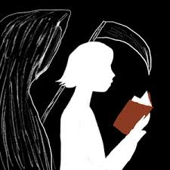
The Book Thief by Markus Zusak
The extraordinary #1 New York Times bestseller that is now a major motion picture, Markus Zusak's unforgettable story is about the ability of books to feed the soul. It is 1939. Nazi Germany. The country is holding its breath. Death has never been busier, and will become busier still. Liesel Meminger is a foster girl living outside of Munich, who scratches out a meager existence for herself by stealing when she encounters something she can’t resist–books. With the help of her accordion-playing foster father, she learns to read and shares her stolen books with her neighbors during bombing raids as well as with the Jewish man hidden in her basement. In superbly crafted writing that burns with intensity, award-winning author Markus Zusak, author of I Am the Messenger, has given us one of the most enduring stories of our time.

Slide 6
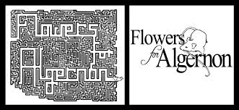
Daniel Keyes wrote little SF but is highly regarded for one classic, Flowers for Algernon. As a 1959 novella it won a Hugo Award; the 1966 novel-length expansion won a Nebula. The Oscar-winning movie adaptation Charly (1968) also spawned a 1980 Broadway musical.
Following his doctor's instructions, engaging simpleton Charlie Gordon tells his own story in semi-literate "progris riports." He dimly wants to better himself, but with an IQ of 68 can't even beat the laboratory mouse Algernon at maze-solving:
I dint feel bad because I watched Algernon and I lernd how to finish the amaze even if it takes me along time.
I dint know mice were so smart.
Algernon is extra-clever thanks to an experimental brain operation so far tried only on animals. Charlie eagerly volunteers as the first human subject. After frustrating delays and agonies of concentration, the effects begin to show and the reports steadily improve: "Punctuation, is? fun!" But getting smarter brings cruel shocks, as Charlie realizes that his merry "friends" at the bakery where he sweeps the floor have all along been laughing at him, never with him. The IQ rise continues, taking him steadily past the human average to genius level and beyond, until he's as intellectually alone as the old, foolish Charlie ever was--and now painfully aware of it. Then, ominously, the smart mouse Algernon begins to deteriorate...
Flowers for Algernon is a timeless tear-jerker with a terrific emotional impact. --David Langford
By Daniel Keyes

Slide 7
House of the Scorpion by Nancy Farmer
Matteo Alacrán was not born; he was harvested. His DNA came from El Patrón, lord of a country called Opium--a strip of poppy fields lying between the United States and what was once called Mexico. Matt's first cell split and divided inside a petri dish. Then he was placed in the womb of a cow, where he continued the miraculous journey from embryo to fetus to baby. He is a boy now, but most consider him a monster--except for El Patrón. El Patrón loves Matt as he loves himself, because Matt is himself. As Matt struggles to understand his existence, he is threatened by a sinister cast of characters, including El Patrón's power-hungry family, and he is surrounded by a dangerous army of bodyguards. Escape is the only chance Matt has to survive. But escape from the Alacrán Estate is no guarantee of freedom, because Matt is marked by his difference in ways he doesn't even suspect.

Slide 8
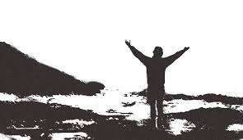
In April 1992 a young man from a well-to-do family hitchhiked to Alaska and walked alone into the wilderness north of Mt. McKinley. His name was Christopher Johnson McCandless. He had given $25,000 in savings to charity, abandoned his car and most of his possessions, burned all the cash in his wallet, and invented a new life for himself. Four months later, his decomposed body was found by a moose hunter....
INTO THE WILD by Jon Krakauer

Slide 9
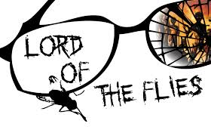
By William Golding
Before The Hunger Games there was Lord of the Flies Lord of the Flies remains as provocative today as when it was first published in 1954, igniting passionate debate with its startling, brutal portrait of human nature. Though critically acclaimed, it was largely ignored upon its initial publication. Yet soon it became a cult favorite among both students and literary critics who compared it to J.D. Salinger's The Catcher in the Rye in its influence on modern thought and literature. William Golding's compelling story about a group of very ordinary small boys marooned on a coral island has become a modern classic. At first it seems as though it is all going to be great fun; but the fun before long becomes furious and life on the island turns into a nightmare of panic and death. As ordinary standards of behaviour collapse, the whole world the boys know collapses with them—the world of cricket and homework and adventure stories—and another world is revealed beneath, primitive and terrible.Labeled a parable, an allegory, a myth, a morality tale, a parody, a political treatise, even a vision of the apocalypse, Lord of the Flies has established itself as a true classic.
"Lord of the Flies is one of my favorite books. That was a big influence on me as a teenager, I still read it every couple of years." —Suzanne Collins, author of The Hunger Games "As exciting, relevant, and thought-provoking now as it was when Golding published it in 1954." —Stephen King

Slide 10
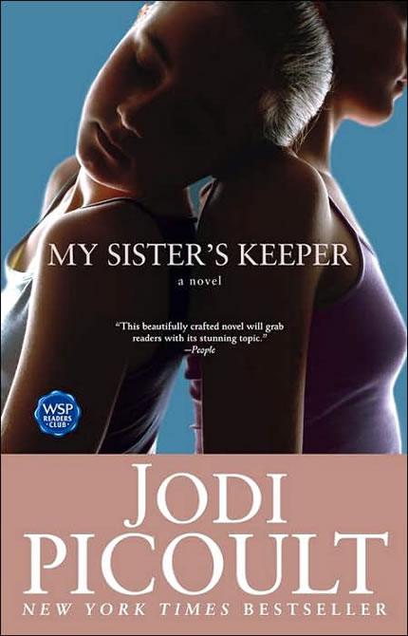
Handouts
My Sister’s Keeper examines what it means to be a good parent, a good sister, and a good person. Is it morally correct to do whatever it takes to save a child's life?
Like most teenagers, Anna is beginning to question who she truly is. But unlike most teenagers, she has always been defined in terms of her sister - and so Anna makes a decision that for most would be unthinkable… a decision that will tear her family apart and have perhaps fatal consequences for the sister she loves. My Sister's Keeper examines what it means to be a good parent, a good sister, a good person. Is it morally correct to do whatever it takes to save a child's life… even if that means infringing upon the rights of another? Is it worth trying to discover who you really are, if that quest makes you like yourself less?

Slide 11
One Flew Over the Cuckoo’s Nest by Ken Kesey
An international bestseller and the basis for a hugely successful film, Ken Kesey's One Flew Over the Cuckoo's Nest was one of the defining works of the 1960s.
A mordant, wickedly subversive parable set in a mental ward, the novel chronicles the head-on collision between its hell-raising, life-affirming hero Randle Patrick McMurphy and the totalitarian rule of Big Nurse. McMurphy swaggers into the mental ward like a blast of fresh air and turns the place upside down, starting a gambling operation, smuggling in wine and women, and egging on the other patients to join him in open rebellion. But McMurphy's revolution against Big Nurse and everything she stands for quickly turns from sport to a fierce power struggle with shattering results.
With One Flew Over the Cuckoo's Nest, Kesey created a work without precedent in American literature, a novel at once comic and tragic that probes the nature of madness and sanity, authority and vitality. Greeted by unanimous acclaim when it was first published, the book has become and enduring favorite of readers.

Slide 12
Girl With A Pearl Earring by Tracy Chevalier
One of the best-loved paintings in the world is a mystery.
Who is the model and why has she been painted? What is she thinking as she stares out at us? Are her wide eyes and enigmatic half-smile innocent or seductive? And why is she wearing a pearl earring?
Girl With a Pearl Earring tells the story of Griet, a 16-year-old Dutch girl who becomes a maid in the house of the painter Johannes Vermeer. Her calm and perceptive manner not only helps her in her household duties, but also attracts the painter's attention. Though different in upbringing, education and social standing, they have a similar way of looking at things. Vermeer slowly draws her into the world of his paintings - the still, luminous images of solitary women in domestic settings.
As Griet becomes part of her master's work, their growing intimacy spreads disruption and jealousy within the ordered household and even - as the scandal seeps out - ripples in the world beyond.

Slide 13
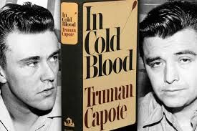
On November 15, 1959, in the small town of Holcomb, Kansas, four members of the Clutter family were savagely murdered by blasts from a shotgun held a few inches from their faces. There was no apparent motive for the crime, and there were almost no clues.
As Truman Capote reconstructs the murder and the investigation that led to the capture, trial, and execution of the killers, he generates both mesmerizing suspense and astonishing empathy. In Cold Blood is a work that transcends its moment, yielding poignant insights into the nature of American violence.

Slide 14
1984 by George Orwell
Written in 1948, 1984 was George Orwell’s chilling prophecy about the future. And while 1984 has come and gone, Orwell’s narrative is timelier than ever. 1984 presents a startling and haunting vision of the world, so powerful that it is completely convincing from start to finish. No one can deny the power of this novel, its hold on the imaginations of multiple generations of readers, or the resiliency of its admonitions—a legacy that seems only to grow with the passage of time.

Slide 15
INVISIBLE MAN by Ralph Ellison
Invisible Man is a milestone in American literature, a book that has continued to engage readers since its appearance in 1952. A first novel by an unknown writer, it remained on the bestseller list for sixteen weeks, won the National Book Award for fiction, and established Ralph Ellison as one of the key writers of the century. The nameless narrator of the novel describes growing up in a black community in the South, attending a Negro college from which he is expelled, moving to New York and becoming the chief spokesman of the Harlem branch of "the Brotherhood", and retreating amid violence and confusion to the basement lair of the Invisible Man he imagines himself to be. The book is a passionate and witty tour de force of style, strongly influenced by T.S. Eliot's The Waste Land, Joyce, and Dostoevsky.

Slide 16
Grade 10 Up–In 1906, Sinclair published The Jungle, a realistic and scathing portrayal of the life of an immigrant worker. Kuper's revised adaptation focuses solely on its hero, Jurgis Rudkus. Readers follow him from his emigration from Lithuania to downtown Chicago, eager to find the American Dream he's heard so much about. But the harsh world of Chi-town quickly shatters his hopes; forced to take a job at a slaughterhouse, he performs the most menial and vile tasks. An injury pushes him to unemployment and, unable to provide for them, he leaves his family in shame. Rudkus transforms from a starry-eyed dreamer into a cynical but valiant man who fights for workers' rights. Kuper's artwork effectively mimics some of the major art movements of the day.

Slide 17
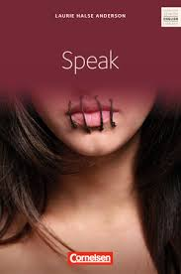
The first ten lies they tell you in high school. "Speak up for yourself--we want to know what you have to say." From the first moment of her freshman year at Merryweather High, Melinda knows this is a big fat lie, part of the nonsense of high school. She is friendless, outcast, because she busted an end-of-summer party by calling the cops, so now nobody will talk to her, let alone listen to her. As time passes, she becomes increasingly isolated and practically stops talking altogether. Only her art class offers any solace, and it is through her work on an art project that she is finally able to face what really happened at that terrible party: she was raped by an upperclassman, a guy who still attends Merryweather and is still a threat to her. Her healing process has just begun when she has another violent encounter with him. But this time Melinda fights back, refuses to be silent, and thereby achieves a measure of vindication. In Laurie Halse Anderson's powerful novel, an utterly believable heroine with a bitterly ironic voice delivers a blow to the hypocritical world of high school. She speaks for many a disenfranchised teenager while demonstrating the importance of speaking up for oneself.
SPEAK by Laurie Halse Anderson

Slide 18
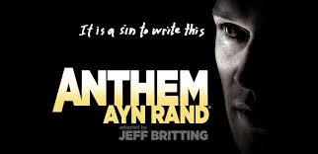
Ayn Rand came of age during the ascendancy of collectivism across the globe — not only in communist Russia, from which she escaped in 1926, but also in fascist Italy, Nazi Germany, and to an alarming degree in her adopted homeland, America. Rand identified collectivism — the idea that individuals should be subjugated to the group and sacrificed for the common good — not only as a moral evil but as the essential cause of the political evils then engulfing the civilized world.
In the summer of 1937, Rand took a break from working on The Fountainhead to write the novelette called Anthem, a short, highly stylized tale of a future dystopia so saturated in collectivism that the word “I” has disappeared from the language.
First published in England in 1938, Anthem was rejected by collectivist-dominated American publishers in the 1930s — an American edition (slightly revised by Rand) did not appear until 1946.

Slide 19
A Separate Peace by John Knowles
An American classic and great bestseller for over thirty years, A Separate Peace is timeless in its description of adolescence during a period when the entire country was losing its innocence to the second world war. Set at a boys’ boarding school in New England during the early years of World War II, A Separate Peace is a harrowing and luminous parable of the dark side of adolescence. Gene is a lonely, introverted intellectual. Phineas is a handsome, taunting, daredevil athlete. What happens between the two friends one summer, like the war itself, banishes the innocence of these boys and their world. A bestseller for more than thirty years, A Separate Peace is John Knowles’s crowning achievement and an undisputed American classic.

Slide 20
The Best Part… the books are available in our awesome library!

