Slide 1
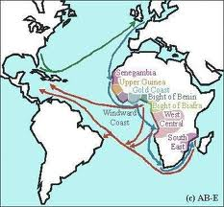
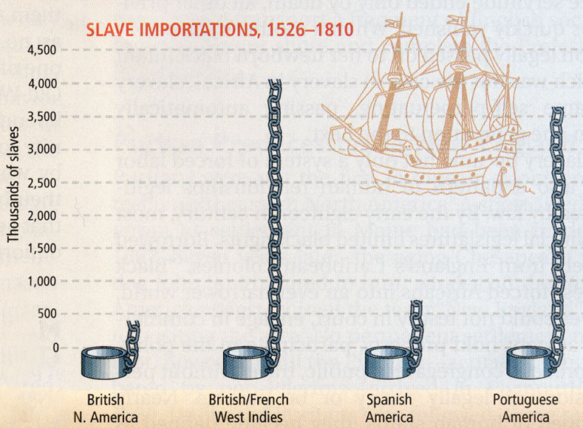
Ch. 21 Africa and the Africans in the Age of the Atlantic Slave Trade

Slide 2
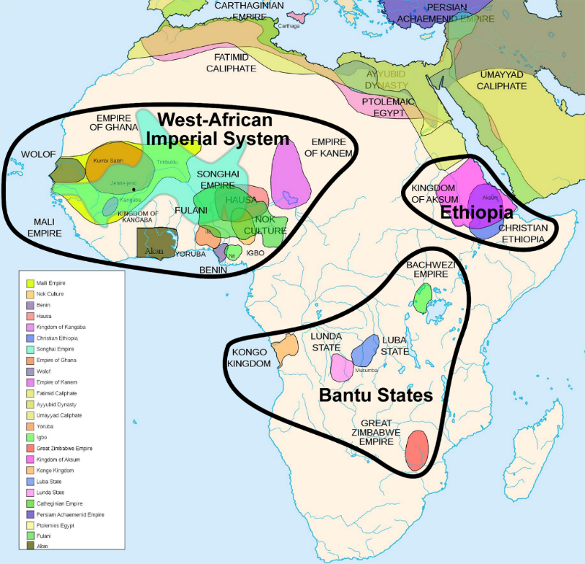
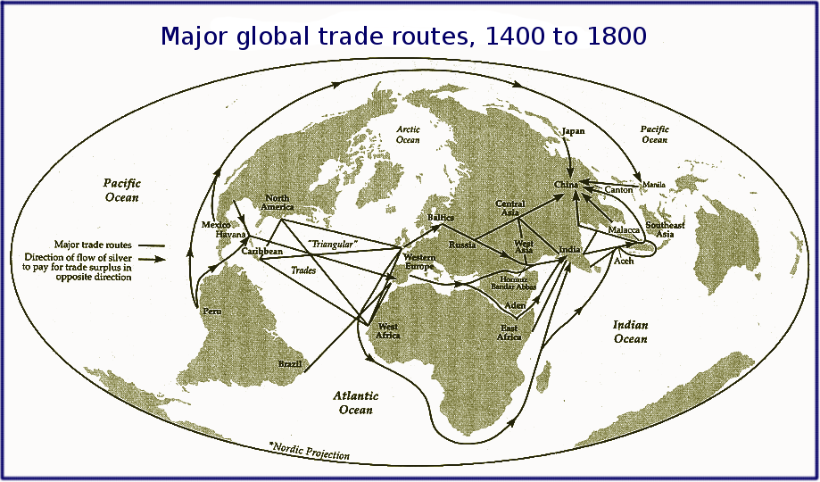
Sub-Saharan Africa was previously linked to the Muslim world in many ways
West African Kingdoms
Swahili city-states
Islam remained important
Eastern Africa – trade with western Asia remained
Influences of Islam and the West (lasted to 19th century)
Religious conversion
Political reorganization
Social changes

Slide 3
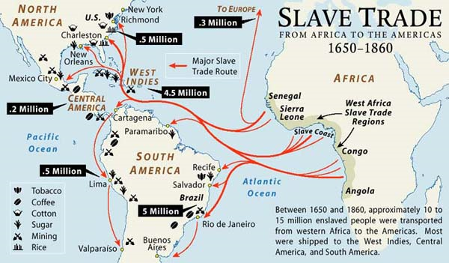
During the age of European maritime and commercial expansion, areas of Africa were brought into expanding world economy
After 1450 – contacts between European and Africans (primarily through slave trade) resulted in the movements of millions of Africans
Middle East
Europe
Americas
Not all European contact with Africa was centered on the slave trade, nor was the desire for slaves the only impulse behind European explorations

Slide 4
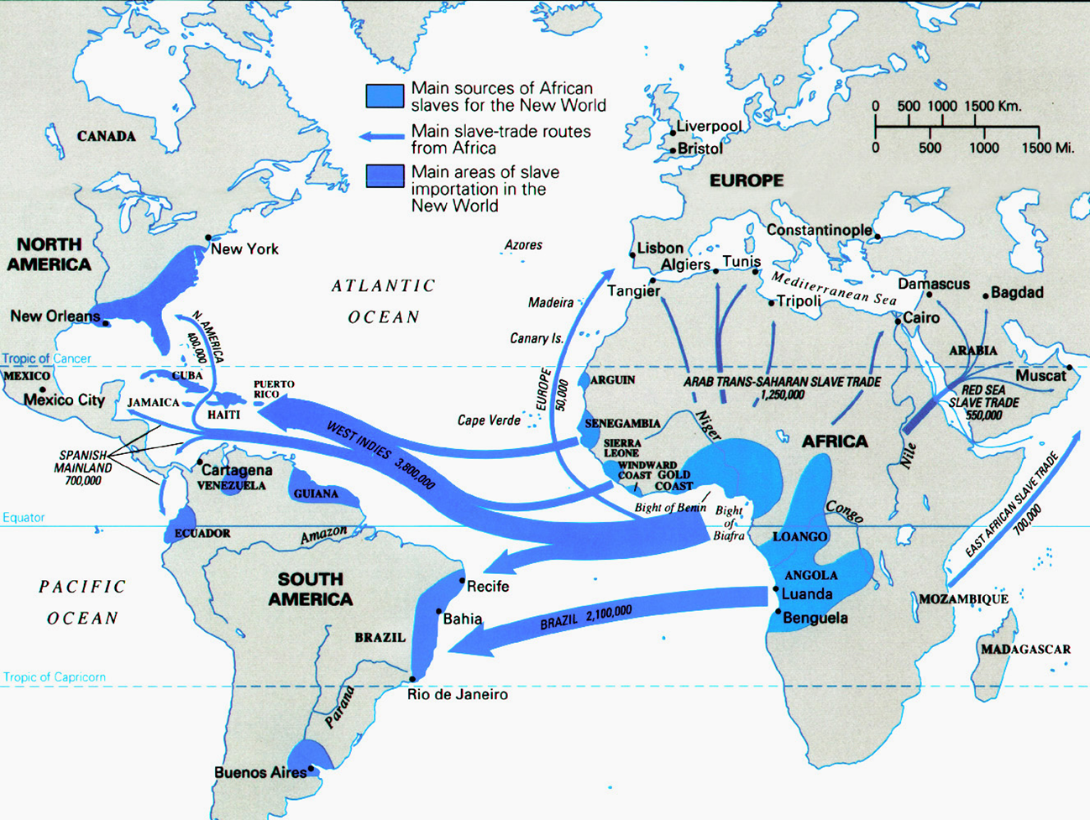

Slide 5
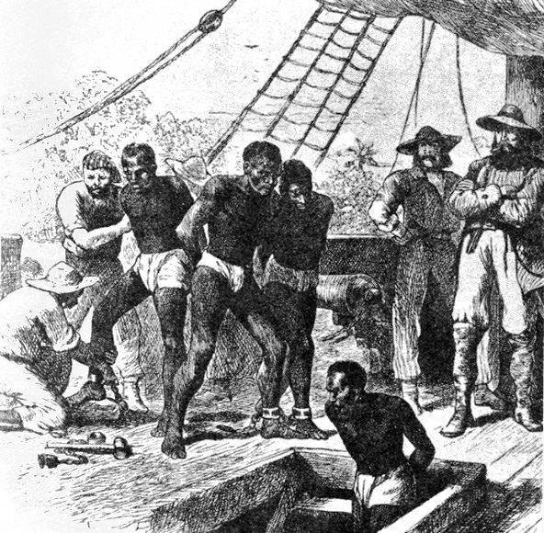
Forced movement of Africans as captive laborers and creation of slave-based societies in the Americas were major aspects of the formation of the modern world and growth of the economies of western Europe
Forced migration was part of the international exchange
Foods, diseases, animals, ideas
African culture was transferred, contributing to the creation of new cultural forms

Slide 6
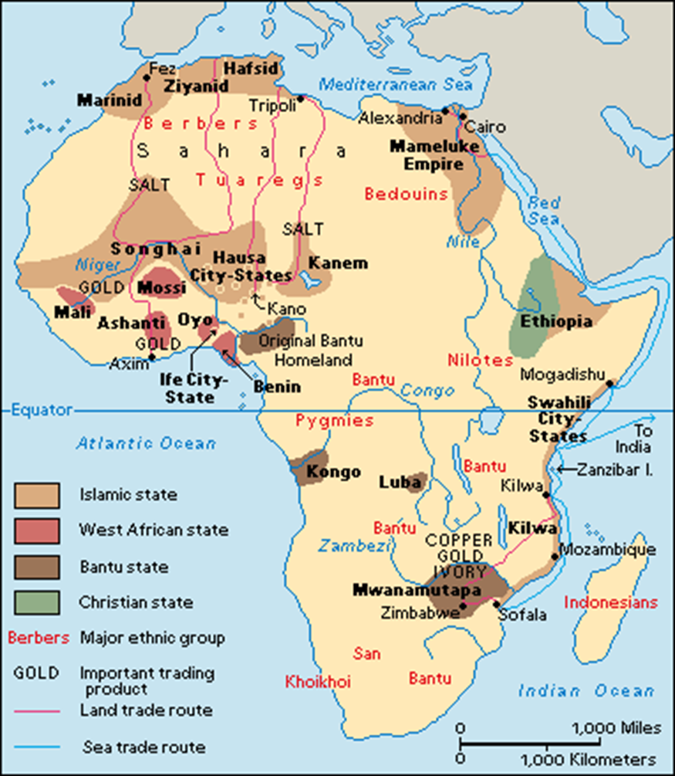
Almost all of Africa remained independent of outside political control, and most cultural development was autonomous as well
Islam consolidated its position in east Africa and the Sudan
In Ethiopia – Christian kingdom of the highlands continued to hold off Muslim rivals
In many places in Africa (as in Europe) independent states formed and began to expand
Resulted from a population expansion
Spread of iron tools and improved agriculture

Slide 7
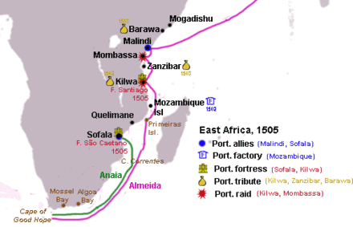
The Atlantic Slave Trade
1487 – Portuguese ships reached the Cape of Good Hope
Along the coast, the Portuguese established factories
Forts and trading posts with resident merchants
Allowed the Portuguese to exercise some control with few personnel
Established with the consent of local rulers, who benefited from access to European commodities and sometimes from the military support the Portuguese provided in local wars
The Portuguese were not powerful enough to enforce their will on the larger west African states

Slide 8
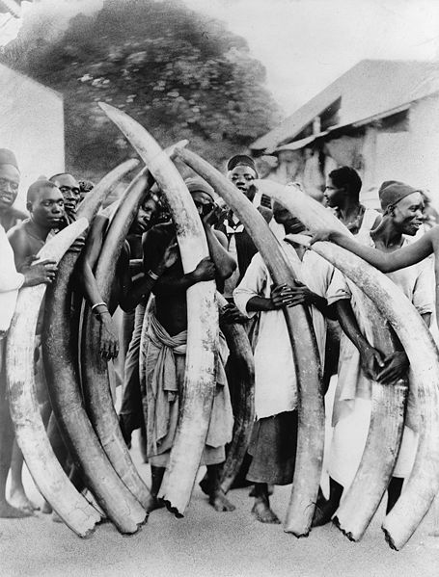
Africans acquired goods from the Portuguese, who sometimes provided African rulers with slaves brought from other stretches of the coast
In return, the Portuguese received ivory, pepper, animal skins, and gold

Slide 9
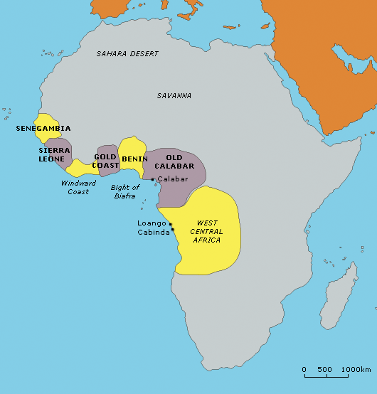
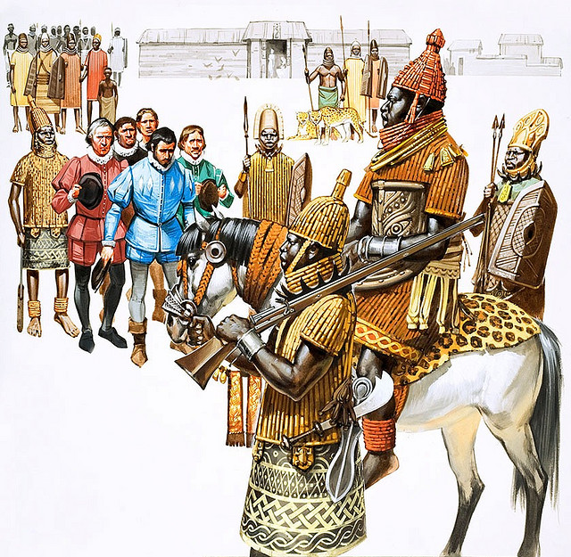
Trade was the basis of Portuguese relations with Africans
Political, religious, and social relations
Senegambian coast – small states did not impress the Portuguese
Suspicious of Muslims, their traditional enemies
When they reached the Gold Coast (modern Ghana) and found the Kingdom of Benin, they were impressed by the power of the ruler and the magnificence of his court
Other large African states provoked similar responses
King of Benin receive Portuguese traders

Slide 10
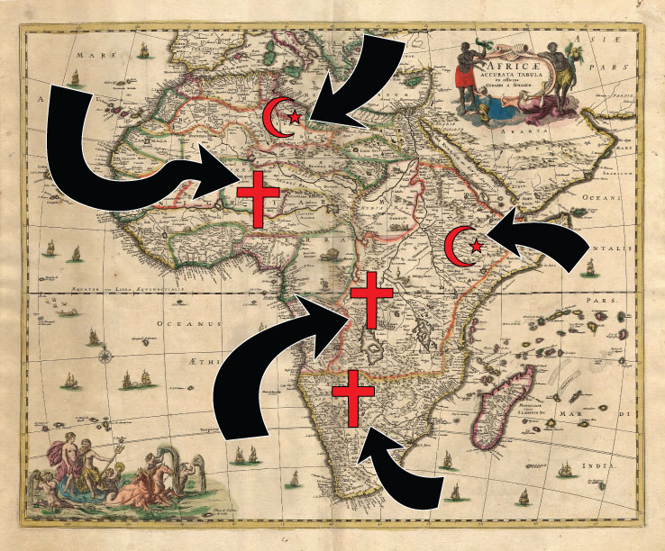
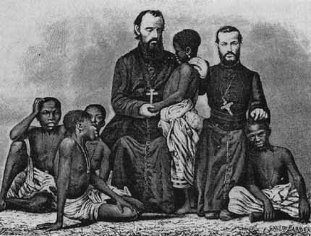
1484 - Missionary efforts were made to convert the rulers of Benin, Kongo, and other African kingdoms
Kongo – members of the royal family were converted
The whole Kingdom was eventually brought under Christianity
Ruler Nzinga Mvemba (1507-1543)
Portuguese advisors and missionaries

Slide 11
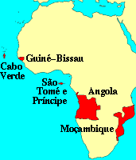
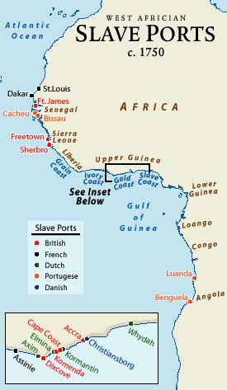
1570s – Portuguese colony of Angola
Portuguese tried to dominate the existing trading system of the African ports in the Indian Ocean and Red Sea
Portuguese effort was primarily commercial, accompanied by a strong missionary effort
17th century – Dutch, English, French, and others competed with the Portuguese and displaced them (to some extent)
System of fortified trading stations
Combination of force and diplomacy
Alliances with local rulers
Predominance of commercial relations

Slide 12
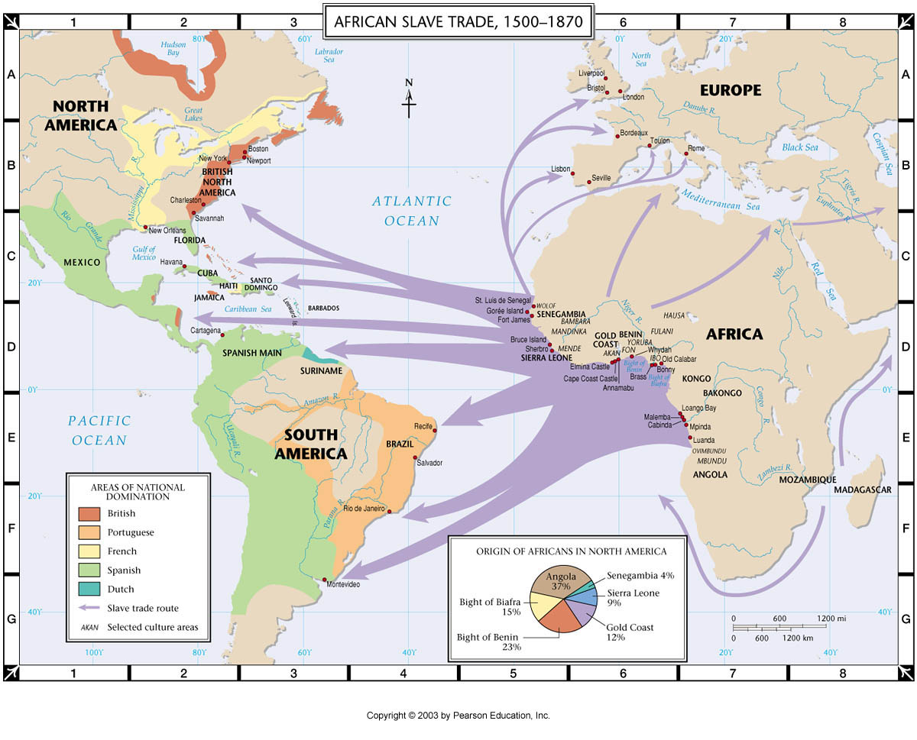
For a long time Portugal’s major interest was gold, pepper, and other products
A central element in this pattern was the slave trade
Slavery as an institution had been extensive in the Roman Empire but had died out in most of Europe during the Middle Ages
Replaced by serfdom
Exception : Iberian Peninsula
Christians vs. Muslims
1441 – first slaves brought to Portugal from Africa
Slaves became a common trade item

Slide 13
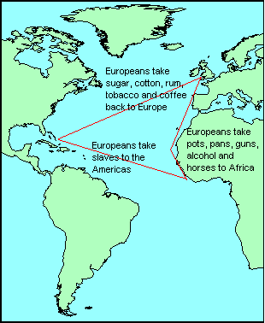
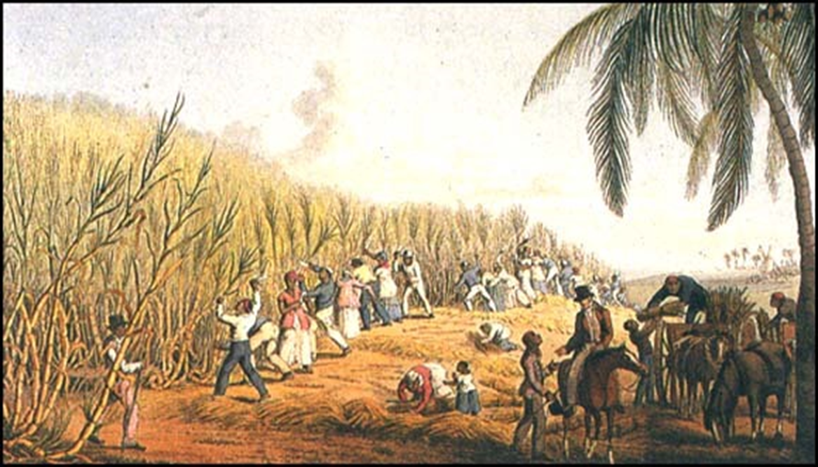
Slaves were acquired by raiding or by trade
More success through trade, but effect on slaves were similar
Slave trade increases when the Portuguese and the Spanish develop sugar plantations on the Atlantic islands
Demanded many workers and constant labor under difficult conditions
Tropical or sub-tropical environment

Slide 14
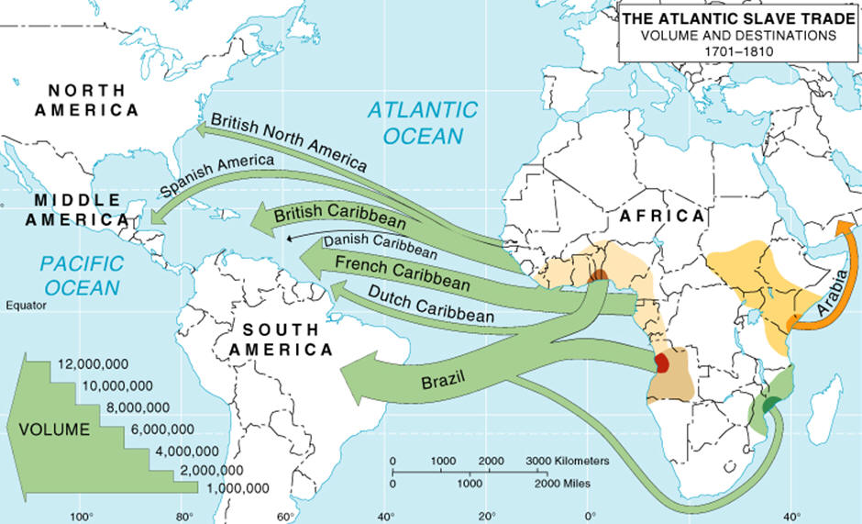
After 1550 - The slave trade grew significantly in volume and complexity as the American plantation colonies (especially Brazil) began to develop
By 1600 – the slave trade predominated over all other kinds of commerce on the African coast

Slide 15
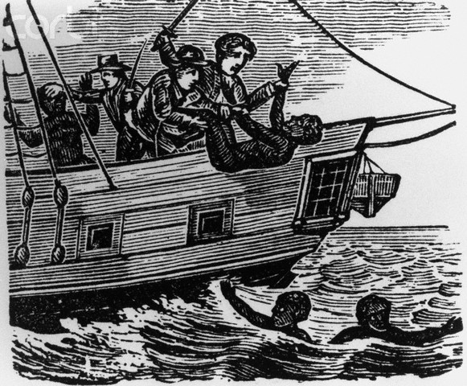
Trend Toward Expansion
Estimates of the volume of trade vary widely
1450-1850 : estimated 12 million Africans were shipped across the Atlantic
Mortality rate of 10 to 20 percent on ships
18th century – peak of Atlantic Slave trade
7 million slaves

Slide 16
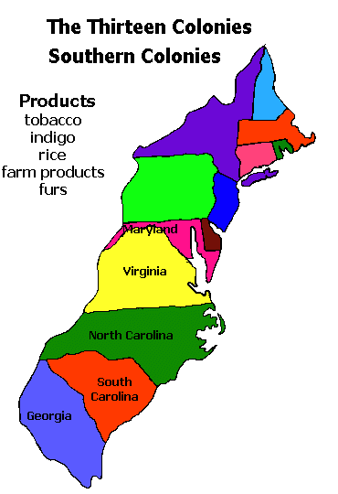
The high volume of the slave trade was necessary to the slave owners
Slave mortality high
Fertility was low (more men than women)
Exception: United States
Temperate climate
Few worked in dangerous and unhealthy occupations
Sugar and mining
The only way to maintain or expand the number was slaves was by importing more from Africa
Exception – southern United States
Depended more on natural population growth

Slide 17
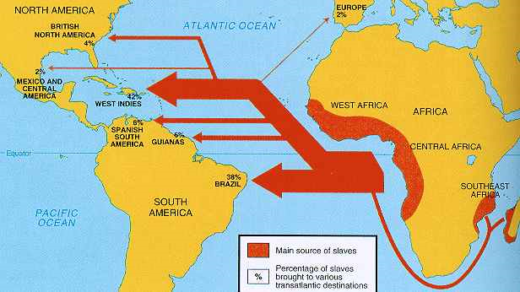
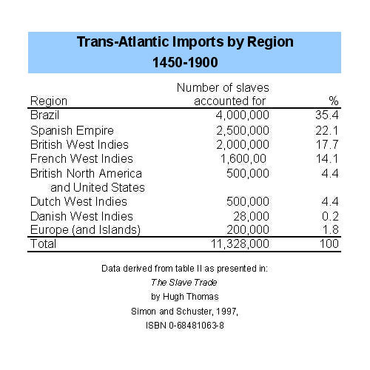
1530-1650: Spanish America and Brazil received the majority of African slaves
After English and French began to grow sugar in the Caribbean
Islands of Jamaica, Barbados, and St. Domingue (Haiti) became important terminals for slaves

Slide 18
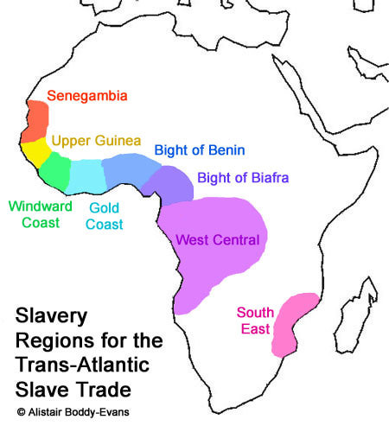
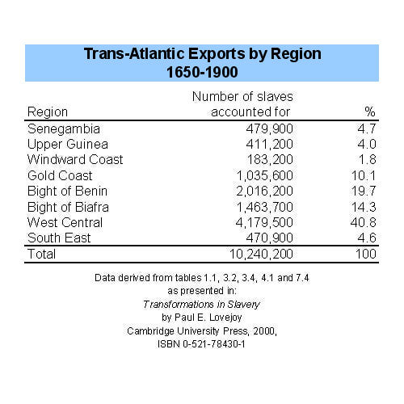
The older trans-Sahara, Red Sea, and east African slave trades in the hands of Muslim traders continued throughout the period
Added another 3 million African slaves exported in this period
The Atlantic slave trade drew slaves from across the continent
16th century – Senegambia region
17th century – West central Africa; Gold Coast and Slave Coast
Dahomey and Benin

Slide 19
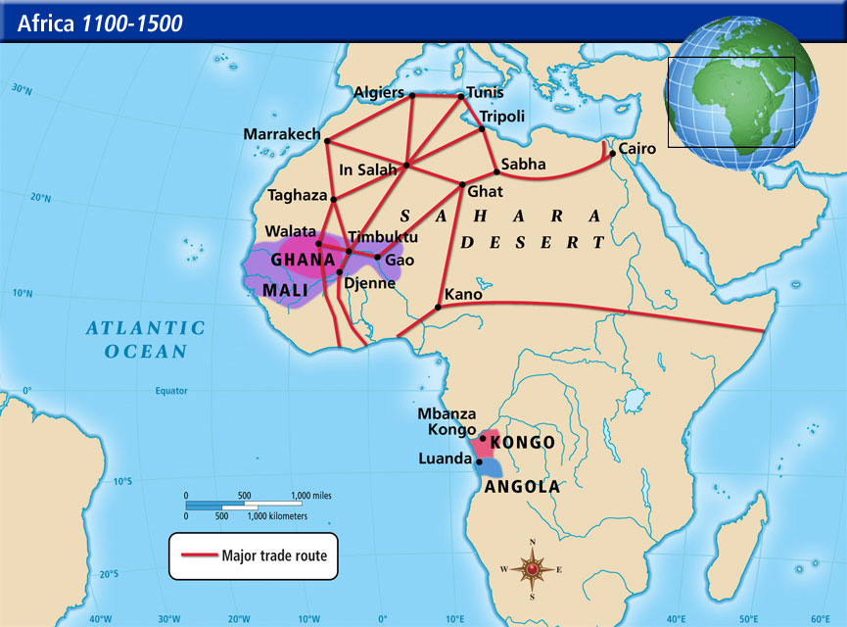
Demographic Patterns
Majority of trans-Saharan slave trade consisted of women
Concubines and domestic servants in north Africa and the Middle East
Atlantic slave trade concentrated on men
Planters and mine owners in the Americas were seeking workers for heavy labor
African societies that sold captives into slavery often preferred to sell the men
Neededwomen and children as domestic slaves or to extend existing kin groups

Slide 20
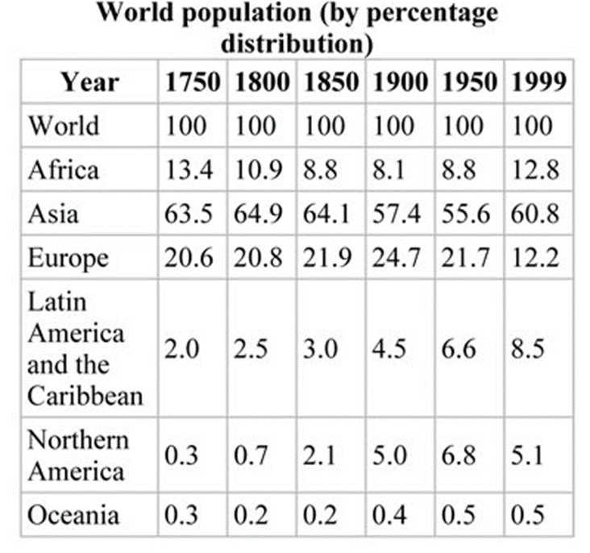
Atlantic trade had demographic impact on at least certain parts of west and central Africa
½ population decline
As the Atlantic trade developed, new crops, such as maize and manioc, were introduced to Africa that provided new food resources for the population
Helped recover from the losses to the slave trade

Slide 21
Organization of the Trade
Patterns of contact and trade established by the Portuguese at first were followed by rival Europeans on the African coast
Control of the slave trade generally reflected the political situation in Europe
Until about 1630 – Portuguese controlled most of the coastal trade and were the major suppliers of their own colony of Brazil and Spanish settlements in America

Slide 22
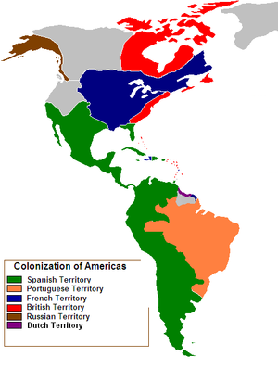
Growth of slave-based plantation colonies in the Caribbean led other Europeans to compete with the Portuguese
Dutch needed to supply conquests in northeastern Brazil
1637 - Seized El Mina
1641-1648: Angola
1600s – English were eager to have their own source of slaves for their colonies in Barbados, Jamaica, and Virginia
Royal African Company
1660s – French
Did not become a major player in slave trade until 18th century

Slide 23
Each of these European nations established merchant towns or trade forts in Africa
Provided a steady source of captives
For the Europeans stationed on the coast, Africa was a graveyard
Tropical diseases
Fewer than 10% of employees of the Royal Africa Company who went to Africa returned to England
European mortality among the crews of slave ships was very high
Tropical diseases (malaria)
The slave trade proved deadly to all involved
At least most Europeans had a choice

Slide 24
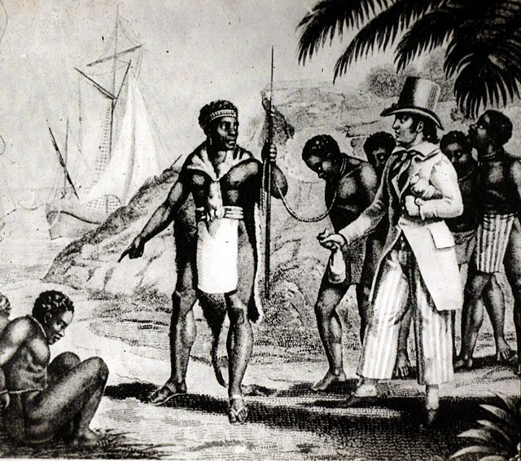
European agents for the companies often had to deal directly with local rulers
Paid a tax or offered gifts
Forms of currency – iron bars, brass rings, cowrie shells
Both Europeans and Africans were actively involved in slave trade
Not always clear who was in control

Slide 25
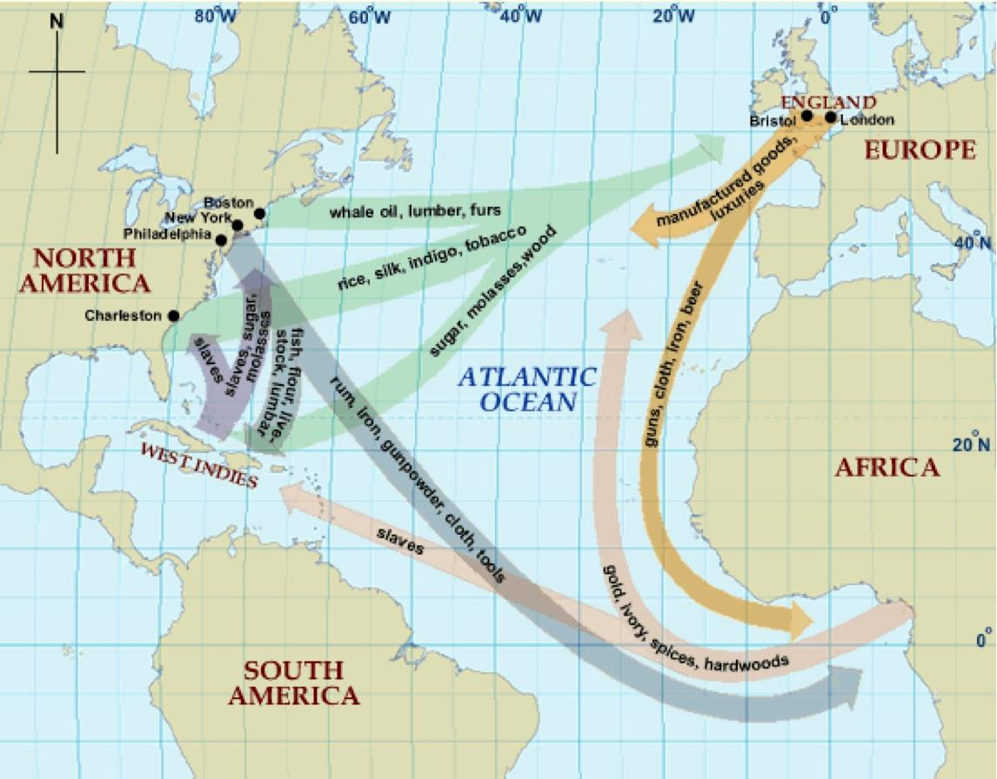
Historians have long debated the profitability of the slave trade
Aided the rise of commercial capitalism
Possible origins of the Industrial Revolution
Many people profited from trade in African slaves
Slave trade involved risks and costs

Slide 26
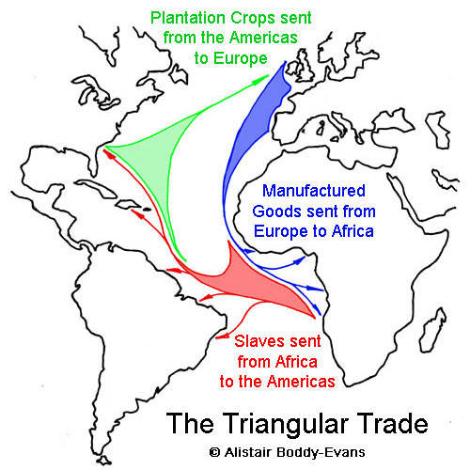
Triangular trade –
slave were carried to the Americas
sugar, tobacco, and other goods were then carried to Europe
European products were sent to the coast of Africa
In Africa, the slave trade often drew economies into dependence on trade with Europeans and suppressed the growth of other economic activities

Slide 27
African Societies, Slavery, and the Slave Trade
Europeans justified the enslavement of Africans by pointing out that slavery already existed on that continent
Aristotle – “property with a soul”
Control of slaves was one of the few ways to improve social standing in African society
Nonegalitarian
All land was owned by state or ruler
Slaves were used as servants, concubines, soldiers, administrators, and field workers

Slide 28
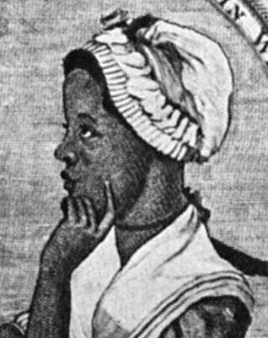
Among the forest states of west Africa (Benin) and in the Kongo kingdom in central Africa, slavery was already important before European arrival
But… Atlantic trade opened up new opportunities for expansion and intensification of slavery in those societies
In most cases, slaves were denied choice about their lives and actions
Placed in dependent or inferior positions
Often considered aliens
Enslavement of women was a central feature of African slavery
Domestic slavery

Slide 29
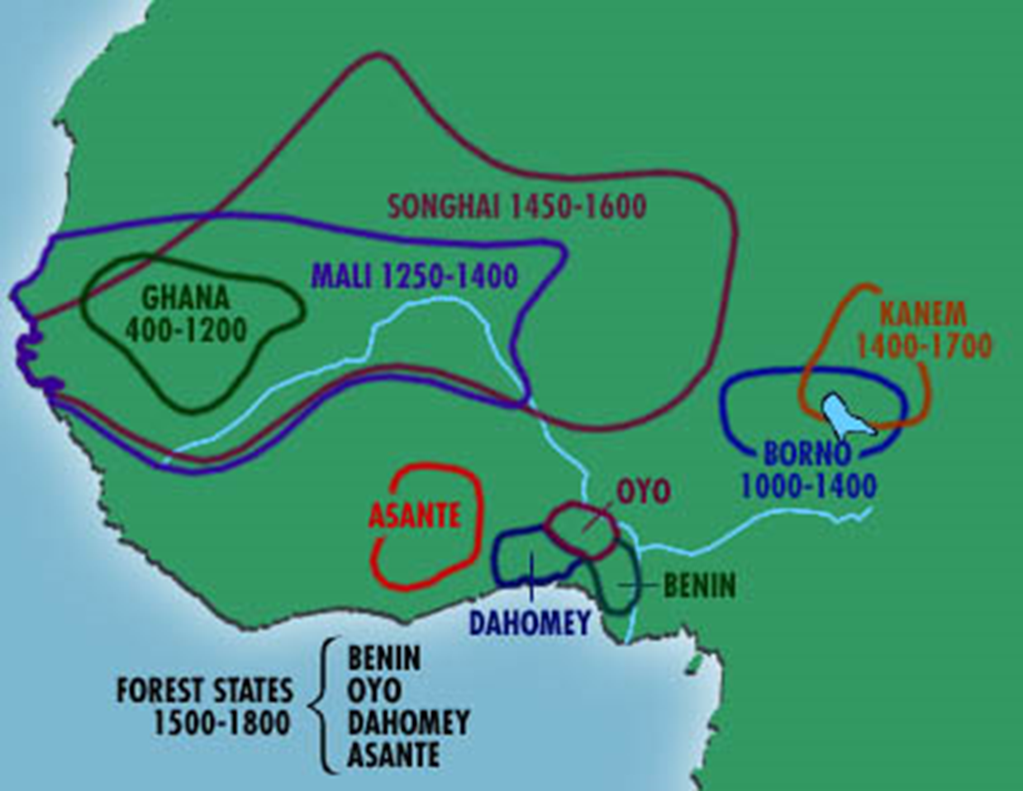
In the Sudanic states of the savanna, Islamic concepts of slavery had been introduced
Legitimate fate for nonbelievers
Illegal for Muslims
In general, African rulers did not enslave their own people, except for crimes or in other unusual circumstances
Enslaved their neighbors
Expanding, centralizing states often were the major suppliers of slaves to the Europeans as well as to societies in which slavery was an important institution

Slide 30
Slaving and African Politics
Quote from French agent
“The trade in slaves is the business of kings, rich men, and prime merchants”
European merchants and royal officials were able to tap existing routes, markets, and institutions
New and constant demand intensified enslavement in Africa
Changed the nature of slavery itself in many African societies

Slide 31
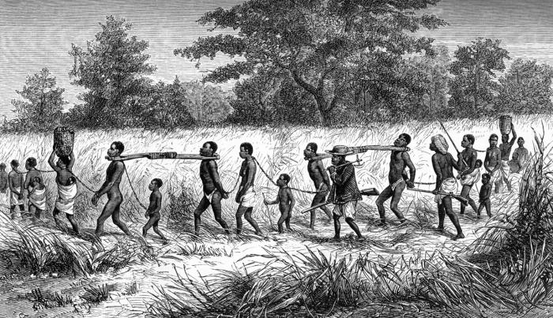
Many states of central and western Africa were small and fragmented
Instability caused by competition and warfare as states tried to expand at the expense of their neighbors
Warrior or soldier became important
Endless wars promoted the importance of military and made the sale of captives into the slave trade an extension of the politics of regions of Africa
Increasing centralization and hierarchy could be seen in African societies
However… contrary trend of self-sufficiency and anti-authoritarian ideas developed among the peoples who bore the brunt of the slaving attacks

Slide 32
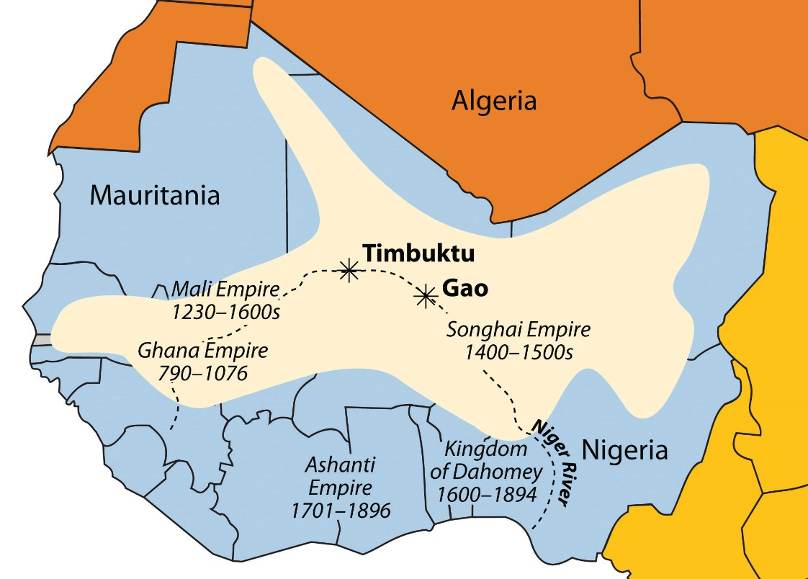
African Societies: Asante
In the Gold Coast, the Asante empire rose during the era of the slave trade.
Osei Tutu became the first asantehene, or supreme civil and religious leader
Control of the gold-producing zones
Constant supply of prisoners to be sold as slaves for western arms/weapons
Maintained power until 1820s as the dominant state of the Gold Coast
Slaves made up almost two-thirds of Asante’s trade
Gold remained important export

Slide 33
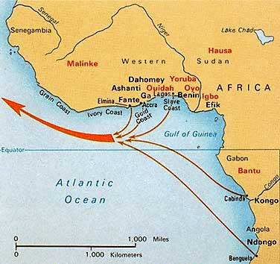
Benin
Part of Slave Coast
Kingdom of Benin was at the height of its power when the Europeans arrived
1516 – ruler (oba) limited the slave trade
For a long time most trade controlled by king and was in pepper, textiles, and ivory rather than slaves
18th century – significant slave trade
European pressure
Goals of Benin nobility

Slide 34
Dahomey
17th century – rose to power
Rulers traded slaves for firearms
Led to autocratic government
The royal court controlled the slave trade and raised armies that were used to raid neighbors for more captives
Conquered territory
Eliminated royal families
Imposed traditions
Developed ruling ideologies that were comparable to European absolutism
Well into the 19th century, Dahomey was a slaving state, and dependence on the trade
Negative effects on society as a whole

Slide 35
Emphasis on slave trade should not obscure the creative process within many of the African states
Creativity of societies seen in traditional arts
Crafts such as bronze casting, woodcarving, and weaving flourished
Much of this artistic production also had a religious function or contained religious symbolism
African artists made the spiritual world visually apparent
Europeans came to appreciate African arts and skills
16th century – Portuguese began to employ African artists
Many of these objects ended up in the collections of nobles and kings throughout Renaissance Europe
Growing contact between Africa and wider world

Slide 36
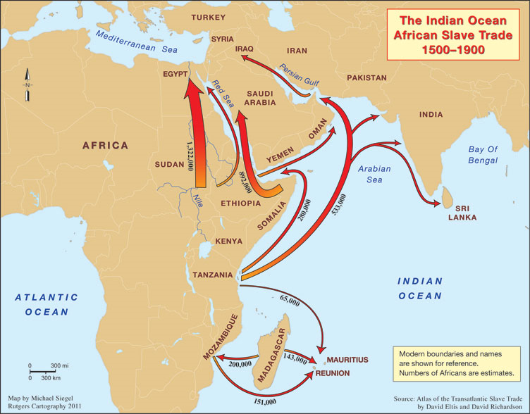
East Africa and the Sudan
West Africa obviously was the region most directly influenced by the trans-Atlantic slave trade
On the east coast of Africa, the Swahili trading cities continued their commerce in the Indian Ocean
Adjust to the military presence of the Portuguese and Ottoman Turks
Trade to the interior continued to bring ivory, gold, and a steady supply of slaves
Many of these slaves were destined for the harems and households of Arabia and Middle East
Ended by 1900

Slide 37
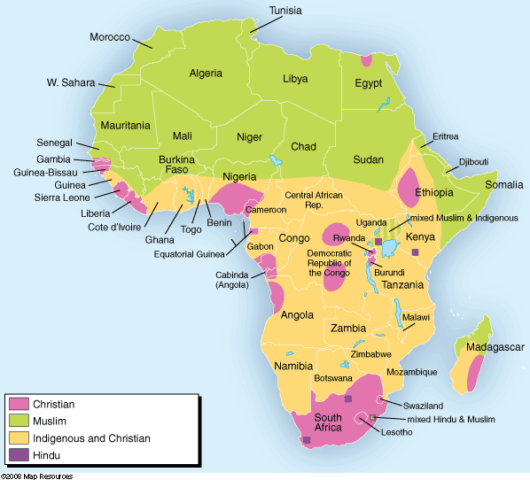
End of 18th century - northern savanna
Process of Islamization entered a new and violent stage
Islamic reformists tried to eliminate pagan practices
Sufi variant of Islam extended their influence throughout the Muslim trade networks in the Senegambia region and the Western Sudan

Slide 38
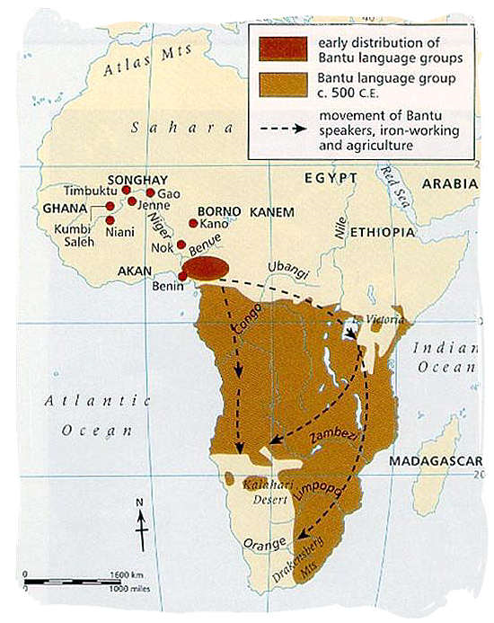
White Settlers and Africans in Southern Africa
Southern end of continent was minimally impacted by slave trade
16th century – Bantu-speaking peoples occupied much of the eastern regions of southern Africa
Practiced agriculture and herding
Worked iron and copper into tools and weapons
Traded with neighbors
Spoke related languages
Tswana, Sotho, Zulu, Xhosa
Process of expansion led to competition for land and the absorption of newly conquered groups
Foreign trade with Portuguese on East African Coast
Population increase among southern Bantu

Slide 39
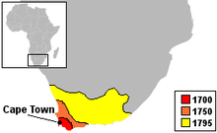
1652 – Dutch East India Company established a colony at the Cape of Good Hope to serve as a facility post for ships sailing to Asia
Large farms developed on the fertile lands around this colony
Depended on slave labor brought from Indonesia and Asia, but soon enslaved local Africans
Expansion of the colony and its labor needs led to a series of wars with the San and Khoikhoi populations, who were pushed farther to the north and west

Slide 40
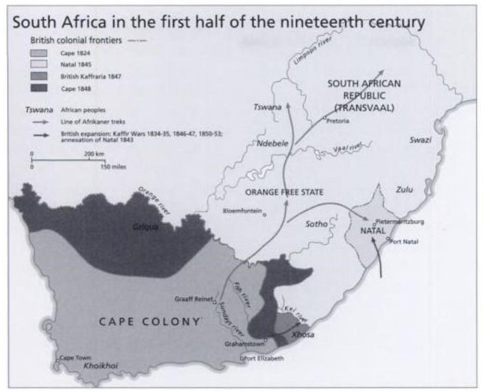
1760s – Dutch (Boer) farmers had crossed the Orange River in search of new lands
Saw the fertile plains and hills as theirs, and they saw the Africans as intruders and a possible source of labor
1800 – Cape colony
17,00 settlers (Afrikaners)
26,000 slaves
14,000 Khoikhoi

Slide 41
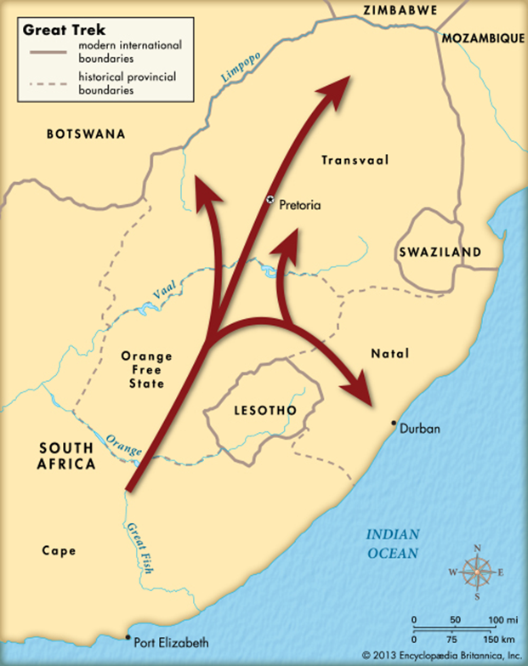
1795 - Great Britain seized Cape Colony and took it under formal British control in 1815
British government attempts to limit the Boer settlements and their use of African labor were unsuccessful
19th century – series of wars between Dutch and Bantu
Competition for farming and grazing land
Various government measures, the accelerating arrival of English-speaking immigrants, and the lure of better lands caused groups of Boers to move to the north
Moved into lands occupied by the southern Nguni
Eventually created a number of autonomous Boer states
After 1834 – Britain abolished slavery and imposed restrictions on land-holding
Groups of Boers stages a Great Trek far to the north to be free of government interference

Slide 42
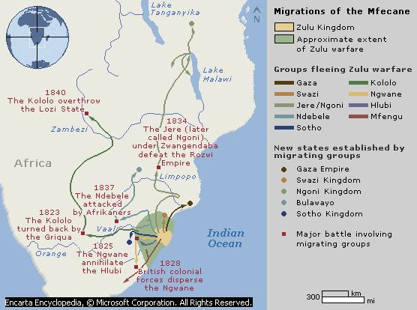
Zulu rise to power
The architect of Bantu society was Shaka Zulu
Created the mfecane, or wars of crushing and wandering.
The Boers (Dutch settlers) were able to survive the growth of Zulu power

Slide 43
The African Diaspora
The slave trade and the horrifying Middle Passage carried millions of Africans from their original homelands
In the Americas (especially plantation colonies) they became a large segment of the population
African cultures were adapted to a new environments and conditions
The import into Africa of European firearms, Indian textiles, Indonesian cowrie shells, and American tobacco in return for African ivory, gold, and especially slaves demonstrated Africa’s integration into the mercantile structure of the world
Prices of slaves rose steadily in the 18th century
Terms of trade increasingly favored African dealers

Slide 44
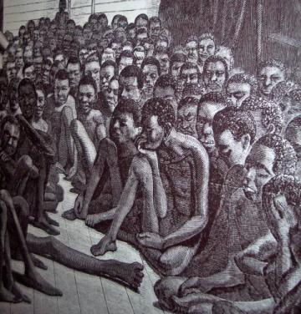
Slave Lives
For slaves themselves, slavery meant
Destruction of their villages or their capture in war
Separation from friends and family
Forced march to an interior trading town or to the slave pens at the coast
Deadly conditions
As many as 1/3 of captives died along the way or in the slave pens
Eventually loaded onto crowded ships
Unsanitary conditions
Long voyage

Slide 45
Worst example
1737 Dutch ship
700 of the 716 slaves died on the voyage
Middle Passage – slave voyage to the Americas
Taken from their homes, branded, confined, and shackled, they faced not only the dangers of poor hygiene, disease, and bad treatment but also the fear of being eaten or worse by Europeans
Suicide
Resistance
Did not strip Africans of their culture
Retained languages, beliefs, artistic traditions, and memories of their past

Slide 46
Africans in America
Slaves carried across the Atlantic were brought mainly to the plantations and mines of America
First in sugar production
Later… rice, cotton, and tobacco
Plantation system already used for producing sugar on the Atlantic islands of Spain and Portugal was transferred to the New World
West Africans, coming from societies in which herding, metallurgy, and intensive agriculture were widely practiced, were sought by Europeans for the specialized tasks of making sugar

Slide 47
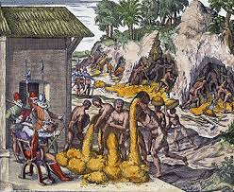
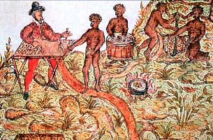
There was almost no occupation that slaves did not perform, although most were agricultural laborers
Gold mining in Brazil
Silver mining in Mexico
Urban slavery (characteristic of Latin American cities)
Artisans, street vendors, household servants

Slide 48
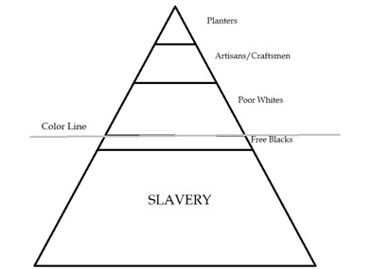
American Slave Societies
Each American slave-based society reflected the variations of its European origin and its component African cultures
But… there were similarities
Recognition of distinctions between African-born salt water slaves (invariably black) and their American-born descendants (Creole slaves, mulattos)
Creole and mulatto slaves given more opportunities to acquire skilled jobs or work as house servants; more likely to win freedom
Hierarchy of status
Whites on top, slaves at bottom, free people in the middle

Slide 49
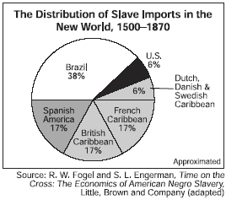
Caribbean and Brazil differed significantly from the southern colonies of British North America
British North America - depended less on imported Africans because of natural population growth among slaves; less influenced by Africa
By mid-18th century – most places in North America was reproducing itself
1850 – fewer than 1 percent of the slaves there were African born

Slide 50
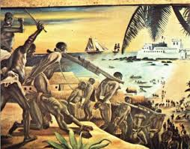
The People and Gods in Exile
Africans brought to America faced many problems
Working conditions exhausting
Life was short
Family formation difficult
General shortage of female slaves
Family members could be separated by sale or by a master’s impulse
Most slaves lived in family units, even though marriages were not always authorized by the religion of their masters
Throughout the Americas (wherever Africans were brought) aspects of their language, religion, artistic sensibilities, and other cultural elements survived
African slaves had to adapt and to incorporate other African peoples’ ideas and customs into their own lives

Slide 51
Religion was an obvious example of continuity and adaptation
Slaves were converted to Catholicism by the Spaniards and Portuguese
Still, African religious ideas and practiced did not die out
Many Africans slaves were accused of witchcraft by the Inquisition in those colonies
In many cases, slaves held their new faith in Christianity and their African beliefs as the same time

Slide 52
Resistance and rebellion were other aspects of African-American history
Defiance, running away, and direct confrontation were present wherever slaves were held
1508 – African runaways disrupted communications on Hispaniola
1527 – plot to rebel was uncovered in Mexico City
Runaway communities were persistent in Jamaica, Colombia, Venezuela, Haiti, and Brazil

Slide 53
Africa and the End of the Slave Trade
Opponents of slavery and the brutality of trade had appeared in the mid 18th century
New intellectual movements (Enlightenment)
Philosopher Jean-Jacques Rousseau in France and political economist Adam Smith in England both wrote against slavery

Slide 54
England, as the major maritime power of the period, was the key to the end of the slave trade
John Wesley and William Wilberforce
1807 - After parliamentary debate, the British slave trade was abolished
Britain tried to impose abolition of the slave trade on other countries throughout the Atlantic
Spain and Portugal were pressured to gradually suppress the trade and the British navy was used to enforce these agreements by capturing illegal slave ships
1888 – full end of slavery
Abolished in Brazil

