Slide 1
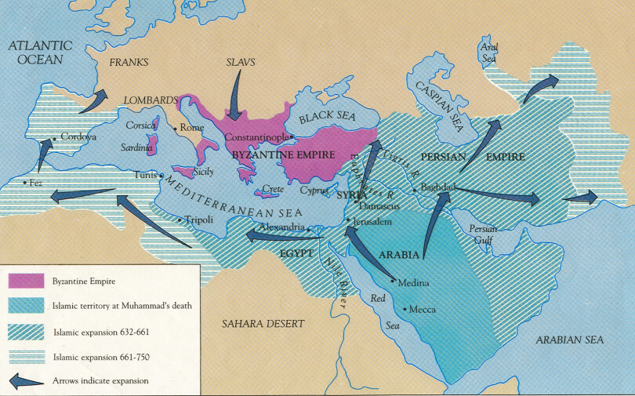
Chapter 6
The First Global Civilization: The Rise and Spread of Islam

Slide 2
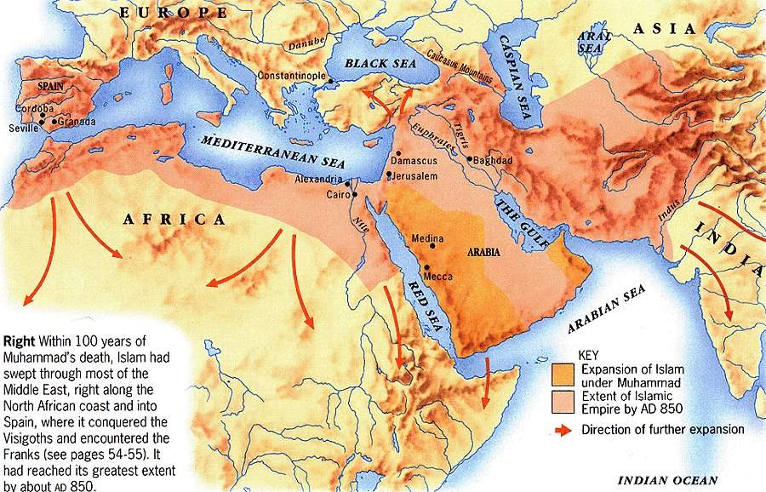
Islam – “submission, the self surrender of the believer to the will of one, true God, Allah”
Muslims – followers of the Islamic faith
Muhammad – prophet
Muslims conquered an empire extending from Spain in the west to central Asia in the east
Combined classical civilizations of Greece, Egypt, and Persia

Slide 3
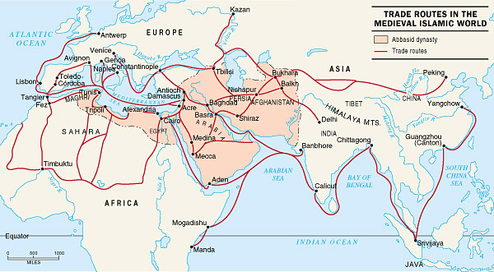
Islamic civilization spread by merchants, wandering mystics, and warriors across Africa, Asia, and southern Europe
Muslim traders and conquerors became the prime agents for the transfer of food crops, technology, and ideas
Muslim scholars studied, preserved, and improved on the learning of ancient civilizations (Greece, Persia, Egypt, and south Asia)

Slide 4
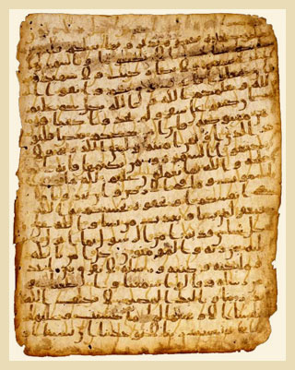
Muslim works in philosophy, literature, mathematics, and the sciences elevated Arabic
Arabic – the language of the Quran
Quran – holy book containing Allah’s revelations to Muhammad
Allah – God of the Islamic religions

Slide 5
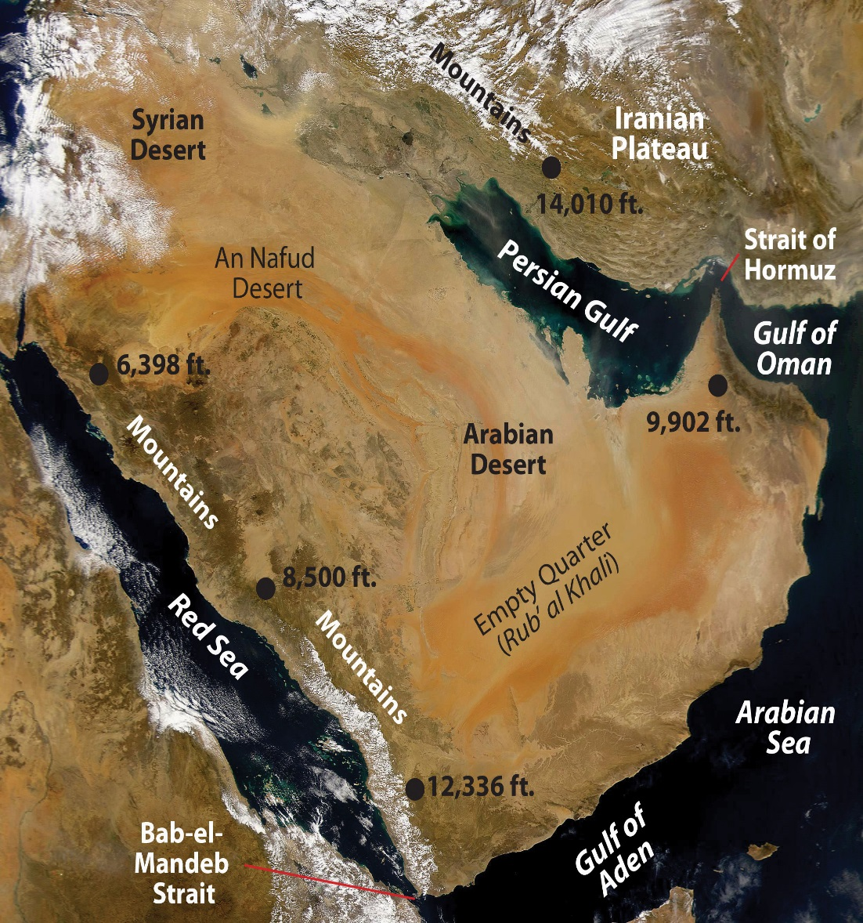
Desert and town: the arabian world and the birth of islam
Arabian peninsula – most inhospitable desert in the world
Bedouin – nomadic groups (camel and goat herding )living in the area
Organized in kinship-based tribes and clans that often sparred with one another over scarce natural resources

Slide 6
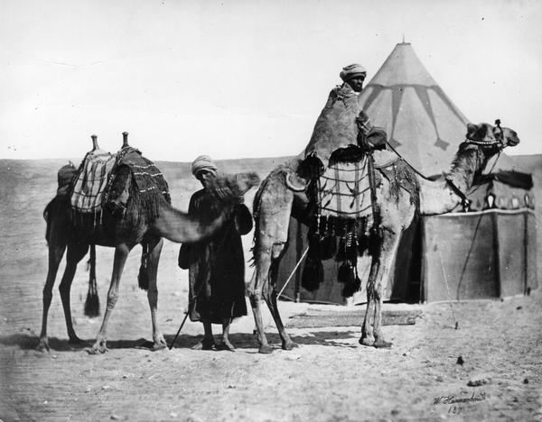
Clan identity, clan rivalries, and the cycle for vengeance
Bedouin herders lived in kin-related clan groups
Lived in highly mobile tents
Clans were clustered in larger tribal groupings
Strong dependence on and loyalty to one’s family and clan
Survival depended on cooperation with and support from kin
Wide disparities of wealth and status within clan groups and between clans of the same tribe

Slide 7
Shayks (leaders of tribes and clans), warriors, and slaves (remnants of rival clans defeated in war)
Wars often broke out as a result of one clan encroaching on the pasture area of another clan
Battles were fought according to a code of chivalry quite common in early cultures

Slide 8
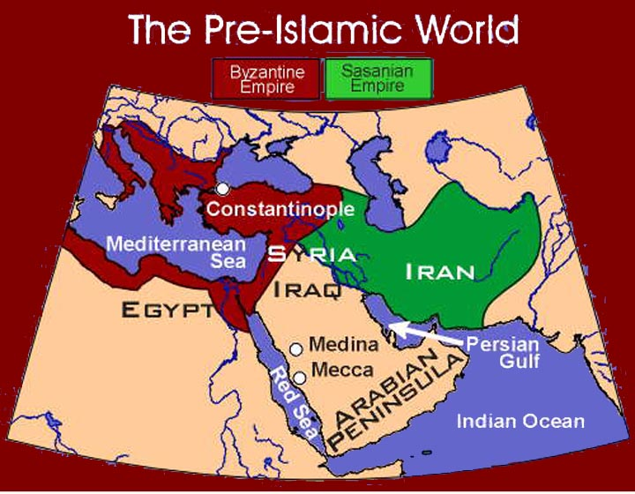
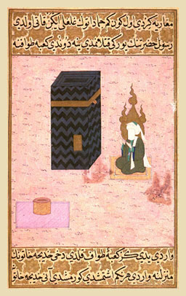
Towns and long distance trade
Mecca and Medina – Trading towns in the region close to the Red Sea
Mecca – founded by the Umayyad clan of the Quraysh bedouin tribe (members of the clan dominated its politics and commercial economy)
Wealth of Mecca – Ka’ba (most revered religious shrines in the pre-Islamic world; also called the Black Stone)

Slide 9
Cities established in an oasis
Wells and springs made sedentary agriculture possible (date palms, fruit and seeds traded to the bedouins)
Mecca – dominated by Umayyad
Medina – contested by two bedouin and three Jewish clans

Slide 10
Marriage and family in pre-islamic arabia
Women in pre-Islamic Arabian bedouin culture enjoyed greater freedom and higher status than those who lived in neighboring civilized centers (Byzantine and Sasanian Empires)
Women had key economic roles (milking camels and weaving cloth to raising children)
Man was required to pay a bride-price to his prospective wife’s family
Women did not wear veils
Women were not by any means considered equal to men
Could not gain glory as warriors
Customary practices of property control, inheritance, and divorce heavily favored men

Slide 11
Poets and neglected gods
Arab material culture was not highly developed
Little art or architecture of worth
Main focus of cultural creativity was poetry
Bedouin religion was for most clans a blend of animism (spirits residing in ordinary objects) and polytheism

Slide 12
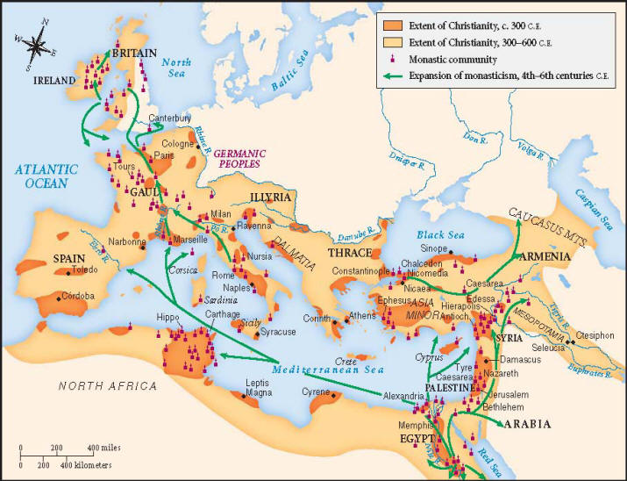
The life of muhammad and the genesis of islam
By the 6th century C.E., the camel nomads were dominant throughout much of Arabia
Trading centers such as Mecca and Medina depended on alliances with neighboring bedouin tribes to keep the caravan routes open
Influence of established monotheistic religions entered Arabia
Rise of a number of Arab prophets who urged bedouin tribes to renounce idol worship and rely on a single, almighty god

Slide 13
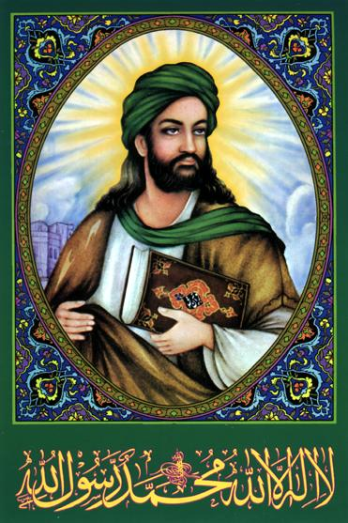
Muhammad’s vision
Born into a minor branch of a powerful Meccan family
Raised by grandfather
Became a trader and business manager
His travels put him in contact with other clans, as well as groups of monotheists (Jews and Christians)

Slide 14
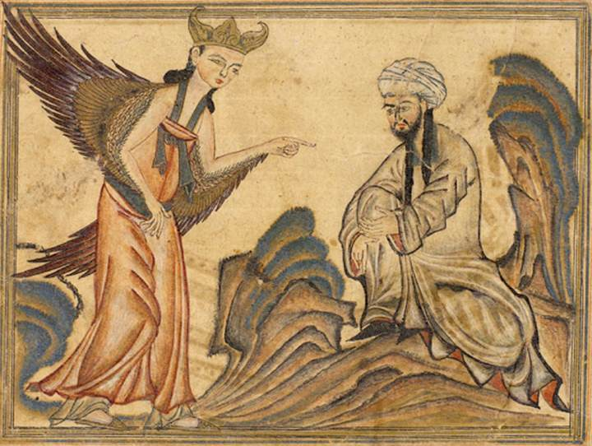
Muhammad had a religious experience as he described as a vision from Allah
Visited by Angel Gabriel as a messenger of Allah
Other visions followed in which Muhammad received revelations that eventually became the basic tenets of the Islamic faith

Slide 15
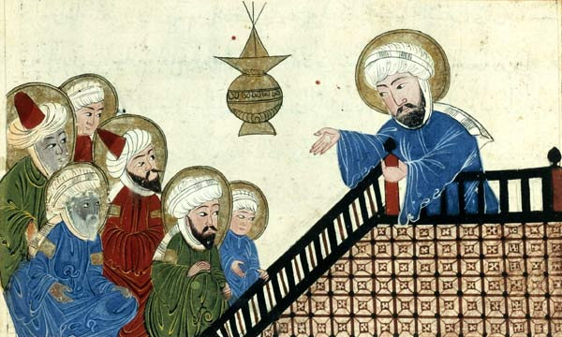
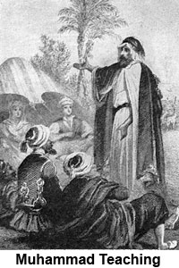
Muhammad began sharing his revelations with relatives and friends
Umayyad political leaders and merchants felt threatened
Seen as dangerous to Mecca’s status as a pilgrimage destination of those who came to worship the myriad of gods and spirits of the ka’ba)

Slide 16
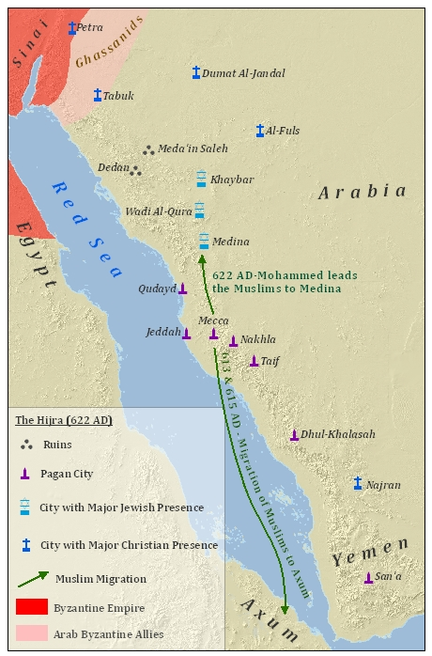
Verge of civil war by 622
Muhammad managed to escape with his followers to Medina
The fateful flight to Medina (hijrah) marks the founding date of the new religion (year 1 on the Muslim calendar)

Slide 17
The growth of islam during muhammad’s life
Muhammad began to refer to himself as a prophet who offered a more complete revelation of Allah
Proved to be an adept political and military organizer
His wisdom and skill won followers who accompanied him on raids of Meccan caravans
The Quraysh (most powerful Meccan tribe during the time of Muhammed) responded with a series of attacks on Muhammed
628 – peace treaty

Slide 18
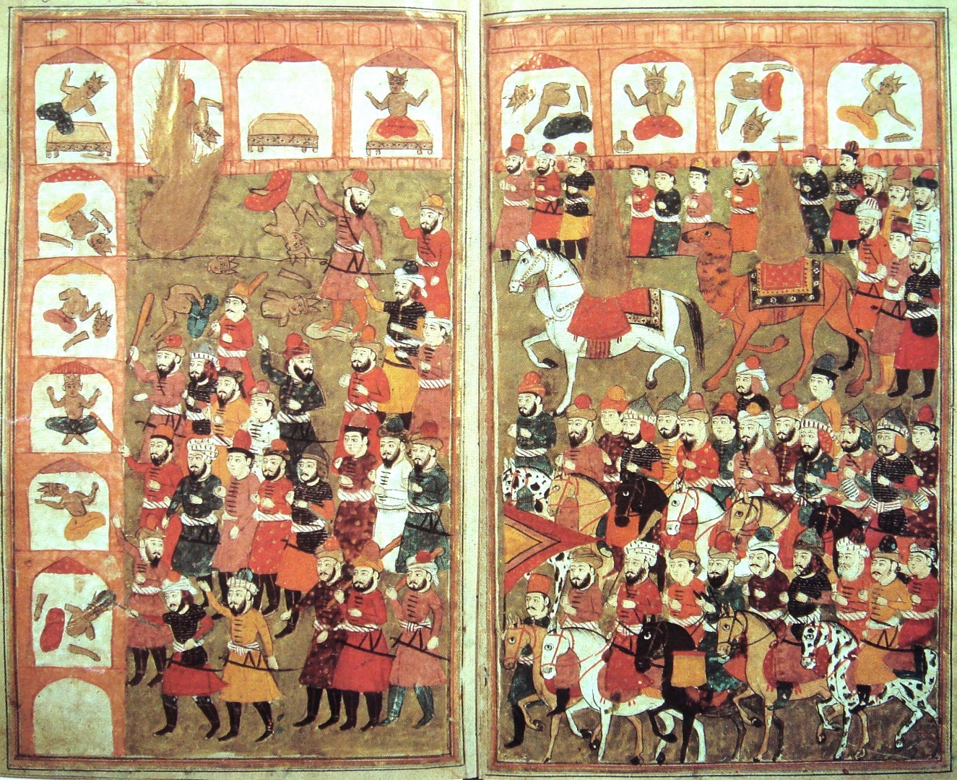
In 629, Muhammad triumphantly returned to Mecca with 10,000 supporters
Smashed all idols of the shrine, leaving the Black Stone alone to symbolize the acceptance of Allah as the one god
Muhammad gradually won over the Umayyads and most of the other inhabitants of Mecca to the new faith

Slide 19
Arabs and islam
The new religion preached by Muhammad had much to offer the divided peoples of Arabia
It gave them a form of monotheism that belonged to no single tribe and transcended clan and class divisions
Provided a religion that was distinctly Arab in origin
God was one; there were no saints, and angels were nothing more than messengers

Slide 20
Islam offered the possibility of an end to the vendettas and feuds that had so long divided the people of Arabia
Made possible a degree of political unity
Islam stressed the dignity of all believers and their equality in the eyes of Allah
Promoted a moral code that stressed the responsibility of the rich helping the poor
Zakat – charity tax
Forbade the rich to exploit the poor
Late Judgment – would determine their fate in eternity

Slide 21
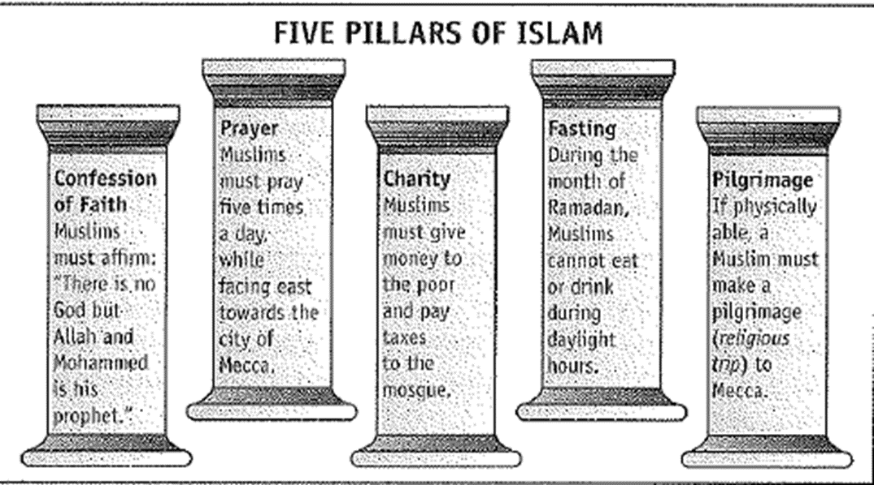

Slide 22
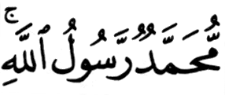
1. The Shahada
The testimony.
The declaration of faith:
There is no god worthy of worship except God, and Muhammad is His Messenger [or Prophet].
1

Slide 23
2. The Salah
The mandatory prayers performed 5 times a day: * dawn * noon * late afternoon * sunset * before going to bed
Wash before praying.
Face Mecca and use a prayer rug.
2

Slide 24
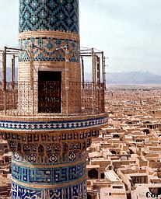
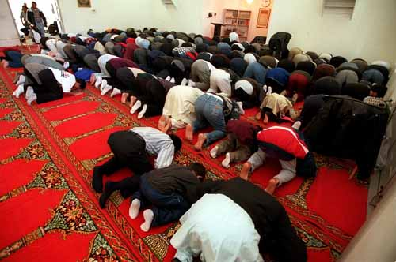
2. The Salat
The call to prayer by the muezzin in the minaret.
Pray in the mosque on Friday.
2

Slide 25
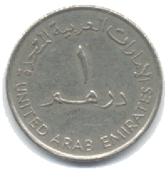
3. The Zakat
Almsgiving (charitable donations).
Muslims believe that all things belong to God.
Zakat means both “purification” and “growth.”
About 2.5% of your income.
3

Slide 26
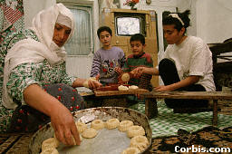
4. The Sawm
Fasting during the holy month of Ramadan.
Considered a method of self- purification.
No eating or drinking from sunrise to sunset during Ramadan.
4

Slide 27
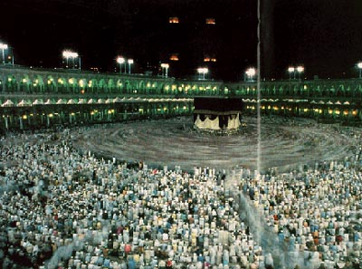
5. The Hajj
The pilgrimage to Mecca.
Must be done at least once in a Muslim’s lifetime.
2-3 million Muslims make the pilgrimage every year.
5

Slide 28
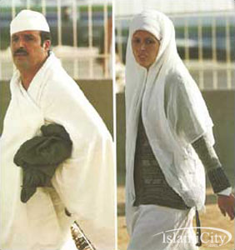
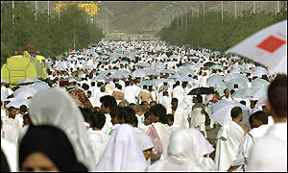
5. The Hajj
Those who complete the pilgrimage can add the title hajji to their name.
5

Slide 29
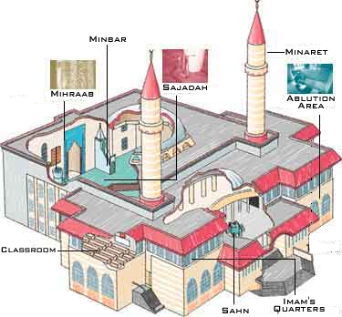
The Mosque
The Muslim place of worship.

Slide 30
The Spread of Islam
Easy to learn and practice.
No priesthood.
Teaches equality.
Non-Muslims, who were “Peoples of the Book,” were allowed religious freedom, but paid additional taxes.
Easily “portable” → nomads & trade routes.
Jihad (“Holy War”) against pagans and other non-believers (“infidels”).

Slide 31
Universal elements in islam
1) Confession of faith – To become a Muslim, a person must make this statement: “There is no God but Allah, and Muhammad is his Prophet.”
2) Prayer – Muslims must pray five time daily, turned to face Mecca
3) Fasting – Fore one month of the Muslim year (Ramadan), Muslims must fast from sunup to sundown, demonstrating to the umma their commitment to the religion

Slide 32
4) Alms – The faithful must give a portion of their wealth as alms to help the needy, a requirement that also helped to build cohesion in the umma
5) Hajj – Once in a lifetime, any Muslim who could possibly do it is expected to make a pilgrimage (call the hajj) to Mecca to worship Allah at the Ka’ba.

Slide 33
Muslims were not to eat pork nor drink alcoholic beverages
A man could marry as many as four wives (as Muhammad had done), but only as long as he could provide for them
Marriage with non-Muslims was forbidden
Mosque
Islam stressed equality of all believers in the eyes of Allah

Slide 34
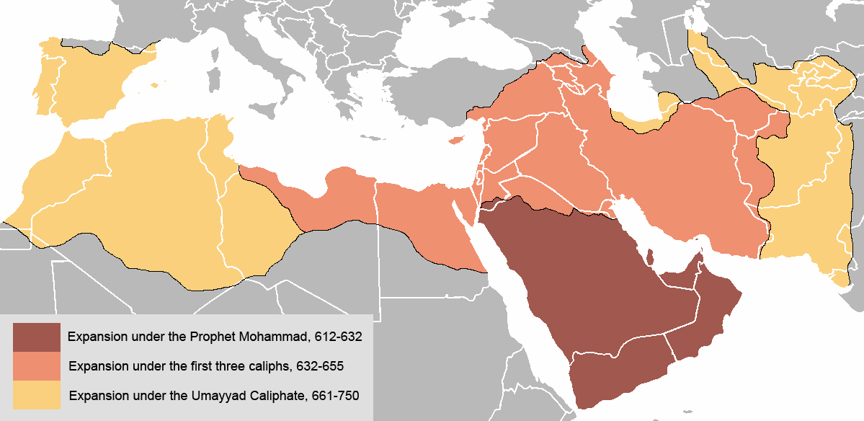

Slide 35
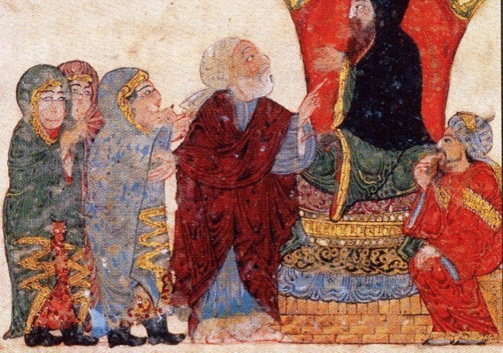
Bedouin – Nomadic clans
---------------------------------------------------
Problems
No successor to Muhammad
Caliph – Political and religious successor to Muhammad

Slide 36
Sunni
Muhammad left no successor
Felt caliph should be chosen by Muslim leaders
One is appointed from among peers
Abu Bakr—Friend of Muhammad
Shiite
Muhammad left a chosen successor
Felt only true successors were blood descendents of Muhammad
Ali—Son-in-law, cousin of Muhammad

Slide 37
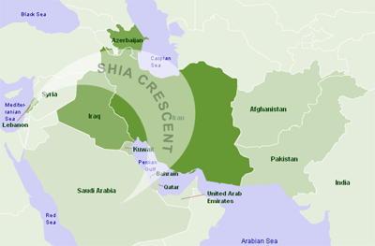
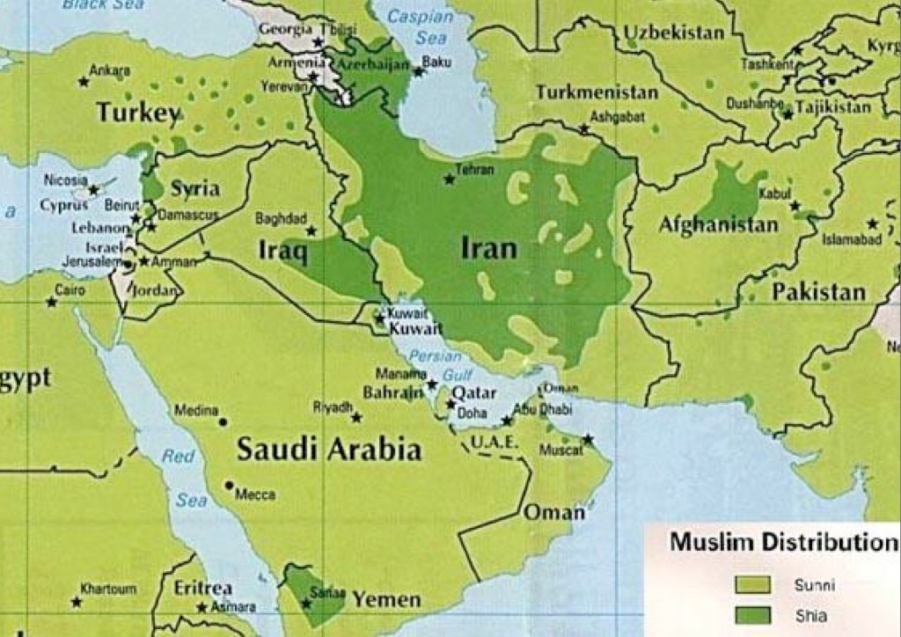

Slide 38
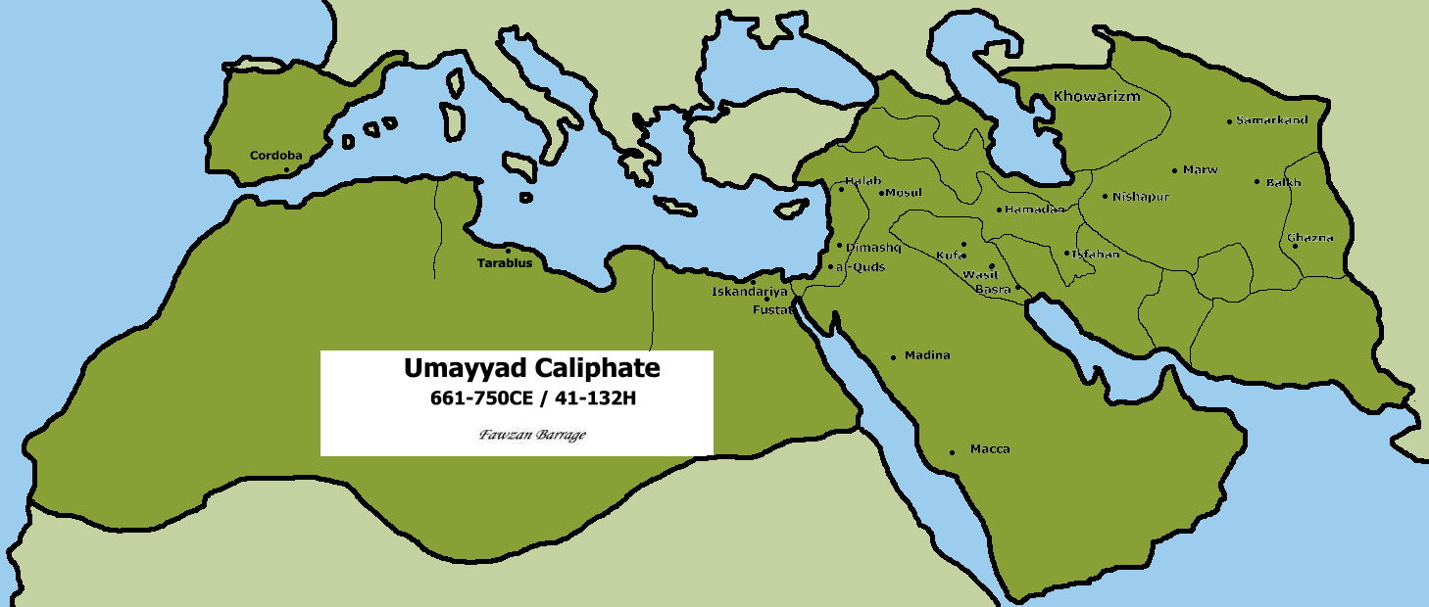
The arab empire of the umayyads (661-750)
Muhammad’s victory over the Umayyads and the resulting allegiance of many of the bedouin tribes of Arabia created a new center of power in the Middle Eastern cradle of civilization
Under the Umayyid rule, the Arabs rapidly build a vast empire, which established the foundations for an enduring Islamic civilization by the time of its fall

Slide 39
Having united most of Arabia under the Islamic banner by 633, Muslim military commanders began to mount serious expeditions beyond the peninsula
Courage of warriors of Islam combined with weakness of the empires that bordered Arabia
Empire built from these conquests was Arab rather than Islamic
Little desire to convert the subject populations to new religion

Slide 40
Consolidation and division in the islamic community
Leadership crisis – Who would succeed Mohammad?
Caliph – the political and religious successor to Muhammad
Caliphate – Islamic empire/dynasty
Ali (cousin to Muhammad) vs Abu Bakr (original follower of Muhammad)
Umma chose Abu Bakr
first caliph/successor to Mohammad

Slide 41
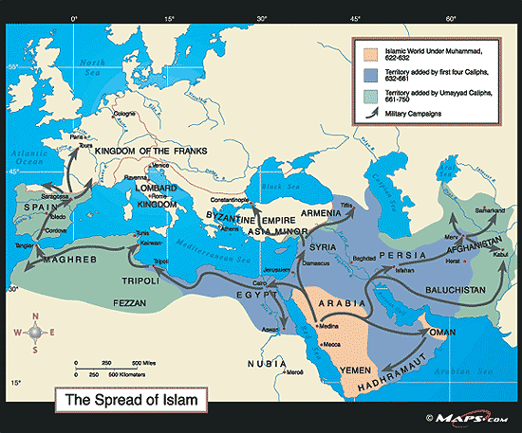
Under Abu Bakr, Muslim military commanders raided areas north and east of Arabia (Iraq, Syria, Egypt)
Weakness of Byzantine and Sassanid Empires (remnants of greater Roman and Persian Empires)
With no political powers to stop them, Arab soldiers poured into the old centers of civilization and took over their governments under the three successor caliphs to Abu Bakr

Slide 42
Success of Arab conquests: weakness of empires; religious fervor
Jihad – “struggle” applied to defeating non-Muslim areas, especially in hopes that their efforts would secure berths in “paradise”
The fourth caliph, Ali (Mohammad’s son-in-law) was assassinated in 661 leading to a factional war
Ali’s supporters argued that legitimate caliphs could only be members of Muhammad’s family (Shi’ites)
Shi’ites rejected the authority of the first three caliphs and also Ali’s successor, Muawiya, who founded the Umayyad Dynasty

Slide 43
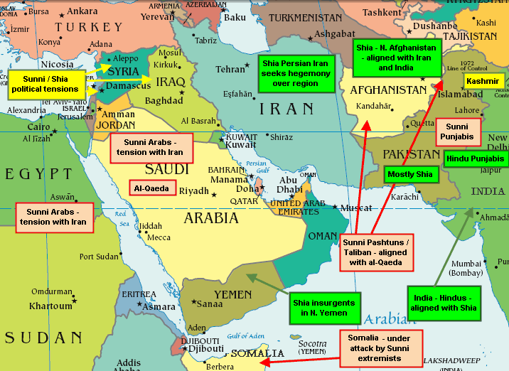
The supporters of Muawiya and his successors were known as Sunni (majority)
Sunnis believed all of the early caliphs to be legitimate, and agreed that the Umayyads also had the right to rule
The split between the Sunnis, who backed the Umayyads, and the Shi’ites, or supporters of Ali, remains to this day
Hostility between the branches of the Islamic faithful was heightened in the years after Ali’s death by the continuing struggle between the Umayyads and Ali’s second son, Husayn.

Slide 44
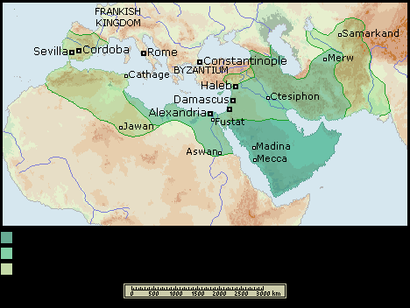
The umayyad dynasty (661-750)
The first of the Umayyads was Muawiya (whose election led to the split)
Moved capital city from Medina to Damascus (Syria)
More centrally located; area heavily populated by non-Arabs
The office of the caliph became more powerful and imperial, with a lavish palace and court that greatly contrasted to the simple lifestyles of Muhammad and his successors

Slide 45
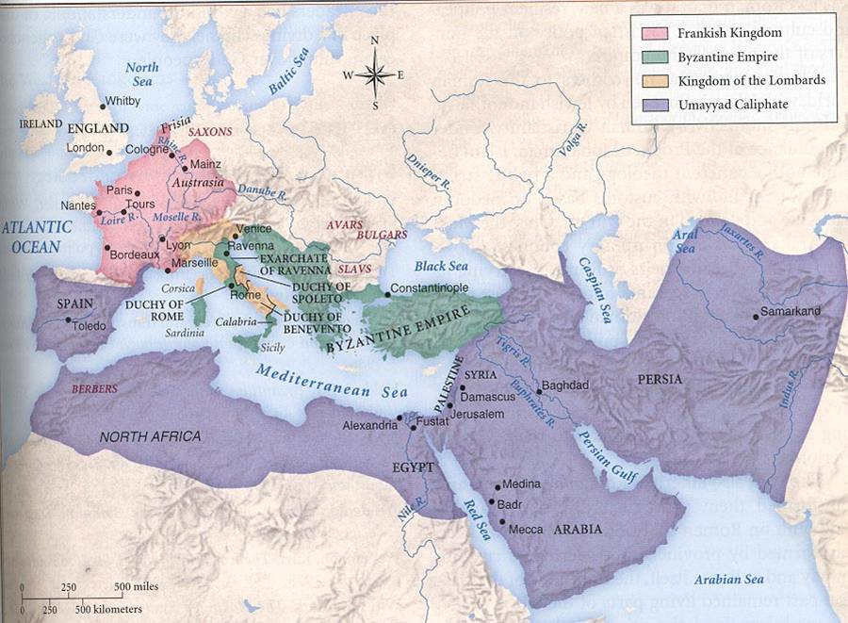
Under the Umayyads, the military continued to conquer east and west, but rate of growth slowed
East – Afghanistan
West – northern Africa and Christian Spain
The Muslim advance was finally halted in 733 at the battle of tours in central France by the Frankish leader Charles Martel

Slide 46
The Muslims built a bureaucracy to govern their vast empire
Core of caliph’s government and the army officers were Muslim Arabs who generally lived in urban centers and shared in the rewards gained from new conquests
Rural areas – non-Arab people who paid taxes to support government
Non-Arab Muslim converts received few financial or social benefits (few conversions)

Slide 47
People of the book (Jews and Christians) were treated better, although they had to pay the same taxes as other subject people
In 740s rebel mawali (non-Arab) joined forces to demand social and religious equality with Arab Muslims, and eventually overthrew the Umayyad Dynasty
Abbasid clan took control of the caliphate in 750, when they moved the capital from troubled Damascus east to the newly built city of Baghdad, which was destined to rule over the golden age of Islamic civilization

Slide 48
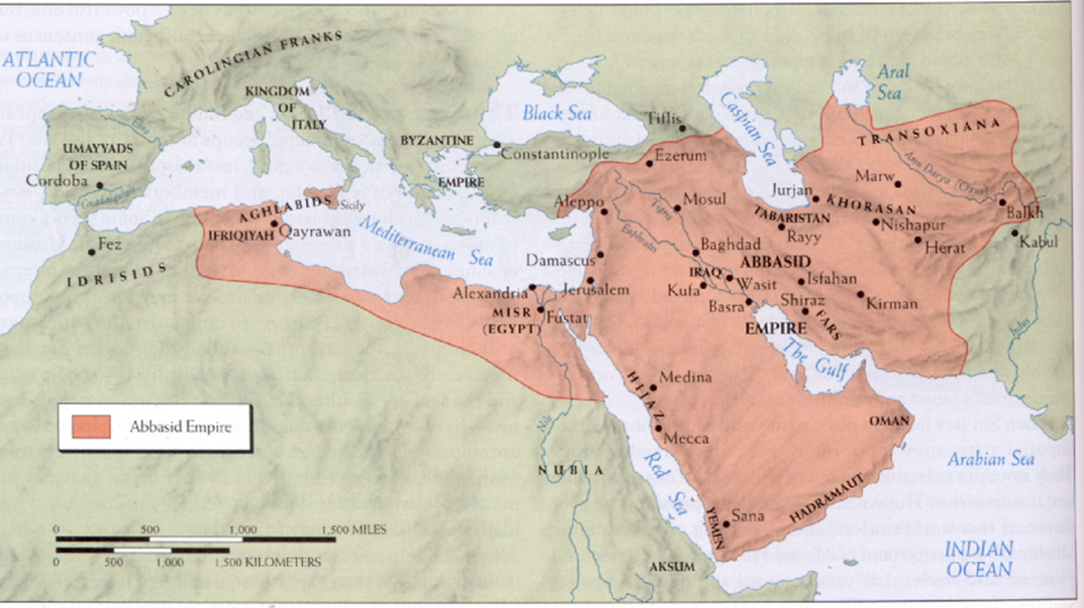
The abbasid dynasty (750-1258)
The Abbasids claimed to be descendants of Muhammad’s uncle, so at first they were more acceptable to Shiites than the Umayyads
Opened the religion to all on an equal basis
Others (non-Arabs) found their way into powerful positions
Dynamic, heterogeneous civilization

Slide 49
Sheer size, poor communications, and collusion between Abbasid officials and local notables meant that the farther the town or village was from the capital, the less effectively royal commands were carried out
Abbasids placed themselves above Islamic laws
Stopped short of calling themselves divine
“shadow of God”

Slide 50
Islamic conversion and mawali acceptance
The Abbasid era saw the full integration of new converts, both Arab and non-Arab (mawali)
Mass conversions to Islam were encouraged for all peoples of the empire
Converts were admitted on an equal footing with the first generations of believers
Converts exempt from paying the head tax and had greater opportunities to get advanced schooling and launch careers as administrators, traders, or judges
Finally defeated by Mongols (1258)

Slide 51
Golden age of islam
During the Abbasid Dynasty, Islamic civilization experienced a “golden age” (800-1200)
Widespread Arabic language (unifying force)
Borrowed invention of paper from China
Thousands of poems
Madrasas – urban universities that actively preserved and translated the writings of ancient Greeks and Indians
Arabic numerals – still used today (allowed the development of algebra)
Made advances in optical science, pharmacology, and anatomy

Slide 52
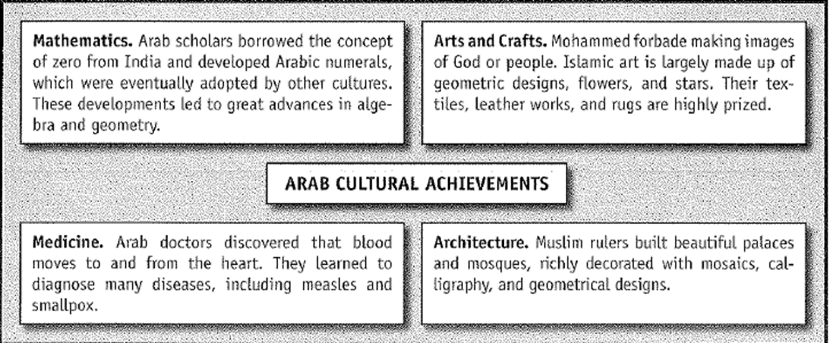

Slide 53
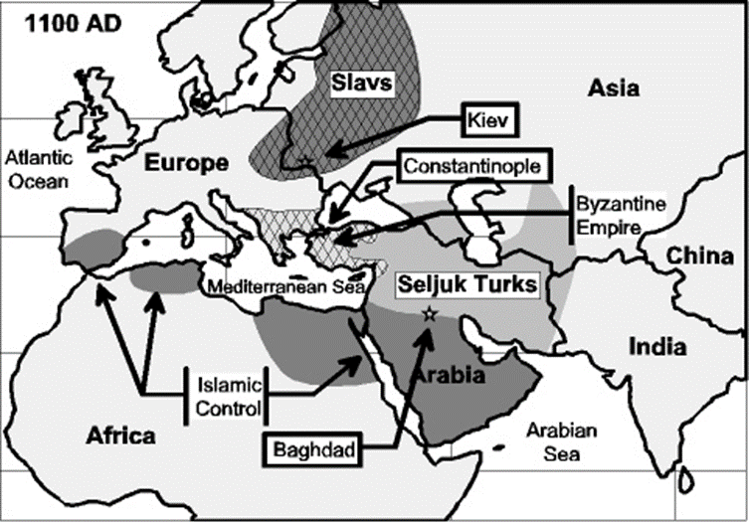
Decline and fall of abbasid caliphate
Caliphates were always weakened by religious splits within their ranks (Sunnis and Shi’ites)
Difficulty of holding together a highly diversified empire from one central location (Baghdad)
Slave revolts and peasant uprisings
Later Abbasid caliphs were incompetent

Slide 54
First Flowering of Islamic Learning
Initially illiterate, they rapidly absorbed the culture of Persia, Rome, Hellenistic Greece, and Mesopotamia
Muslim philosophers preserved the writings of the Greeks and transmitted these critical concepts through an Islamic filter to the West

Slide 55
Achievements
The creation of a global empire
The emergence of one of the universal religions
The preservation of the cultures of ancient Hellenistic Greece and Persia,
Construction of a Eurasian trade system that would survive until the 16th century

