Slide 1
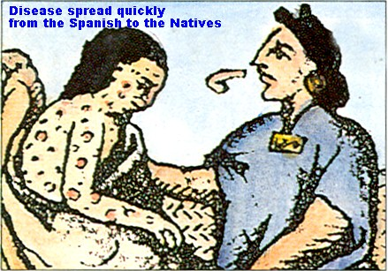
Chapter 19
Early Latin America

Slide 2
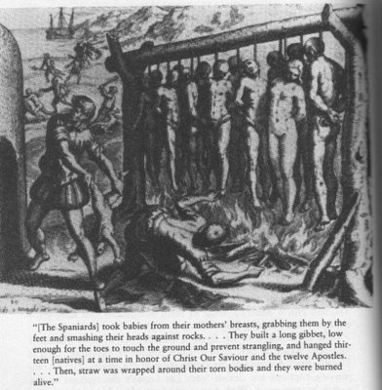
15th – 16th centuries : Spain and Portugal created empires in America
In contrast to Russia, these were dependent empires
Western forms were imposed on many Latin American people, Russian leaders decided what aspects of the West to borrow
  Language
  Religion
  Social structure
Western advantages – gunpowder, metal equipment, horses, disease
  Conquerors force highly unequal relationships on subject populations

Slide 3
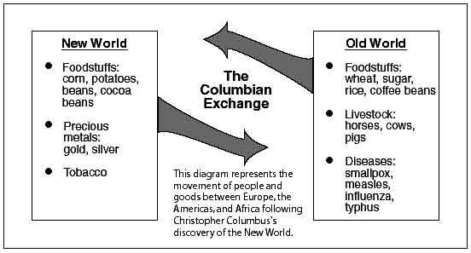
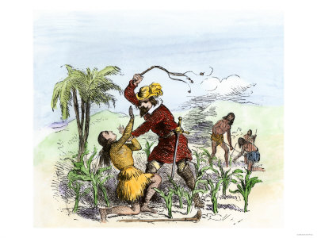
Latin America was immediately drawn into New World economy
  Provided silver, new crops, and other goods
Societies of Latin America created new political and cultural forms
Spanish and Portuguese (Iberians) mixed with Native Americans (and their earlier civilization forms) and imported African slaves
Portuguese, English, Spanish, and French all created large landed estates (plantations) worked by coerced laborers – ultimately African slaves
Europeans exploited precious metals when they were discovered
  silver

Slide 4
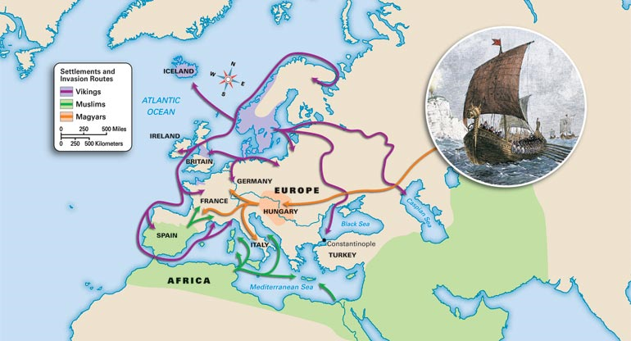
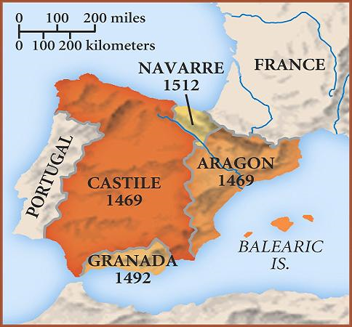
Spaniards and Portuguese: From Reconquest to Conquest
Iberian Peninsula – Phoenicians, Carthaginians, Romans, Goths
  During the Middle Ages had become a cultural frontier between Christianity and Islam
    Created a strong tradition of military conquest and rule over peoples of other beliefs and customs
  Christian Kingdoms had emerged
    Portugal (Atlantic coast)
    Aragon (Eastern Spain)
    Castile (center of Iberian Peninsula)

Slide 5
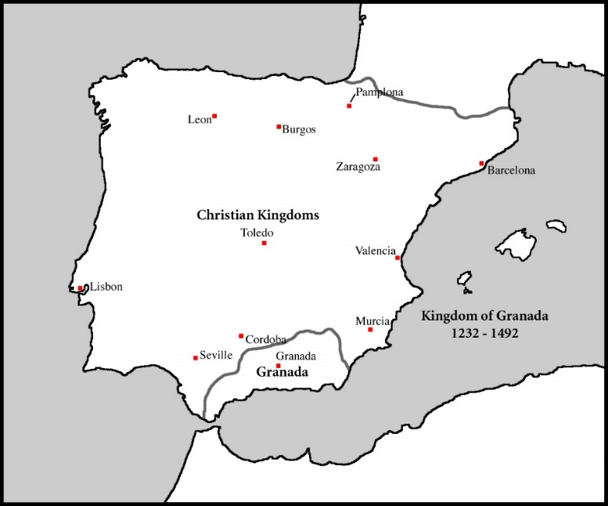
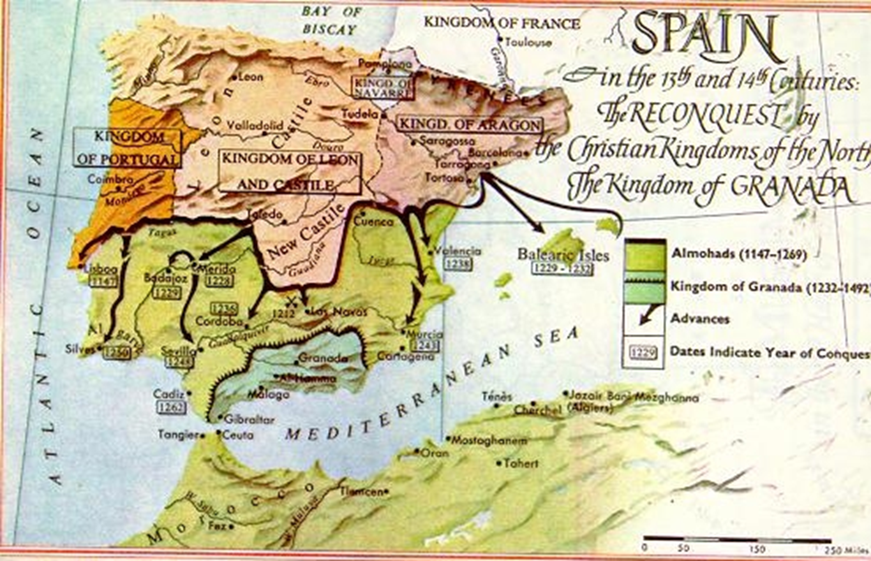
Mid-15th century – process of political and religious unification of Iberian Peninsula
  Ferdinand of Aragon
  Isabella of Castile
1492 - With the fall of Granada (the last Muslim Kingdom) Christianity triumphed throughout the peninsula
  Isabella ordered Jews within her territory to convert or leave the country
  Would ultimately support Christopher Columbus

Slide 6
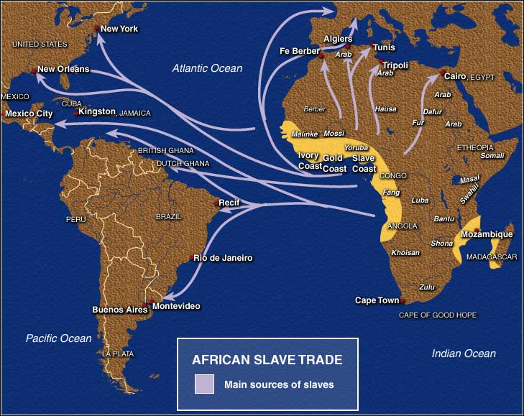
Iberian Society and Tradition
Spanish and Portuguese were heavily urban
  Many peasants living in small towns and villages
Many commoners who came to America as conquerors sought to recreate themselves as a new nobility
  Indians - serfs
  Encomiendas – provided the framework for relations based on economic dominance
Iberian peninsula maintained a tradition of holding slaves
  African slaves had been imported from the trans-Sahara trade
  The extension of slavery to America built on this tradition

Slide 7
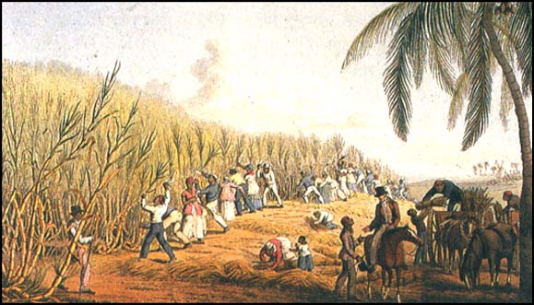
Political centralization of both Portugal and Castile depended on a professional bureaucracy
  Lawyers and judges
  Comparison with China
Religion and the church played an important role in Iberian politics
  Close links between church and state
  Would extend to the New World
In the Atlantic islands, extensive estates were established, leading to a slave trade with Africa and a highly commercial agricultural system based on sugar
  Brazil would extend this pattern

Slide 8
The Chronology of Conquest
1492-1570 : Era of Conquest
  Main lines of administration and economy were set out
  Human destruction and creation
  Vast areas of two continents and millions of people were brought under European control
1570-1700: Phase of consolidation and maturity
  Colonial institutions and societies took their definite form
18th century: Period of reform and reorganization
  Spanish America
  Portuguese Brazil
  Intensified the colonial relationship
  Planted the seeds of dissatisfaction and revolt

Slide 9
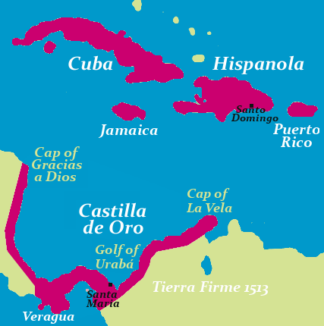
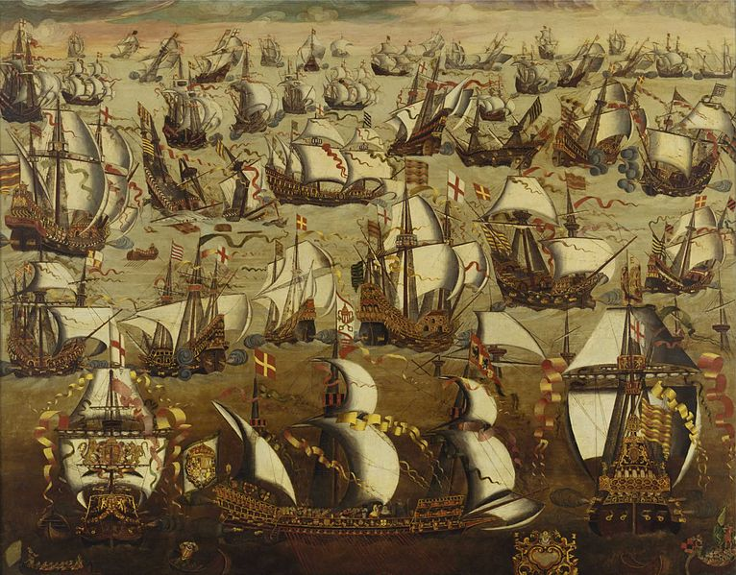
The Caribbean Crucible
1493-1520: Exploration and settlement in the Caribbean
  1493 – Santo Domingo (Hispaniola)
  1508 - Puerto Rico
  1511 – Cuba
  1513 – settlements existed in Panama and on northern coast of South America
All fell under Spanish control

Slide 10
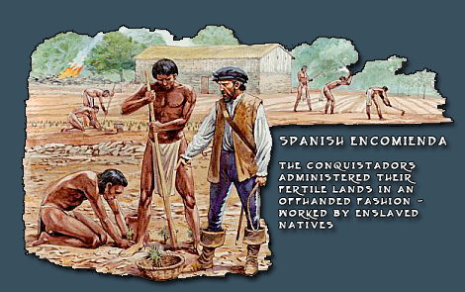
In the Caribbean, the agricultural Taino Indians of the islands provided surplus of labor
  Encomienda – grants of Indians given to individual Spanish
    Similar to serfdom
Gold hunting, slaving, and European diseases rapidly depopulated the islands
  Within two decades little was left there to hold Spanish attention
    Spanish would set up a few strongly fortified ports to guard their commercial lifeline, but Caribbean would become a colonial backwater until sugar and slaves created resurgence

Slide 11
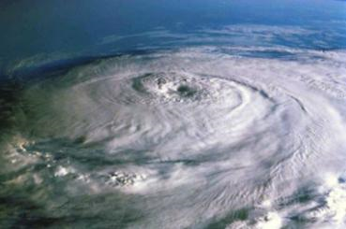
Spaniards established Iberian-style cities but had to adapt them to American realities
  Hurricanes and Indians caused many towns to be moved or abandoned
Royal administration
  Creation of administrative institutions
    Governorship
    Treasury office
    Royal court of appeals (staffed by professional magistrates)

Slide 12
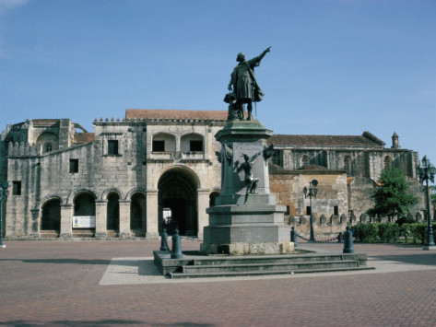
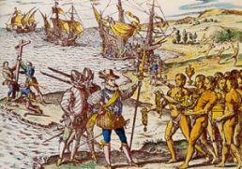
A body of laws was developed based on those of Spain (and changed by American experience)
The church
  First – individual priests
  Then… missionaries (such as the Dominicans and Jesuits)
1530 – cathedral built on Hispaniola, and a university soon followed

Slide 13
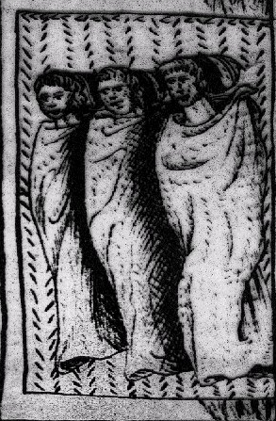
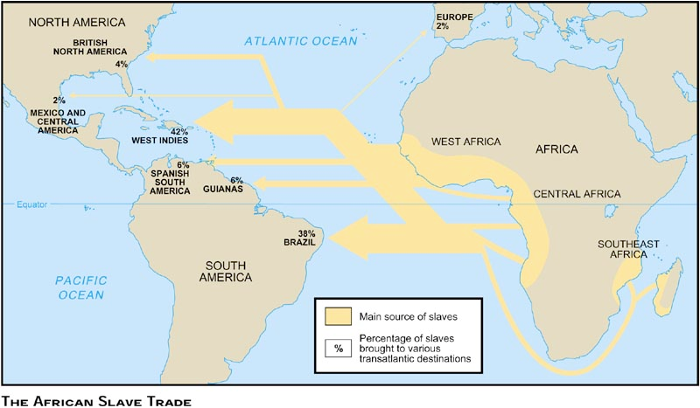
Rumors and hopes stimulated immigration from Spain
  1510 – large numbers of Spanish women
Virtual annihilation of the Indians on Caribbean
  Within 30 years – most of the Indian population had died or been killed
  Destruction of Indians led to further expeditions toward the mainland
Transformation of the islands’ economies – sugar production
  Led to African slave trade

Slide 14
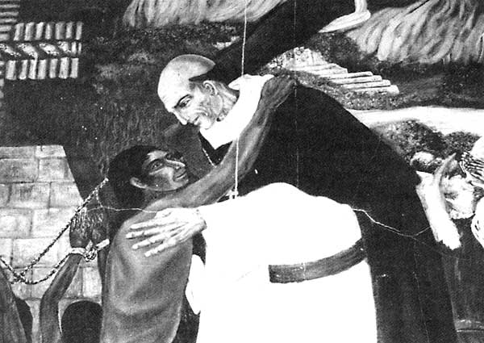
As early as 1510 – the mistreatment and destruction of the Indians led to attempts by clerics and royal administrators to end the worst abuses
  Dominican friar Bartolome de Las Casas (1484-1566)
    Conquistador turned priest
    Initiated the struggle for justice

Slide 15
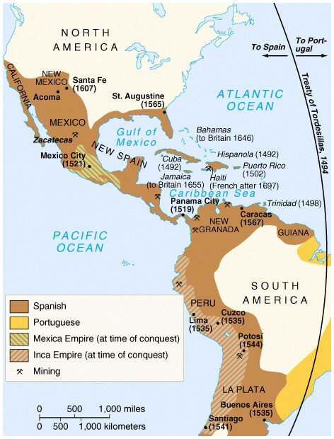
The Paths of Conquest
In less than a century, a large portion of two continents and islands, inhabited by millions of people, was brought under Spanish control
Spanish expeditions – 50 to 500 men
After conquest – women, missionaries, administrators, and artisans came in to form society
The conquest of the Americas was two – pronged
  Mexico
  South America

Slide 16
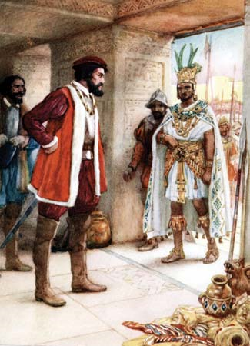
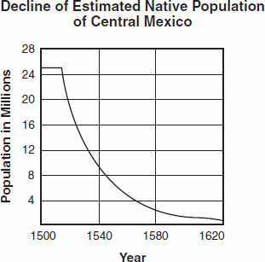
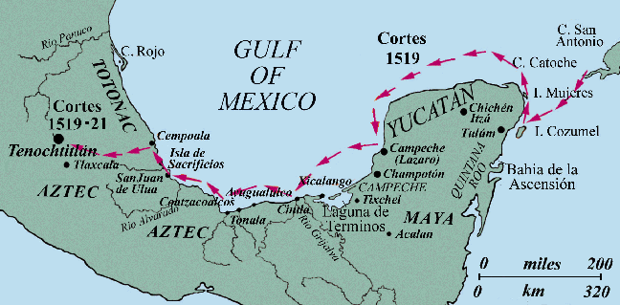
1519 – Hernan Cortes led an expedition of 600 men to the coast of Mexico
  Established base at Veracruz
  Battled towns subject to Aztec Empire
    Created alliances with Indian groups
  Reached island capital Tenochtitlan
    Aztec emperor Moctezuma II was captured and killed
    1521 – disease, starvation, and battle bring city down

Slide 17
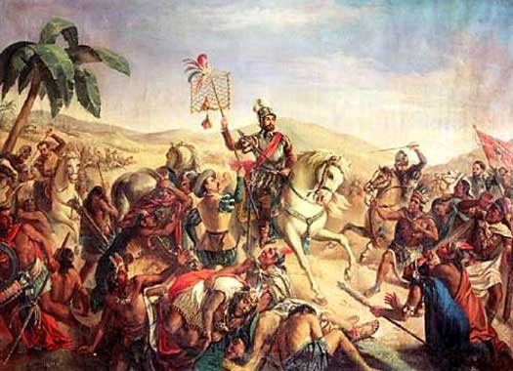
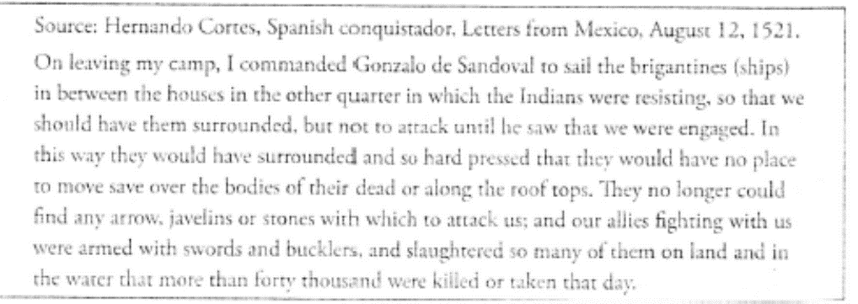

Slide 18
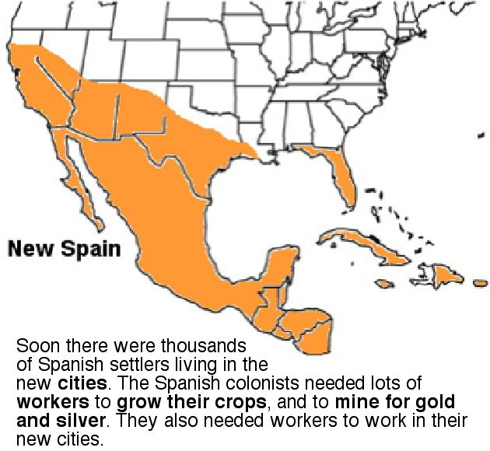
1535 – most of central Mexico had been brought under Spanish control as the kingdom of New Spain
  Network of towns
  Dense agricultural populations
Spanish pushed their conquest southward into Guatemala and Honduras and northward into the area of the nomadic Indians of north central Mexico

Slide 19
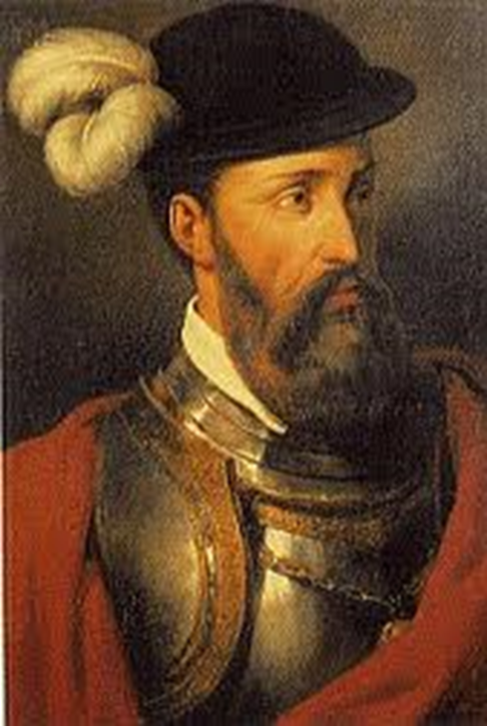
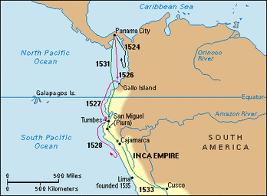
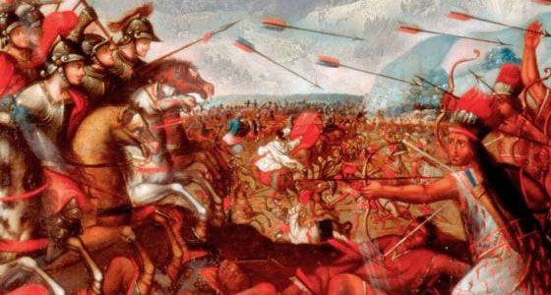
Second area of conquests was northern South America and Panama
  1535 – Francisco Pizarro led his men to the conquest of the Inca Empire (had been weakened by long civil war)
    Fewer than 200 Spaniards and Indian allies brought a great Indian Empire down
    1533 – Cuzco fell
Spanish decided to build their major city at Lima
  Closer to the coast
1540 – most of Peru was under Spanish control
  Active resistance continued for another 30 years

Slide 20
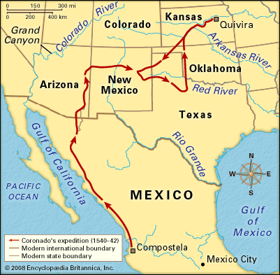
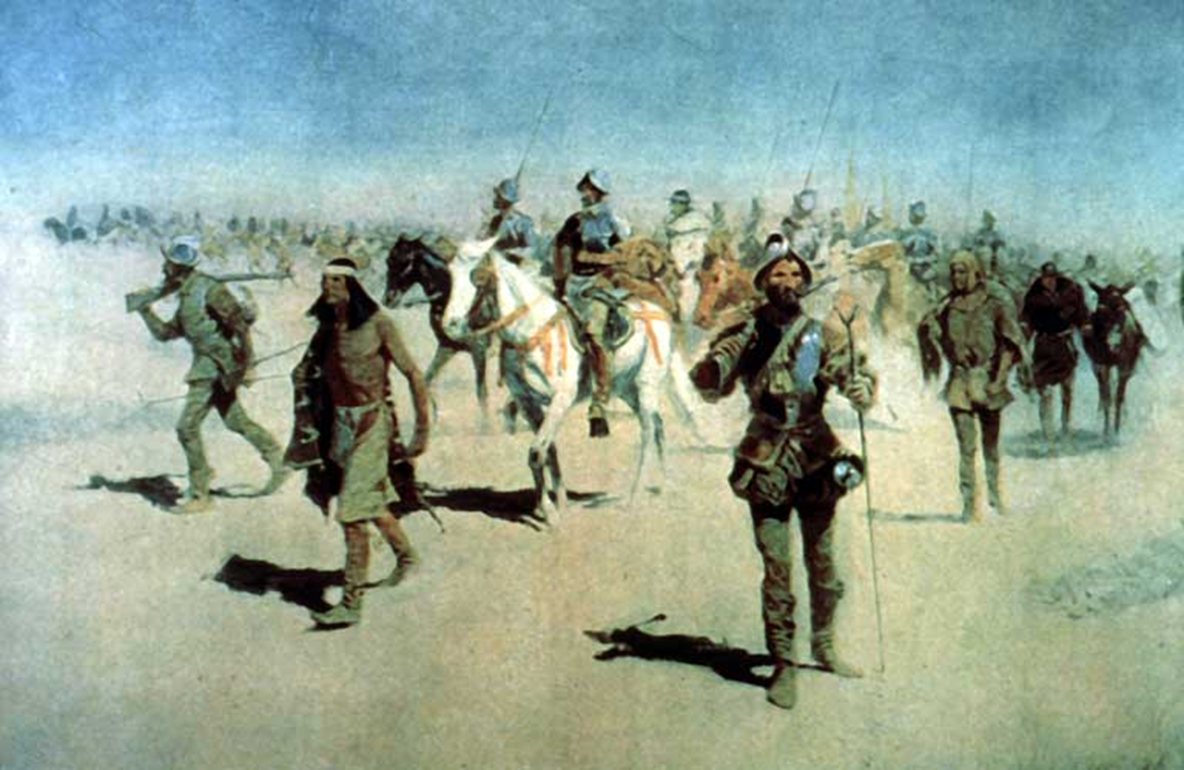
1540-1542: Francisco Vazquez de Coronado
  Searching for mythical cities of gold
  Southwestern United States (as far as Kansas)
1541 – Pedro de Valdivia
  Conquered the Araucanian Indians of central Chile
  Setup Santiago
1536 – Spain founded Buenos Aires
  Abandoned by Indian resistanace
1541-1542: Gonzalo Pizarro
  Went into Amazon Basin
1570 – 192 Spanish cities and towns throughout the Americas

Slide 21
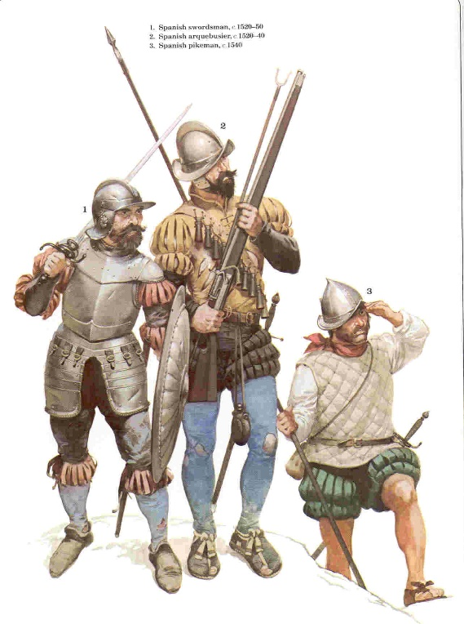
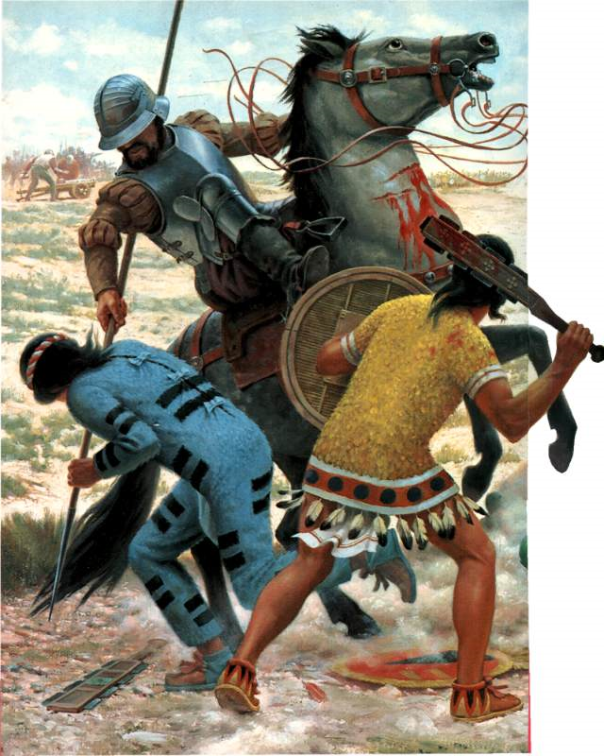
The Conquerors
Conquerors
  Few were Professional soldiers
  Hoping to better themselves and serve God by converting the Indians
  Actively searching for treasure
  Satisfied by grants of Indians, who could be taxed or put to work
  Horses, firearms, and steel weapons gave them a great advantage over the stone technology of the Indians
  Aided by disease
Internal divisions and rivalries within the Indian Empires made civilizations vulnerable

Slide 22
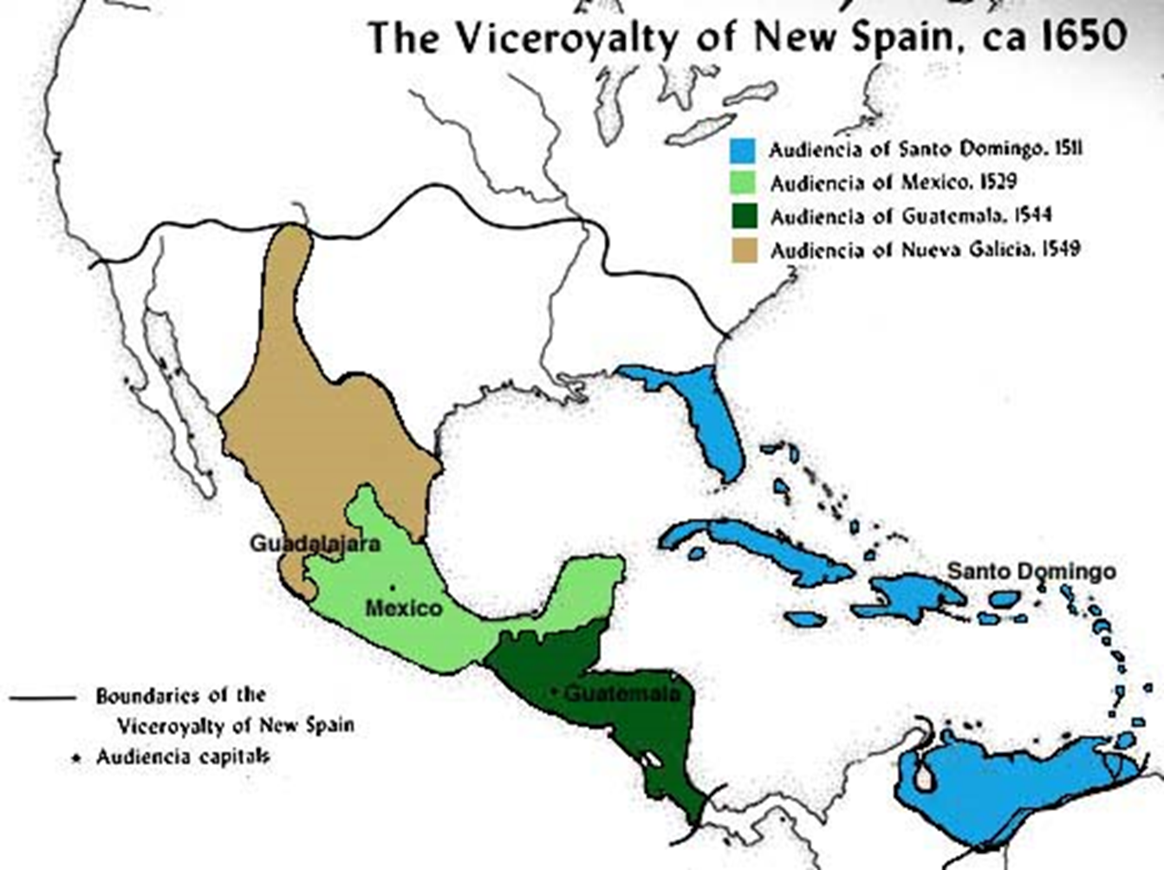
1570 – age of conquest coming to a close
Generation of conquerors were replaced
  Bureaucrats
  Merchants
  Colonists
Institutions of colonial rule and basis of economy were regularized
  Viceroys
  Law courts in main centers

Slide 23
Conquest and Morality
Who were the Indians?
Were they fully human?
  Not fully human
  Born to serve
Was it proper to convert them to Christianity?
Was the conquest of their lands justified?
  Juan Gines de Sepulved justified Spanish behavior using Aristotle’s argument
    Came to FREE Indians from unjust lords and bring the light of salvation
  Father Bartolome de las Casas argued that it was not; they had never brought harm on Christians

Slide 24
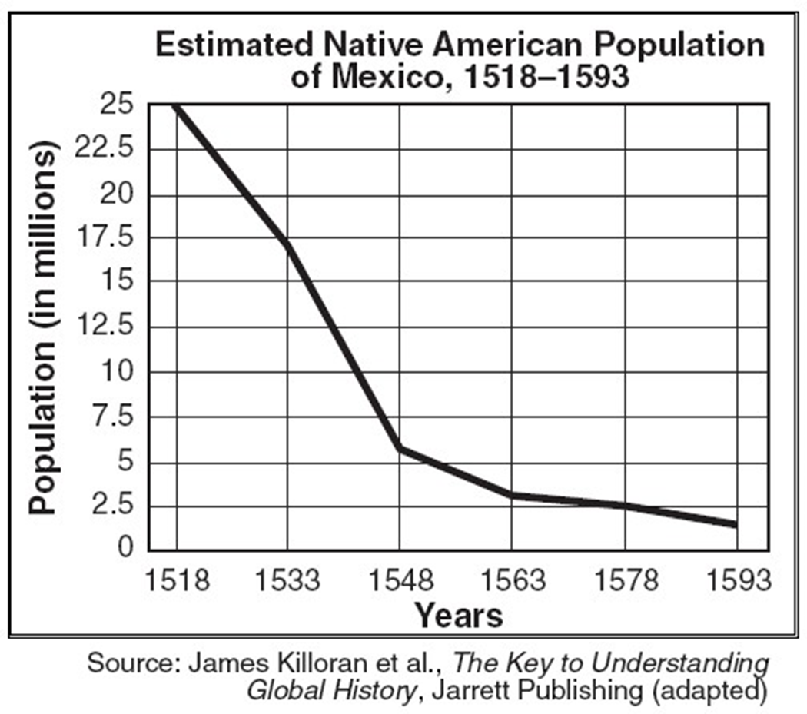
Destruction and Transformation of Indian Societies
Suffered a severe decline of population – demographic catastrophe
On the main islands of the Caribbean
  Indian population nearly disappeared by 1540
In central Mexico
  1519 – 25 million
  1580 – 2 million
Peru
  1530 – 10 million
  1590 – 1.5 million
Smallpox, influenza, and measles wreaked havoc on Indian population, which had developed no immunities against these diseases

Slide 25
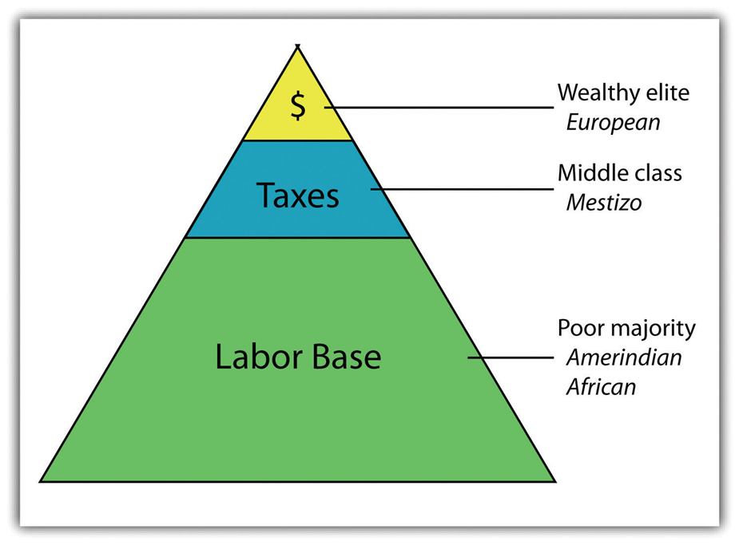
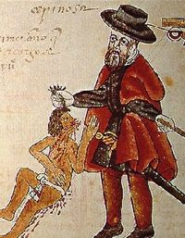
Exploitation of the Indians
The old Indian religion priestly class eliminated
Traditional Indian nobility remained and became the middlemen for taxes and labor demands of new rulers
Encomienda System
  Originally given to conquerors
    Tax and force labor
  Destructed to Indian societies
  1620s -As the Indian population declined, the value of encomiendas diminished
    Conquerers increasingly sought grants of land

Slide 26
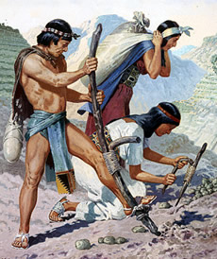
Colonial government increasingly extracted labor (Peru – mita) and taxes from native peoples
  Similar to China
  Built churches and roads
  Mining
  agriculture
  Paid a wage, but system was abused by local officials
17th century – many Indians left their villages to avoid labor and tax obligations
  Growth of wage labor system
  Many Indians worked for wages on Spanish-owned mines and fares or in cities
At the local level, many aspects of Indian life remained
  Selective in their adaptation of European foods, technology, and culture

Slide 27
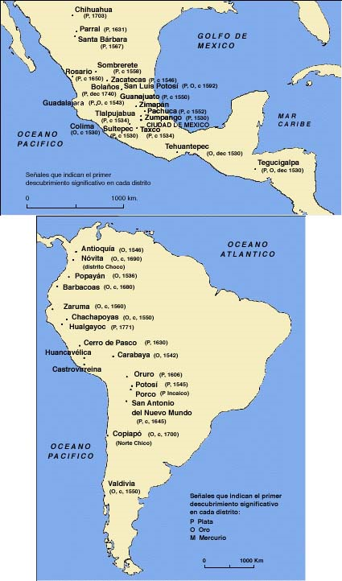
Colonial Economies and Governments
Spanish America was an agrarian society
  80 percent of population lived and worked on land
Mining was the essential activity and the basis of Spain’s rule in the Indies
  Exchange of America’s precious metals for manufactured goods from Europe
Gold was found in the Caribbean, Colombia, and Chile, but it was silver far more than gold that formed the basis of Spain’s wealth in America

Slide 28
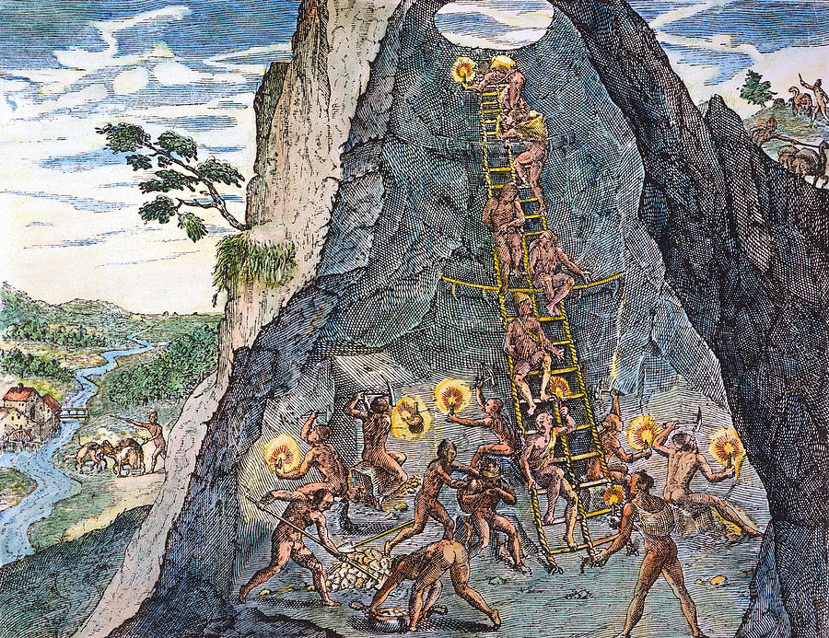
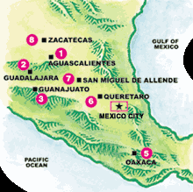
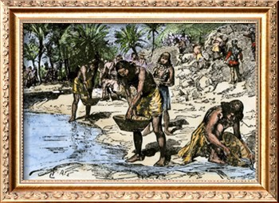
The Silver Heart of Empire
1545 – 1565 : major silver discoveries made in Mexico and Peru
  Peru – Potosi
  Mexico – Zacatecas
  Both areas became wealthy mining centers with lavish churches and a luxurious way of life for some
Although indigenous methods were used at first, most mining techniques were European in origin

Slide 29
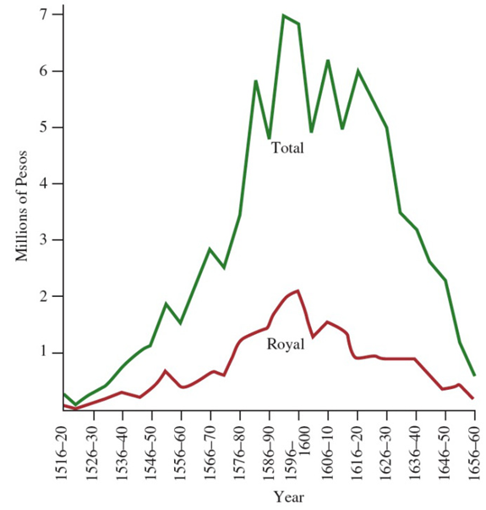
Spanish law says all subsoil rights belong to the crown, but mines owned by individuals
  Had to pay the crown 1/5th
Mining stimulated many other aspects of the economy
  Food and clothing
From Spain’s perspective, mining was the heart of the colonial economy

Slide 30
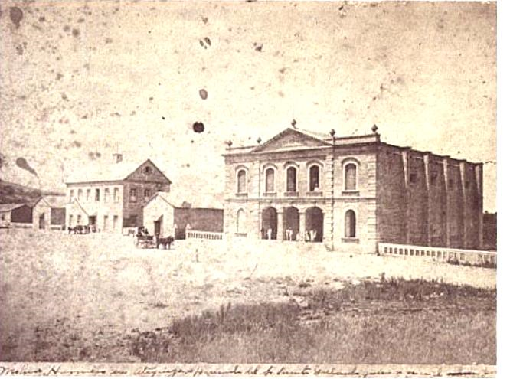
Haciendas and Villages
Haciendas – family owned rural estates (plantations, mines, factories)
  Produced grains, grapes, and livestock
    mainly for consumers in America
  Developed throughout the central areas of Spanish America
  Labor force came from Indians
  Became the basis of wealth and power for the local aristocracy in many regions

Slide 31
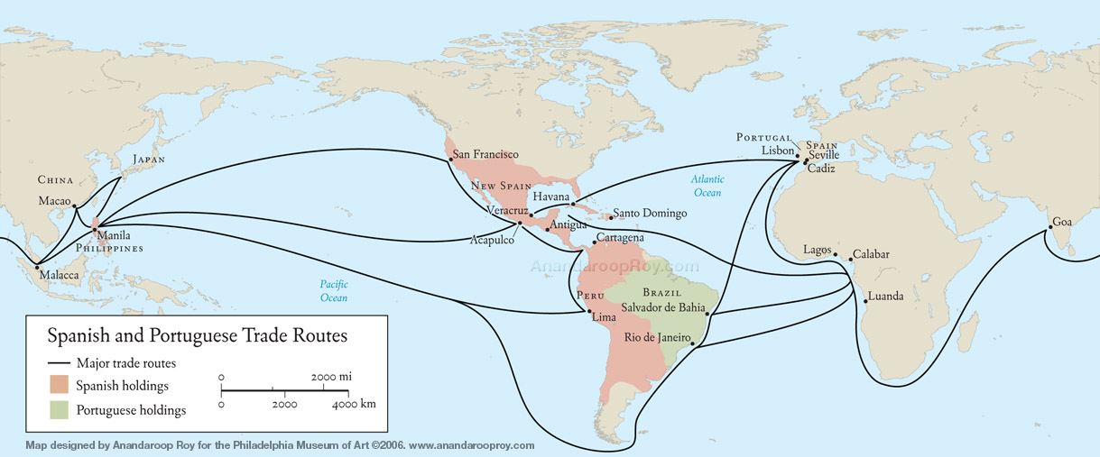
Industry and Commerce
Ecuador, New Spain, Peru – sheep raising led to the development of small textile sweatshops
  Produced common cloth
    Usually by women
America became self-sufficient for its basic foods and material goods
  Looked to Europe only for luxury items not locally available
American “kingdoms” had a silver heart, and the whole Spanish commercial system was organized around that fact
Spain allowed only Spaniards to trade with America and imposed tight restrictions
  Other Europeans looked on the Indies trade with envy

Slide 32
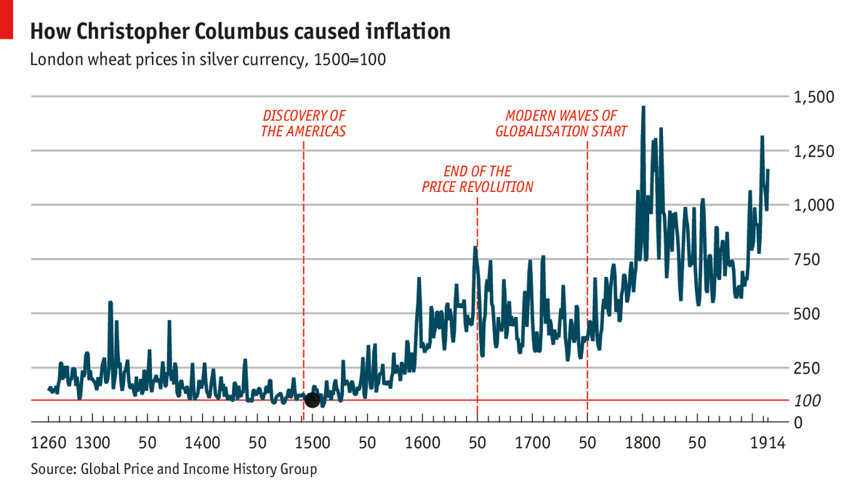
In general, the supply of American silver to Spain was continuous and made the colonies seem worth the effort
  Paid for Spain’s European wars, its long-term debts, and the purchase of manufactured goods to be sent back to the Indies
    Less than half of the silver remained in Spain
Importation of silver caused inflation
    First in Spain and then throughout western Europe during the 16th century
Spain depended more on the taxes levied on its own population than it did on the exploitation of its Native American subjects

Slide 33
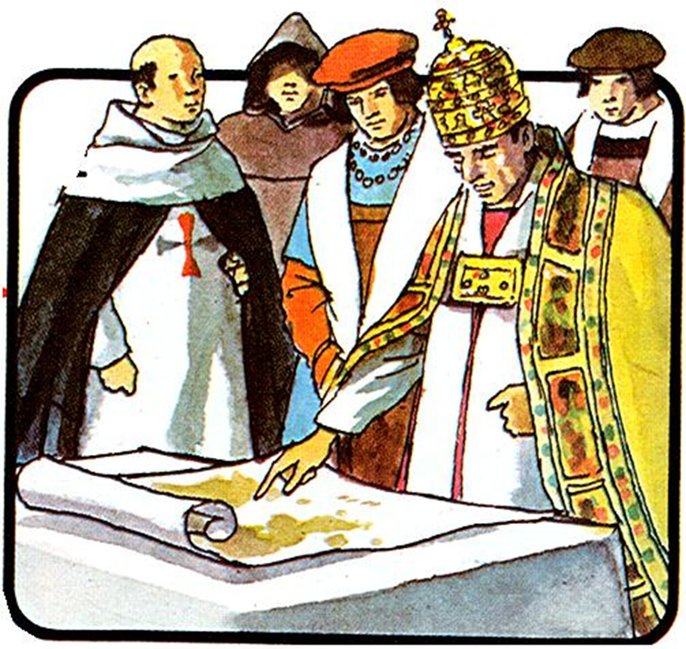
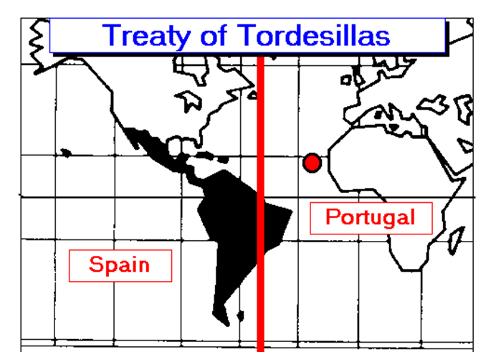
Ruling and Empire: State and Church
Spain controlled its American empire through a carefully regulated bureaucratic system
Sovereignty rested with the crown
  Based not on the right of conquest but on a papal grant that awarded the Indies to Castile in return for its services in bringing those lands and peoples into the Christian community
1494 – Treaty of Tordesillas
  Between Castile and Portugal
  Clarified the spheres of influence and right of possession of the two kingdoms by drawing a hypothetical north-south line around the globe
  Portugal – lands to the east of line
  Castile – lands to the west of the line

Slide 34
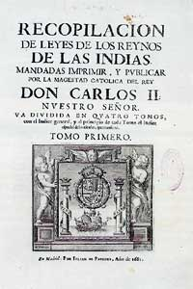
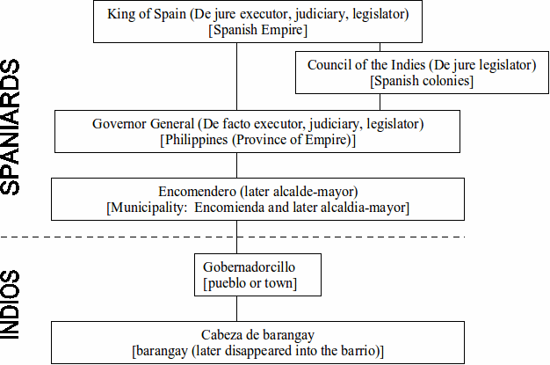
Spanish empire became a great bureaucratic system
Letrados - Administers of the law
  University trained lawyers from Spain
  Exercised legislative and administrative authority
Recopilacion (1681) – codified laws into the basis for government in the colonies
King ruled through the Council of the Indies in Spain
  Issued the laws and advised him

Slide 35

16th century -Spain created two viceroyalities
  Mexico City
  Lima
  Viceroys – high ranking nobles who were direct representatives of the king
    Military, legislative, and judicial powers
Viceroyalities of New Spain and Peru were subdivided into ten judicial divisions controlled by superior courts
  Called audiencies
  Staffed by professional royal magistrates who helped to make and apply law
Local level – royally appointed magistrates applied the laws, collected taxes, and assigned the work required of Indian communities
Below them were other lower level bureaucrats
  minor officials, customs and tax collectors, municipal officers, and inspectors

Slide 36

To some extent, the clergy formed another branch of the government
  Catholic religious orders carried out the widespread conversion of the Indians, established churches in the towns and villages
    Franciscans, Dominicans, Jesuits
  Pope – Christianize the peoples of the new lands
    Primary justification for Spain’s rule
Some of the early missionaries became ardent defenders of Indian rights and admirers of Indian culture
  Franciscan priest Fray Bernardino de Sahagun became an expert in the Nahuatl language and composed a bilingual encyclopedia of Aztec culture
Some Spanish priests, who attempted to convert the native peoples to Christianity by gentle means, tried to protect the Indians. However, these priests were few in number, and rarely succeeded.

Slide 37

In core areas of Peru and New Spain, the missionary church eventually was replaced by an institutional structure of parishes and bishoprics
  Complicated church hierarchy developed
The Catholic church profoundly influenced the cultural and intellectual life of the colonies
  Stimulated the work of architects and artists
  Published a high percentage of religious books, as well as works of history, poetry, philosophy, law, and language
  Schools run by clergy
    Provided training in law and theology

Slide 38

Brazil: The First Plantation Colony
1532 – settlement established
  Portuguese nobles were given strips of land along the coast to colonize and develop
  Sugar plantations were established using first Indian, then African slaves
1549 – Portuguese king sent a governor general and other officials to create a royal capital at Salvador
  First Jesuit missionaries also arrived
1600 – Indian resistance had been broke in many places by military action, missionary activity, or epidemic disease

Slide 39


Brazil: Sugar and Slavery
The plantation economy gave rise to a social hierarchy based on race
  TOP: White plantation owners became an aristocracy
  MIDDLE: Artisans, small farmers, and free laborers were drawn from the ranks of people born of marriages between Indians, whites, and African slaves.
  BOTTOM: Slaves, whose condition was marked both by race and servile status.

Slide 40


Brazil’s age of GOLD
In 1695, explorers in the interior of Brazil discovered gold in the region of Minas Gerais
  Labor in the mines, as in the plantations, was provided mostly by slaves
Brazil would be the greatest source of gold in the Western world
  The Portuguese government moved to promote its interests in mining production (immigration)
    Had disastrous effects on the Indian population; expansion of slavery
  Rio de Janeiro, the city closest to the mines replaced Salvador as the capital of Brazil
  Brazil signed a treaty with Britain to obtain manufactured products
    Much of the Brazilian gold flowed from Portugal to England to pay for manufactured goods
    Brazil and Portugal were economically dependent on England.

Slide 41

Multiracial societies
Indians, Europeans, Africans
  Europeans – conquerors and voluntary immigrants
  Indians – conquered peoples
  Africans – slaves

Slide 42


The Society of Castas
1516 – Spanish crown tried to sponsor mixed marriages
  Would later try to limit the opportunities for mixed offspring
With few European women available, mixed marriages and informal unions were common
  Result… growth of a large population of mixed background called mestizos
    Their status (especially in early years) was higher than Indians
    Became members of an intermediate category
    Not fully accepted as equals to Spaniards and yet expected to live according to the standards of Spanish society
Similar process in Brazil and Caribbean
  Large number of African slaves
    Result… mulatto

Slide 43

Together, the people of mixed origins were called castas
  1650 – 5 to 10 percent of population
  1750 – 35 to 40 percent of population
As mixed population grew in Spanish America, increasing restrictions were placed on them
Most of the wealthy merchants, land owners, bureaucrats, and miners were white
Peninsulares vs Creoles
  Peninsulares – born in Spain
  Creoles – born in New World
    Dominated local economies
    Contribute to the movements for independence in Latin America

Slide 44
Women were in a subordinate position
  Could not serve in government
  Expected to assume the duties of motherhood and household
  After marriage, women came under the authority of their husbands
Lower class women often controlled small-scale commerce in towns and villages, worked in the fields, and labored at the looms of small factories.
Marriages often were arranged and accompanied by the payment of a dowry

Slide 45

Shifting Balance of Politics and Trade
The Spanish kings were weak by the late 17th century and did not provide adequate leadership
  overwhelmed by foreign wars, increasing debt, declining population, and internal revolts
Spain threatened by a powerful France and the rising mercantile strength of England and Holland (whose Protestantism also made them rivals of Catholic Spain)
  1654 – English took Jamaica
  1697 – French take western Hispaniola (Haiti)
Other islands fell to the English, French, and Dutch
  Many of the islands turned to sugar production and the creation of slave and plantation colonies (similar to Brazil)

Slide 46
Failure of Spanish mercantile and political system
  Annual fleets became irregular
  Silver payments from America decline
  Most goods shipped to the Indies and even the ships that carried them were non-Spanish in origin
  Colonies became increasingly self-sufficient in basic commodities
  As central government became weaker, local aristocrats in the colonies exercised increasing control over the economy and government of their regions
  Widespread corruption in many branches of government

Slide 47

Final crisis
  1701 – Spanish king Charles II died without a heir
Philip of Anjou (a Bourbon) and a relative of the king of France was named successor of the Spanish throne
  War of Spanish Succession (1702-1713)
    Ended with the Treaty of Utrecht – recognition of a branch of the Bourbon family as rulers of Spain
    Commercial concessions giving France and England more control
      Spain’s commercial monopoly was now broken
Philip V of Spain and the Duke of Vendôme commanded the Franco-Spanish charge at the Battle of Villaviciosa by Jean Alaux (1840).

Slide 48
The Bourbon Reforms
The new Bourbon dynasty in Spain launched a series of reforms aimed at strengthening the state and its economy
  “enlightened despotism”
    Mix of absolute monarchy and Enlightenment principles
  Economic nationalism
    Material improvements for state
  Desire for strong centralized government to institute economic, administrative, and military reforms in Spain and its empire
    System of taxation tightened, navy reformed, and new ships were built
    New ports open in Spain and America for Indies trade
    Eliminate corrupt Creoles from upper level bureaucracy of colonies
  Goal – make Spanish government more effective, more powerful, and better able to direct the economy
    Groups or institutions that opposed these measures would be punished or suppressed
      Jesuits expelled
    Church and nobility not attacked as long as they did not conflict with authority of crown

Slide 49
Many of the reforms in America were linked directly to defense and military matters
During the Bourbon reforms, the government took an active role in the economy
  State monopolies established
    Tobacco and gunpowder
  Monopoly companies were granted exclusive rights to develop certain colonial areas
    In return… developing the economies of those areas
Mining inspectors and experts had been sent to Peru and New Spain to suggest reforms and introduce new techniques
  Allow production to expand
  Silver output reached new heights
Short run – restructuring of government and economy revived the Spanish Empire
Long run – removal of Creoles from government, the creation of a militia with a Creole officer crops, the opening of commerce, and other such changes contributed to a growing sense of dissatisfaction among the elite

Slide 50

Reaction and Revolt
Despite evident prosperity, reforms disturbed social and political relations in the colonies and led to colonial resistance
    The Comunero Revolt in New Granada (1781)
    Tupac Amaru rebellion in Peru
  Social and racial divisions prevented common action against colonial administrations

