Slide 1
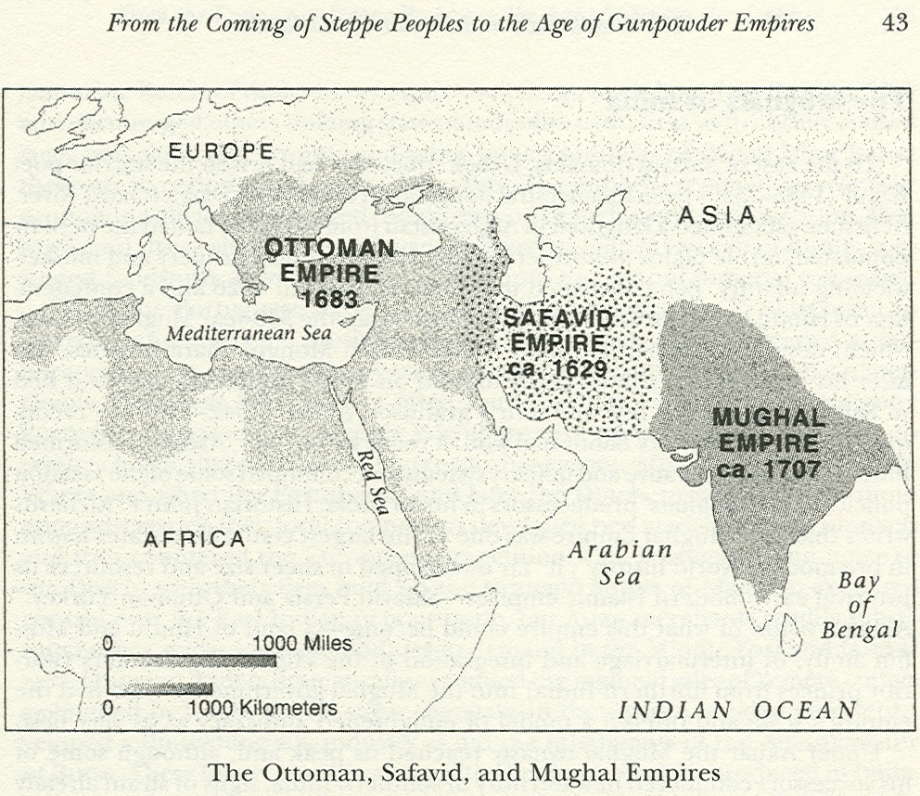
Muslim Empires Chapter 20

Slide 2
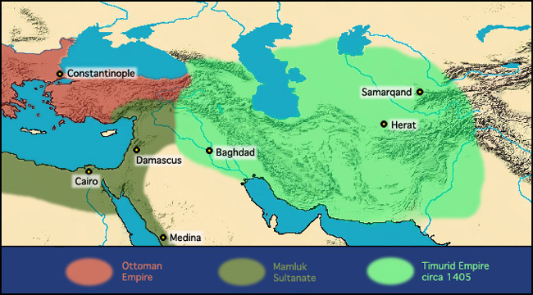
Introduction
Islamic world in shambles by end of 14th century
First half of 13th century – Nomadic invasions of Islamic heartlands by Mongols
Last decades of 14th century – armies of Timur
Many Islamic cities laid to waste

Slide 3
Similarities between Gunpowder empires
Islamic dynasties
Origins in the Turkic nomadic cultures of central Asian steppe
A religious commitment for Islamic conversion in both Ottoman and Safavid dynasties
Empires based on military conquest
Effectively used firearms
Ruled by absolute monarchs
Their governments and military were supported by taxes levied on the conquered farming people
Artistic and literary interests

Slide 4
Differences between gunpowder empires
Mughals
subjects mostly non-Muslim populations
Safavid
Subjects mostly Muslims
Shia
Challenged Ottomans for leadership in Islamic world
Ottoman
First centuries – subjects largely Christian from the
15th century onward- subjects mostly Muslim
Sunni

Slide 5
Ottomans: Important ideas
Ottoman dynasty
Turkic nomadic people from the central Asia
Built an empire in eastern Mediterranean
Ended the Byzantine Empire, then went deep into eastern and central Europe
Ruled large number of Christians
17th century – weakened by Muslim and European rivals
The dynasty practiced social reforms to cope with Western powers

Slide 6
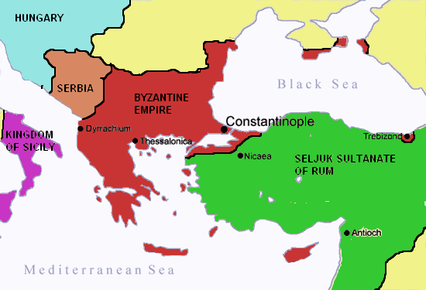
From frontier warriors to empire builders
1243 – Mongol invasion in eastern Anatolia
Collapse of Seljuk Turkic kingdom of Rum in Asia Minor
Open the way for Ottomans to seize power
Began to build an empire based in Anatolia
1350s – Ottomans advanced from Asia Minor into Europe
By end of 14th century, the Ottomans conquered large portions of the Balkans
1402- Armies of Timur swept into Anatolia and defeated the Ottoman sultan Bayazid at Angora
Led to civil war
Mehmed I reunified the empire and continued conquests in Europe and Asia Minor

Slide 7
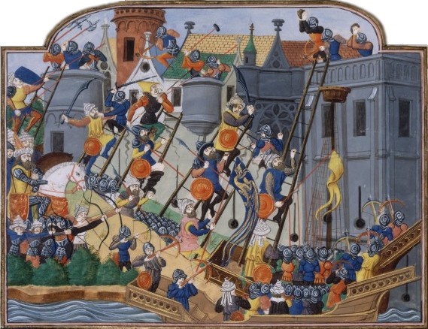
1453 - the Ottomans, led by Mehmed II – The Conqueror, won a victory capturing Constantinople, capital of the once powerful Byzantine Empire
100,000 Ottoman soldiers assaulted the triple ring of land walls that had protected the city for centuries

Slide 8
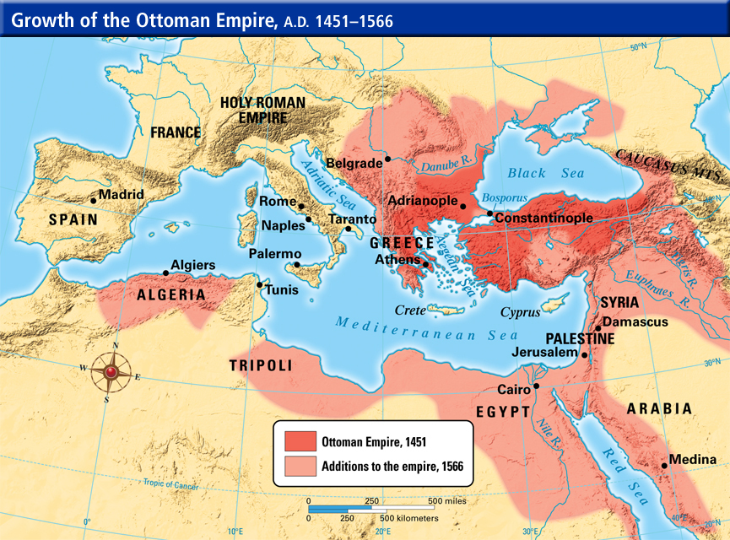
Over the next two centuries after conquering Constantinople
Extended into Syria and Egypt and across North Africa
Ruled the bulk of the Arab world
Became the protectors of the Islamic heartlands
Spread through the Balkans into Hungary in Europe, and around the Black and Red Seas
Became a threat to Christian Europe
Became a formidable naval power in the Mediterranean

Slide 9
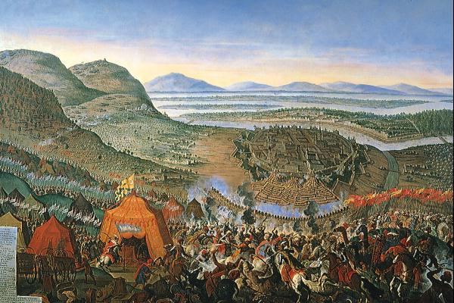
1863- Ottoman armies laid siege to the capital of the Austrian Habsburg dynasty at Vienna
Ottomans remained a major force in European politics until the late 19th century

Slide 10
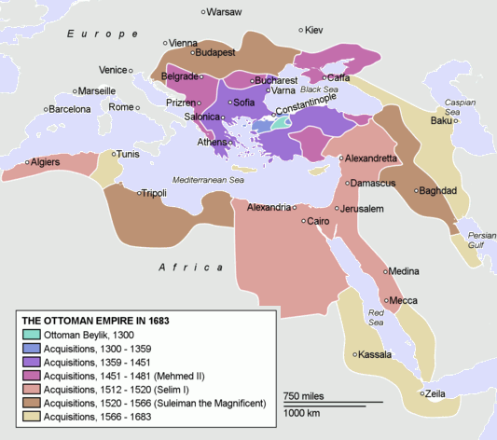

Slide 11
A state Geared to Warfare
The Ottoman Empire was founded and extended to spread Islam through waging of the jihad, or holy war
Military leaders played dominant role
Economy of the empire was geared to warfare and expansion
13th-16th centuries – Turkic cavalry mainly responsible for Ottomans early conquests
Gradually developed into a warrior aristocracy
Granted control over land and peasant producers
Competed with religious leaders and administrators for control of the expanding Ottoman bureaucracy
Built up regional and local bases of support
Competed with the sultans and the central bureaucracy for revenue and labor control

Slide 12
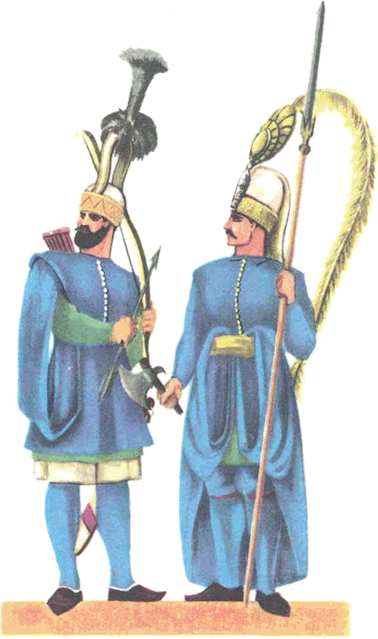
Mid 15th century – Janissaries
Imperial armies dominated by infantry divisions
Forcibly conscripted as adolescent boys in conquered areas
Balkans – majority Christian faith
Sometimes the boys’ parents willingly turned their sons over to Ottoman recruiters
Opportunities for advancement
Legally slaves
Given extensive schooling
Converted to Islam
Some served in the palace or bureaucracy
Controlled the artillery and firearms
Vital to Ottoman success in warfare with Christian and Muslim enemies
Became the most powerful component in the Ottoman military machine
Steady decline of the role of the aristocratic cavalry
15th century – deeply involved in government
Mid 16th century – Power to remove sultans and decide which one of a dying ruler’s sons would mount the throne

Slide 13
Sultans and Their Court
Ottoman rulers were absolute monarchs
Maintained power by putting the warrior elite, Janissaries, and administrators (Islamic religious scholars and legal experts) against each other
Commerce within the empire was in the hands of Christian and Jewish trading groups
Dhimmis – “peoples of the Book”
Under the protection of the Ottoman rulers
Ottoman conquest meant effective administration and tax relief for the peoples of areas annexed to the empire
Early Ottoman sultans were very capable rulers

Slide 14
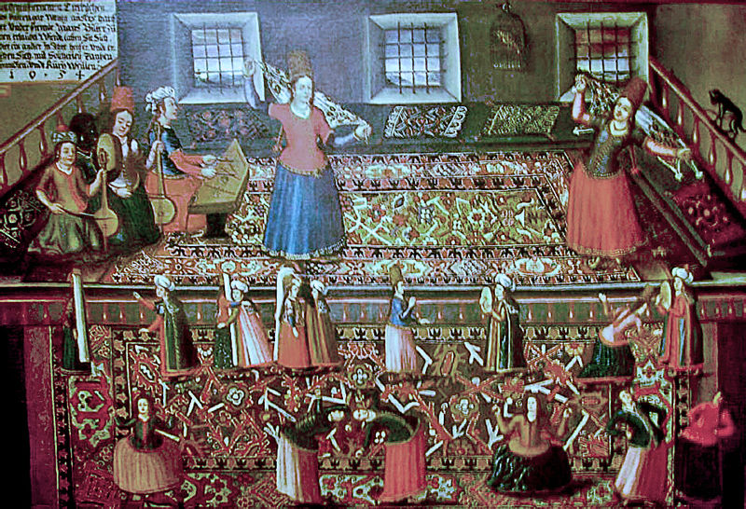
Like the Abbasid caliphs, the Ottoman sultans grew more distant from their subjects as the empire grew
Marble palaces
Luxurious gardens
Surrounded by slaves
Many wives and concubines of their harems
Elaborate governmental ceremonies

Slide 15
Grand Vizier
Carried out day-to-day administration
In charge of the large bureaucracy
Head of the imperial administration
Held more real power than the sultan
Political succession remained vague and contested
Similar to earlier Muslim dynasties
Many talented and experienced claimants to the throne
Warfare among sultans sons

Slide 16
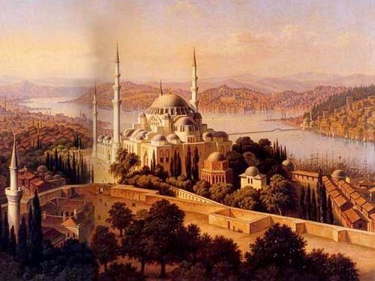
Constantinople restored and Ottoman Culture
Constantinople
Capital of the Ottoman Empire
Mehmed II - restore its ancient glory
Cathedral of Saint Sophia converted into one of the grandest mosques in the Islamic world
New mosques and palaces built
Benefited from architectural advances from the Byzantine heritage
Aqueducts
Supply the growing population with water
Markets reopened
City’s defenses were repaired

Slide 17
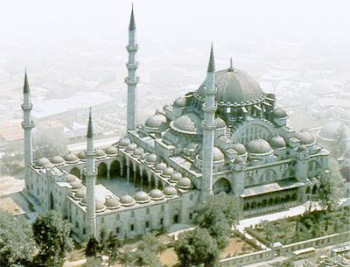
Each sultan after Mehmed strove to be remembered for efforts to beautify the capital
1550s – Suleyman I had the Suleymaniye mosque built
Among the largest domed structures in the world
One of the great engineering achievements of Islamic civilization

Slide 18
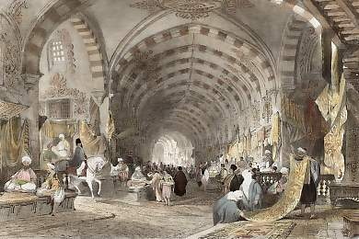
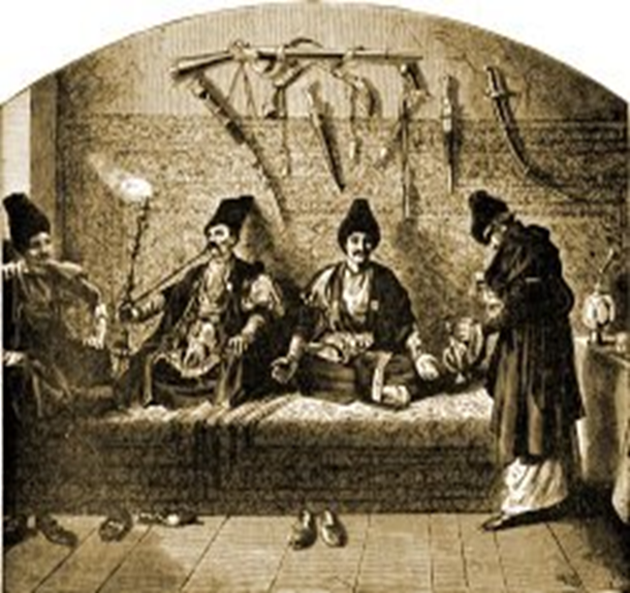
Constantinople
Sultans and powerful administrators built mansions, rest houses, religious schools, and hospitals
Bazaars
Merchants and travelers from throughout the empire and places as distant as England
East Indies - Spices
Africa - Ivory
Russia – Slaves and forest products
Persia – Carpets
Coffeehouses
Men gathered to smoke tobacco, gossip, do business, and play chess
Major role in cultural life
Poets and scholars could congregate, read their latest works aloud, and debate about politics and merits of each other’s ideas

Slide 19
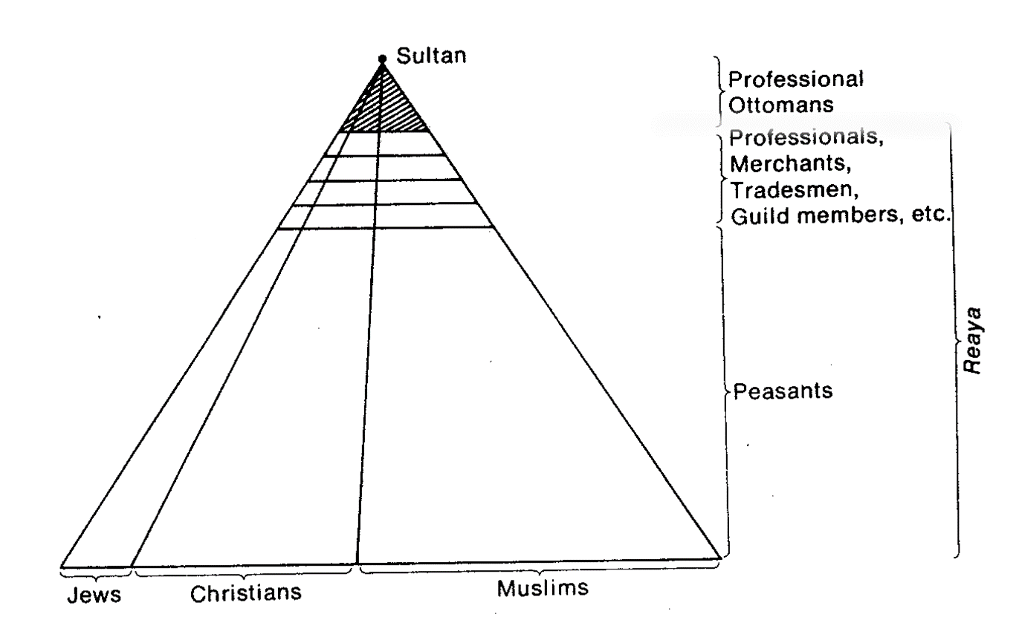
Merchant and artisan classes
Ottoman government inspectors closely regulated commercial exchanges and handicraft production
Ensured that standard weights and measures were used
License the opening of new shops
Regulated the entry of apprentice artisans into the trades
Monitored the quality of goods they produced
Like their counterparts in medieval European towns, the artisans were organized into guilds
Set craft standards
Arbitrated disputes between members
Provided financial assistance for needy members
Supervised closely by government
Wide array of occupational groups, including entertainers, prostitutes, and ordinary laborers

Slide 20
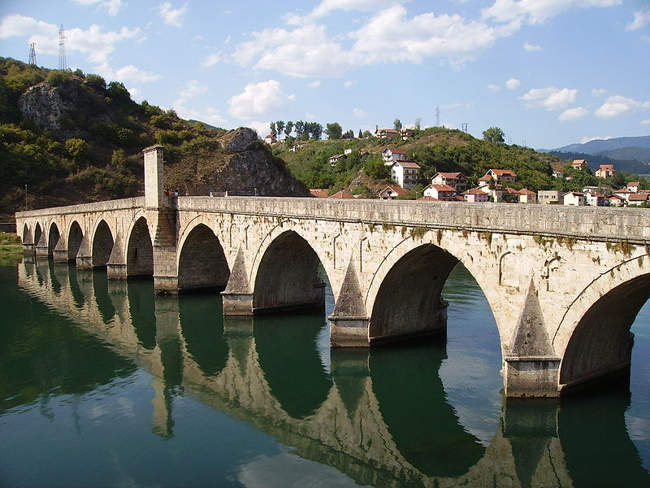
Language in the Ottoman Empire
Early Ottomans had written in Persian
Arabic remained an important language for works on law and religion
17th century - The Turkish language became the preferred language for poets, historians and the Ottoman bureaucracy
Ottoman empire legacy
Poetry, ceramics, carpet manufacturing, architecture
Mehmed Paša Sokolović Bridge, completed in 1577 by Mimar Sinan, the greatest architect of the classical period of Ottoman architecture

Slide 21
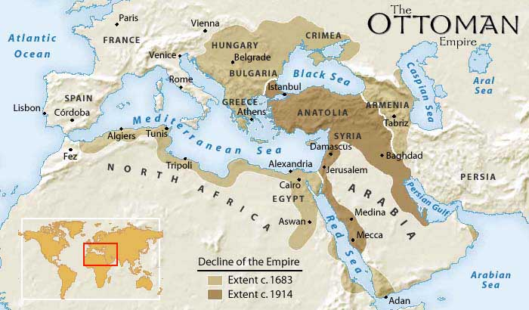
The problem of ottoman decline
Mid-17th century – Ottoman Empire in decline
Internal revolts
Periodic conflicts with powerful foreign rivals
Russian, Austrian, Spanish, and Safavid empires
Too large to be maintained
Pre-industrial transportation and communications
Possibilities for new conquests ran out
Lands began to be lost to Christian and Muslim enemies
Difficulty maintaining oversized bureaucracy and army
Decline in effectiveness of administrative system
Rampant growth of corruption

Slide 22
Ottoman Empire in decline
Regional and local officials
Retain more revenue for their own purposes
Squeezed the peasants and the laborers who worked their lands for additional taxes and services
Peasant uprisings and flight resulted in abandonment of cultivated lands, which further drained the resources of the empires
17th century – growing problems in imperial administration
End of practice assigning the royal princes administrative or military positions to prepare them to rule
Successors to the throne were kept like hostages in special sections of the palace
Produced monarchs far less prepared to rule
Later Sultans
Weak and addicted to drink, drugs, and pleasures of the harem
Pawns in the power struggles of the viziers and other powerful officials that had increasing influence over the Janissary corps

Slide 23
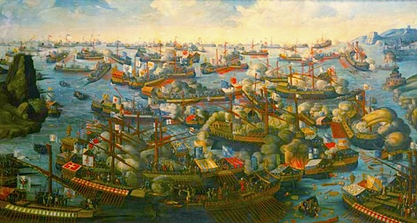
Military reverses and the ottoman retreat
The Ottomans fell behind European rivals in the ability to wage war
Reliance on huge siege guns
Janissaries’ determination to block all military changes that might jeopardize the power they had gained
Lost control of the eastern Mediterranean
1571- Battle at Lepanto vs Spanish and Venetian fleet
Ottomans failed to drive the Portuguese from control of the Indian Ocean
Portuguese control of trading goods, particularly spices, enriched the Ottomans’ Christian rivals

Slide 24
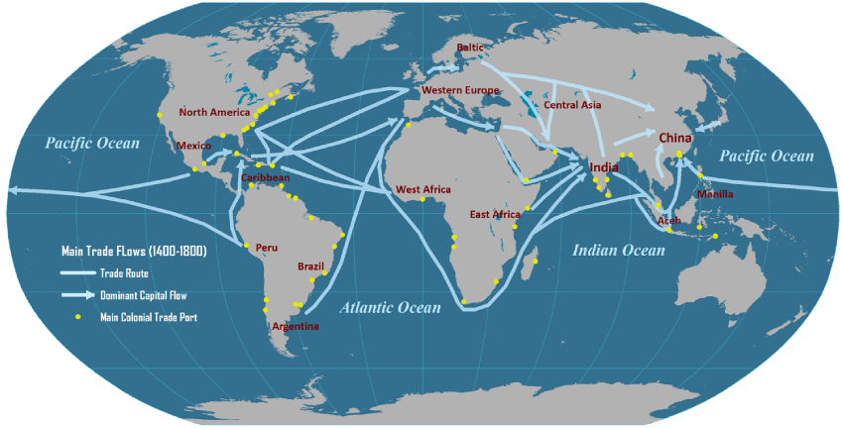
More problems for the Ottoman Empire
Late 16th century – Long term inflation in the Ottoman Empire
Large amounts of silver flowed into the Empire from mines worked by American Indian laborers in the Spanish empire in Peru and Mexico
17th and 18th centuries - Janissaries and religious scholars
Blocked most Western-inspired innovations that sultans tried to introduce

Slide 25
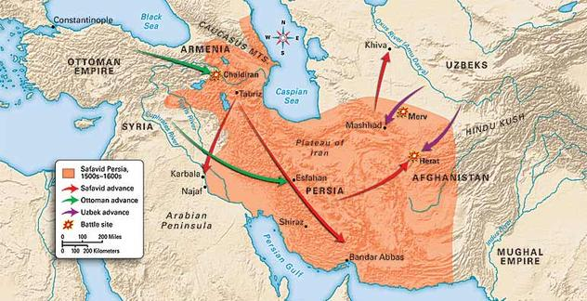
The Shi’ite challenge of the safavids
Similar to the Ottomans, the Safavid dynasty
13th and 14th centuries - Arose from the struggles of rival Turkic nomadic groups in the wake of Mongol and Timurid invasions
Highly militant strain of Islam
Unlike the Ottomans, the Safavid dynasty embraced the Shi’ite variant of Islam

Slide 26
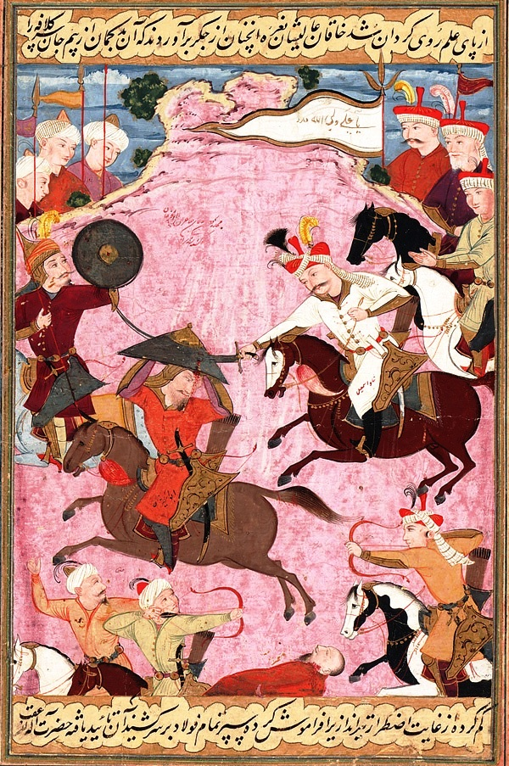
The rise of the Safavid dynasty
Roots in a family of Sufi mystics and religious preachers
14th century- Sal al-Din
Sufi
Started a militant campaign to purify and reform Islam
Spread Muslim teachings among the Turkic tribes
After collapse of Mongol authority, other Safavid Sufi leaders gained increasing support
Red Heads –
Nickname for Safavid followers because of their distinctive headgear
Preach Shi’ite doctrines
Had many enemies

Slide 27
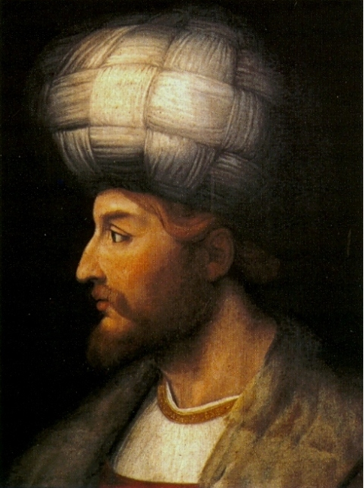
Isma’il
Sufi commander
1501 - Took the city of Tabriz
Proclaimed shah, or emperor
Followers conquered most of Persia, drove the Safavid’s ancient enemies back into central Asian steppes, and advanced into what is now Iraq

Slide 28
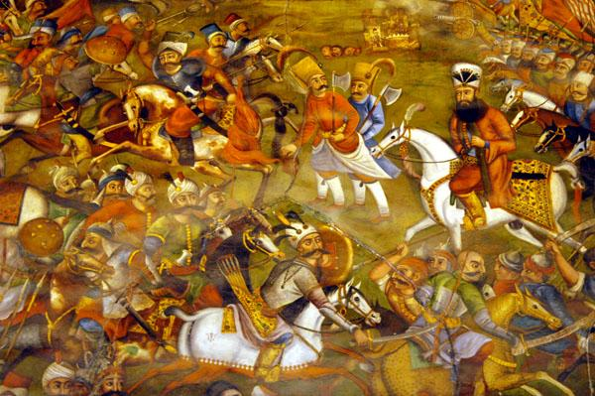
August 1514 – Battle at Chaldiran (NW Persia)
One of the most fateful battles in Islamic history
Clash between Shi’I and Sunni variants of Islam
Savafid led by Isma’il vs. Ottomans led by Sultan Selim
Devastating defeat for the Safavids
Ottoman victory helped their efforts to build the most powerful empire in the Islamic world
Showed importance of muskets and field cannon in the gunpowder age.
Safavid calvary < cannon and massed muskets of Ottoman forces

Slide 29
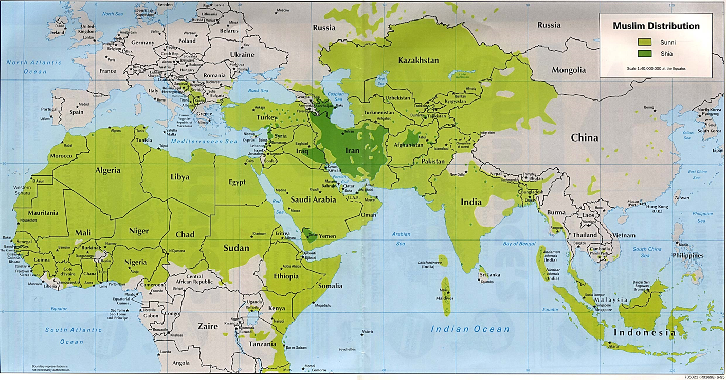
The defeat at Chaldiran put a stop to Isma’il’s dreams of further westward expansion.
Slowed the rapid spread of conversions to Shi’i Islam in the western borderlands
Shi’ism was now confined largely to Persia (Iran) and present day southern Iraq

Slide 30
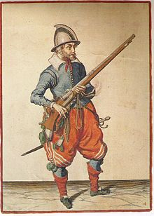
Gunpowder empires and shifting balance of global power
As the outcome of the critical battle of Chaldiran between the Ottomans and Safavids made clear, by the 16th century, firearms had become a decisive element in armed conflict
Key to empire building
In military and political terms, global history had entered a new phase

Slide 31
Politics and war under safavid shahs
After years of turmoil, a new shah, Tahmasp I won the throne
1534-1576
He and his successors, tried to bring the Turkic chiefs under control
Transformed into a warrior nobility
Like their Ottoman counterparts, the Safavid warrior nobles were assigned villages whose peasants had to supply them and their troops with food and labor
Occupied key posts in the imperial administration
Constant threat to Safavid rulers
To met this threat, Safavid rulers recruited Persians for positions at the court and imperial bureaucracy

Slide 32
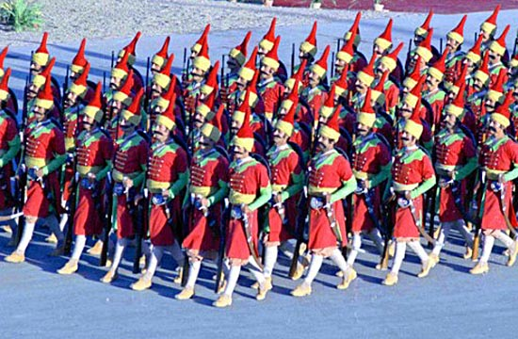
The struggle for power and influence between Turkic and Persian notables was further complicated by recruiting slave boys into the bureaucracy and army
Captured in campaigns in southern Russia
Many rose to position of power
Became a major force in Safavid political struggles
Educated and converted to Islam by Abbas the Great
Backbone of military forces
Some granted provincial governorships and high offices of court
Monopolized the firearms that had become increasingly prominent in Safavid armies
Abbas the Great built up a standing army of nearly 40,000 troops and an elite bodyguard

Slide 33
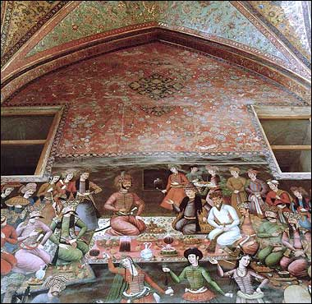
Safavid state
Although the Safavid family originally wrote in Turkish, Persian gradually replaced Turkish as the language of the court and bureaucracy
The Safavid rulers:
Used grand titles like “Padishah”
King of kings
Presided from their high thrones in lavish palace complexes surrounded by servants
Used elaborate court rituals
Claimed descent from one of the Shi’ite imams, or successors of Ali

Slide 34
Safavid religion
The Safavid
Changed from their militant shi’ite ideology to one more modified
Mullahs – Persian religious scholars who entered into the service of the state and were paid by the government
Both local mosque officials and prayer leaders
Supervised and supported by the state
Converted most of the Iranian population to Shi’ism during the centuries of Safavid rule
Sunni Muslims, Christians, Jews, Zoroastrians, and followers of Sufi preachers were pressured to convert to Shi’ism
When dynasty weakened, religious experts and mullahs grew more independent
Voiced their own interpretations of the sacred text rather than government interpretation
Shi’ism provided ideological support for the Safavid dynasty and became an important part of Iranian identity
Set the people of the region off from most of their Arab and Turkic neighbors

Slide 35
Elite affluence and artistic splendor
Abbas I (1588-1629)
Established his empire as a major center of international trade and culture
Built a network of roads and rest houses
Strove to make merchants and travelers safe within his domains
Set up workshops to manufacture the silk textiles and splendid Persian carpets that were in great demand
Encouraged Iranian merchants to trade not only with their Muslim neighbors and India and China to the east but also with the Portuguese, Dutch, and English
Devoted special attention to his capital at Isfahan
Built a great square which was lined with two-story shops, great mosques, and government offices
Founded several colleges
Constructed numerous public baths

Slide 36
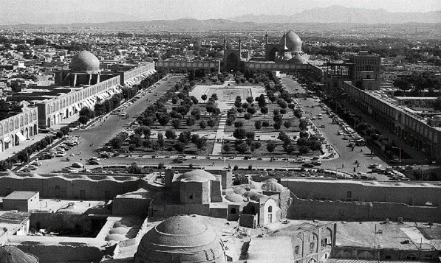
ISFAHAN, Abbas the great’s capital

Slide 37
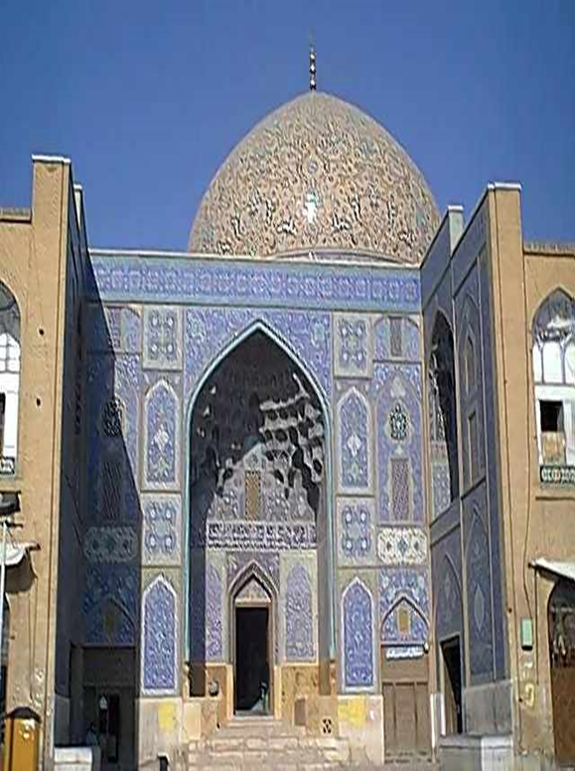
Great mosques that Abbas I had built at Isfahan were the glory of his reign
Distinguished the monumental construction of the Safavid
Vividly colored ceramic tiles
Massive domes and minarets
Geometric designs
Floral patterns
Verses from the Quran written in stylized Arabic

Slide 38
Society and Gender Roles: Ottoman and Safavid Comparisons
Ottomans and Safavid social systems had much in common
Warrior aristocracies
Shared power with the absolutist monarchs of each empire
Enjoyed prestige and luxury in the capital and on rural estates
Gradually retreated to estates, making life increasingly difficult for peasants
As real power of the rulers declined, demands of landlord class grew harsher
Peasantry
Foreign invasions, civil strife, and breakdown of vital services caused misery
Banditry, peasant uprisings, and flight from the land further drained the resources of both empires
Rulers
Encouraged handicraft production and trade
Imperial workshops making such things as miniature paintings, rugs and weapons
Supported public works projects and paid workers well
Engineers, stonemasons, carpenters, and other artisans

Slide 39
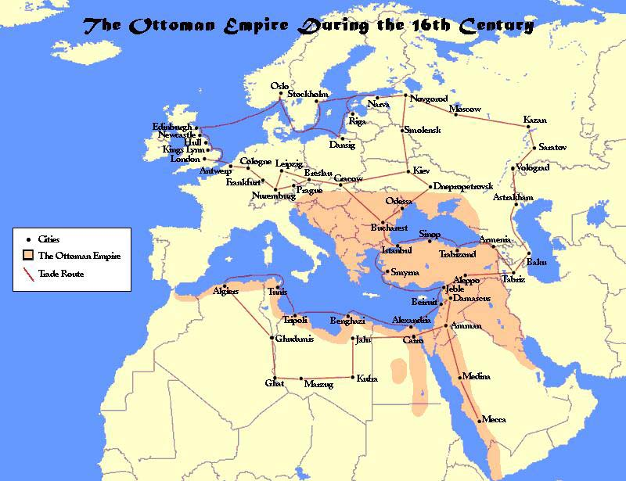
Some emperors would increase both internal and international trade
Ottomans had upper hand in large-scale trade
Controlled by minority groups (Christians and Jews) who had extensive contacts with overseas traders that the bazaar merchants of the Safavid normally lacked
Still behind Western Europe
Safavid economy remained much more constricted, less market oriented, and more technologically backwards than Ottomans

Slide 40
Women in Islamic societies under ottomans and safavids
Ottoman and Safavid women faced legal and social disadvantages
Subordinated to fathers and husbands Seldom had political or religious power
Patriarchal codes dictated seclusion and veiling
Imposed on all classes, but especially the elite
Even women of nomadic Turkic and Mongol backgrounds gradually lost their independence
Wives and concubines of the rulers and royal princes continued to exert influence behind the throne
Many ordinary women were active in trade and moneylending
Although records suggest that women could influence Islamic law that protected their rights to inheritance, most women probably lived undesirable lives

Slide 41
Rapid demise of the safavid empire
Reasons for fall of Safavid Dynasty
Abbas’s fears of being replaced by one of his sons caused him to kill or blind all who could legitimately succeed him
An easily manipulated grandson was placed on the throne after Abbas’s death
Practice of confining the princes to the atmosphere of luxury led to a sharp fall in the quality of Safavid Rulers
Able shahs, such as Abbas II, were too few to halt the decline of the imperial administration or deal effectively with many foreign threats
Factional disputes and rebellions
Nomadic raiders and Ottoman and Mughal armies took Safavid territory
Decline in labor and revenue
March 1722 – Isfahan was besieged by Afghani tribes
October 1722 – 80,000 of the capital’s inhabitants died of starvation and disease
City fell and Safavid power was ended

Slide 42
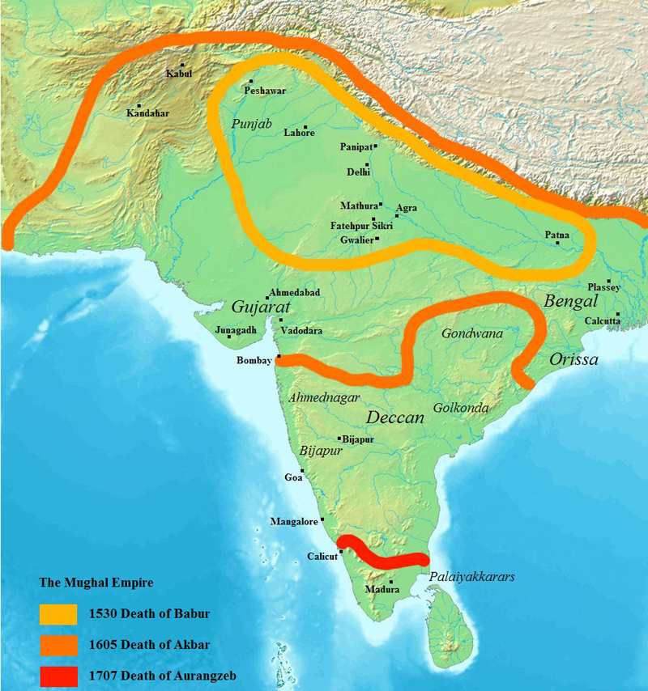
Mughals and the apex of muslim civilization in india
Important Ideas:
16th c. Babur and his descendants spread the power of the Mughal dynasty through much of the Indian subcontinent
Under their rule, Islam peaked as a blend of Hindu – Islamic civilization
By the 17th c. the dynasty declined due to
Wars of succession to the Mughal throne
Nomadic incursions from Persia and Afghanistan
Internal revolts by the Mughal’s non-Muslim subjects

Slide 43
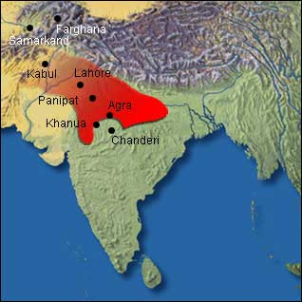
Barbur –
founder of the Mughal dynasty
claimed to be a descendant from the Mongol khans
Also descended from Turkic warriors
followers were from Turkic or mixed nomadic origins
His motives for conquest were not religious in nature
Before creation of Mughal dynasty, he lost his original kingdom, centered on Farghana in central Asia

Slide 44
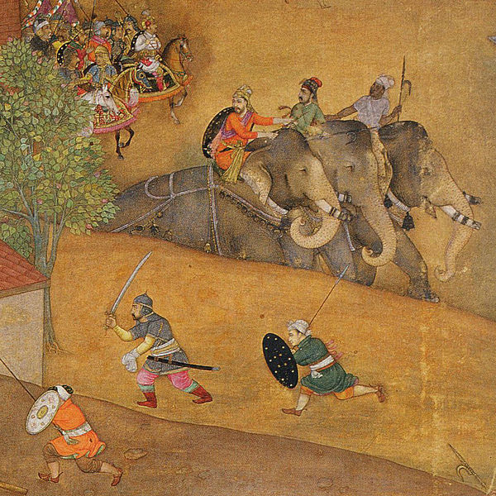
1526 – Barbur moved into India
A seasoned military commander and head of an experienced and well-organized army
Defeated the Muslim Lodi dynasty of northern India
Used gun carts, movable artillery, and cavalry tactics
Hundreds of war elephants that trampled thousands of Lodi infantrymen
Within two years, he had conquered large portions of the Indus and Ganges plains
Established a dynasty that would last more than 300 years

Slide 45
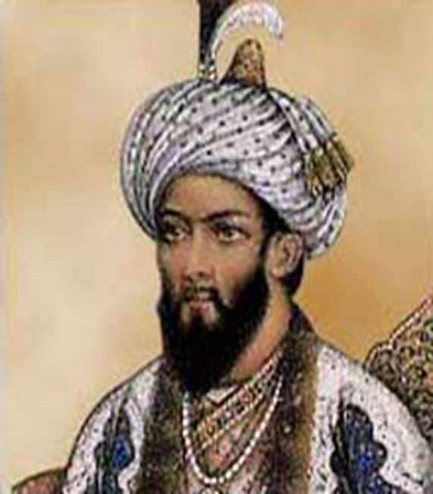
Barbur
Military strategist
Fierce fighter who went into battle alongside his troops
Cultivated a taste for the arts and music
Wrote one of the great histories of India
Musician
Designed gardens for his new capital at Delhi
Better conqueror than administrator
Did little to reform the very ineffective Lodi bureaucracy he had taken over
1530 – died at the age of 48
Succeeded by his brother, Humayan

Slide 46
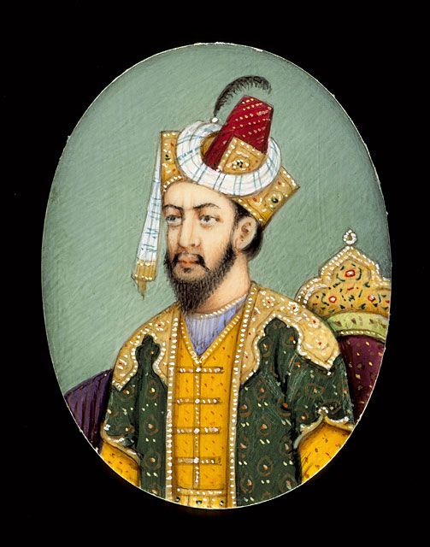
Humayan
Brother disputed his succession
1540 – Armies shattered and forced to flee to Persia and live in exile
1545- launched a series of campaigns into India that restored Mughal rule to the northern plains
Shortly thereafter, he had an accident which resulted in his death

Slide 47
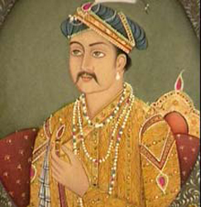
Akbar and the Basis for a lasting empire
Akbar
Humayan’s son and successor
Proved to be one of the greatest leaders in history
Compared to monarchs like Elizabeth I of England, Philip of Spain, and the Muslim rulers Suleyman the Magnificent and Abbas I

Slide 48
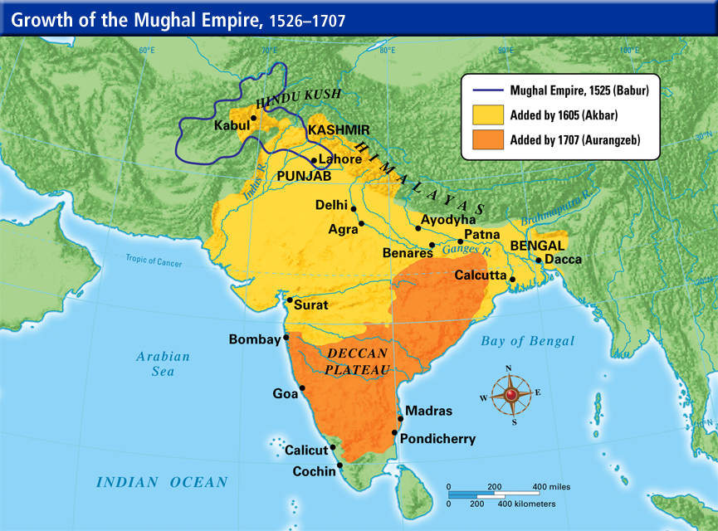
Akbar
Courageous military commander
United India under his rule
Overseer of military and administrative systems that would form backbone of Mughal Empire for centuries
Patron of the arts
Social reformer
Inventor of his own universalistic religion
Din-i-Ilahi
Though illiterate, by listening to others read to him, he became educated

Slide 49
Akbar’s administrative reforms
Encouraged intermarriage between the Mughal and Hindu aristocracy
Abolished the much-hated jizya, or head tax on Hindu unbelievers
Used by earlier Muslim rulers
Promoted Hindus to highest ranks in government
Ended a long-standing ban on the building of new Hindu temples
Ordered Muslims to respect cows
Din-i-Ilahi
Believed would united his Hindu and Muslim subjects
Muslim and Hindu warrior aristocrats
Supporters of the Mughal dynasty were granted peasant villages for their support
Required to maintain calvary if emperor needed services

Slide 50
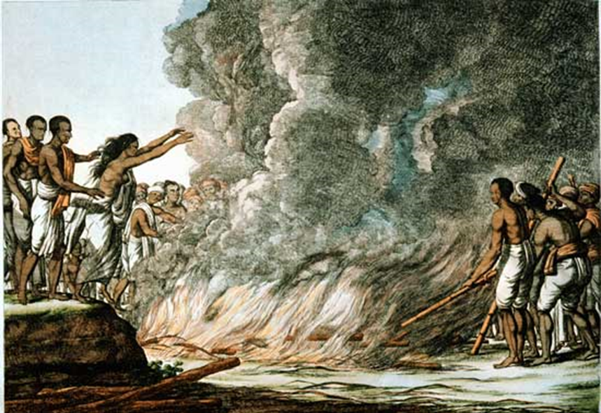
Social Reform and Social Change created by akbar
Established living quarters for beggars and vagabonds
Regulate consumption of alcohol
For women, he encouraged widow remarriage
Taboo for both Hindus and Muslims
Discouraged child marriages
Limited impact
Legally prohibited sati
Burning of high-caste Hindu women on their husband’s funeral pyres
Risky move for Akbar due the acceptance of this act by powerful Hindu princes and warrior classes
Relief for women in purdah, or seclusion in their homes
Encouraged the merchants of some cities to set aside special market days for women only

Slide 51
Mughal Splendor and Early European Contacts
1605 - Akbar died
Knew that Din-i-Ilahi, the religion he had created to reconcile his Hindu and Muslim subjects, had been rejected
Akbar’s successors were his two sons, Jahangir (1605-1627) and Shah Jahan (1627-1658)
Did not add territory to Empire
Mughal India reached the peak of its splendor
Mughal armies, supplied with elephant and artillery forces, surpassed those of even the most powerful European rulers
Late 17th century – Mughal India had become one of the major overseas destinations for European traders
Europeans brought products from throughout Asia, to exchange for a variety of Indian manufactures, particularly cotton
Indian textiles were popular among the working and middle classes in Britain and Europe because they were easily washed and inexpensive
Madras – still popular today

Slide 52
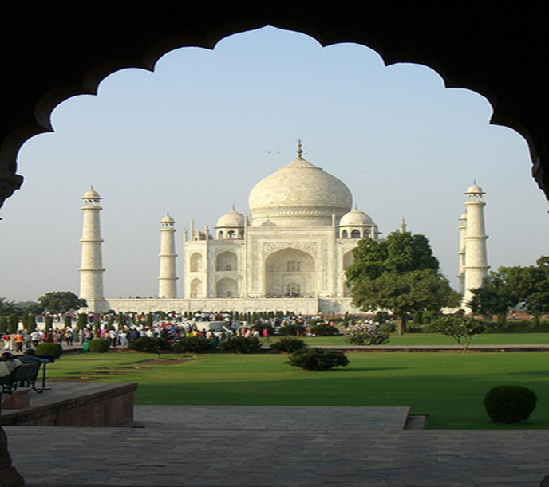
Artistic Achievement in the Mughal Era
Jahangir and Shah Jahan
Continued Akbar’s policy toward the Hindu majority and retained most of the alliances with Hindu princes and local leaders.
Little change in the administrative works
Fought their wars in the same way
Neglected the affairs of the state
Showed little interest in conquest and politics
Both enjoyed the good life
Pleasure in elaborate court ceremonies, lavish processions, palaces and jewel-studded wardrobes, etc.
Were great patrons of fine arts
Promoted works in miniatures – especially ones of traditional Islamic subjects, battles, court scenes, animals and plants
Favored stunning architectural works – best known was the Taj Mahal
Tomb for Shah Jahan’s wife

Slide 53
Court Politics and the Position of Elite and Ordinary Women
In both case of Akbar’s sons, the wives took advantage of their husbands’ neglect of politics
Jahangir’s wife:
Amassed power by packing the court with able relatives who would dominate the empire
Was a big spender and major patron of needed charities
Shah Jahan’s cosort, Mumtaz Mahal
As involved in court politics
Did amass limited power
Mostly remembered for the love and devotion to Shah Jahan
The state women of India after the rulers’ deaths:
Child marriage again became popular – age limit lowered
Widow remarriage nearly died out
Seclusion became more strictly enforced for upper-case women, both Hindu and Muslim
Muslim women mostly had to veil themselves
Practice of sati spread
Birth of girls was no big deal

Slide 54
Beginning of Imperial decline
Later years of the Mughal Empire
Threatened by internal decay and growing dangers for external enemies
Needed essential administrative, military, and social reforms
Creation of a bloated and corrupt bureaucracy
Army was bloated and backward in weaponry and tactics
Peasants and urban workers had seen their productivity and living standards fall steadily
Taj Mahal and other wonders of the Mughal artistic imagination had been paid for by the mass of the people at a very high price

Slide 55
Aurangzeb
Shah Jahan’s son and successor
Neglected the affairs of the state
Determined to extend Mughal control over the whole Indian subcontinent
Increased the number of empires enemies
Strained the allegiance of its vassals and allies
Greatly overextended its huge but obsolete military forces
Conquered most of the subcontinent
Almost endless warfare drained the treasury and further enlarged an inefficient bureaucracy and army without gaining corresponding increases in revenues
Diverted him from the administrative tasks and reforms essential to dynasty’s strength
South – conquering territory; North – peasant uprisings and revolts by Muslim and Hindu princes

Slide 56
Aurangzeb believed it was his duty to purify Indian Islam and rid it of the Hindu influences he was convinced were steadily corrupting it
Non-Muslims were given far fewer posts at the upper levels of bureaucracy
Personal contact with the Emperor was severely restricted
Forbade the building of new temples
Put an end to Hindu religious festivals
Reinstated the hated head tax on unbelieves
Attempt to force subjects to convert to Islam
Fell heavily on the Hindu poor

Slide 57
By the end of Aurangzeb’s reign, the Mughal Empire
Was far larger than it had been under any of the earlier emperors, but extremely unstable
Further declined with the rise of new sects like the Sikhs (more resources drained)
The Sikhs were persecuted causing them to transform Sikhism into an anti-Muslim force
Suffered from internal rebellions
Additionally, Muslim kingdoms in central and east India resisted Mughal hegemony (influence of one state over another) and Islamic invaders waited in the wings to strike the weakening Mughals
As centralized political control broke down and warfare increased, the temptation of others to intervene grew
English who saw potential opportunities in India

