Slide 1
The Russian Revolution
Chapter 30

Slide 2
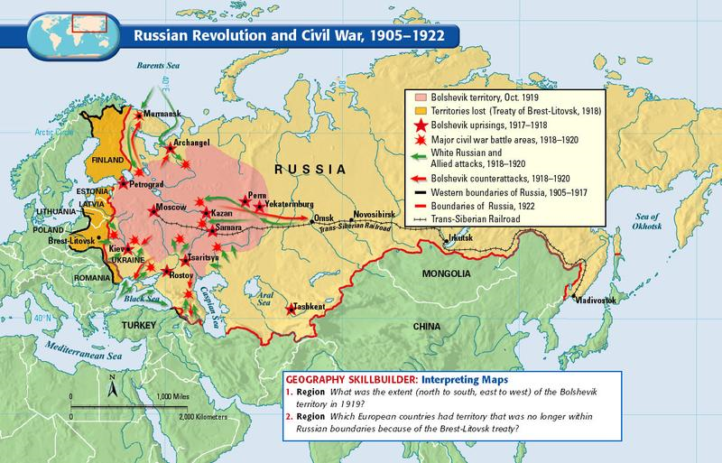
The Russian Revolution
March 1917 – strikes and food riots broke out in Russia’s capital, Petrograd (renamed St. Petersburg in 1991)
  Misery of WWI
  Conditions of early industrialization
  Incomplete rural reform
  Unresponsive political system
Rioters wanted food, work, and a new political regime
A council of workers (called a soviet) took over the city government and arrested the tsar’s ministers
  Tsar Nicholas abdicated, the Duma declared Russia a republic

Slide 3
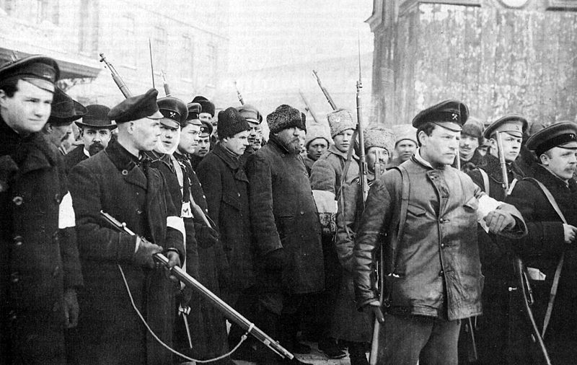
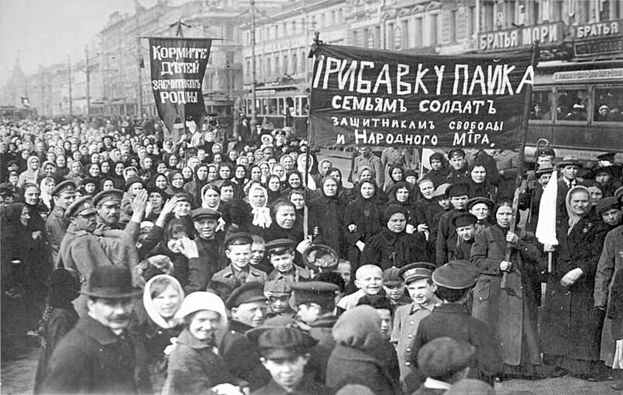
Left: Armed workers and soldiers escorting captured policemen. Petrograd, 1917
Right: workers protesting in the streets

Slide 4
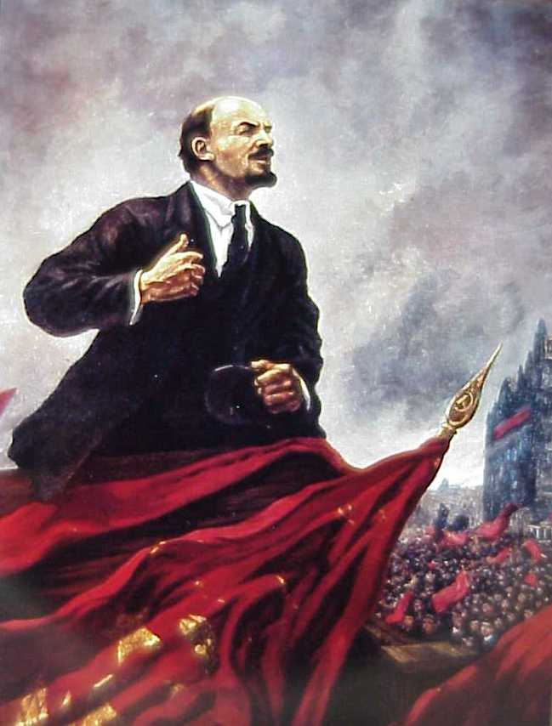
Liberalism to Communism
After the March 1917 revolution a liberal provisional government struggled to rule country
  Ruled for only eight months
  Liberalism not deeply rooted in Russia
  Refused to withdraw from WWI
    Increased economic misery and popular discontent
  Held back from massive land reforms, leaving peasants unhappy
Serious popular unrest continued…
  In November (October, by the Russian calendar), a second revolution expelled liberal leadership
    The Bolshevik leader, Lenin, gains control

Slide 5
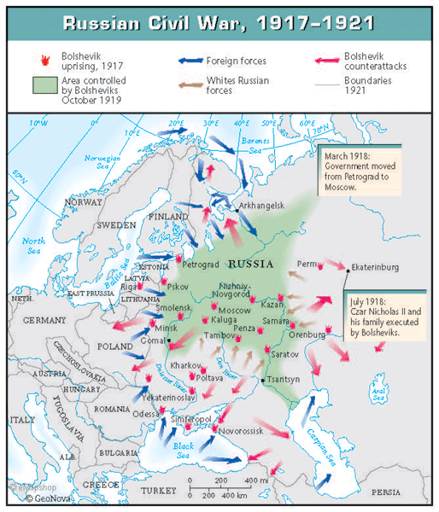
A civil war followed between those who supported Lenin’s program and those who wished to return to the rule of the Tsar
  “Reds” – supporters of Lenin
    Were victorious (secured the position of the new Communist government)
    Had support of the peasants and workers
  “Whites” – supporters of a Tsar
    Had support from the United States
After winning the civil war, Lenin executed Tsar Nicholas II and his family in cold blood so that the monarchy could never been restored

Slide 6
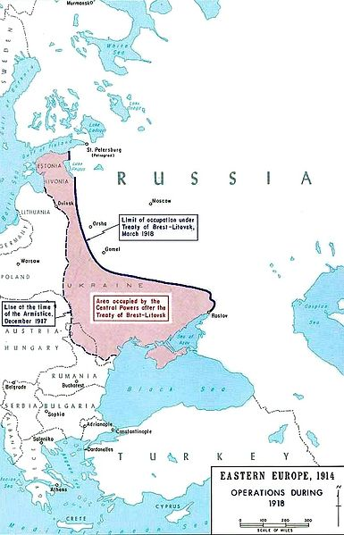
Lenin and the Bolsheviks (Russian Communist Party) faced several immediate problems
  1917- Brest-Litovsk treaty
    Humiliating peace treaty with Germany
    Gave up part of western Russia in return for an end to hostilities
    Nullified after WWI
  Russia ignored at Versailles peace conference
    Communist beliefs
  Internal political rivals
    Social Revolution Party – emphasized peasant support and rural reform
      Lenin shut down the Party

Slide 7
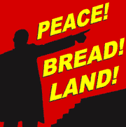
1918-1921: internal civil war continued
  Tsarist generals, religiously faithful peasants, and minority nationalities fought against the communist regime
    Suffered continuing economic distress
Once in power, Lenin quickly decreed a redistribution of land to the peasants and nationalized (government takeover) basic industry
  Created widespread opposition, particularly among landed peasants
  Agriculture and manufacturing declined

Slide 8
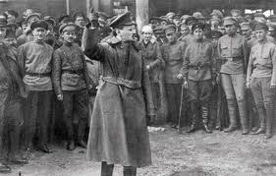
Stabilization of the New Regime
Communist leadership would restore order on several key foundations
  Powerful new army
    Red Army
    Under the leadership of Leon Trotsky
  1921 – New Economic Policy
    Some private ownership was allowed in small-scale manufacturing and agriculture
    State continued to set basic economic policies, but combined that with individual initiative
    Under this temporary policy, food production began to recover

Slide 9
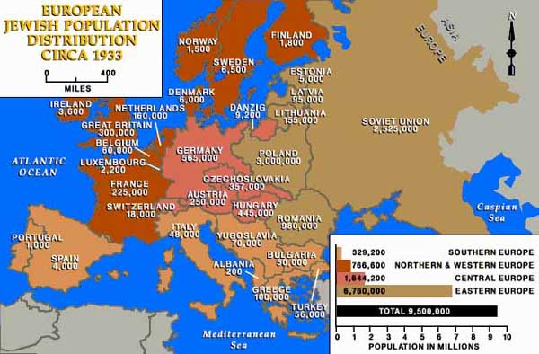
1923- New constitution set up a federal system of socialist republics, known as the Union of Soviet Socialist Republics.
  Ethnic Russians would control central government
  Certain groups (especially Jews) given no representation

Slide 10
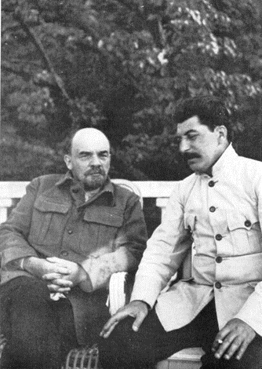
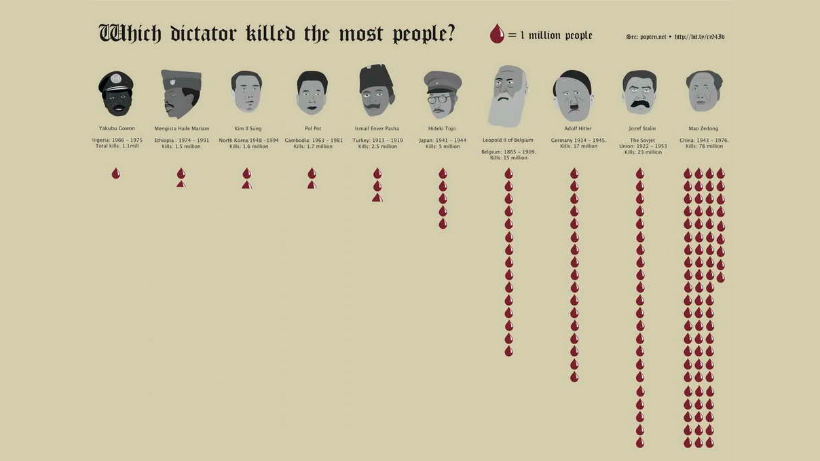
1924 – Lenin died; Joseph Stalin emerges as leader of Soviet state
Stalin represented a strongly nationalist version of communism
  Represented the anti-Western strain in Russian tradition
  Rival leaders were killed or expelled

Slide 11
Building Soviet Society
The mid-1920s were a surprisingly open-ended period in Soviet history
  Youth movements, women’s groups, and particularly organizations of workers all actively debated policies
  Workers were able to influence management practices, and women’s groups helped carve out legal equality and new educational and work opportunities for their members
  Rapid spread of education
    Beliefs in communist political analysis and science
    Literacy gained ground

Slide 12
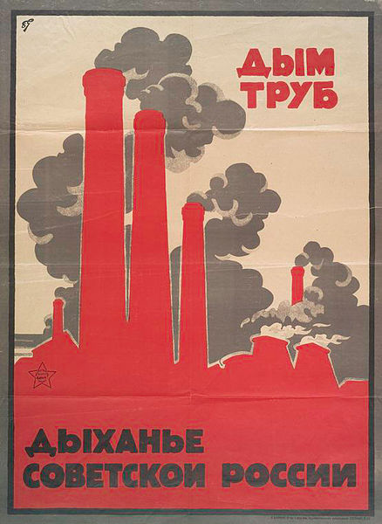
Stalinism
1927 – Joseph Stalin acquired full power over potential rivals
  Authoritarian control
  Renewal of socialism
    Lenin’s New Economic Plan had moved away from socialism and was terminated
By this time, the majority of land was in the hands of a minority of wealthy, commercially oriented peasants (kulaks)
  Profit-based market agriculture
Stalin wanted an industrial society in full control the state (a noncapitalist modernization)
  Willing to borrow Western techniques and advice, but insisted on Russian control

Slide 13
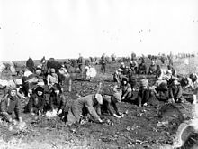
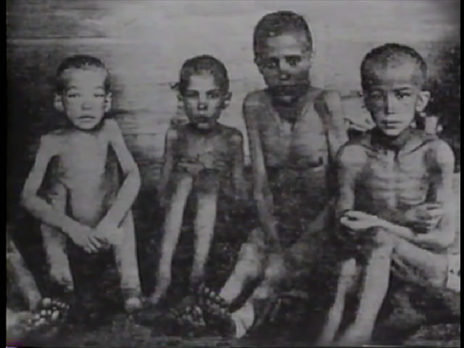
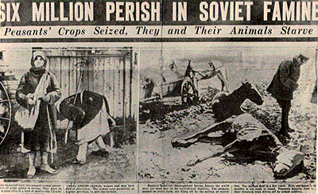
Centralized Economic Policies
1928 - Collectivization – Large, state-run farms rather than individual holdings (like the West)
  Would make peasants share scarce machines while increasing Communist party control
  Communist party agitators pressed peasants to join in collectives
  Most kulaks refused to cooperate, often destroying livestock and other property rather than submitting to collectivization
    Caused devastating famine
    Early 1930s – millions of kulaks were killed or deported to Siberia
  Never successful
    Peasants who participated were unmotivated
    Agricultural production remained low

Slide 14
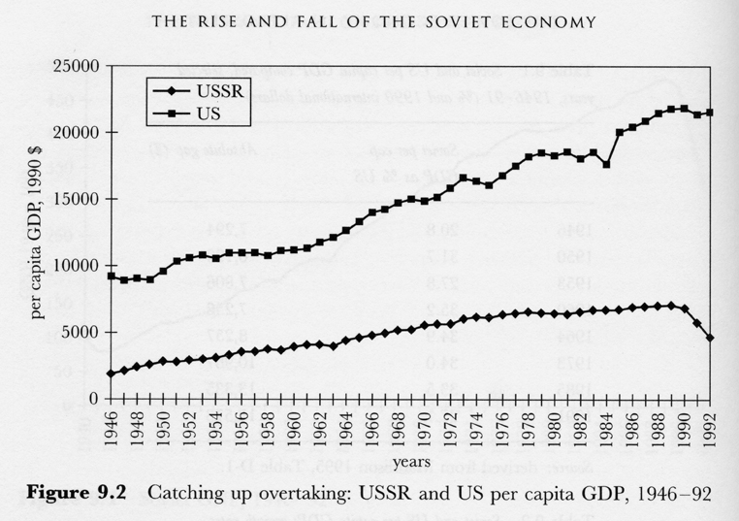
Under Stalin, the government built massive factories for metallurgy, mining, and electric power to
  Five-year plans – set clear priorities for industrial development, including expected output levels and new facilities
  Made Russia an industrial country independent of Western-dominated world banking and trading patterns
  Russia’s great natural resources prepared for possible war with Hitler’s anticommunist Germany
  Rapid industrial growth occurred
    During the first two five-year plans, to 1937 - (while West is experiencing economic depression) Soviet output of machinery and metal products grew significantly
    Soviet Union – third industrial power
      Behind Germany and United States

Slide 15
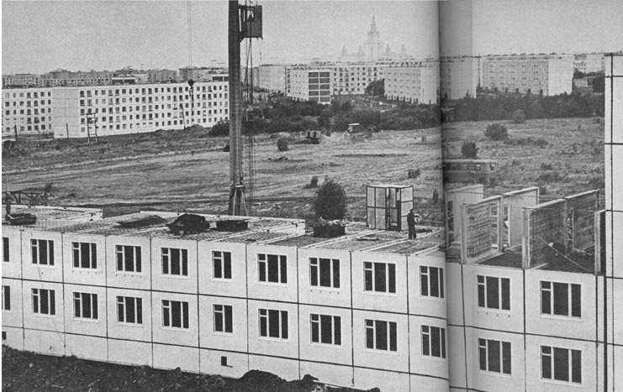
Toward and Industrial Society
Increasing numbers of people were crowded into inadequate housing
  Government reluctant to put too many resources into housing
Factory discipline was strict as communist managers tried to instill new habits into former peasants
Communist policy quickly built up a network of welfare services
  Even more than the West

Slide 16
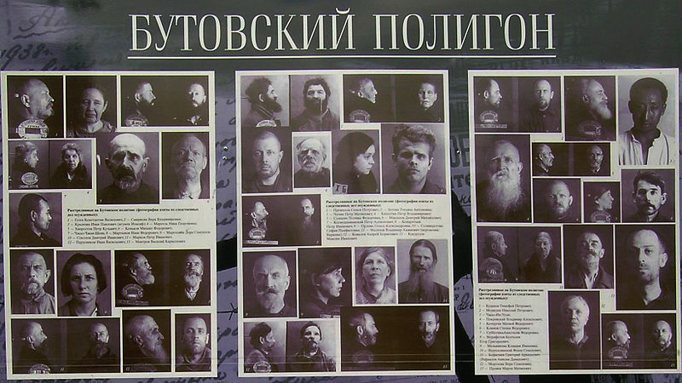
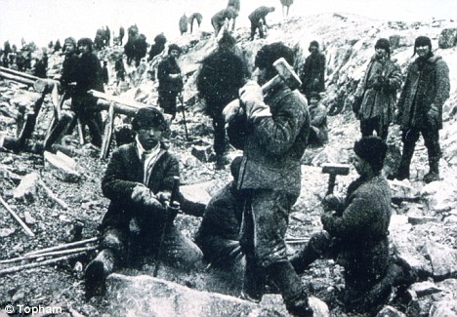
Totalitarian Rule
Stalin combined his industrialization program with a new intensification of government police procedures
  Used the party and state apparatus to monopolize power even more than Hitler’s state attempted
  Opponents and imagined opponents of his version of communism were executed
    1937-1938: the great purge
      Hundreds of party leaders intimidated into confessing imaginary crimes against the state
        Most put to death
    Thousands of people sent to Siberian labor camps
  News outlets were monopolized by the state the party
  1934 - Secret police renamed Ministry of Internal Affairs
  Atmosphere of terror spread in Soviet Society

Slide 17
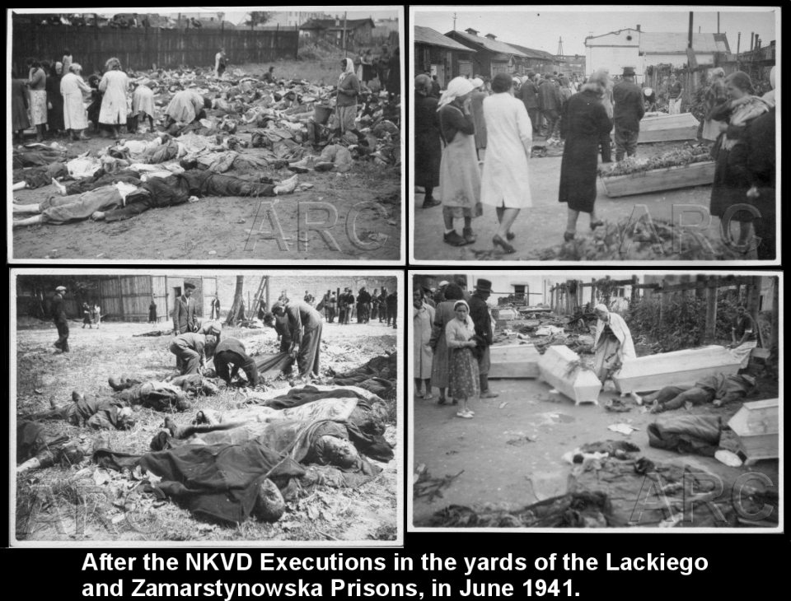

Slide 18
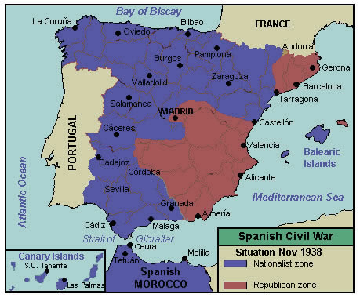
In foreign policy, Stalin had to pay close attention to Nazi Germany
  Hitler hated the Slavic peoples and communism, and wanted to create a “living room” for Germany to the east
  Stalin initially hoped that he could cooperate with Western democracies in blocking the German threat
    Cooperated in the Spanish Civil War in 1936 and 1937 , but France and Britain incapable of forceful action and were suspicious of the Soviets

Slide 19
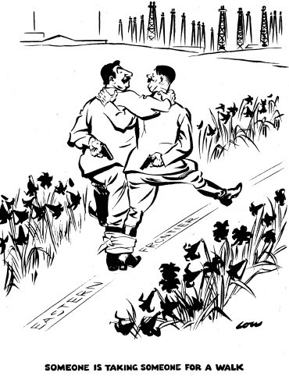
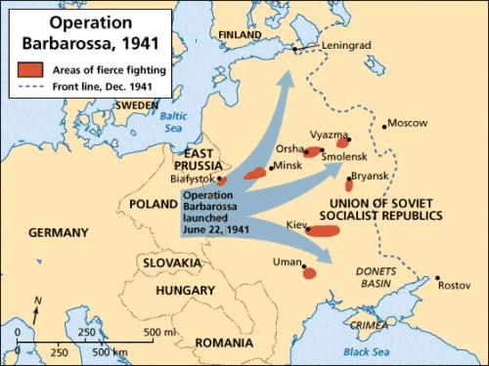
1939 – Ribbentrop-Molotov pact
  Stalin’s historic agreement with Hitler
  Bought some time for greater war preparation
  Enabled Soviet troops to attack eastern Poland and Finland
    Regain territories lost in WWI
    Revival of Russia’s long interest in conquest
The Nazis, after occupying France and being defeated in Britain, turn east towards the Soviet Union
  1941 – Nazis invade Soviet Union
  Soviet Union allied with Western Powers, including United States

Slide 20
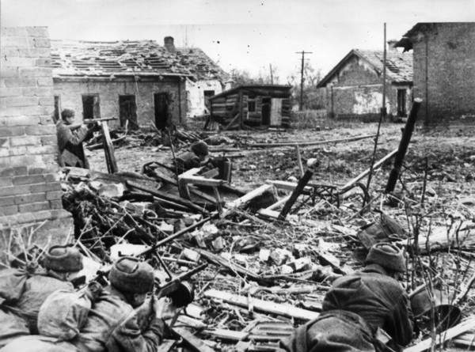
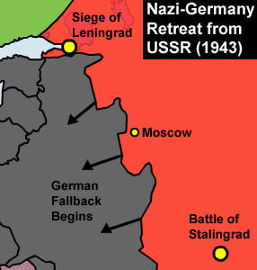
The Soviet Union’s new industrial base proved vital in providing the material needed for war
Cities such as Leningrad and Stalingrad were overwhelmed by Germans for months, with huge loss of life
1943 – Red Army pressed westward
Russia was able to regain its former western boundaries at the expense of nations such as Poland

Slide 21
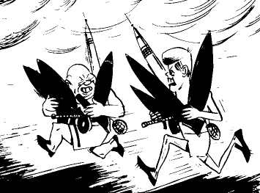
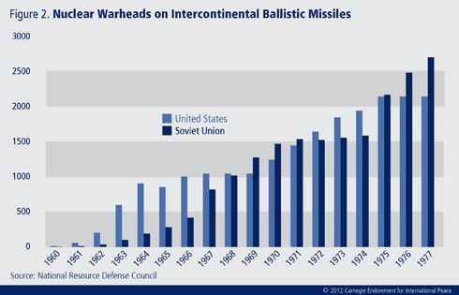
The Soviet Union as a Superpower
Soviet Union emerged as a world power
  Industrialization
    Weapon development – atomic and hydrogen bombs
  WWII push westward
  Established a protectorate over the communist regime of North Korea to match the American protectorate in South Korea
  Aided the victorious Communist party in China
  1970s – New ally in communist Vietnam
    Provided naval bases for Russian fleet
  Growing military and economic strength gave the postwar Soviet Union new leverage in the Middle East, Africa, and even parts of Latin America
    1960s – allied with Cuba
      Cuban Missile Crisis

Slide 22
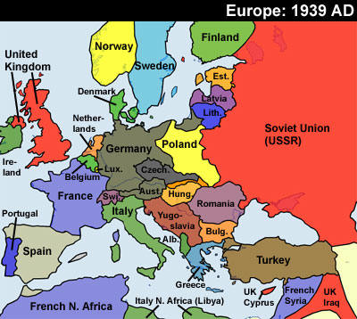
The New Soviet Empire in Eastern Europe
Clearest extension of the Soviet sphere developed right after WWII in eastern Europe
  Helped launch the cold war
The small nations of eastern Europe (mostly new or revived after WWI) had gone through a troubled period between the world wars
  Vulnerable to Nazi and then Soviet advances
  By 1918 -Consumed by nationalist excitement at independence
  Bitter rivalries weakened them diplomatically and economically
  Most went from democratic to authoritarian governments
    Poland – dictator
    Yugoslavia - monarch
  Social tensions
  Remained primarily agricultural and heavily dependent on sales to western Europe
    Hurt by the depression
  Most nations tried to block land reforms

Slide 23
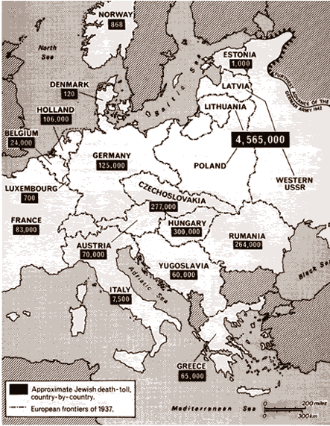
The Nazis would attack eastern Europe
  Ineffective Western response
  Czechoslovakia, Poland, and Yugoslavia seized by German or Italian forces
Several other east European authoritarians allied themselves directly with Hitler
  Shared ideological leanings
  Fear of the Soviet Union
Eastern Europe fell under Nazi control for four years
  Compelled to provide troops and labor for Hitler
  Subject to Holocaust attack on the Jews

Slide 24
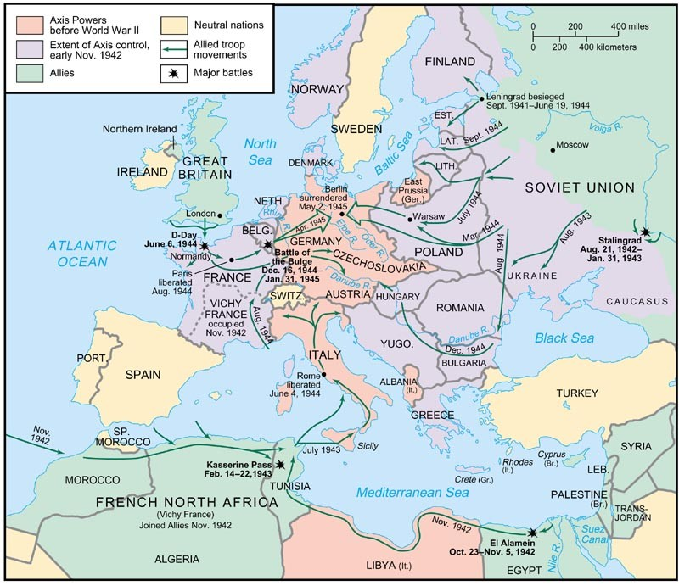
1943 -The Red Armies directly liberated all of eastern Europe and the eastern part of Germany to the Elbe River
  Exceptions: Greece and Yugoslavia
1945-1948 – Soviet military might and collaboration with local communist movements crushed opposition parties and forced out noncommunist regimes
  Soviet takeover of eastern Europe

Slide 25
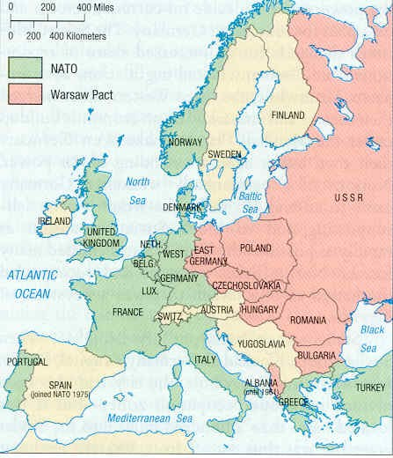
Early 1950s – New Soviet-sponsored regimes
  Attacked possible rivals for power
    Including Catholic church
  Implemented mass education and propaganda
  Collectivization of agriculture ended the large estate system
  Industrialization was pushed through successive five-year plans
  After formation of NATO, most east European nations joined the Warsaw Pact
    Common defense alliance
  Soviet troops stationed throughout Eastern Europe
    Confront the Western alliance
    Monitor new regimes and loyalty to the cause

Slide 26
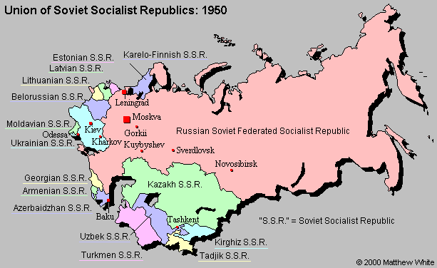

Slide 27
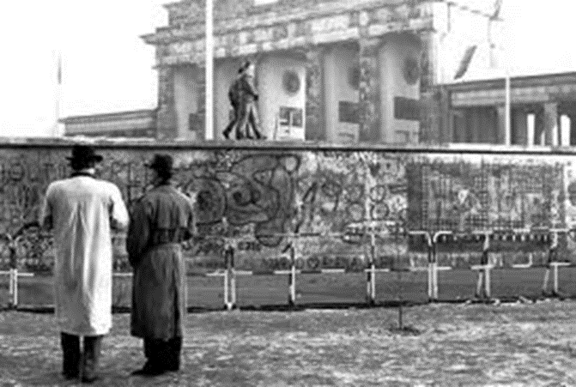
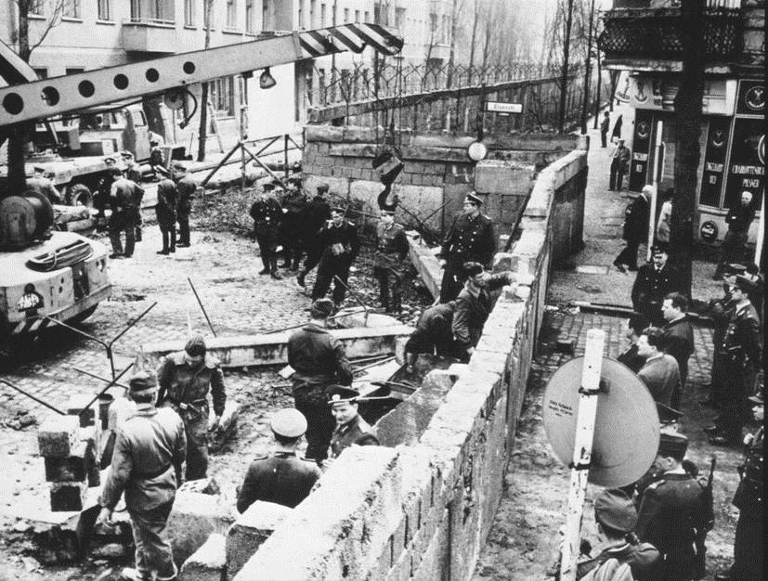
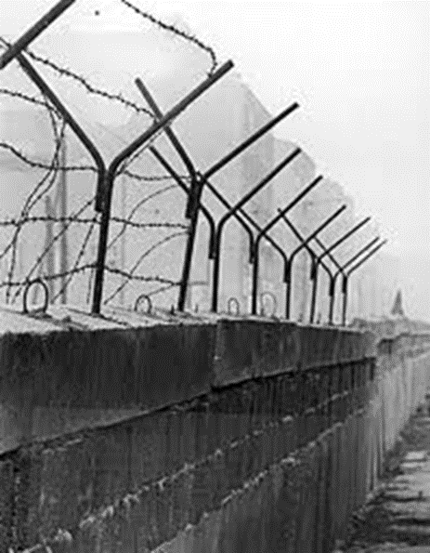
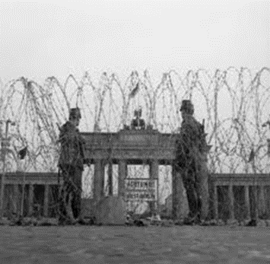
1953 – dissatisfaction with tight controls in East Germany brought workers’ uprising
  Repressed by Soviet troops
  Widespread exodus to West Germany
    1961 – Berlin Wall built to contain the flow
    All along the new borders of eastern Europe, barbed wire fences and armed patrols kept people in

Slide 28
1956 – relaxation of Stalinism
  More liberal communist leaders arose in Hungary and Poland, creating greater freedom within communism
    Poland
      Allowed to halt agricultural collectivization, establishing widespread peasant ownership of land
      Catholic Church gained greater tolerance
    Hungary
      New regime was cruelly crushed by Soviet army and replaced by hard-lined Stalinist leadership

Slide 29
Evolution of Domestic Policies
After WWII – Stalinist policies continued
  Strict Communist party and police controls
  After 1947 – news media blasted America as an evil power and corrupt society
  Fearful of a new war with the U.S., many agreed to a strong national government
  Mid 20th century - Strict limits on travel and outside media kept the Soviet Union isolated
    Culture and economy removed from world patterns
  Politically – emphasis on central controls
    Party membership was necessary to bureaucratic promotion
      6% of population belonged to Communist Party

Slide 30
Soviet Culture: Promoting New Beliefs
Government and Communist Party cultural agenda
  War on Orthodox church and other religions to create a secular society
    Did not try to abolish the Orthodox church outright
      Barred from giving religious instruction to anyone under 18
    Limited freedom of religion for Jewish minority
    Marxist, scientific orthodoxy
  Artistic, literary styles, and political writings were monitored carefully to ensure that they were pro-Communist Party
  Educational system was used to create a loyal, pro-Communist youth
    Train and recruit technicians and bureaucrats
  Opposed Western cultural elements of the 19th century tsarist elite
    Modern Western styles of art and literature were attacked as corrupt

Slide 31
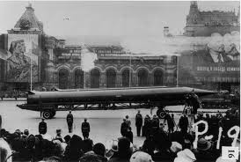
Soviet culture placed strong emphasis on science and social science
  Scientists enjoyed great prestige and power
  Research heavily funded by government
  Several fundamental discoveries in physics, chemistry, and mathematics
  Contributed to technology and weaponry

Slide 32
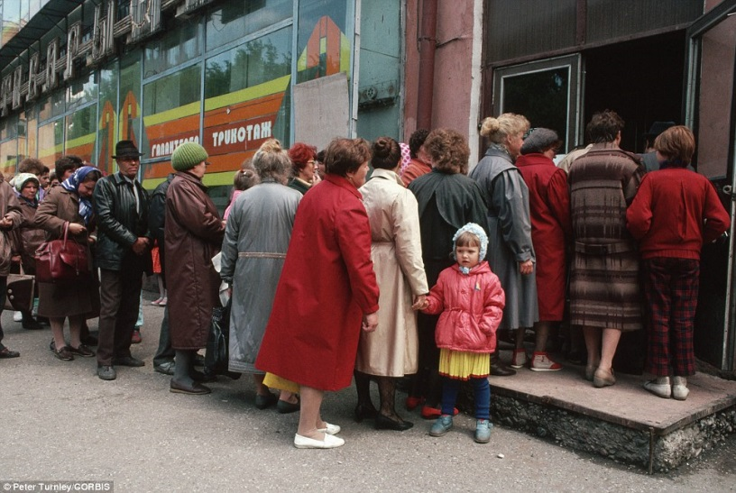
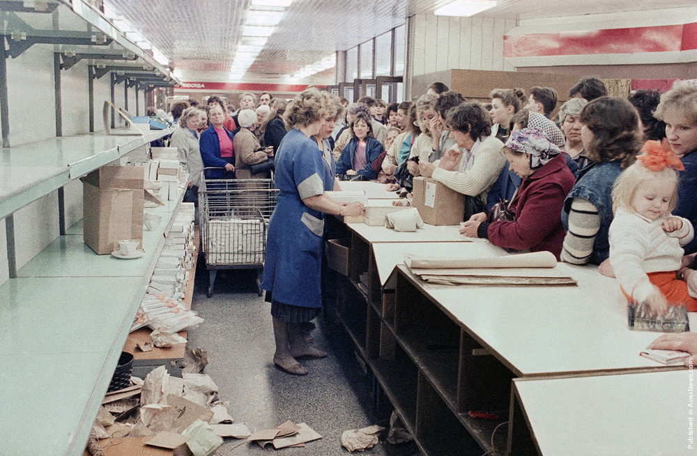
Economy and Society
Between 1920s to 1950s- Soviet Union became industrial society
  Manufacturing grew rapidly
  City populations rose to more than 50 percent of population
  By 1950s – most of Eastern Europe was industrialized
  State control of nearly all economic sectors
    Lagged in the priorities it placed on consumer goods
      Automobiles, housing construction
  Complaints about poor consumer products and long lines to obtain desired goods remained a feature of Soviet and eastern European life

Slide 33
Soviet family reacted to some of the same pressure of industrialization the Western family experienced
  Massive movement to the cities and crowded housing
  Nuclear family unit
  Birth rate dropped
  Declining infant death rates
    Improved diets and medical care
  Children more strictly disciplined than the West
  Most married women worked
    essential feature of an economy struggling to industrialize
    Performed many heavy physical tasks
    dominated some professions, such as medicine

Slide 34
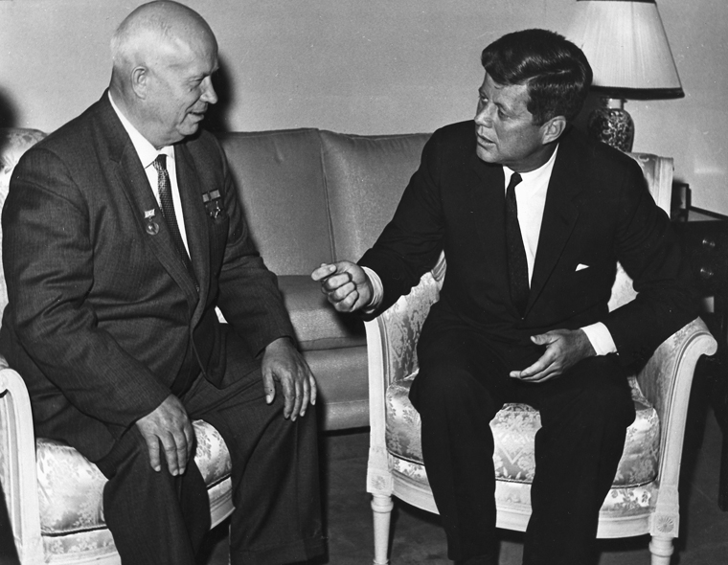
De-Stalinzation
1953 – Stalin dies
  Gradual loosening of Stalin’s cultural isolation
1956 – Nikita Khrushchev
  Attacked Stalinism for its concentration of power and arbitrary dictatorship
  Condemned Stalin for his treatment of political opponents and failure in preparing for WWII
  Decentralized some decision making
  Police repression eased
  Outright critics of regime less likely to be executed
    Sent to psychiatric institutions instead
  Still… party control and centralized economic planning

Slide 35
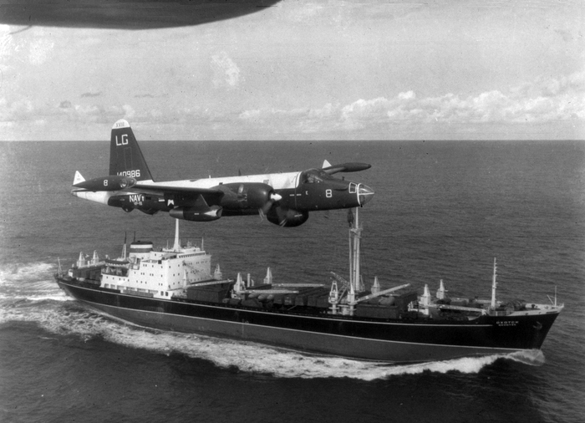
From Khrushchev’s fall from power into 1980s
  Soviet Union remained stable
    Recurrent worries over sluggish productivity compelled expensive grain deals with Western nations, including the United States
  Cold War policies eased
  Soviet desire to beat the West in industry
1962 – Soviet government installed missiles in Cuba (Cuban Missile Crisis)
  Khrushchev had no desire for war, and would promote a new policy of peaceful coexistence

Slide 36
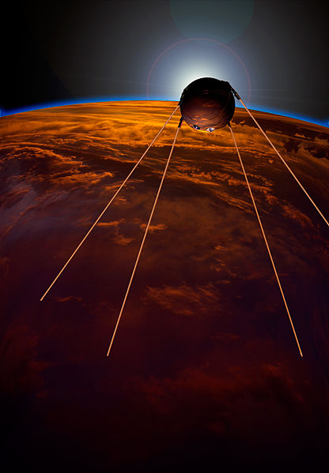
Khrushchev wanted to beat United States economically
1957 – Sputnik
  First satellite send into space
1961 – Yuri Gagarin was first manned flight into space
1960s – greater access to Western media
  Lowered cold war tensions with the West
1970s – Soviet Union invaded Afghanistan
  Desire to create puppet regime
1980s – problems of work motivation and discipline
  Lack of consumer goods
  Many workers found little reason for great diligence
  High rates of alcoholism
    Increased death rates

Slide 37
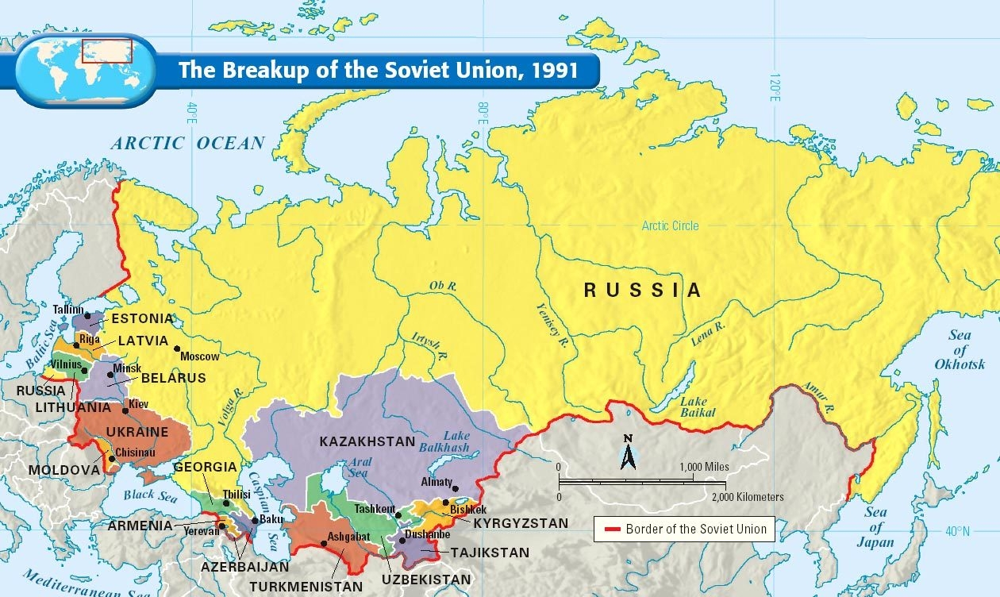
The Explosion of 1980s and 1990s
1985 onward
  intensive reform
  Soviet Union would begin to dismantle
    Deteriorating Soviet economic performance
    Costs of military rivalry with the United States

Slide 38
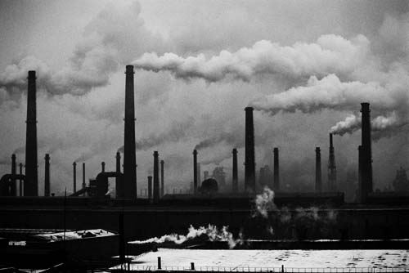
Economic Stagnation
By 1980s – Stagnant economy
  Rigid central planning
  Health problems
    Extensive environmental damage throughout Eastern Europe
      Half of all rivers severely polluted
      40% of agricultural land endangered
    High rates and severity of respiratory and other diseases
    Highest infant mortality rates in the world
  Military spending
    1/3 of national income
  Poor worker morale

Slide 39
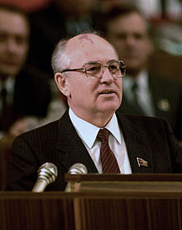
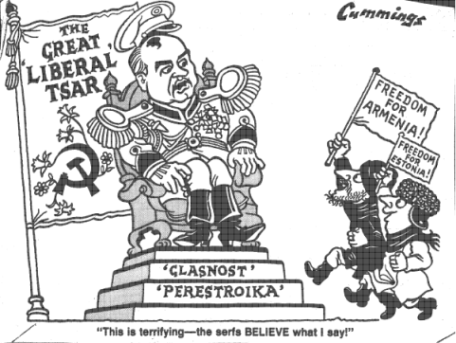
Reform and Agitation
1985 – Mikhail Gorbachev
  Western style, dressing in fashionable clothes
  Open press conferences
  Allowed Soviet media to engage in active debate and report on problems and successes
  Reduction in nuclear armaments
  Ended war in Afghanistan
  Policy of glasnost – openness
    New freedom to comment and criticize
  Market incentives to grow economy
  Still… strong limits on political freedom
  Opened Soviet union to fuller participation in world economy
    McDonald’s in Moscow
  Perestroika – economic restructuring
    More private ownership
    Decentralized control in industry and agriculture
    Foreign investment newly encouraged
  Reductions in Soviet military spending
    Free resources for consumer goods

Slide 40
1988 – Gorbachev encouraged a new constitution
  Gave power to a new parliament
    Congress of People’s Deputies
  Abolished Communist monopoly on elections
    Important opposition groups developed both inside and outside the party
      Conservatives vs. Radicals
  1990 – Gorbachev elected President
1988 onward - Despite reforms, continued economic stagnation provoked agitation among minority nationalities who wanted indepedence
  Muslims and Armenian Christians rioted in the south
  Baltic nationalists and other European minorities

Slide 41
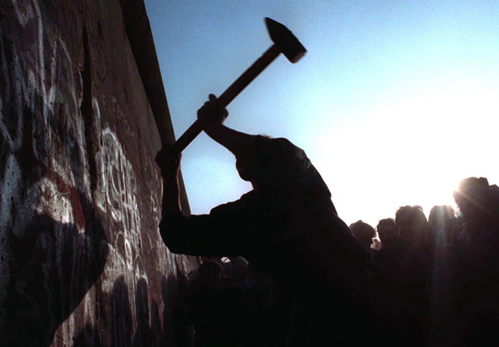
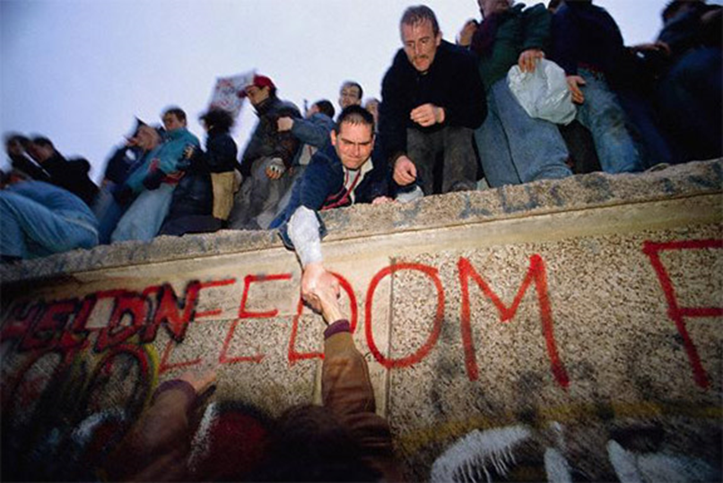
Dismantling the Soviet Empire
Many Eastern Europe states uniformly moved for greater independence
  1989 - Bulgaria
    Communist leader ousted and free elections arranged
  1988 – Hungary
    Changed leadership and installed a noncommunist president
  1988 – Poland
    Installed a noncommunist government
    Dismantle the state-run economy
  1989 – East-Germany
    Expelled key leaders and moved rapidly toward unification with West Germany
    Berlin Wall was dismantled and a noncommunist won a free election
  1989 – Czechoslovakia
    Installed a new government
    Introduced free elections
    Market driven economy
  Romania –
    Violence occurred as the authoritarian communist leader was swept out by force

Slide 42
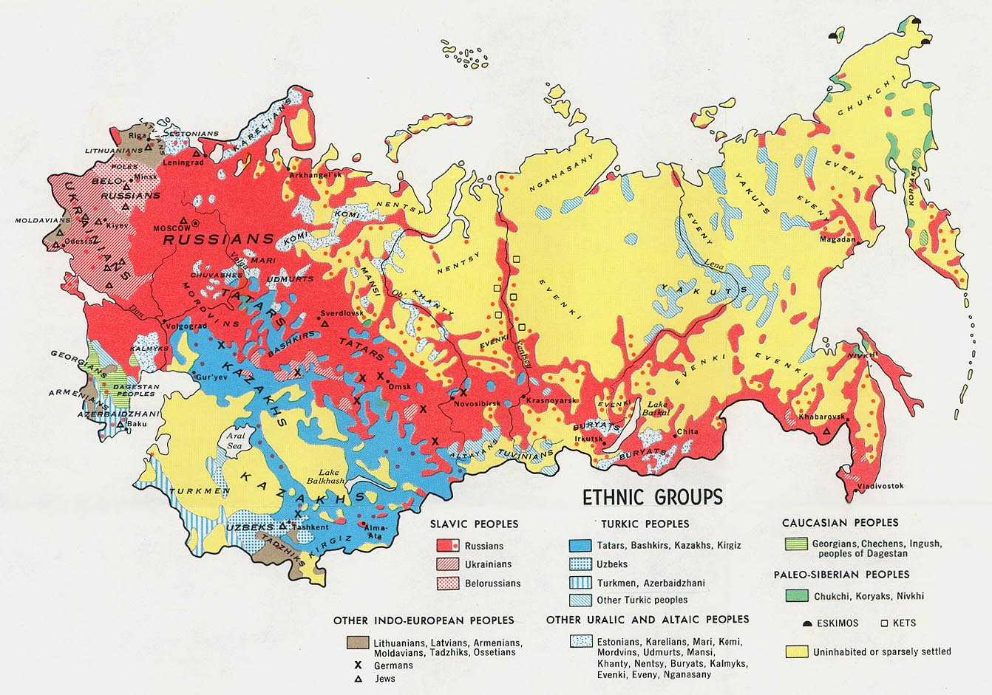
Reform in eastern Europe (like in Soviet Union) was complicated by clashes between nationalities
  Romanians and Hungarians fought
  Bulgarians attacked a Turkish minority
  Yugoslavia had clashes between rival Slavic groups
  Bitter fighting broke out in Bosnia, with Serbs, Croats, and Muslims all fighting for territory
    1998-1999 – bloody clashes between Serbs and Albanians in the province of Kosovo prompted heavy handed outside interventions

Slide 43
Shocks in 1991: The End of the Soviet Union
1991 – attempted government coup in Soviet Union
  Gorbachev’s presidency and democratic decentralization were threatened
  New attacks on the Communist party
  New independence movements by minority nationalities
    Baltic republics declared independence again
      widespread international recognition
    European borders – Belarus, Ukraine, Moldova
    Muslim areas of Central Asia

Slide 44
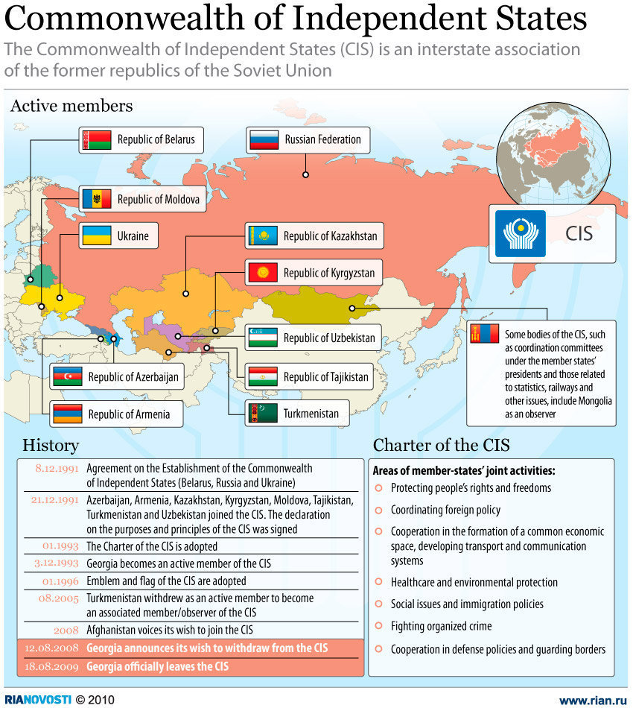
December 1991 – the Soviet Union was dismantled and replaced by a loose union of the successor republics
  The Commonwealth of Independent States
  Most of the republics, which had been tied into the larger Soviet economy, faced serious economic problems

Slide 45
Boris Yeltsin - Elected president of the Russian Republic
  Communist party dissolved
  Struggled to gain a political base
    Pitted against the parliament, composed mainly of former communists
  1993 – Yeltsin and army emerged victorious when an armed clash emerged
  Another constitution written, designed to stabilize democracy
  Economic reforms – more private enterprise with protection for some state-run operations
  Diplomatically – Continued collaboration with the West
  Cultural creativity remained high, with greater freedom to publish
    Limited funding for scientific research
Late 1990s – economy remained very weak
  Production levels down
  Supplies to consumers uncertain
  High unemployment
  Economy came to near collapse as the value of the ruble plummeted
  Organized crime gained ground

Slide 46
Conclusion: What’s next?
Recent trends in Russian history demonstrate that Russia and East Europe had changed relatively little in some ways during the twentieth century.
  Ethnic differences continue to divide the new nations of the post-Soviet era
  Religion continued to remain a vital force
  Russia remained attracted to Western culture, including the concepts of political liberty and a market economy
  Strong, central authority remains and democracy has not been well-established

