Slide 1
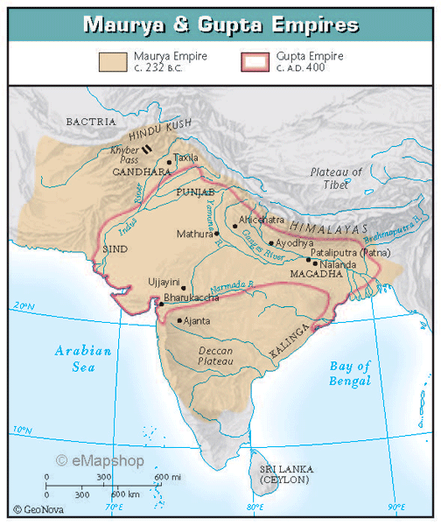
Chapter 3
Classical Civilization India

Slide 2
Classical China – focus on politics/philosophical values
Classical India – focus on religion and social structure
  Agricultural society dictated many similarities with China (most people peasant farmers focused on food production for family survival)

Slide 3
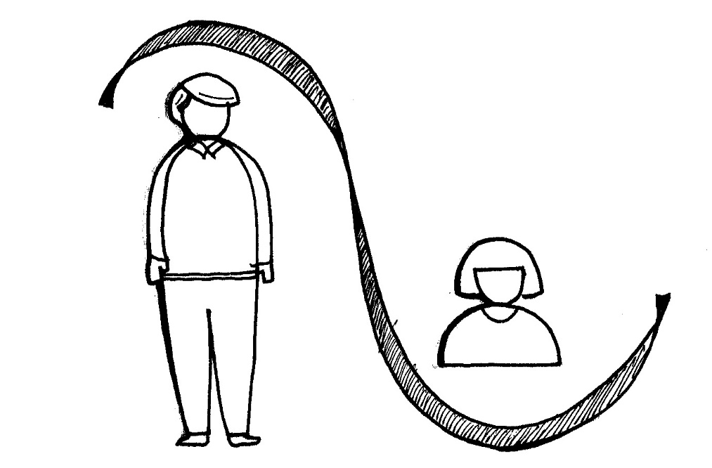
Male ownership of property (patriarchal)
Women held as inferiors and often treated as possessions

Slide 4
India was frequently open to influences from the Middle East/Mediterranean world.
  Persian Empire- brought new artistic styles and political concepts
Alexander the Great invaded India (327 B.C.E.)
  Hellenistic Culture
  Alexander was the son of Philip (King of Macedonia)

Slide 5
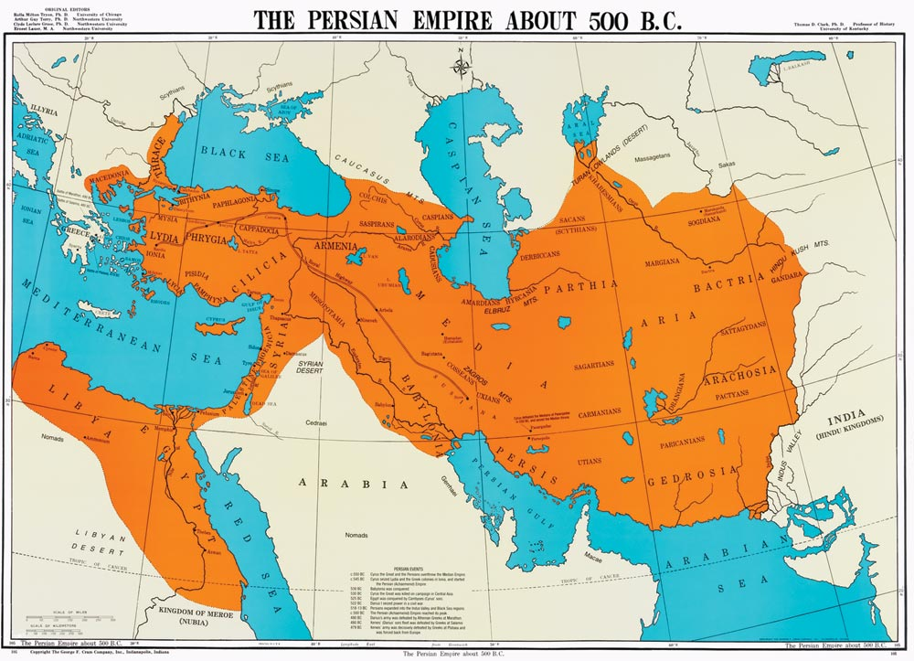

Slide 6
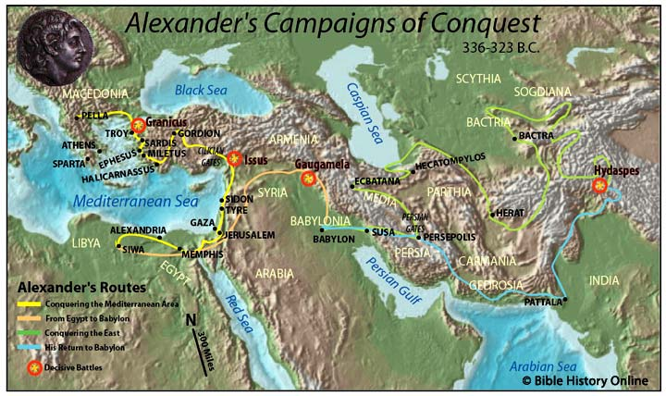

Slide 7
Divisions within subcontinent created greater diversity than China’s Middle Kingdom
Agricultural regions (Indus and Ganges)
Herding economy (mountainous northern regions)
This creates: economic diversity, racial and language differences

Slide 8
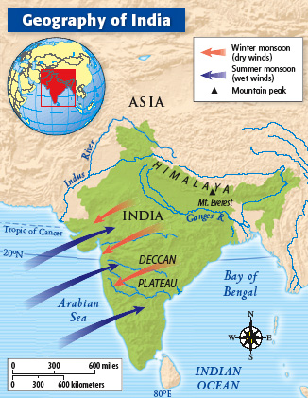
Monsoons

Slide 9
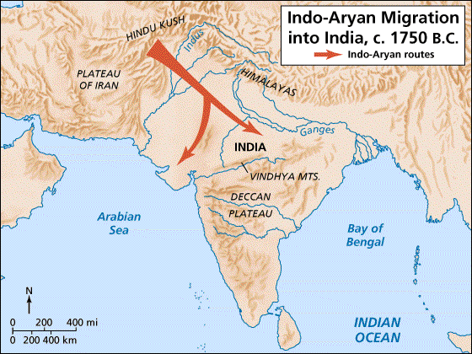

Slide 10
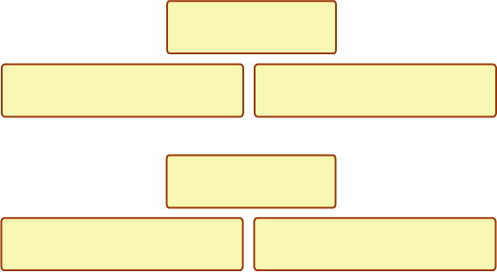
Aryan Civilization
The Aryans destroyed and looted the civilization of the Indus Valley and built a new Indian civilization, which reflected the following characteristics:
Nomadic warriors
Built no cities and left no statues
Felt superior to the people
they conquered
Polytheistic
Religious teachings from the Vedas
People born into castes, or social groups, which they could not change

Slide 11
During the formative period (Vedic and Epic ages), the Aryan (Indo-Europeans) migrants made an impact on the culture and social structure of India
  Hunting and herding peoples from Central Asia
  Introduction of Sanskrit
  Extended farming from Indus to Ganges – iron tools cleared dense vegetation
  Upanishads

Slide 12
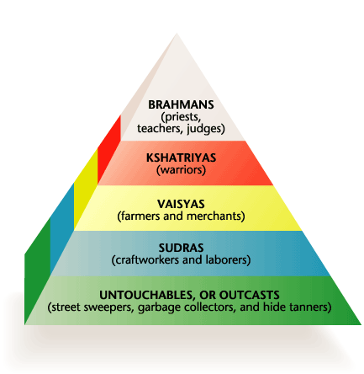
INDIA’S CASTE SYSTEM

Slide 13
Caste System
Indian caste system
  established relationships between the Aryan conquerors and the indigenous people
  People divided into four varnas based on occupation and purity:
    Brahmins (scholars and priests)
    Ksatriyas (ruling and warrior class)
    Vaisyas (merchants, farmers, craftsmen)
    Shudras (servants)
    Untouchables

Slide 14
Provided a way for India’s various races (both conquerors and the conquered) to live together without conflict
  Different kinds of people could live side by side in village or city, separated by caste
  Caste promoted tolerance

Slide 15
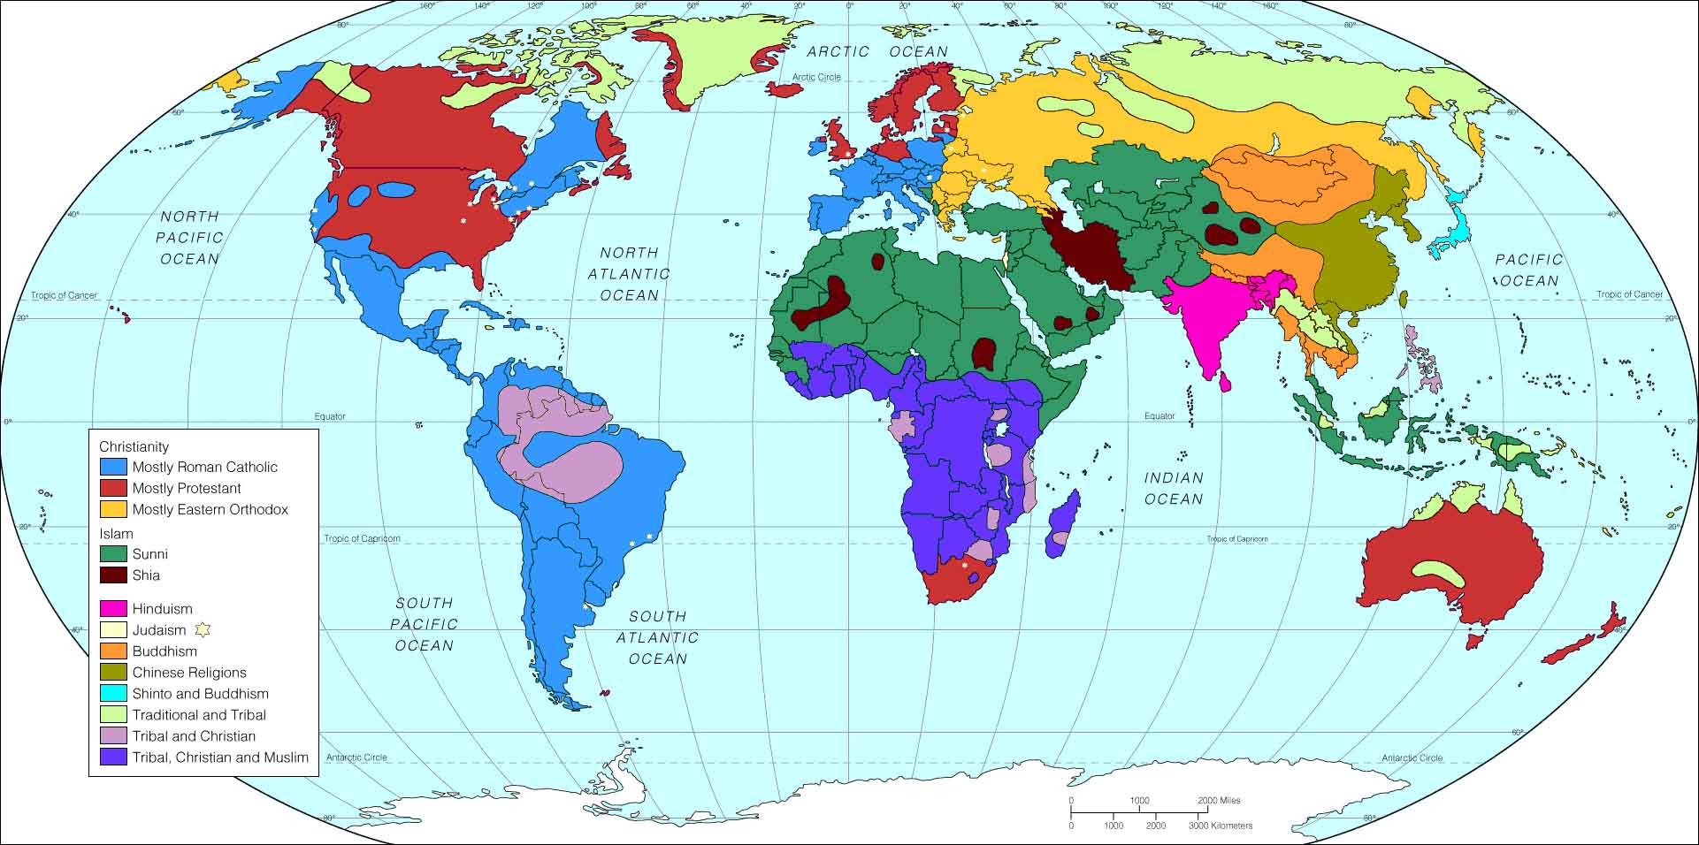
Aryan conquest of the Indus Valley established their religious beliefs on the Indian subcontinent

Slide 16
Hinduism
Many gods and goddesses who regulated natural forces and possessed human qualities
Gods presided over fire, the sun, death, etc.
One supreme force called Brahma, the creator, who is in all things
Hindu gods are manifestations of Brahma
Vishnu – the preserver
Shiva – the destroyer

Slide 17
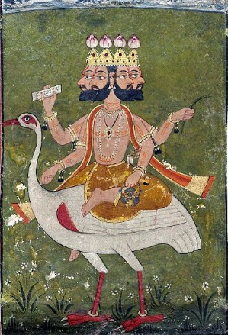
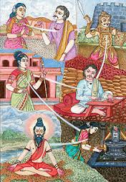
Goal of Hindus – merge with Brahma (impossible to accomplish in one lifetime)
Reincarnation
Caste system
karma
Dharma (rules and obligations of the caste)
The cycle of life, death, rebirth continues until you achieve moksha – internal peace and release of soul
No central sacred text – Vedas, Upanishads

Slide 19
Buddhism
At times, the tensions within Hinduism broke down for some individuals, producing rebellions against the dominant religion.
One rebellion (during the Epic Age) led to a new religion around 563 B.C.E.
  Guatama (Buddha) – Indian prince
    Questioned the poverty and misery

Slide 20
Four Nobles Truths:
All life is suffering
Suffering is caused by desire
One can be freed of this desire
One is freed by following what’s called the Eightfold Path

Slide 21
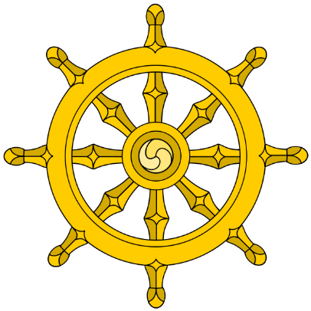
Eightfold Path: right understanding, purpose, speech, conduct, livelihood, effort, awareness, and concentration
Stop desiring if you want to stop suffering
Ultimate goal: nirvana
Holy life could be achieved through individual effort from any level of society
Attracted many followers – conversion of Mauryan emperor Ashoka
Buddhism did not witness a permanent following in India. Why not?
  Spread to China, Korea, Japan, Sri Lanka

Slide 23
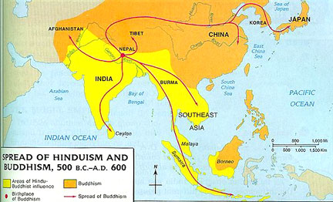

Slide 24
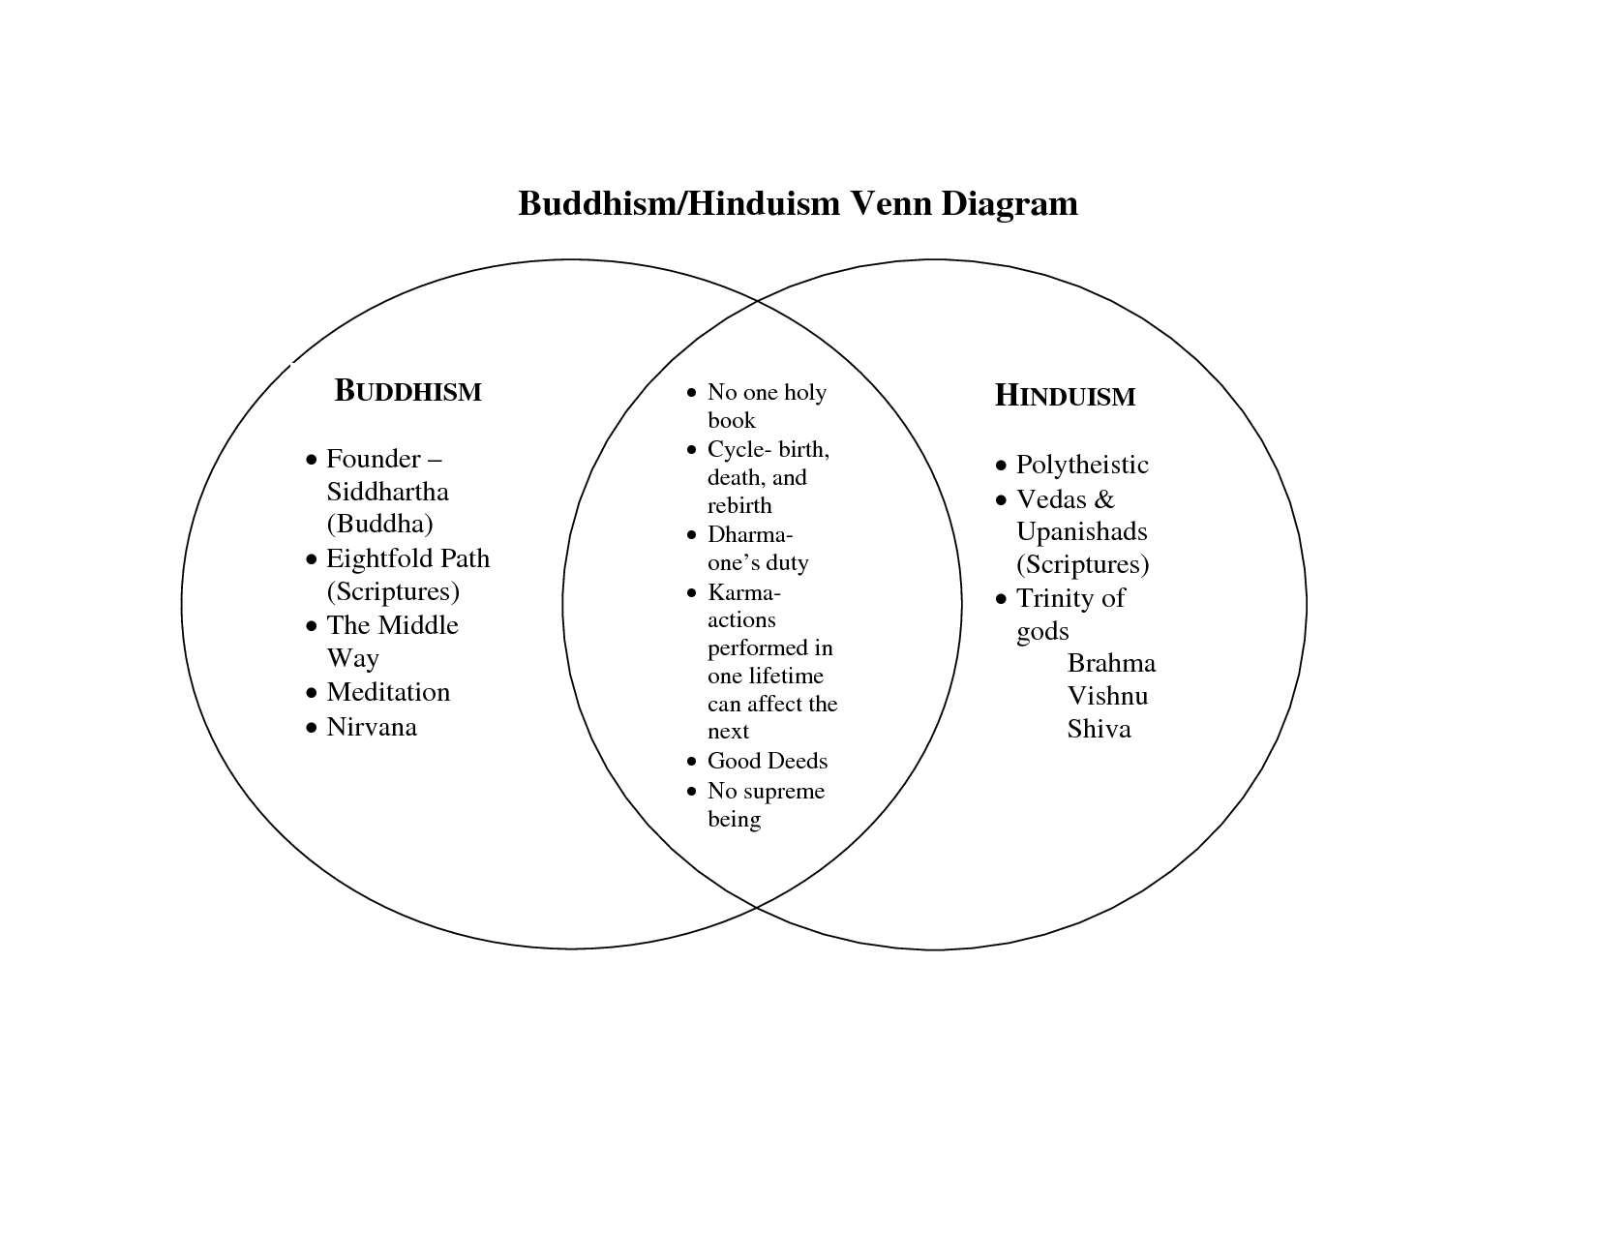

Slide 25
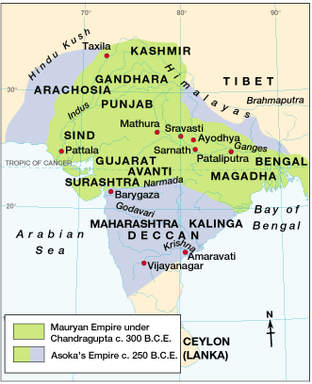
The Maurya Empire
321 BCE – 185 BCE

Slide 26
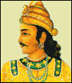
Mauryan Empire In India (321 to 180 B.C.E.)
6th century BCE - Following the invasions of the Aryans, India developed into small regional kingdoms which often fought each other (decentralized)
  Periods of centralization
Chandragupta – maintained large armies, developed a substantial bureaucracy (even a post office)
  unified smaller Aryan Kingdoms into a civilization

Slide 27
Chandragupta’s grandson, Ashoka (269-232 B.C.E.)
  Extended Mauryan conquests, gaining control of all but the southern tip of India
  Fierce fighting led to his conversion of Buddhism – sent Buddhist monks across Central Asia and into Southeast Asia
  Collected taxes, built roads, hospitals, and rest houses, which facilitated trade

Slide 28
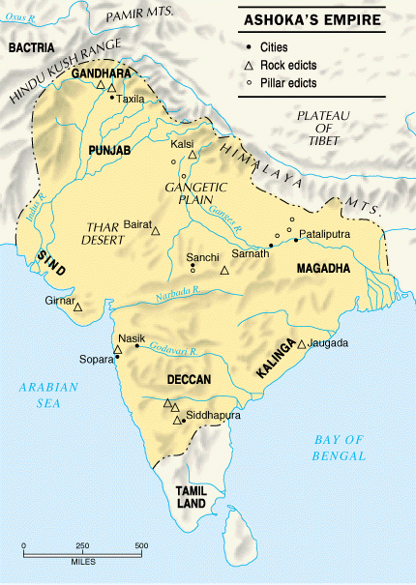

Slide 29
Reasons for the success of Mauryan Empire:
Trade – silk, cotton, and elephants (among hundreds of other items) to Mesopotamia and the eastern Roman Empire
Powerful military

Slide 30
After Ashoka, the empire began to fall apart
  Regional kingdoms surfaced once again
  New invaders – Kushans
  Greatest Kushan King, Kaniska, converted to Buddhism (which hurt the religion)
  The collapse of the Kushan state (220 C.E.) ushered in another hundred years of political instability

Slide 31
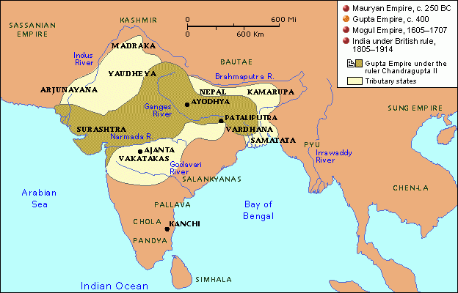

Slide 32
Gupta Empire (320-550 C.E.)
Chandra Gupta
  Decentralized government (local governments and administration had power)
  Hinduism becomes primary religion (Buddhism mostly disappears from India subcontinent)
  Promoted Sanskrit (language of educated people)
Known as the “Golden Age of Indian history”
Empire was overturned in 535 C.E. by a new invasion of nomadic warriors, the Huns.

Slide 33
Gupta Achievements
1000 diseases
classified
500 healing
plants identified
Printed
medicinal guides
Kalidasa
Plastic
Surgery
Medicine
Literature
Inoculations
Gupta
India
C-sections
performed
Solar
Calendar
Astronomy
Mathematics
Decimal
System
The earth
is round
PI = 3.1416
Concept
of Zero

Slide 34
