Slide 1
Ch. 31 Japan and the Pacific Rim

Slide 2
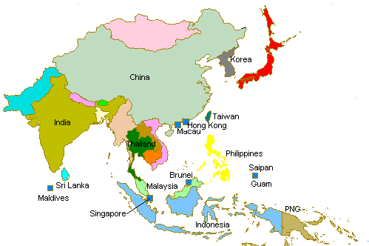
Introduction
In the 20th century, states of the Pacific Rim developed powerful economies that challenged the West
Key state – Japan
19th century – reforms of Meiji era
1930s – military attacks on China and large stretches of southeast Asia and Pacific
After its loss in WWII - Japan reappeared as a leader in Pacific industrialization
Challenged Western industrial powers
Continued to draw raw materials from much of the world
After World War II, South Korea, Taiwan, and the city-states of Hong Kong, and Singapore also industrialized

Slide 3
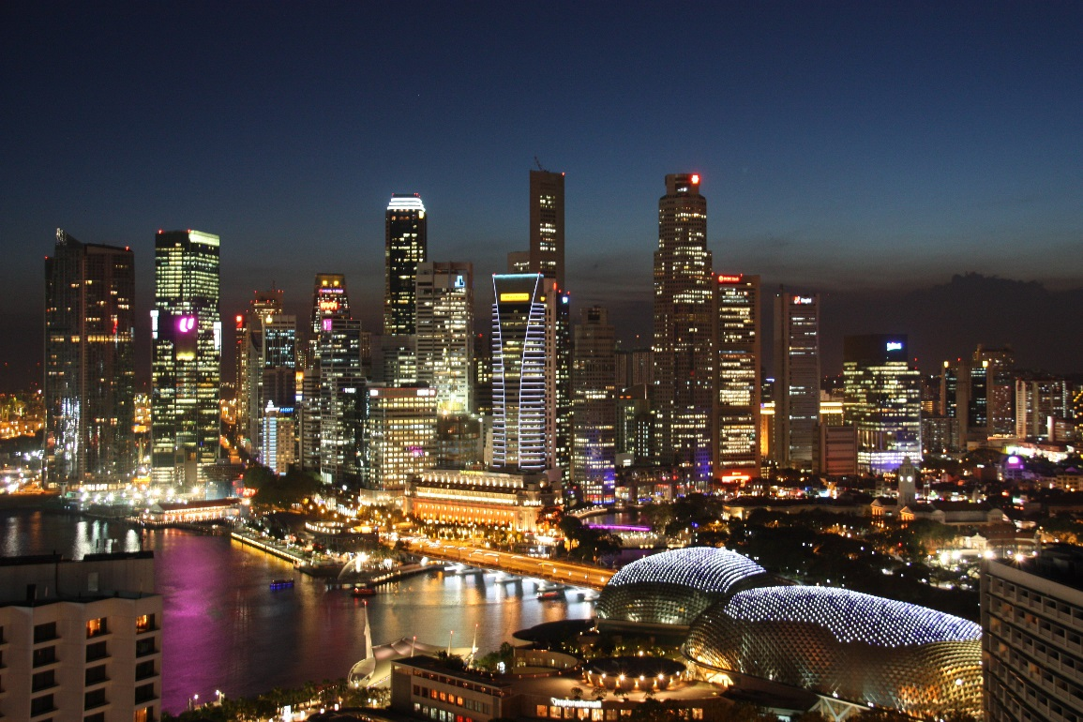
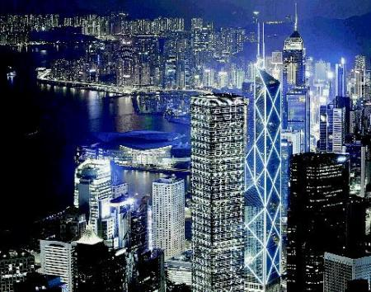
Singapore
Hong Kong

Slide 4
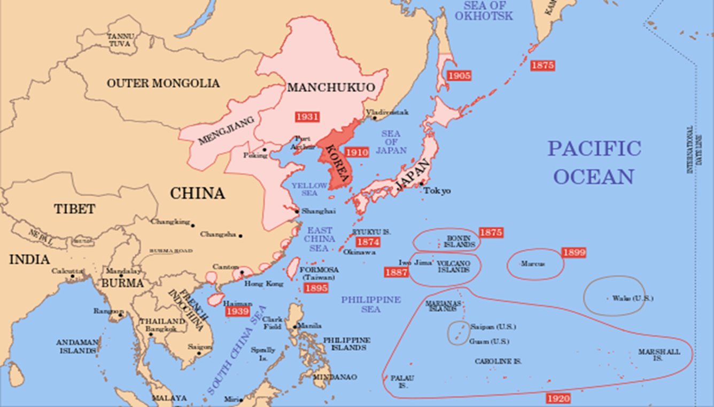
Decades of Turmoil: The World Wars and Their Consequences
After 1900, Japan was an expansionist power
1910 – formally annexed Korea
Ruled its new colonies firmly
Demanding taxes and raw materials
Securing markets for its growing industrial output

Slide 5
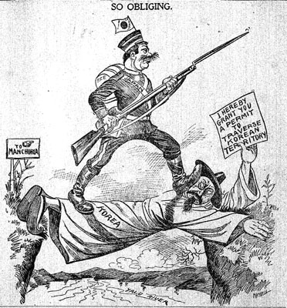

Slide 6
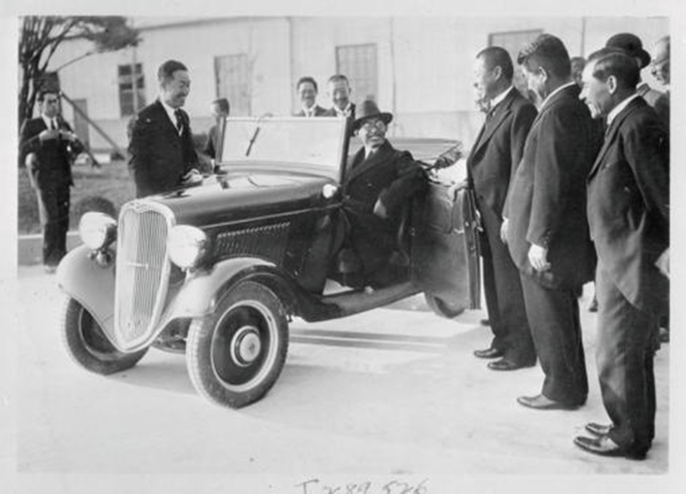
Japan's Ongoing Development
Japanese industry continued to lag behind Western levels
Relied heavy on low-wage labor and export of a small number of items such as silk
1890 – 16 million pounds of silk exported
1929 – 93 million pounds of silk exported
By the 1920s there was expansion in areas of heavy industry and other areas:
New equipment, industrial combines – the zaibatsu
rapid growth in shipbuilding and metals
Relied heavily on Japanese bureaucracy
Agriculture productivity – fertilizers and new equipment
Increase in electric power
Popular consumer culture developed
Workers began attended moving and reading newspapers
Education advanced
1925 – primary school attendance universal
Number of secondary schools and technical colleges increased

Slide 7
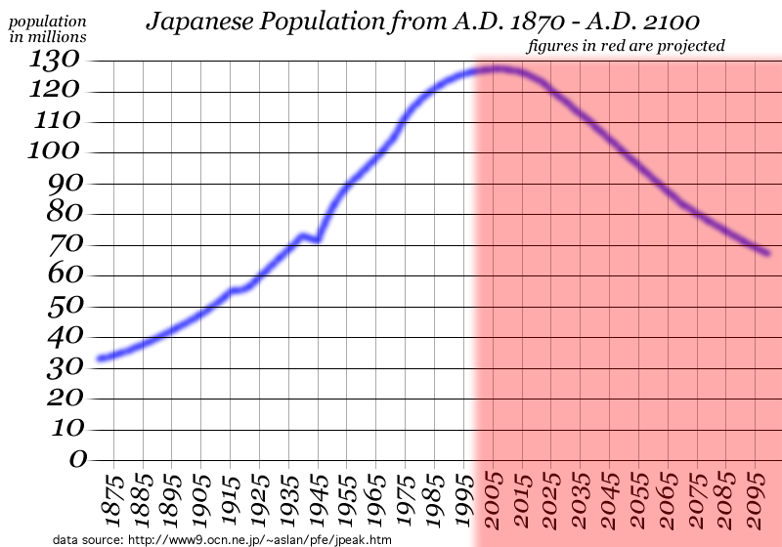
Limits on Japanese economic advance
Vulnerability to economic conditions outside Japan
Competition from artificial fibers produced by Western chemical companies weakened silk exports
1930s – Great Depression
Recovered quickly
New export boom
Government spending on building up its war machine
Population growth
1868 – 30 million
1900 – 45 million
1940 – 73 million
Limited improvements in standards of living
Crowded, migrant-filled cities

Slide 8
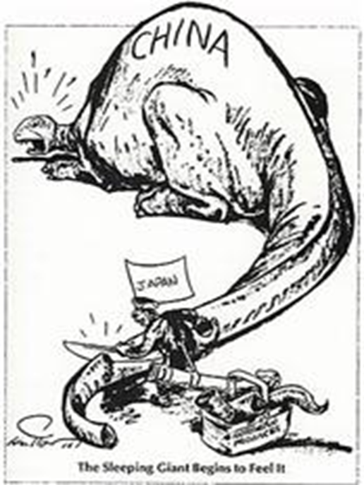
Political Crisis and Growing Militarism
By 1938, Japanese military had taken a major role in setting diplomatic policy
Militarism
Cause of World War II
Seized Manchuria, Korea, and Japan
Japan sold half its exports to and received 40% of imports from
Both military and economic leaders pressed for wider conquests
Malaya – rubber
Dutch East Indies - oil

Slide 9
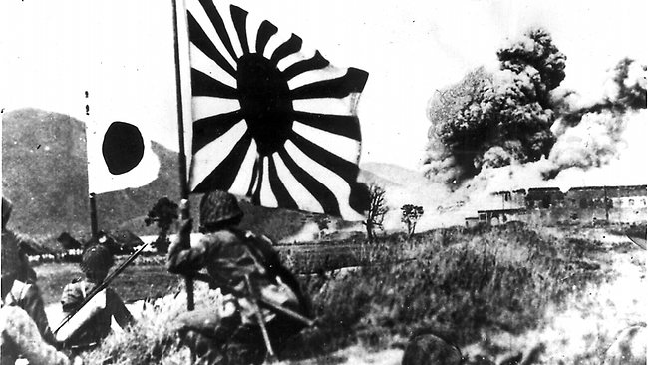
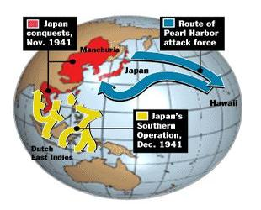
1931 – Japanese invades Japan
General Tojo Hideki

Slide 10
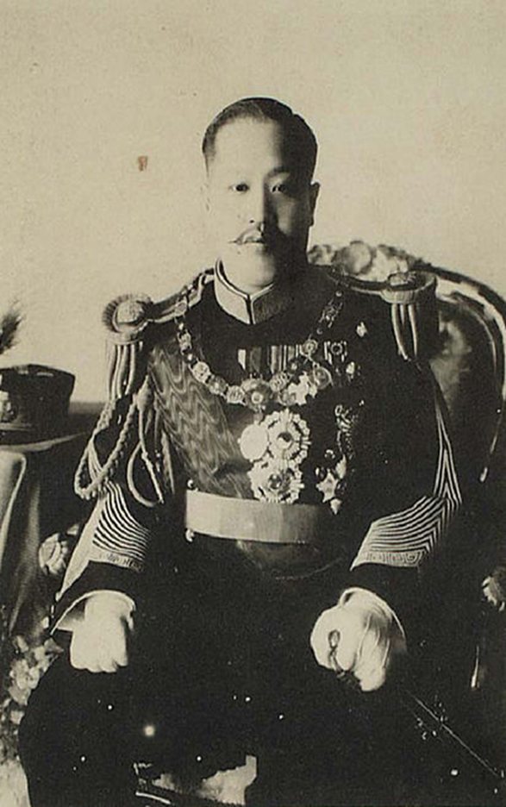
Change in Other Pacific Rim Areas
Interwar period – Korea controlled by Japan
Monarchy abolished
Japanese launched effort to suppress Korean culture and promote adoption of Japanese ways
Korean-language newspapers were banned
Korean teachers required to wear Japanese uniforms and carry swords
Japanese money, weights and measures, and language instruction were introduced
Korean peasantry compelled to concentrate on rice production for export to Japan
Japanese military police forcibly conscripted Korean youths for troops in war effort
Sunjong – Korean monarchy abolished in 1909

Slide 11
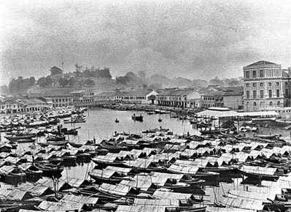
Singapore was held as part of Britain’s colony of Malaya
Largely Chinese population
Naval base for Britain
Served as a growing international seaport linked by road and rail to the rubber and tin producing areas of Malaya
Suffered greatly during the Japanese World War II occupation
Widespread unemployment and poverty

Slide 12
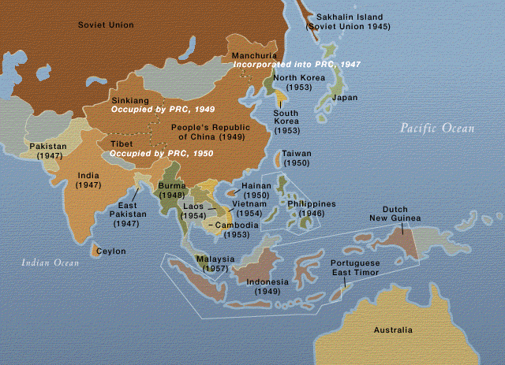
After WWII
Korea divided between Russian zone of occupation in north and American zone in south
Taiwan was restored to China
United States regained the Philippines
Pledged to grant independence quickly
Desired to regain key military bases
European powers restored controls over their holdings in Vietnam, Malaya, and Indonesia
Japan was occupied by American forces
Introduced major changes to prevent a recurrence of military aggression

Slide 13
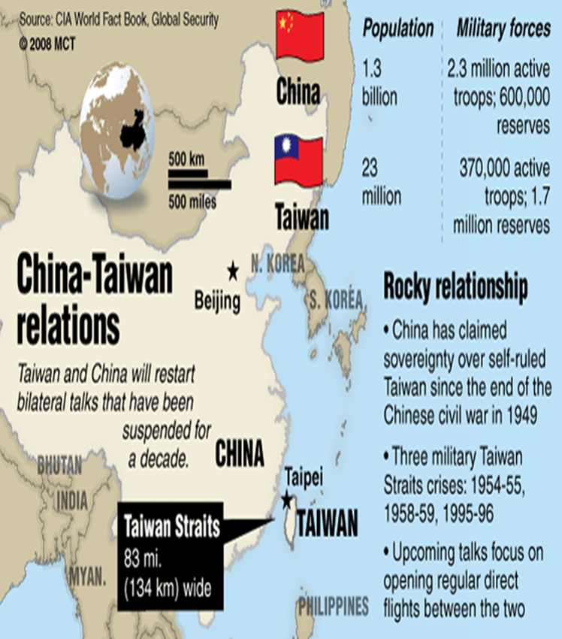
New Divisions and the End of Empires
A decade after WWII
The Philippines, Malaya, and Indonesia all gained their independence
Taiwan continued to be ruled by a Nationalist government led by Chiang Kai-shek while China was under a communist government
Korean War
U.S. intervention kept South Korea’s independence secure
Japan was recreated in the pattern laid out by the United States

Slide 14
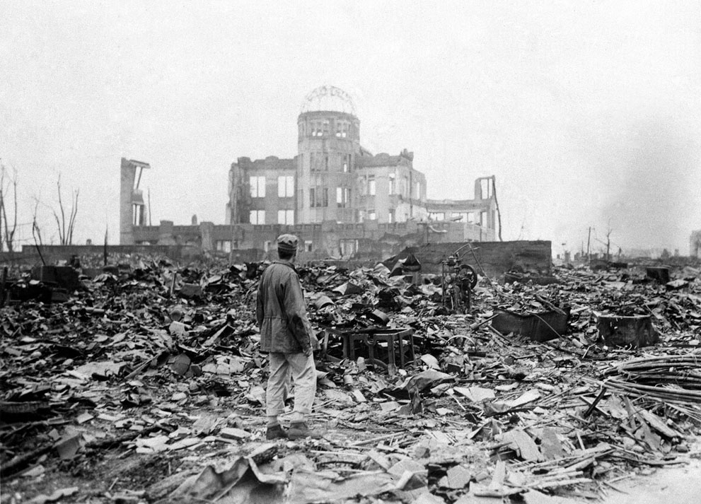
Japanese Recovery
1945 – Japan was in shambles
Cities were burned
Factories destroyed or idle
People impoverished and shocked by the fact of surrender and trauma of bombing
Hiroshima and Nagasaki

Slide 15
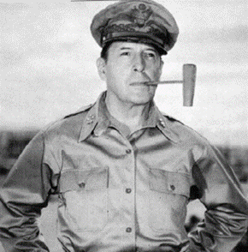
Until 1952 - The U.S. occupation government, headed by General Douglass MacArthur, controlled Japan
Tear down Japan’s wartime political structure
Military forces disbanded
Military power and responsibility in the region retained by the United States
Police decentralized
Many officials removed
Political prisoners released
Women’s suffrage
Encouragement of labor unions
Abolished Shintoism as state religion
Economic reforms
Breaking up landed estates for benefit of small farmers
Dissolving the holdings of the zaibatsu combines
New constitution
Emperor - figurehead
Made the parliament the supreme government body
Civil liberties guaranteed
Gender equality in marriage
Education
Reduced nationalism in textbooks
Opened secondary schools to more social groups
By 1955, Japan's industrial base had recovered to prewar levels and made Japan a competitor of Western industrialized nations

Slide 16
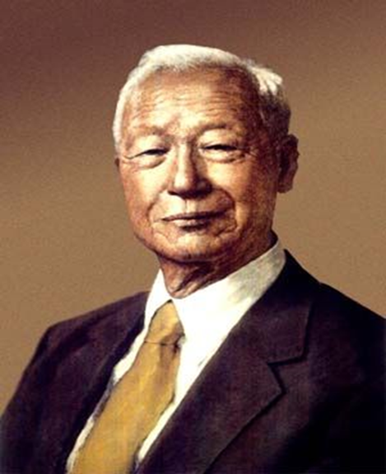
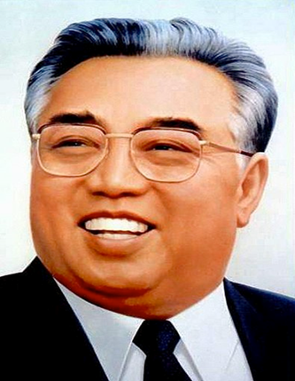
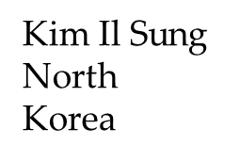
Korea: Intervention and War
1948 – Korea divided as the Cold War intensified
South Korea – Republic of Korea
Sponsored by the United States
Bolstered by an ongoing American presence
Headed by nationalist Syng-man Rhee
Developed parliamentary institutions in form but maintained a strongly authoritarian tone
North Korea – People’s Democratic Republic of Korea
Sponsored by the Soviet Union
Became a communist state with a Stalinist-type emphasis on the power of the leader
Kim Il-Sung
Ruled until death in 1994

Slide 17
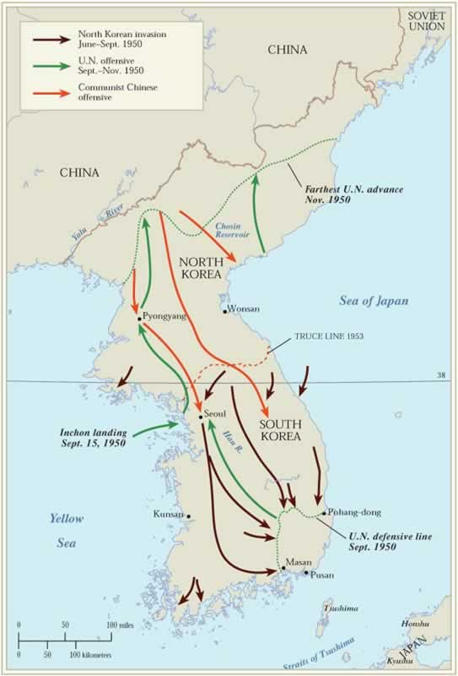
1950 – Korean War
North Korean forces attacked South Korea
Hoped to impose unification on their own terms
United States reacted quickly
President Truman and the United Nations sponsored a largely American force in support of South Korean troops
Allied forces pushed North Korea back
China’s Communist regime supported North Korea
1953 – armistice signed

Slide 18
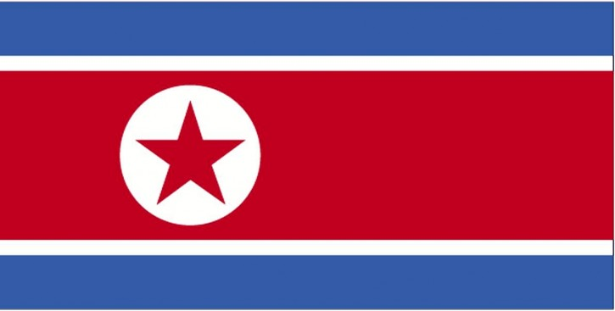
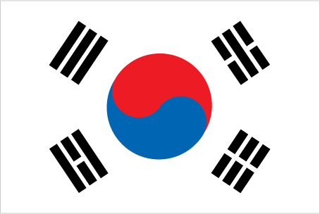
Northern Korea continued as an authoritarian communist regime under Kim Il-Sung
Southern Korea also followed an authoritarian political pattern, but rapidly industrialized with the help of U.S. aid

Slide 19
Emerging Stability in Taiwan, Hong Kong and Singapore
TAIWAN
An authoritarian government under Chiang Kai-shek dominated the native Taiwanese
Attempted to defend the island from communist China
Supported by the United States, the Nationalist regime on Taiwan survived
Hong Kong and Singapore
Both British colonies
Postwar economic boom
1997 - Hong Kong was returned to China
Chinese population swelled as a result of flights from communist rule
Singapore withdrew from Malaya and established independence in 1959
Large British naval base until 1971

Slide 20
Hong Kong and Singapore
Hong Kong as British Colony
Singapore – Once colonized by the British

Slide 21
Japan: The Distinctive Political and Cultural Style
From 1955 onward – The Liberal Democratic Party held government power
1970s-1980s: economic progress
Late 1980s – massive corruption in government
Strong cooperation between government and business
State set production and investment goals while lending public resources to encourage investment and limit imports
The government actively campaigned to promote birth control and abortion
Population growth slowed
Japanese culture preserved important traditional elements
Customary styles in poetry, painting, tea ceremonies, and flower arrangements continued

Slide 22
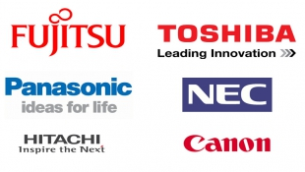
The Economic Surge
After the 1950s, Japan emerged as one of the world's economic giants
1983- the total national product was equal to combined totals of China, both Koreas, Taiwan, India, Pakistan, Australia and Brazil
Per Capital income soared
Still slightly behind leading Western nations
Annual economic growth of at least 10% annually
Surpassed every nation in the 1960s and 1970s
One of the top two or three economic powers worldwide
High savings rates produced capital for investment
Leading Japanese corporations had high volume of international exports and high quality of goods
Automobile manufacturers and electronic equipment

Slide 23
Factors of Japan’s economic performance
Active government encouragement
Educational expansion
More engineers than competitors, such as the United States
Foreign policy
Poured capital into technology and not military
Japan relied on United States for military protection
Highly motivated employees
Ensured lifetime employment to many in the labor force
Low average unemployment rates
Early retirement age
Japanese policies and attitudes made labor less class-conscious
A reflection of older traditions of group solidarity in Japan

Slide 24
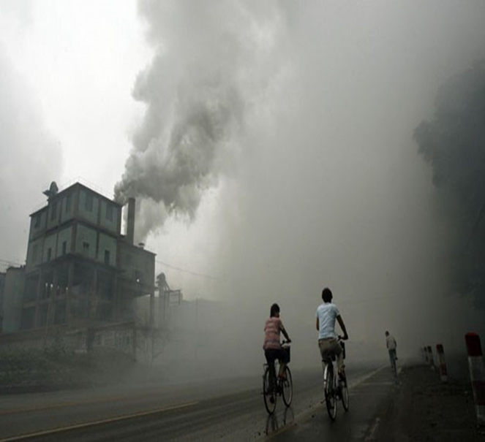
Japanese culture embraced some aspects of the West
Baseball, tennis, golf, Western eating utensils, and an emphasis on youth
Japanese family life
Japanese women increasingly well educated
Experienced an important decline in birth rates
Japan's economic success created resentment and competition among its trade rivals
Pollution became a growing problem in Japanese cities
By the 1990s, economic recession combined with government corruption, raised questions about the continued success of Japan

Slide 25
The Korean Miracle
Korea's government continued to be dominated by the politically motivated military and were dedicated to industrialization
Mid 1950s onward - South Korean government’s primary emphasis on economic growth
Huge industrial firms were created by a combination of government aid and active entrepreneurship
By 1970s – competing successfully in the area of cheap consumer goods, steel, and automobiles in the international markers
Created many general changes
Population growth
1980s – 40 million people
Highest population density on earth – 1000 people per square mile
Government encouraged couples to limit birth rates
Massive air pollution
Increase in per capita income
Huge fortunes coexisted with widespread poverty
Poor better off than those of less developed nations

Slide 26
Advances in Taiwan and the City-States
TAIWAN
Production in both agriculture and industry increased
Stopped planning to invade China
Government planning mixed with private business
The government also poured funds into public education
Literacy rates and technical training rose
1978 – The United States severed ties with the Taiwanese regime
United States recognition of the People’s Republic of China

Slide 27
SINGAPORE
Authoritarianism government controlled all aspects of life
The dominant People’s Action Party suppressed opposition movements
The economic success of the government made it acceptable
Manufacturing and banking supplemented shipping as major sectors of the economy
Electronics, textiles, and oil refining joined shipbuilding as major sectors
1980s – Singapore’s population enjoyed the second highest per capital income in Asia
Educational levels and health conditions improved accordingly

Slide 28
Hong Kong
Continued to serve as a major world port and international banking center with a growing industrial sector
Connected China to the rest of the world
1980s – Textiles and clothing formed 39% of exports
1997 - Hong Kong was returned to China
Promised British to respect Hong Kong’s free market economic system and democratic political rights

Slide 29
Common Themes and New Problems
Similarities between Pacific Rim States:
Shared reliance on government planning
Benefited greatly from the expansion of Japanese market for factory goods
Textiles and other raw materials
1980s – Indonesia, Malaysia, and Thailand began to experience rapid economic growth
Problems with pollution
Final years of 20th century
Growth slowed
Unemployment rose
Currencies lost value

Slide 30
Conclusion
There were several reasons for the rise of the Pacific Rim nations:
a common basis in Chinese culture and heritage, special contacts with the West (either Britain or the United States), and the experience of WWII that reshaped fundamental thinking
Economic rivalries and exportation of industrialization to new Asian regions
Concern over loss of tradition and continued frustration over political authoritarianism have produced some strains
Under any circumstances, the entry of the Pacific Rim nations into the world trade system has been dramatic

