Slide 1
The Mongols
Barbarians or Men of the People and Trade Facilitators?

Slide 2
Timeline
907-1118: Khitan conquest of North China
1037-1194: Seljuk Turks dominant in Middle East
1115-1234: Jurchens (Qin dynasty) rules North China
1126: Song dynasty flees to South China
1206- Temujin takes the name Chinggis Khan; Mongol State founded
1215 – First Mongol attacks on North China; Beijing captured
1219-1223 : First Mongol invasions of Russia and the Islamic World
1227 – Death of Chinggis Khan; Ogedei named successor
1234 – Mongols take all of North China; end of Qin dynasty (Jurchens)

Slide 3
1235-1279: Mongol conquest of South China; end of southern Song dynasty
1236-1240: Mongol conquest of Russia
1240-1241: Mongol invasion of western Europe
1253- Mongol victory over Seljuk Turks; rise of Ottoman Turks in Middle East
1258 – Mongol destruction of Baghdad
1260 – Mameluk rulers (slaves) of Egypt defeat Mongols; end of Mongols drive into west
1260-1294: Reign of Kublai Khan in China
1271-1295: Journey of Marco Polo to central Asia, China, and Southeast Asia
1271-1368: Reign of Yuan (Mongol) dynasty in China
1290s – First true guns used in China

Slide 4
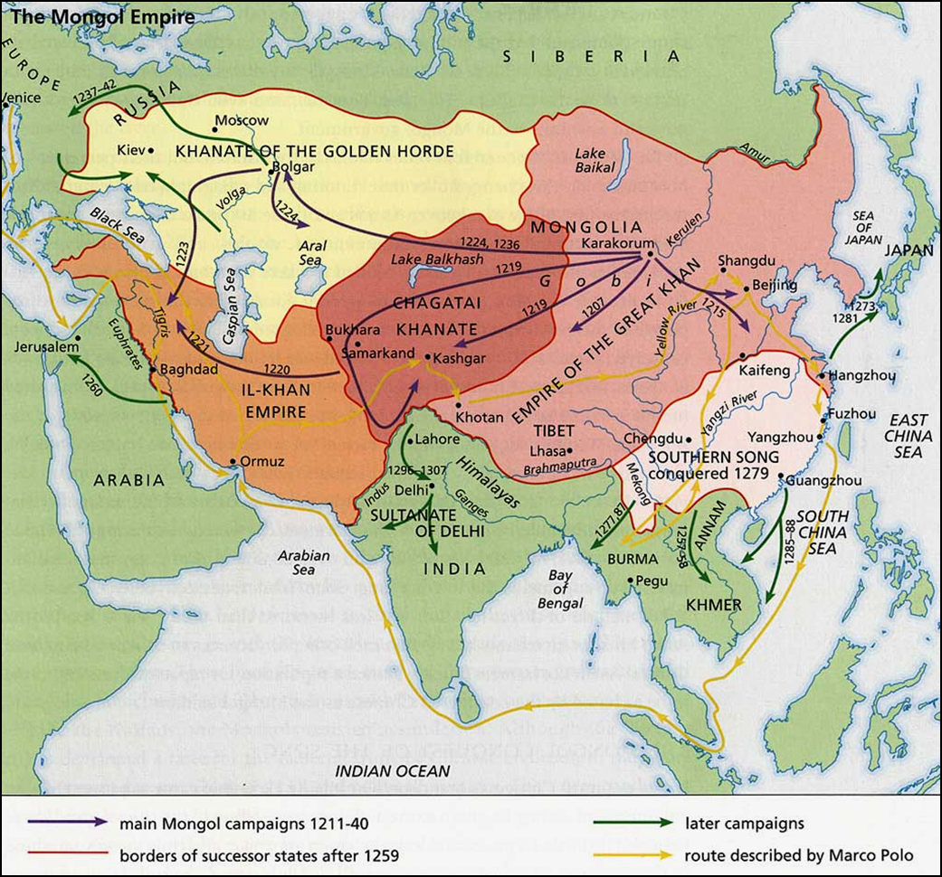
Introduction
Pastoral nomads
The Mongol empire stretched from China to eastern Europe.
Reputation : savage barbarians
they imposed peace on the regions they came to dominate and enabled the establishment of a Eurasian-wide system of trade and cultural exchange.
Silk Road trade safe!

Slide 5
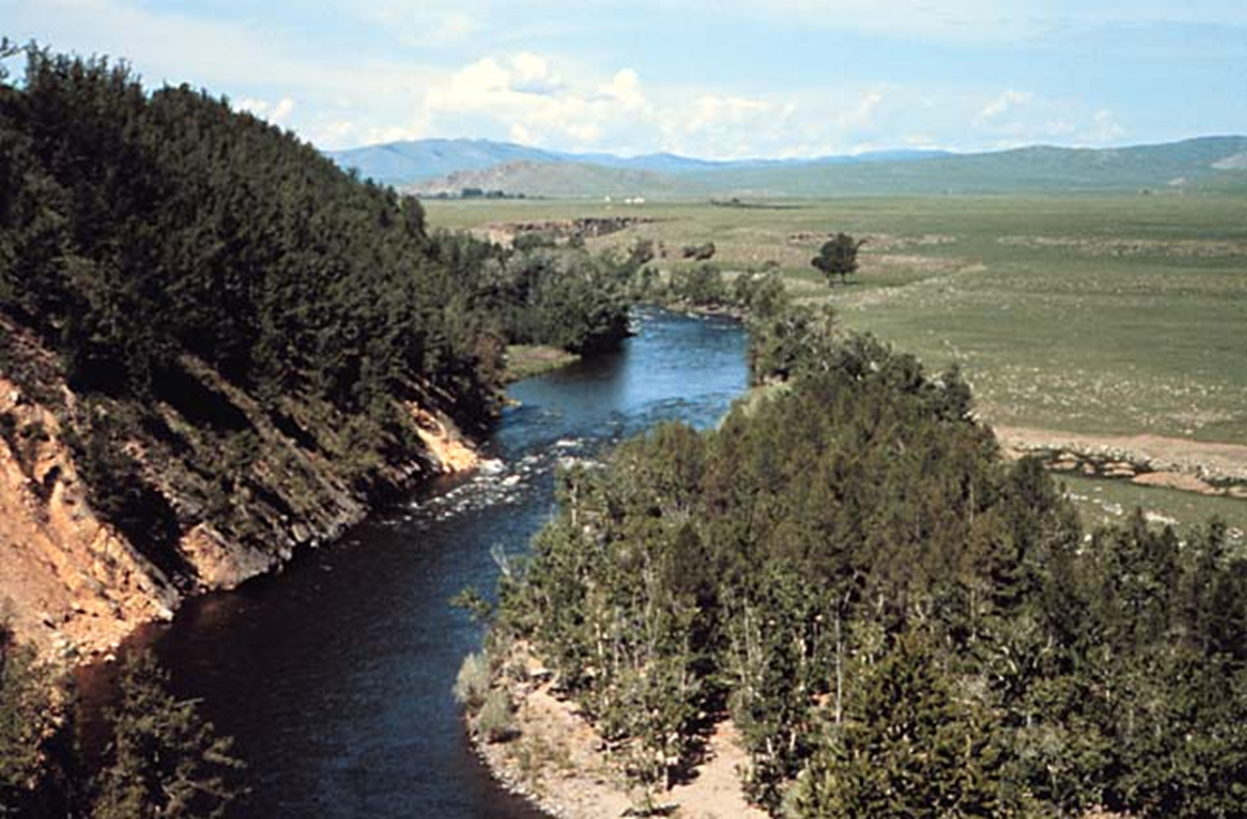
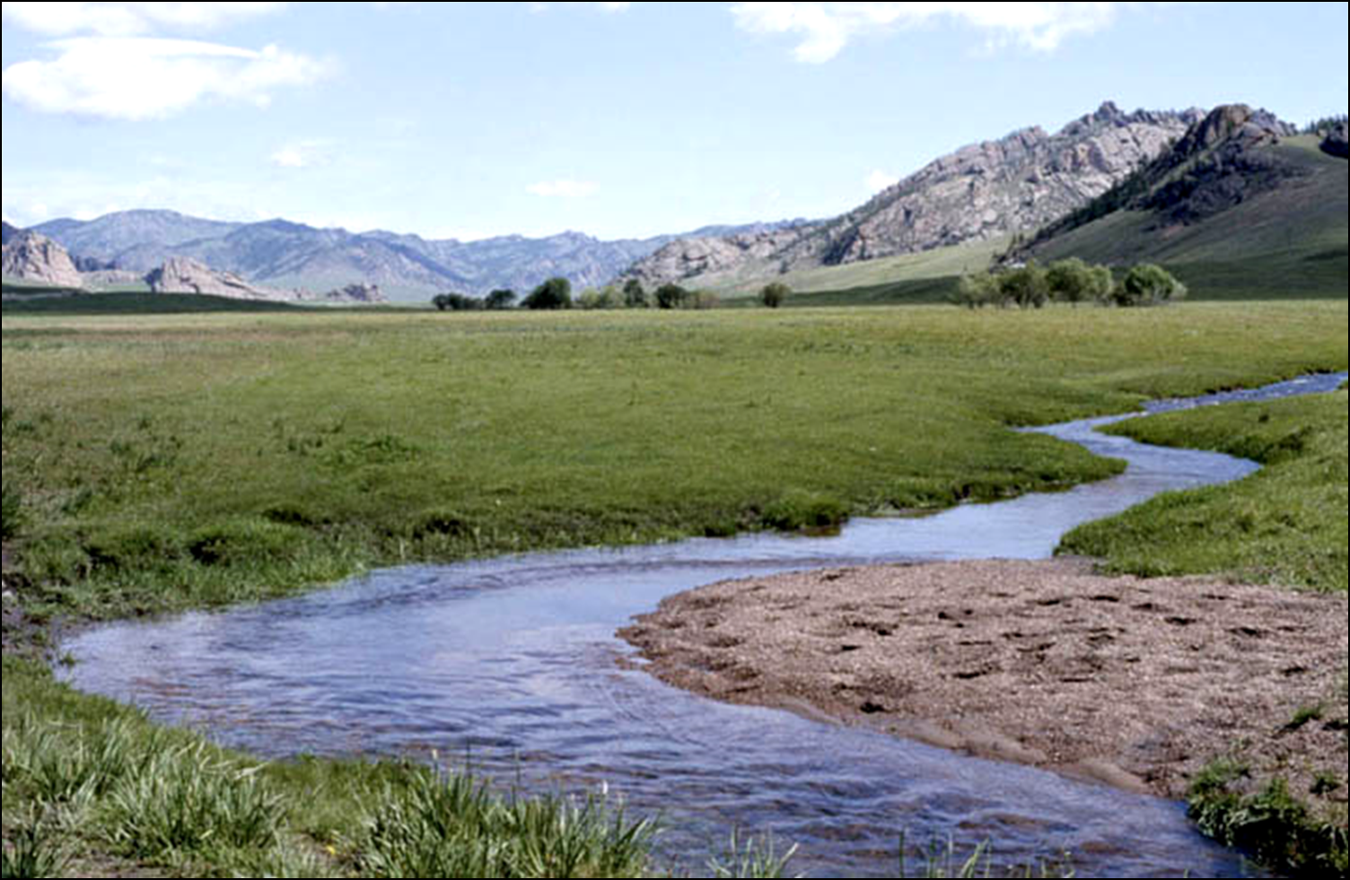
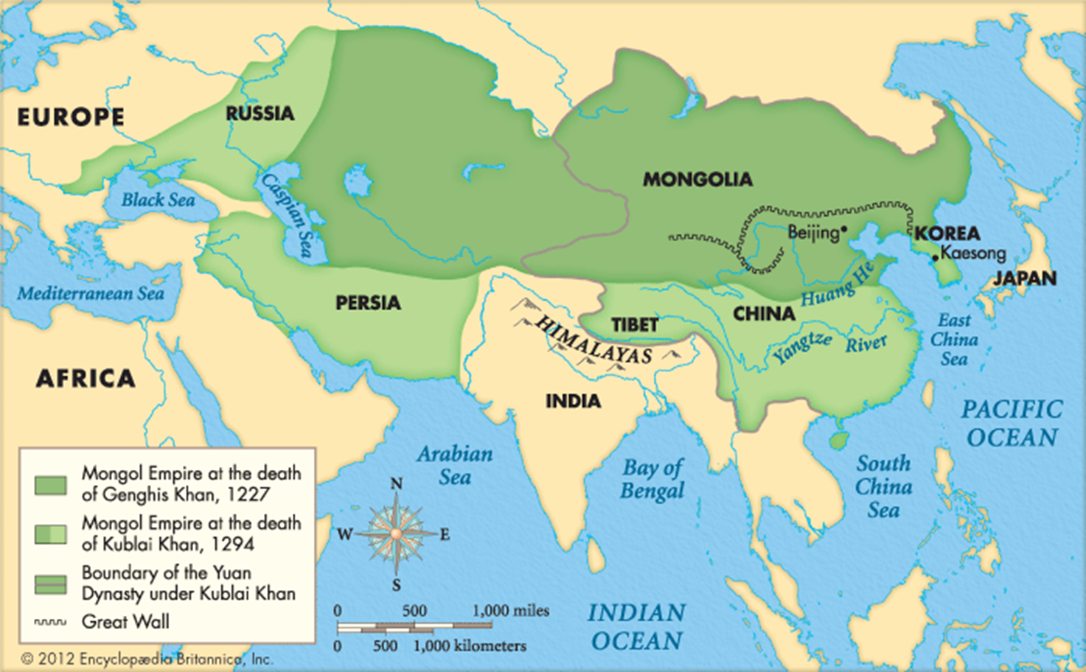
The Rise of the Mongols
Temujin --> Chenghis Khan [“Universal Ruler”]
United the Mongols in 1162, Died in 1227
Built the World’s Largest land Empire
Created his new capital at Karakorum
Notes:
The Nomadic advantage over sedentary societies is that nomads were highly mobile, very effective horsemen, and employed the element of surprise as a battle tactic. Siege warfare was also common.

Slide 6
The Mongol Empire of Chinggis Khan
The Mongols were typical pastoral nomads
They depended on herds of goats and sheep for their livelihood,
engaged in trade
renowned horsemen and women
The basic unit of Mongol society was the tribe composed of kin –related clans.
Clans could be combined in to confederations
Old/weak leaders would be abandoned
Staple foods – meat and milk products provided by their herds; grain and vegetables gained through trade with sedentary people

Slide 7
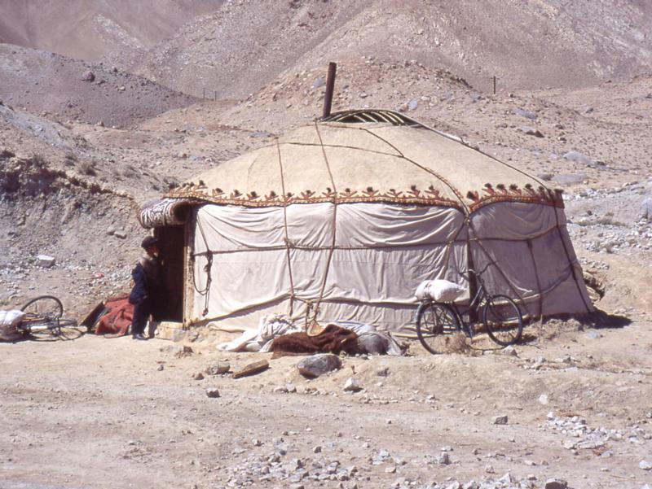
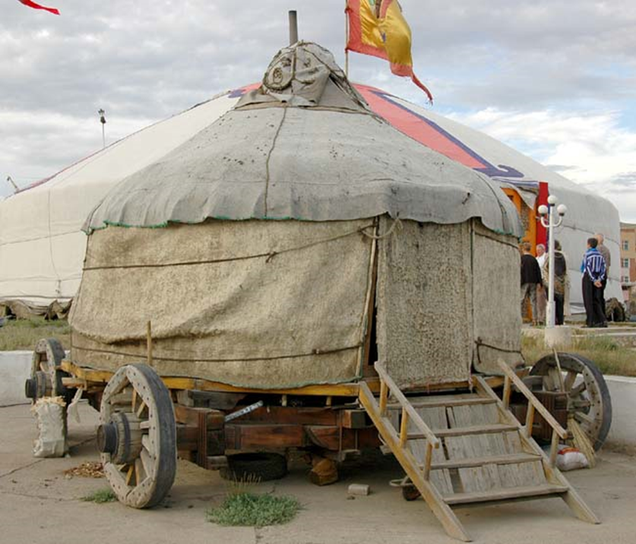
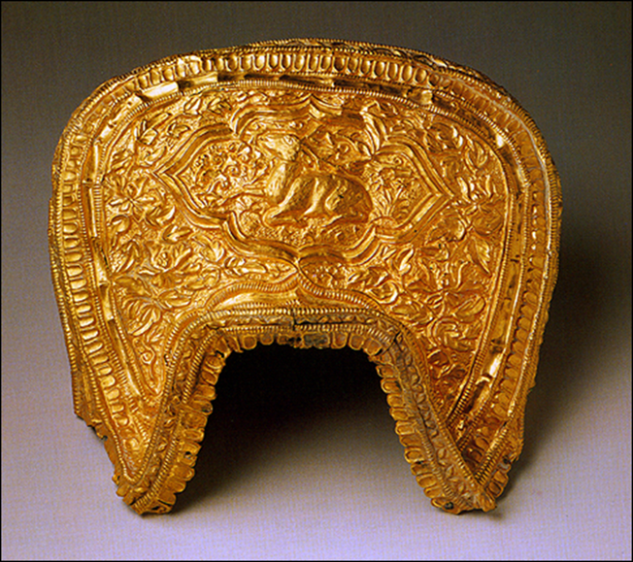
Dressed in sheepskins, made boots from tanned sheep hides, and lived in round felt tents made of wool sheared from animals.
Mongol boys and girls could ride as soon as they were able to walk
Mongol warriors could ride for days on end, sleeping and eating in the saddle

Slide 8
The Making of a Great Warrior: The Early Career of Chinggis Khan
4th-5th centuries - The Mongols had enjoyed brief periods of dominance
Early 12th century – Kabul Khan (Chinggis Khan’s great grandfather) defeated the Qin Kingdom army of North China
Kabul dies - His successors were weak; Mongols fell on hard times

Slide 9
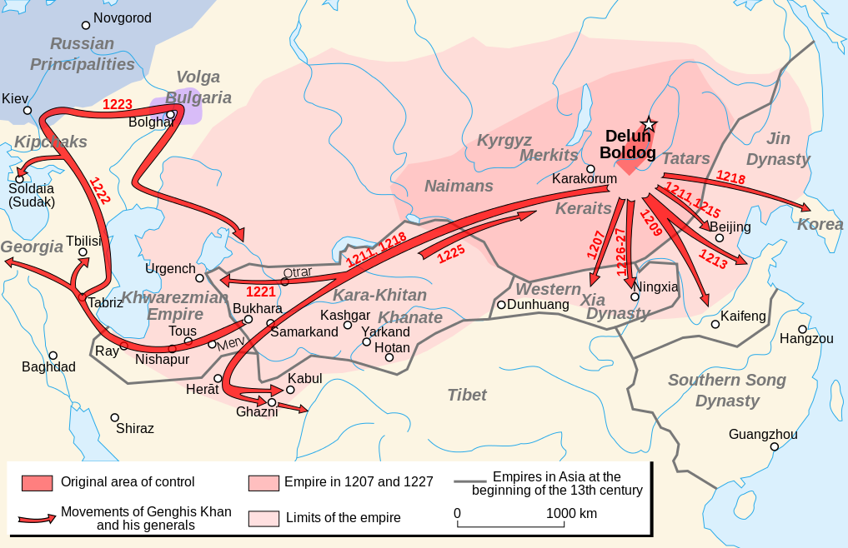
The Early Career of Chinggis Khan (cont.)
Chinggis Khan (born in the 1170s)
Father poisoned by rival nomadic group (Chinggis thrust into leadership position)
Attacked by a rival tribe; 1182 taken prisoner
Made a daring escape; allied with a more powerful clan, and avenged the insults
In 1206, the Mongol chieftains had a meeting (kuriltai) and elected Chinggis Khan khagan, or supreme
Under leadership of a strong leader, the Mongols prepared to launch a massive assault on an unsuspecting world.

Slide 10
Quotes…
“With Heaven's aid I have conquered for you a huge empire. But my life was too short to achieve the conquest of the world. That task is left for you”
“I am the punishment of God...If you had not committed great sins, God would not have sent a punishment like me upon you.”
“The greatest happiness is to scatter your enemy, to drive him before you, to see his cities reduced to ashes, to see those who love him shrouded in tears, and to gather into your bosom his wives and daughters.”

Slide 11
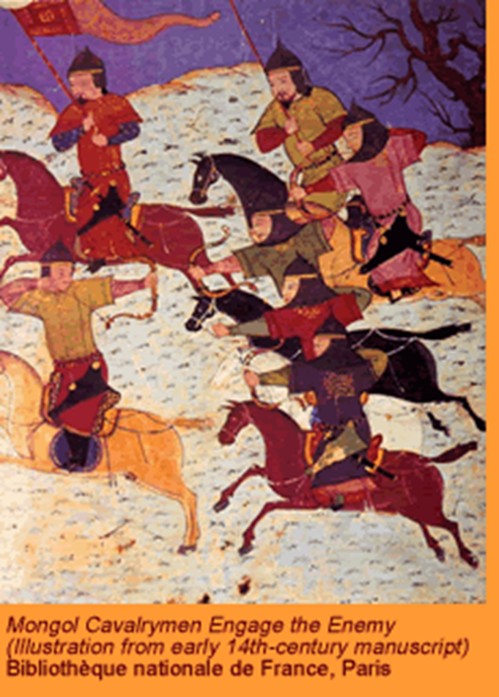
Building the Mongol War Machine
Mongols were trained from youth not only to ride, but to hunt
Physically tough, mobile, and accustomed to killing and death
Variety of weapons
Lances, hatchets, and iron maces
Mongol warriors were not only excellent horsemen but also accomplished archers
Could hit enemy soldiers as distant as 400 yards
Ride 80-90 miles per day
Ride standing up on stirrups

Slide 12
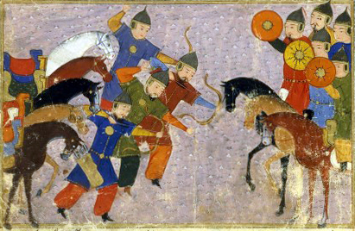
Military strategy
strike before enemies had prepared their defenses
hit unanticipated targets
retreat back to the steppes after suffering temporary loses (fake retreat)
suddenly reappear
Chingiss Khan and his many subordinate commanders brought organization, discipline, and unity of command.
Problems between clans were put aside
Focus on conquest and tribute

Slide 13
Reorganized the tribal armies into units called tumens with 10,000 men.
Divided further into 1000,100,10 warriors
Commanders at each level responsible for training, arming, and disciplining their cavalrymen
Separate messenger force
Carry urgent messages between the Khagan and commanders
Formal code
Severe discipline that mandated death for any soldier who left his unit in battle
Created some of the most accurate maps for the time to show location of areas to invade
New weapons
Variety of flaming and exploding arrows
Gunpowder projectiles
Bronze cannons
13th century – Mongol forces are the best armed, best trained, and most experienced, disciplined, and mobile soldiers in the world

Slide 14
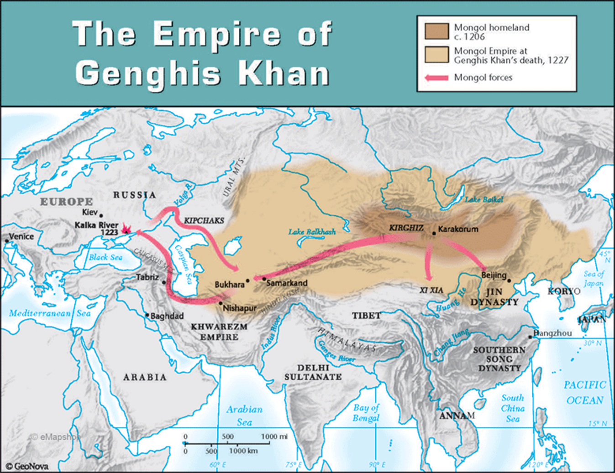
Conquest: The Mongol Empire under Chinggis Khan
Chinggis proclaimed Khagan in 1206 (not even 40 years old)
Supreme ruler of nearly one-half million Mongols
Overlord of 1 to 2 million nomads who had been defeated by his armies
Destiny- warriors born to conquer the known world.
Launched a massive series of assaults in 1207
He defeated the kingdom of Xi Xia in northern China, then attacked the Qin empire of the Jurchen

Slide 15
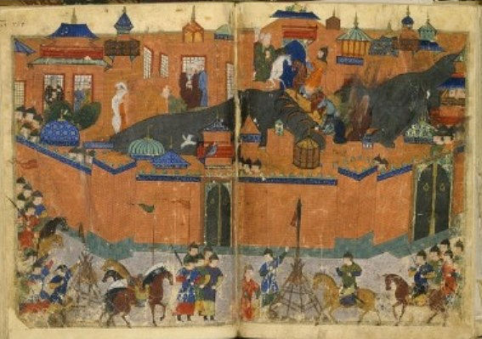
Mongols often spared the lives of famous scholars and artisans
Scholars – advisors
Artisans – useful skills
Towns that surrendered without a fight were usually spared, only required to pay tribute
Towns that fought back were usually sacked once they had been taken
Townspeople were slaughtered and sold into slavery; their homes, palaces, mosques, and temples were reduced to rubble

Slide 16
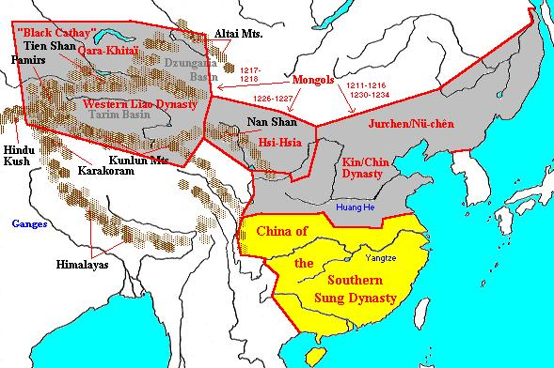
First Assault on the Islamic World: Conquest of China
Once Mongols established a foothold in north China and solidified their empire in the steppes, Mongol armies moved westward against the Kara-Khital Empire
Established by Mongolian speaking people
1219 – annexed by Mongols

Slide 17
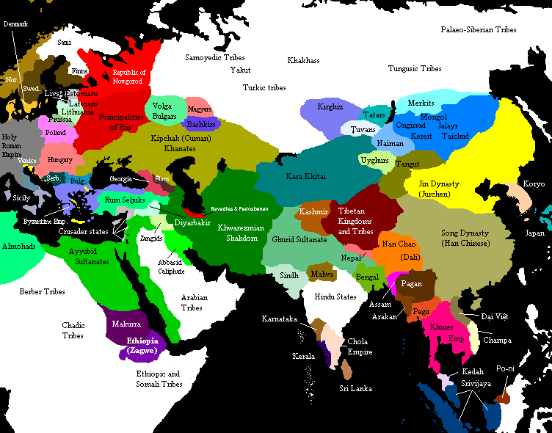
Chinggis Khan then dispatched envoys to demand the submission of Muhammad Shah II
Turkic ruler of the Khwarazm Empire to the west
One of Muhammad’s subordinates had some of Khan’s later envoys killed and sent the rest with shaved heads back to the khagan
Led to war
Khwarazm Empire would be overwhelmed
Great cities fall to new weapons
Armies defeated by Mongol cavalry

Slide 18
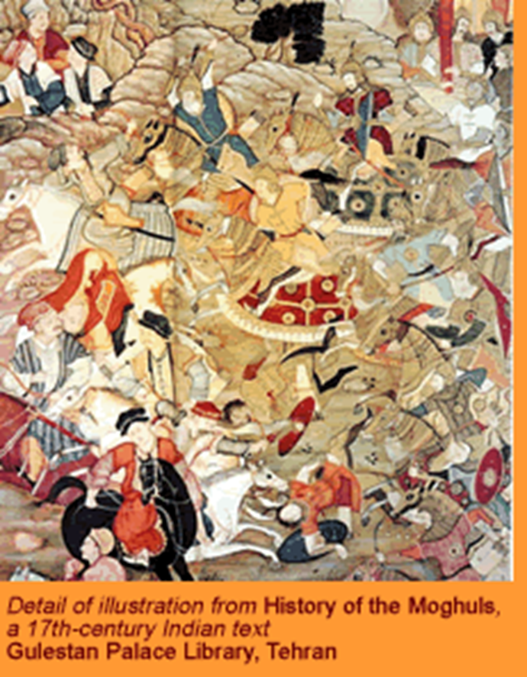
Within two years… Muhammad Shah II retreated across his empire
Chinggis Khan’s domains increase
Adds tens of thousands of Turkic horsemen into his armies
In the last years of Khan’s life...
Destroyed Xi-Xia Kingdom
Overran Qin Empire of North China
1227 – Khan dies, the Mongols ruled an empire that stretched from eastern Persia to North China Sea
BATTLE TACTIC (strategy)
1) Cavalry were sent to attack enemy
2) Cavalry retreated, drawing opposing forces out of formation
3) Main force of heavy cavalry attacks

Slide 19
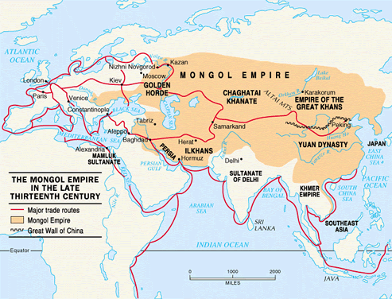
Growth of Mongol Empire
By 1227, the Mongol empire stretched from northern China to the shores of the Persian Gulf.

Slide 20
Life Under the Mongol Imperium
Mongol rule was generally tolerant
Chinggis Khan was committed to building a world where the diverse peoples of his empire could live together in peace
Offered religious toleration to Confucians, Buddhists, Daoists, and Muslims
Chinggis Khan followed shamanistic (focused on nature spirits) beliefs of his ancestors
Once the conquered peoples had been subdued, Khan took interest in their arts and learning

Slide 21
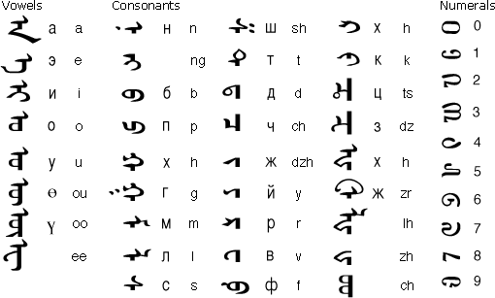
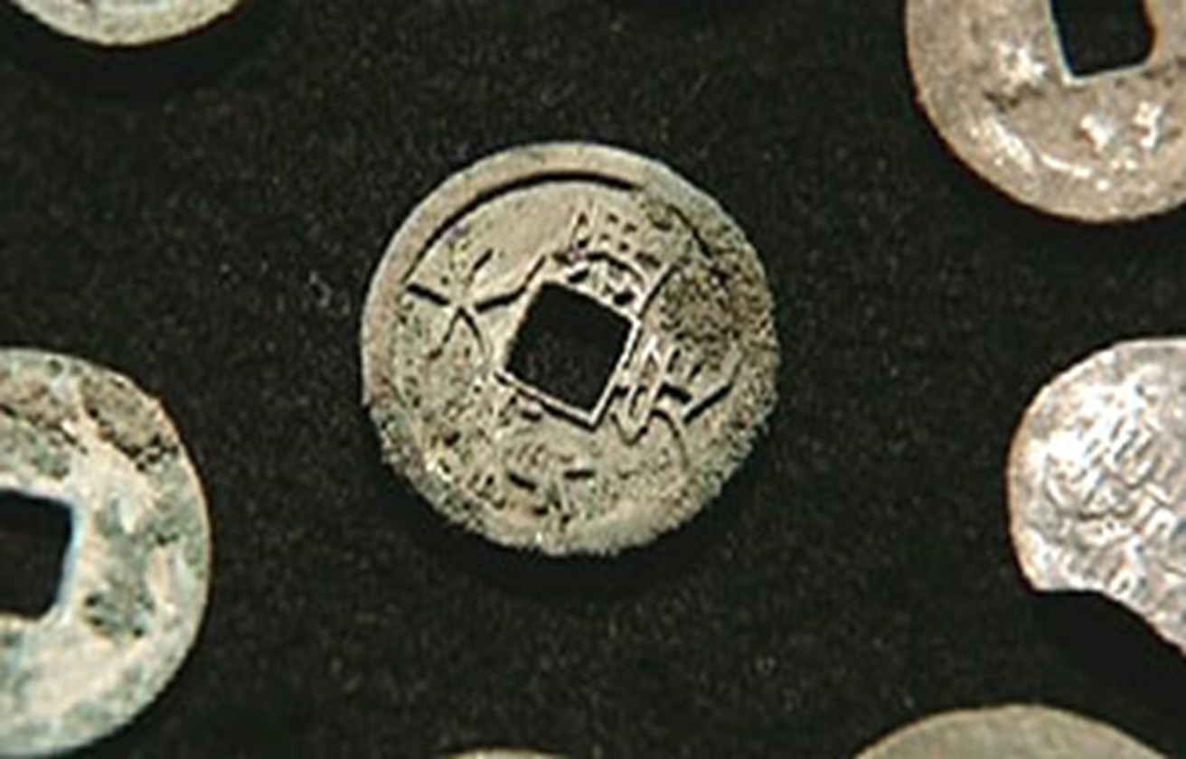
Chinggis Khan formulated a legal code
Intended to end tribal and clan divisions among the Mongols
Legal code enforced by special police force
A script was devised for the Mongolian language
Facilitate recordkeeping and standardization of laws
Under the Mongols- peace, trade and cultural exchange flourished
Handicraft production and scholarship flourished
Artistic creativity was allowed free expression
Trade routes were secured
Wealthy, cosmopolitan cities
They “enjoyed such a peace that a man might have journeyed from the land of sunrise to the land of sunset with a golden platter upon his head without suffering the least violence from anyone.”

Slide 22
The MONGOLS Build Their Empire
Genghis Khan’s Tax Laws:
If you do not pay homage, we will take your prosperity.
If you do not have prosperity, we will take your children.
If you do not have children, we will take your wife.
If you do not have a wife, we will take your head.
Used cruelty as a weapon --> some areas never recovered from Mongol destruction!

Slide 23
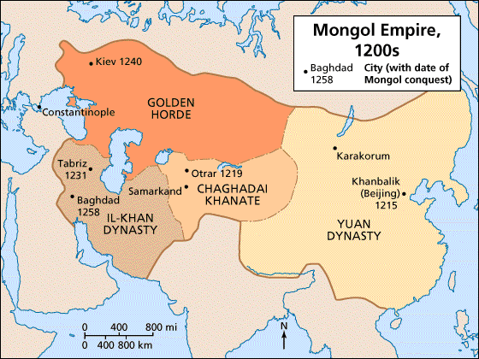
The Death of Chinggis Khan and the Division of the Empire
In 1226, Chinggis Khan turned once again to the rebellious kingdom of Xi-Xia.
After victory Chinggis Khan died and his body was carried to a secret place in the steppes for burial.
Chinggis Khan's three sons and a grandson (Batu) divided the Mongol empire among themselves
Kuriltai was held at Karakorum (Mongol capital) to select successor to Chinggis Khan
Ogedei (3rd son) was elected grand khan

Slide 24
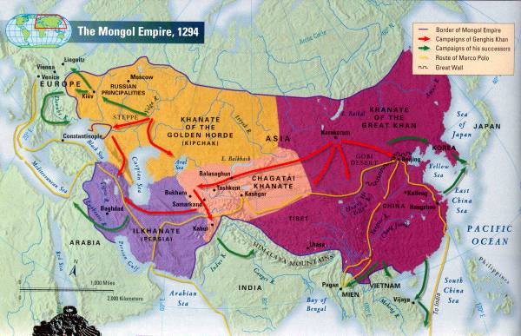
Ogedei was not a very capable military leader, but a crafty diplomat and skillful manipulator
For nearly a decade, Ogedei directed Mongol energies into further campaigns and conquests
Russia and Eastern Europe, Islamic heartlands, and China

Slide 25
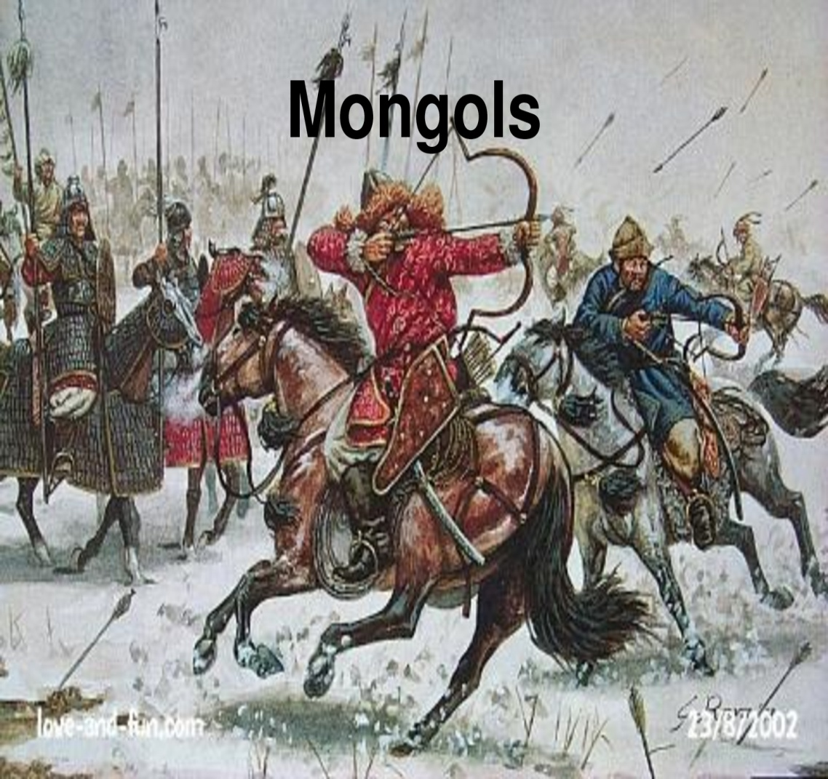
Mongol Drive to the West
Mongol assault on Russia was a side campaign
A chance to prepare for the real prize… Europe
1200s – Kiev had been in decline, and were not ready for the Mongols
Dominated much of Central Russia
Russian princes would not unite and were defeated individually

Slide 26
1236 – Batu (Chinggis Khan’s grandson) led a Mongol force of more than 120,000 cavalrymen into Russian heartlands
1237 to 1238 (and later in 1240) – Tartars (people from hell as the Russians called them) carried out successful winter invasions in Russia
Mongols preferred fighting in winter
Good footing for horses
Frozen lakes
Ryazan, Moscow, Vladimir, and Kiev were destroyed; cities looted; inhabitants slaughtered or led into slavery
Mongols ready for main event… western Europe

Slide 27
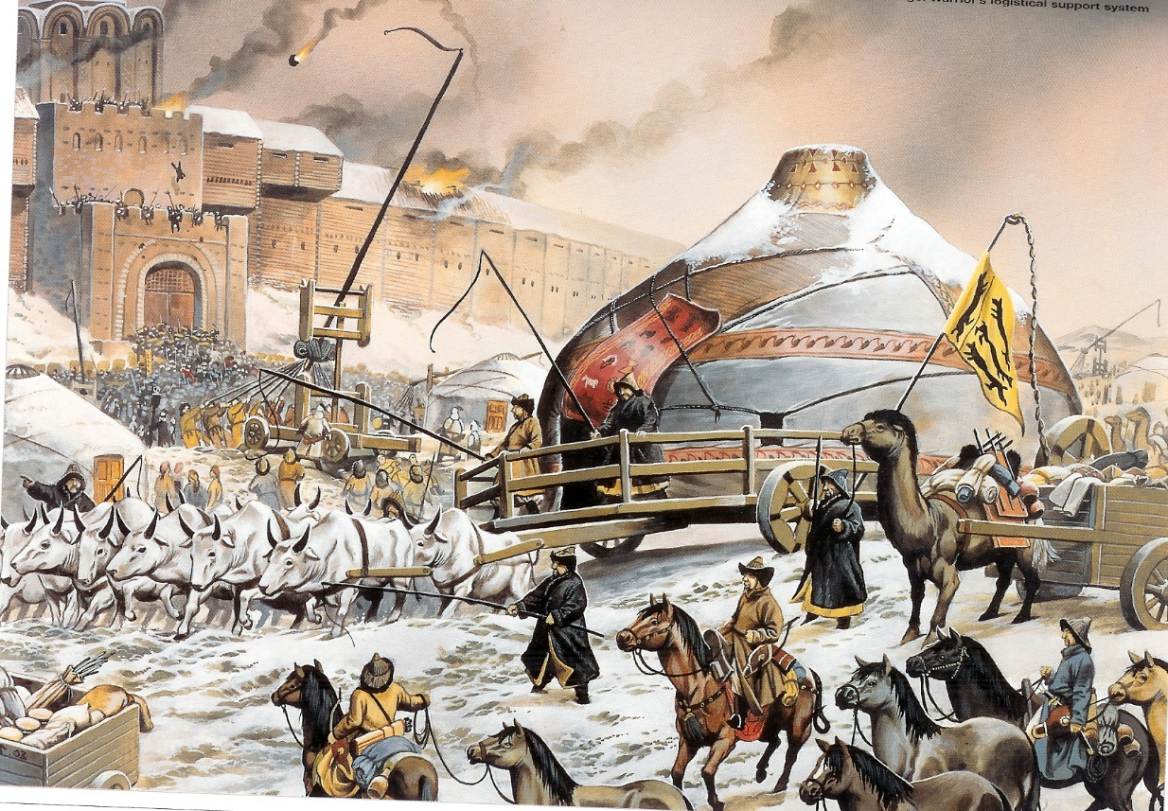
Russia in Bondage
Crushing victories of Batu’s armies initiated two and half centuries of Mongol dominance in Russia
Khan of Golden Horde
Russian princes for to pay tribute
Peasants reduced to serfdom
Give up crops and labor to both their own princes and Mongol overlords
In 1380, Russian forces defeated the Mongols at the battle of Kulikova.
Ensured the central position of Moscow and the Orthodox Church
Led to changes in Russian military organization

Slide 28
Mongol Incursions and the Retreat from Europe
The first Christian reaction to Mongol invasions was positive
Many in western Europe thought Mongol Khan was Prester John (mythical rich and powerful Christian monarch)
Potential ally against the Muslims
The successful conquest of Russia alerted Europe to the potential danger of Mongol assault
Russia – Orthodox Christian
Rulers of Europe were still slow to realize true threat Mongols posed to western Christendom
Just as it appeared the Mongols were going to conquer western Europe, Khagan Ogedei dies,
Force Batu to withdraw in preparation for struggle for succession (campaign never resumed)

Slide 29
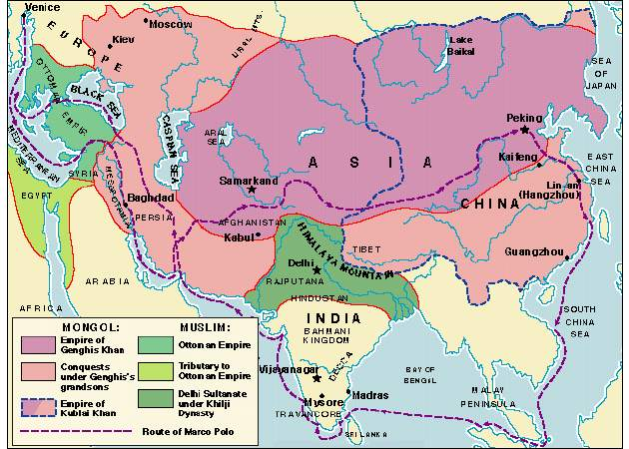
The Mongol Assault on the Islamic Heartlands
After fall of Khwarazm Empire… Mongols move westward to far wealthier Muslim Empires
The conquest of the Muslim heartlands of the Middle East fell to another grandson of Chinggis Khan (Hulegu)
1258 - the Mongols captured and destroyed Baghdad
killed the last of the Abbasid caliphs
800,000 people killed
Ended the Abbasid dynasty that ruled core regions of Islamic world since mid-8th century

Slide 30
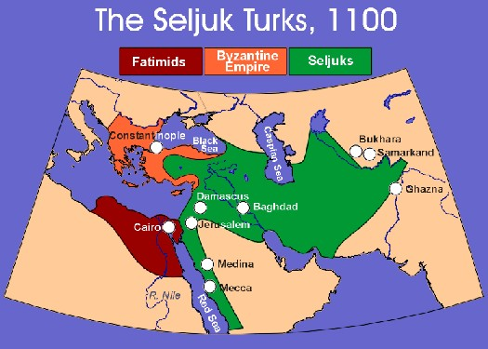
1243 – Mongol victory over Seljuk Turks
Opening Asia Minor, today’s Turkey, to be conquered by a different Turkic people, the Ottomans
Next great power in the Islamic heartlands
The Mongol invasion and the consequent destruction of many cities destroyed the focal points of Islamic culture.
Left faithful without a central authority
Crippled Muslim military

Slide 31
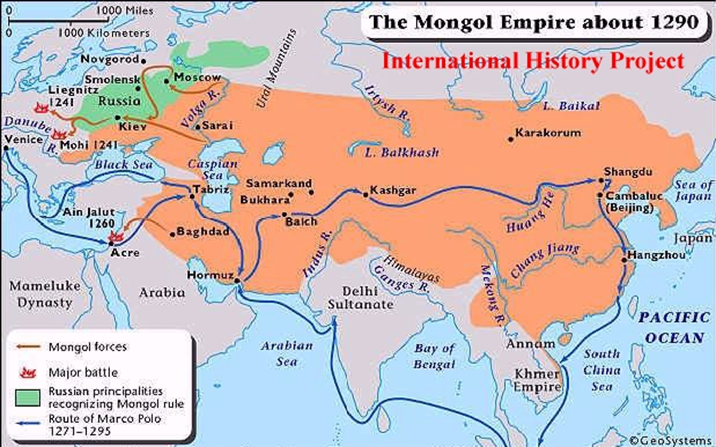
1260 – Mongols were finally defeated by armies of the Mamluk
dynasty in Egypt
Commanders were former Mongol slaves sold in Egypt
Muslims dynasty worked with Christians to defeat the Mongols
Christians had feared that a Mongol victory would leave them the next target of attack

Slide 32
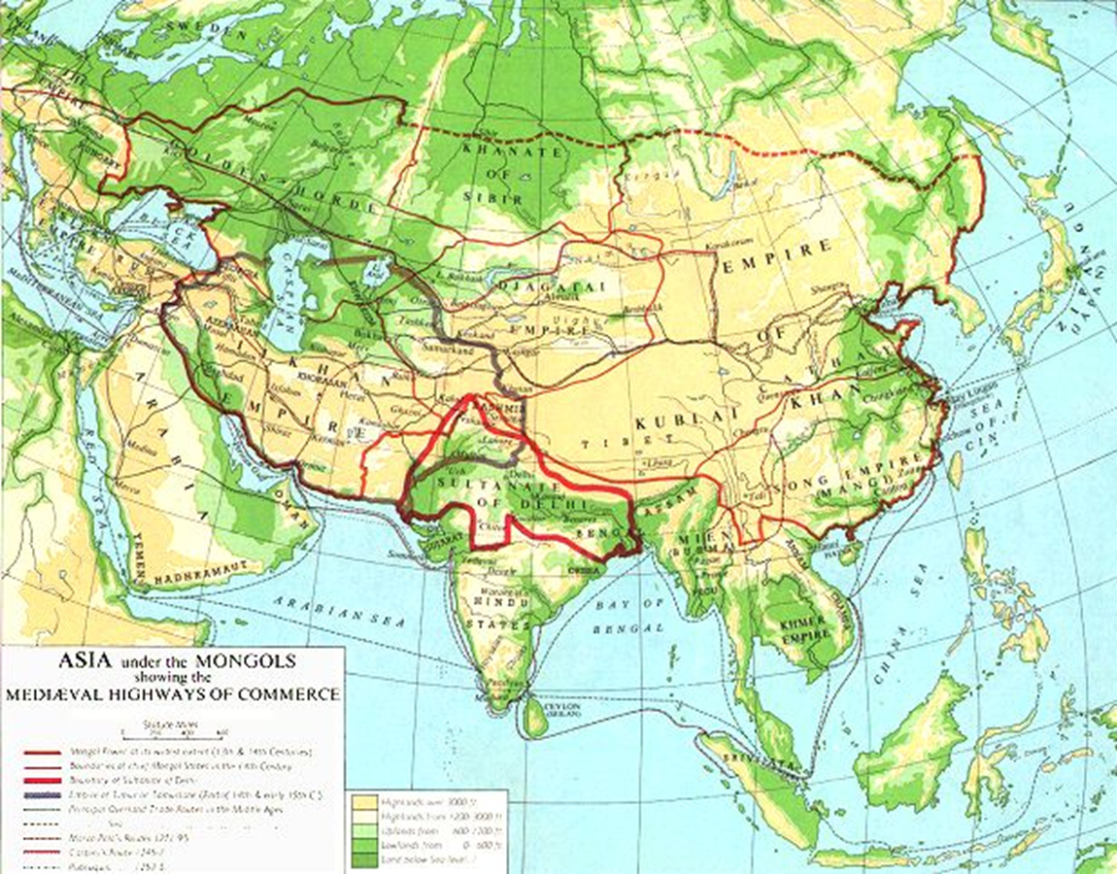
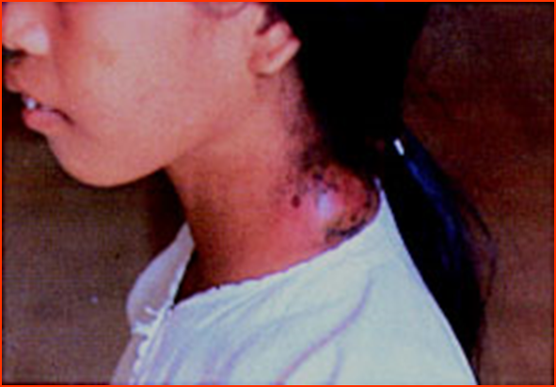
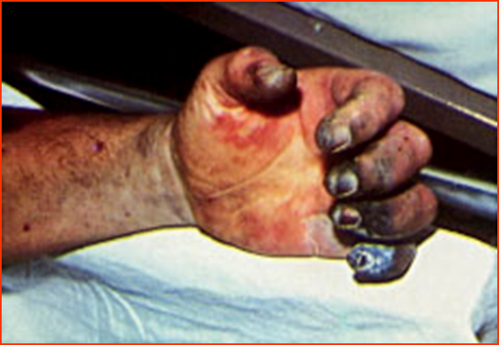
Mongol IMPACT on Europe and the Islamic World
New ways of making war
Impressed Turkic and European enemies
The Mongol invasions caused Europeans to alter their military organization and to adopt the use of gunpowder
Mongol conquests facilitated trade across the Asiatic steppes between Europe and Asia.
Exchange of foods, tools, and ideas on an unprecedented scale
Brought great wealth to traders
The Mongol armies may also have transmitted the plague infection from Asia to European populations.

Slide 33
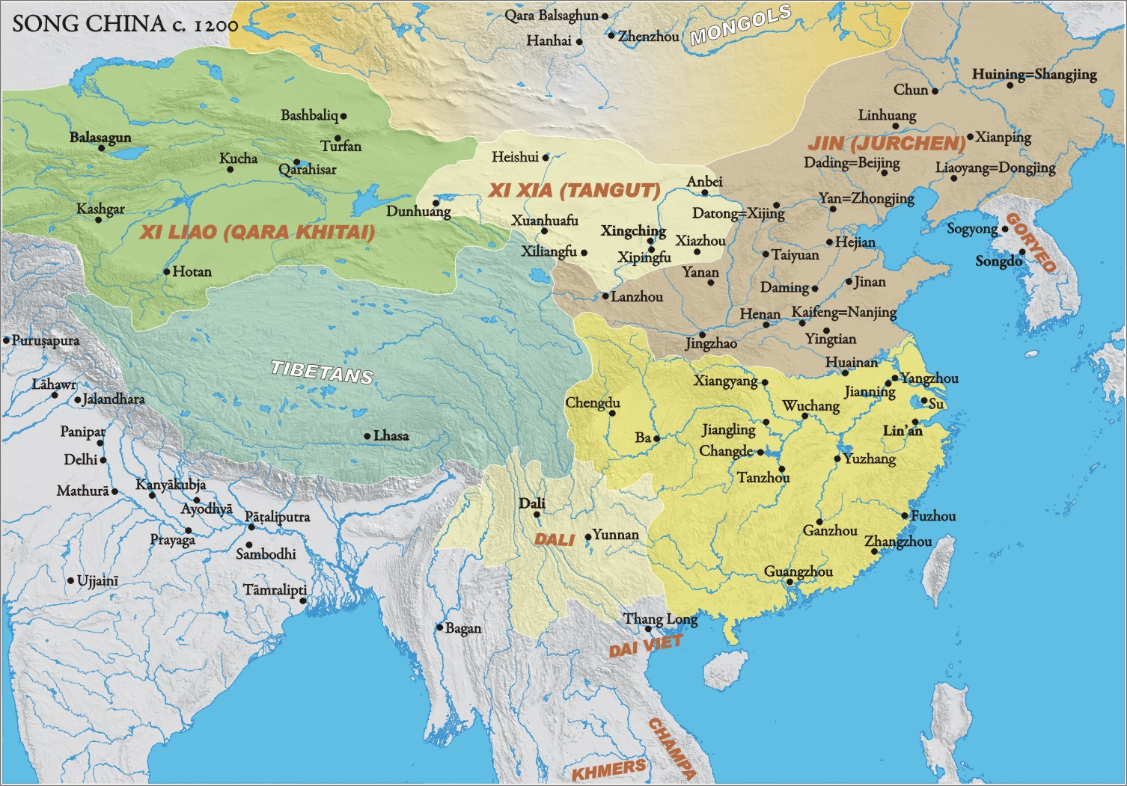
Mongol Interlude in Chinese History
Ogedei elected Khan – Mongol advance into China resumed
Having conquered Xi-Xia and Qin empires, the Mongol commanders turned to what remained of Song empire in south China
Forces directed by Kubilia Khan (grandson of Chinggis Khan)
Toughest areas for Mongols to conquer

Slide 34
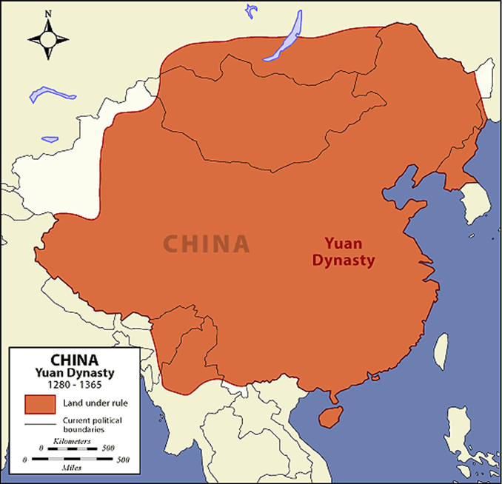
1260- Kubilai assumed title of great Khan
Ruled most China
1271 – 1368 : Reign of the Yuan (Mongol) dynasty in China
Kubilai passed many laws to preserve the distinction between Mongol and Chinese
Forbade Chinese scholars to learn Mongol script
Mongols forbidden to marry ethnic Chinese
Friendships between groups discouraged
Mongol religious ceremonies and customs retained

Slide 35
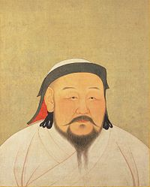
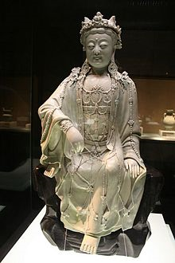
Kubilai Khan had long been fascinated by Chinese civilizations
Surrounded himself with Chinese advisors, some Buddhist, others Daoist or Confucian
Rejected pleas of his Confucian advisors to reestablish civil service exams (which had been discontinued by Qin rulers)
Right: Buddhist statue during Yuan dynasty

Slide 36
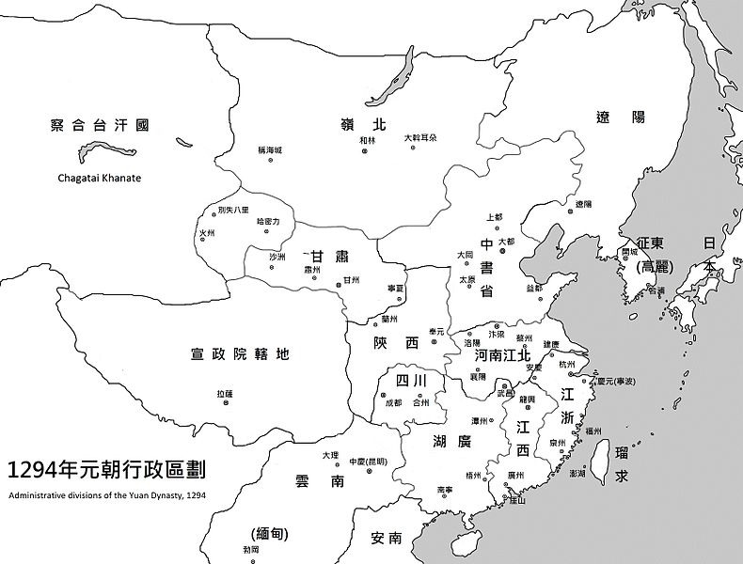
During Yuan era, new social structure was established in China
1) Mongols
2) Asian nomadic and Muslim allies
* Occupied most offices at the highest levels of bureaucracy
3) north Chinese
4) ethnic Chinese and minority peoples of south
* Ethnic Chinese from both north and south ran Yuan bureaucracy at regional and local levels

Slide 37
Gender Roles and the Convergence of Mongol and Chinese Cultures
Mongol women refused to:
recognize the reduced status
adopt the practice of foot-binding
Mongol women retained their rights to property and control within the household as well as the freedom to move about the town and countryside
Chabi, the wife of Kubilai Khan advised her husband in many diplomatic and political matters
Ultimately, living in China eroded the power and freedom of Mongol women
Neo-Confucianism gained ground under Kubilai’s successors

Slide 38
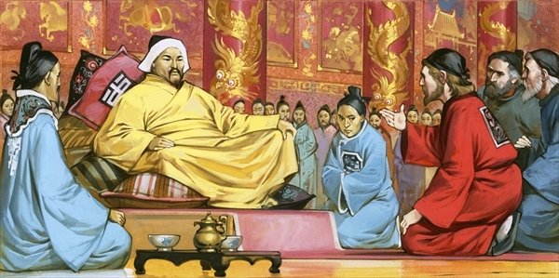
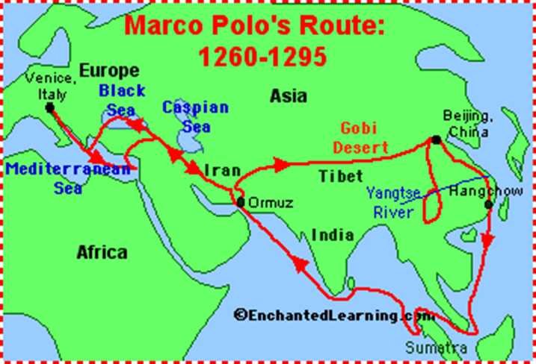
Mongol Tolerance and Foreign Cultural Influences
Muslims and Islamic culture were particularly prominent in the Mongol court in China.
Muslims included in second highest social group
Part of Kubilai’s administrators and advisors
Ran hospitals
As elsewhere, the Mongol overlords of China preserved religious toleration and admitted Orthodox and western Christians, Buddhists and Daoists within their kingdom
It was during the reign of Kubilai Khan that Marco Polo made his journey to China.
From Venice (northern Italy)
13th century
His descriptions of palaces, cities, and wealth of Kubilai’s empire enhanced interest in Asia and helped to inspire efforts by navigators such as Columbus to find a water route to China

Slide 39
Social Policies and Scholar-Gentry Resistance
Chinese made up the vast majority of subjects in Yuan dynasty
Chinese scholar-gentry continued to regard the Yuan as barbarians
Kubilai refused to reinstate the exam, preventing Confucian scholars from dominating government
The Mongol custom of elevating foreigners over Chinese within the central administration made things worse
The Mongols also elevated the social status of artisans and merchants
Remember… Confucian thinkers view merchants as parasites
Only attempts to improve the social and economic condition of the Chinese peasantry did the scholar-gentry approve
Forbade Mongol cavalrymen from turning croplands into pasture
Restored granary system for famine relief
Reduced peasant tax and forced labor burdens
Elementary education in villages

Slide 40
The Fall of the House of Yuan
Eventually the Chinese began to raise rebellions against the Mongol conquerors
Song loyalists raised revolts in the south
Hostility towards Mongols expressed more openly
Nine Decades in China softened the Mongols
Kubilai’s successors lacked his capacity for leadership and ignored day-to-day administrative tasks
Muslim and Chinese functionaries to whom Mongols entrusted the imperial finances enriched themselves (corruption)
Angered hard-pressed peasantry, who bore the burden of rising taxes and demands for forced labor
1350s – dynasty on decline
Banditry and piracy widespread
Government forces weak
Famine
Local uprisings
Mongols start to flee China!

Slide 41
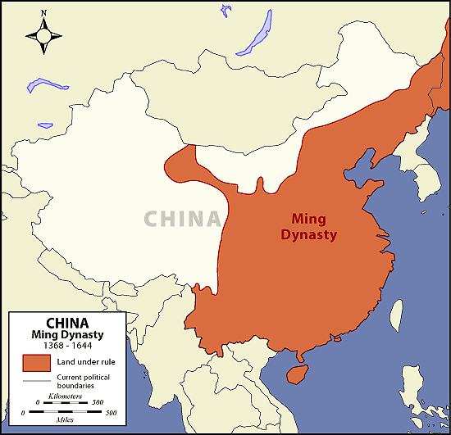
Ultimately… a man from a poor peasant family, Ju Yuanzhang, emerged to found the Ming Dynasty, which ruled China for most of the next three centuries

