Slide 1
CH 9 CIVILIZATION IN EASTERN EUROPE
BYZANTIUM AND
ORTHODOX EUROPE

Slide 2
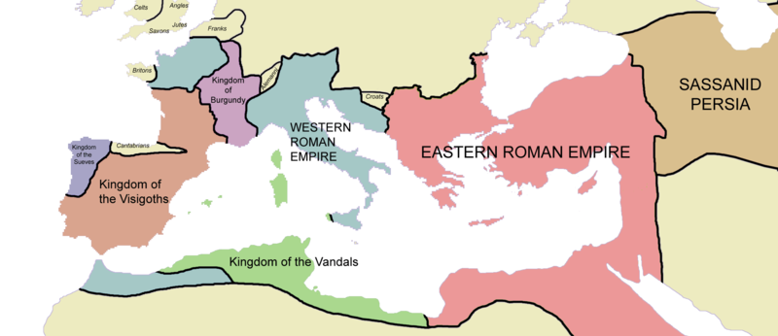
500-1450 C.E. – Byzantine Empire maintains high levels of political, economic, and cultural life
Controlled fluctuating territory in the Balkans, Middle East, and Eastern Mediterranean
Leaders saw themselves as Roman emperors; government in many ways a direct continuation of eastern portion of late Roman Empire

Slide 3
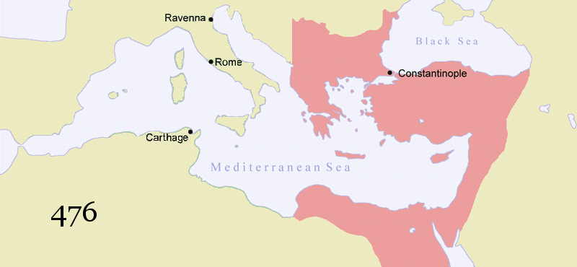
Byzantine Empire lasts for almost a thousands years – from Rome’s collapse in the West to final overthrow of regime by Turkish invaders
Constantinople (capital) – most important city in this time period
Orthodox Christian churches dominate most of Eastern Europe
Major impact on Russia (culturally and politically)
http://upload.wikimedia.org/wikipedia/commons/b/b2/Byzantine_Empire_animated2.gif

Slide 4
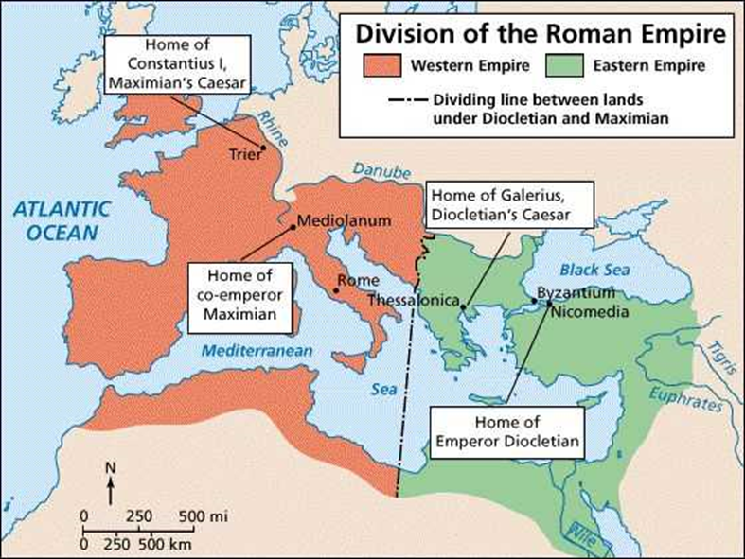
Origins of the Empire
Byzantine Empire began in the 4th century when Romans set up their eastern capital in Constantinople
Emperor Constantine constructed many elegant buildings, including Christian churches
Separate Eastern emperors ruled from the new metropolis, even before western Rome fell to Germanic invaders
Latin was the court language of eastern empire, Greek was the common language
6th century – Emperor Justinian declares Greek the official language; Latin became an inferior, barbaric means of communication

Slide 5
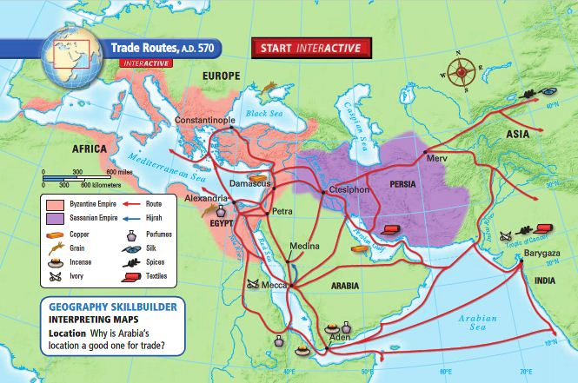
Commerce flourished in Constantinople
Merchant classes declined as state control of trade increased

Slide 6
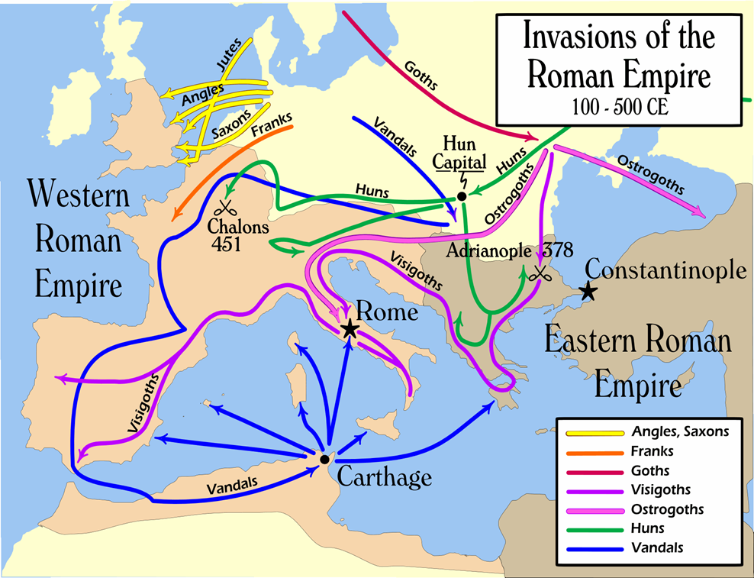
The Byzantine Empire faced many foreign enemies
Pressure less severe than that provided by the Germanic tribes in the west
Recruited armies in the Middle East, not by relying on barbarian troops

Slide 7
JUSTINIAN AND THEODORA

Slide 8
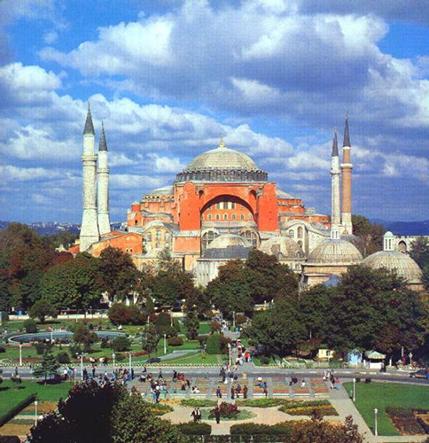
Justinian’s Achievements
Emperor Justinian
Tried to reconquer western territory in an effort to restore Roman Empire
High taxes weakened the East
Rebuilt Constantinople
Ravaged by earlier riots against high taxes
Code of Justinian
Reduced confusion, organized empire
Hagia Sophia
Achievement in engineering/architecture

Slide 9
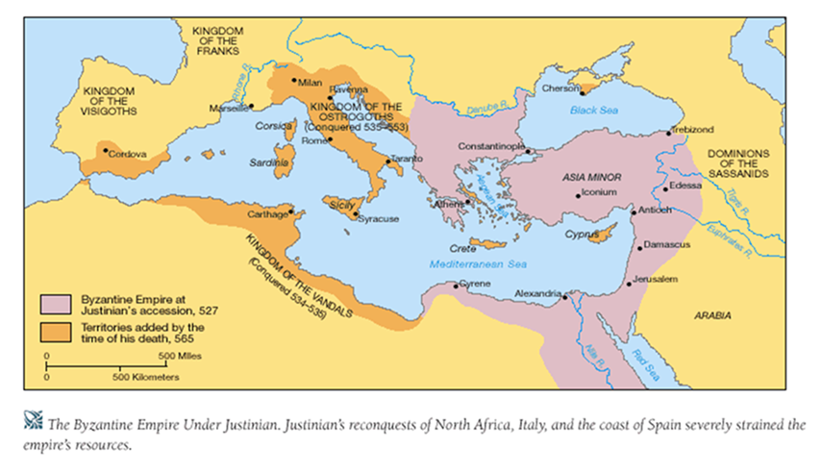

Slide 10
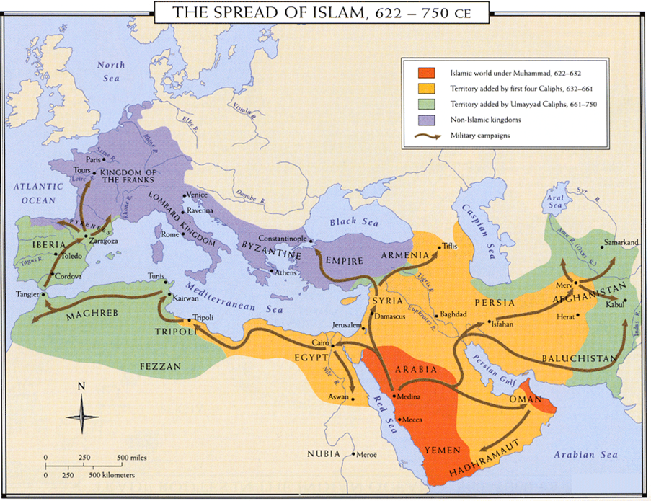
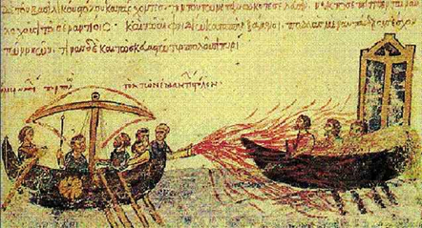
Arab Pressure and the Empire’s Defenses
Justinian’s successors began to concentrate on defending the eastern empire itself
Persian successes in the northern Middle East were reversed
Population forcibly reconverted to Christianity
7th century – Arab Muslims challenge Byzantine naval supremacy in eastern Mediterranean while repeatedly attacking Constantinople
Greek fire (a petroleum, quicklime, and sulfur mixture) devastated Arab ships
Wars with Muslims added new economic burdens
Weakened position of small farmers

Slide 11
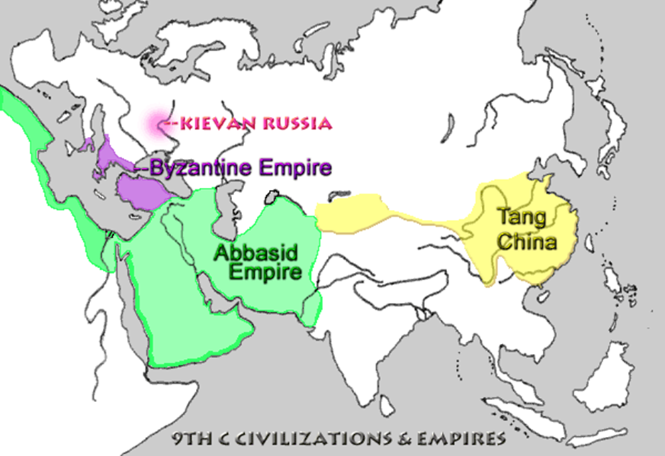
BYZANTINE Religion, Society, and Politics
Emperor – head of church and state
Emperor appointed church bishops and passed religious and secular laws
Large bureaucracy
Trained in Greek classics, philosophy, and science
Recruited from all social classes
Highly centralized government
Bureaucracy > military

Slide 12
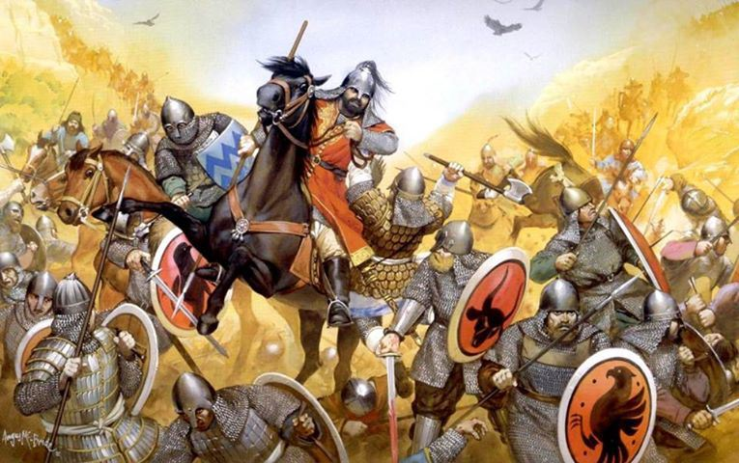
Byzantine military
Adapted the later Roman system by recruiting troops locally and rewarding them with grants of land in return for military service
Sons inherited land in return for continued military responsibility
Many outsiders recruited
Slavs and Armenian Christians

Slide 13
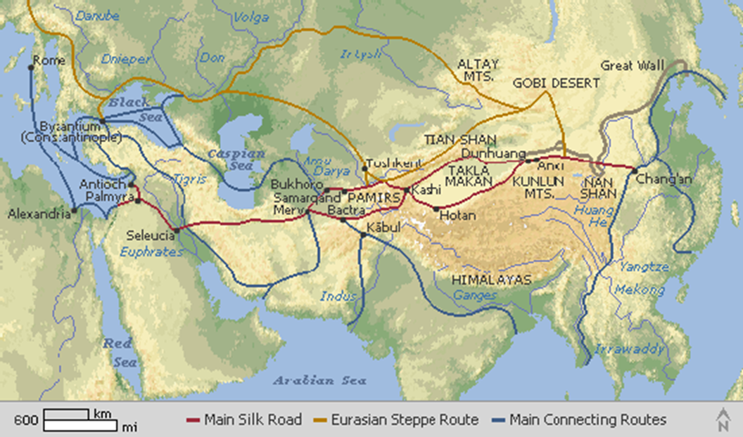
Socially and economically, the empire depended on Constantinople’s control over the countryside, with the bureaucracy regulating trade and controlling food prices
Large peasant class
Supply goods and provide bulk of taxes
Food prices kept artificially low by government

Slide 14
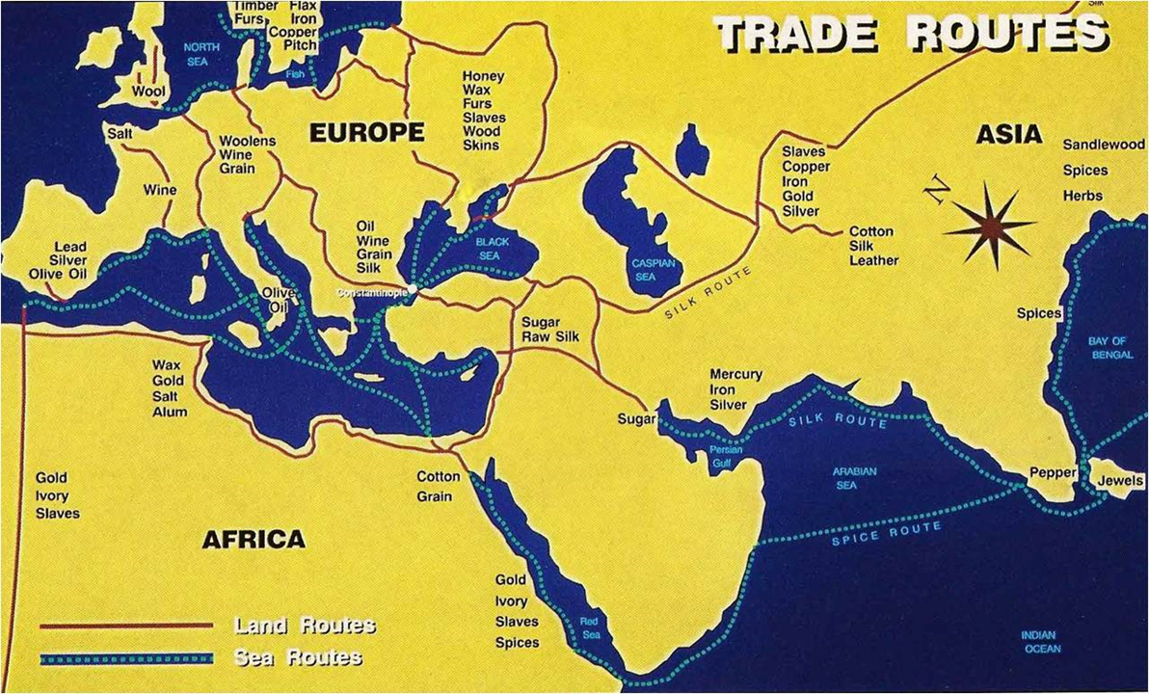
Byzantine Empire trading network
East – Asia; North – Russia and Scandinavia
Silk production expanded
Luxury products, including cloth, carpets, and spices, were sent north
Favorable tradition position with less sophisticated lands
Only China produced luxury goods of comparable quality
Traded actively with India, the Arabs, and east Asia
Received simpler products from western Europe and Africa
Large merchant class never gained significant political power
Government control of trade

Slide 15
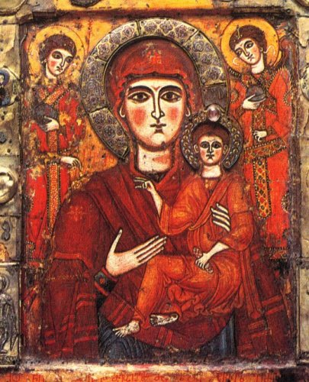
Byzantine cultural life
Education of bureaucrats
Evolving traditions of Eastern (Orthodox) Christianity
Adaption of Roman domed buildings
Elaboration of powerful and richly colored religious mosaics
Tradition of icon painting
Paintings of saints and other religious figures

Slide 16
THE GREAT SPLIT- EAST/WEST
BEFORE THIS THERE HAD BEEN ONLY ONE DOMINANT CHRISTIAN CHURCH
AS THE EMPIRE GREW APART SO DID CHRISTIANITY

Slide 17
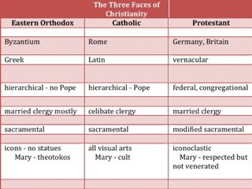
TWO GROUPS- CATHOLICS AND THE ORTHODOX CHURCH
SEVERAL ISSUES DIVIDED THEM:
THE SUPREMACY OF THE POPE IN ROME
Use of local languages in church
Catholics – only Latin
Orthodox – vernacular languages
DIFFERING RITUALS USED IN WORSHIP SERVICES
Kind of bread to use for the celebration of Christ’s last supper
THE USE OF RELIGIOUS ICONS
CHARLEMAGNE BEING CROWNED “ROMAN EMPEROR”
Celibacy for its priests
West – no ; East - yes
1054 - FINALLY THE POPE EXCOMMUNICATED THE EASTERN CHURCH
Patriarch response – excommunicate all Roman Catholics

Slide 18
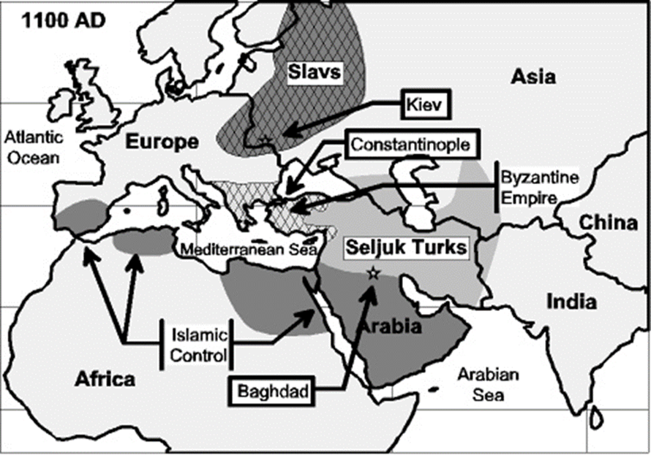
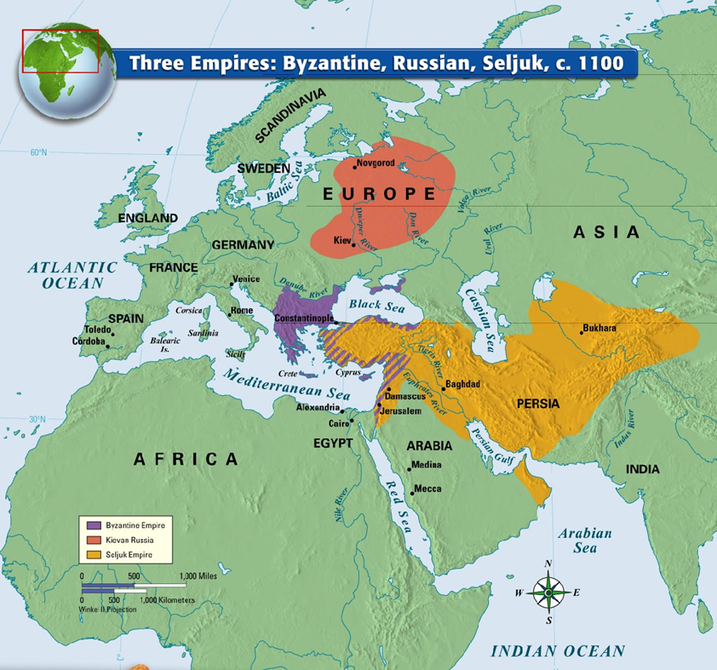
THE DECLINE OF THE BYZANTINE EMPIRE
AFTER THE SPLIT THE EMPIRE WENT INTO A LONG SLIDE
MORE INVASIONS - THE SELJUK TURKS
11TH CENTURY – SELJUKS SEIZED ALMOST ALL THE ASIATIC PROVINCES OF EMPIRE (CUTS OFF TAX REVENUE AND FOOD SUPPLY)
1071- BYZANTINE EMPEROR LOST BATTLE OF MANZIKERT (STAGGERS ON FOR FOUR MORE CENTURIES)
THIS LED TO THE CALL FOR HELP THAT BECAME THE CRUSADES

Slide 19
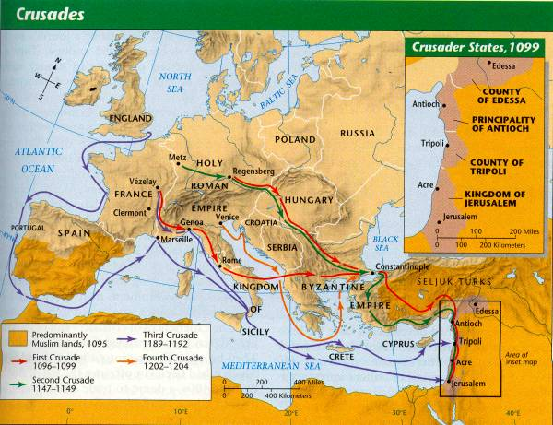
THE CRUSADES
THERE WERE MANY, MANY CRUSADES
FIRST WAS THE MOST SUCCESSFUL
THE GOAL WAS TO LIBERATE THE HOLY LAND

Slide 20
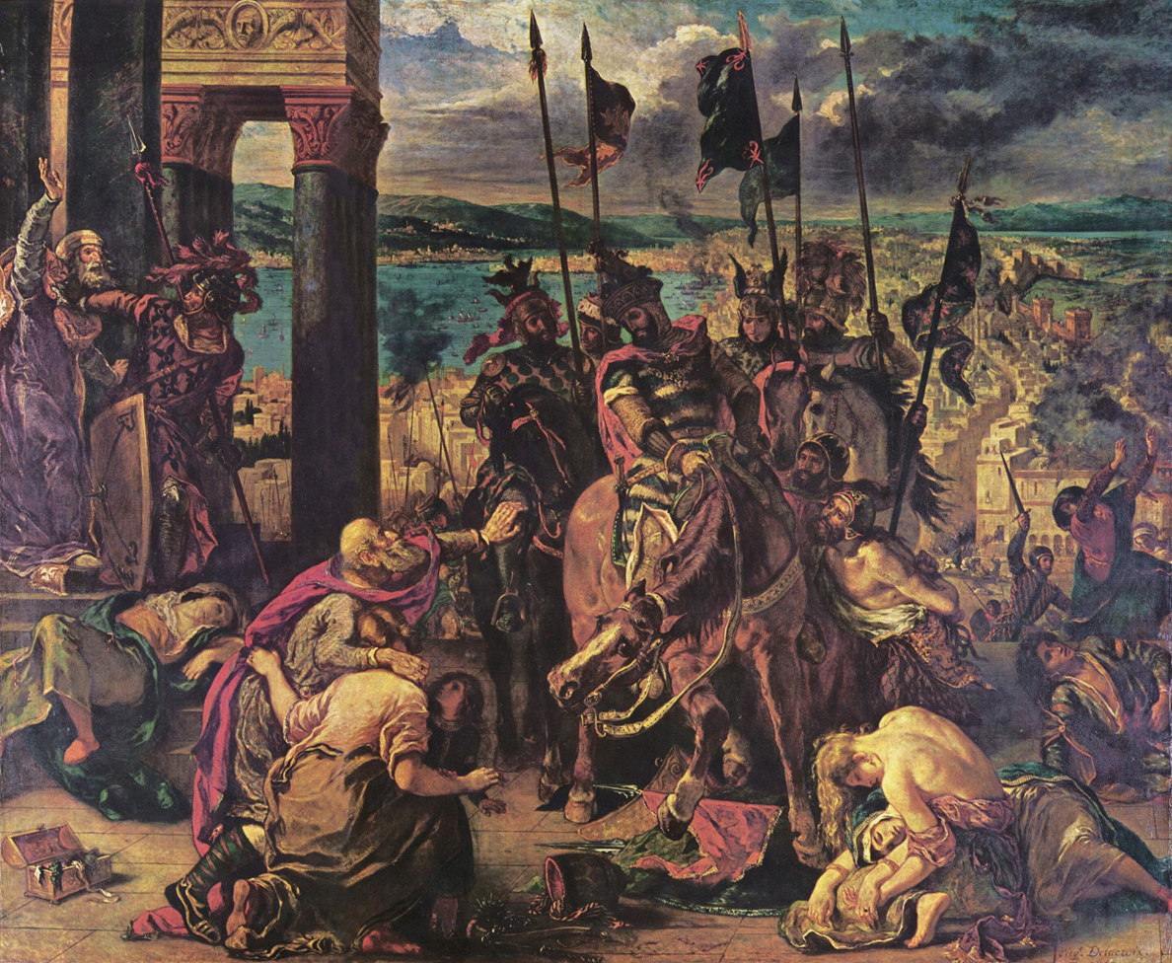
CRUSADERS ARE SUPPOSED TO DEFEND CHRISTIANITY, RETAKE THE HOLY LAND
4TH CRUSADE STOPS IN CONSTANINOPLE- WRECKS THE CITY, NEVER GETS ANY FARTHER

Slide 21
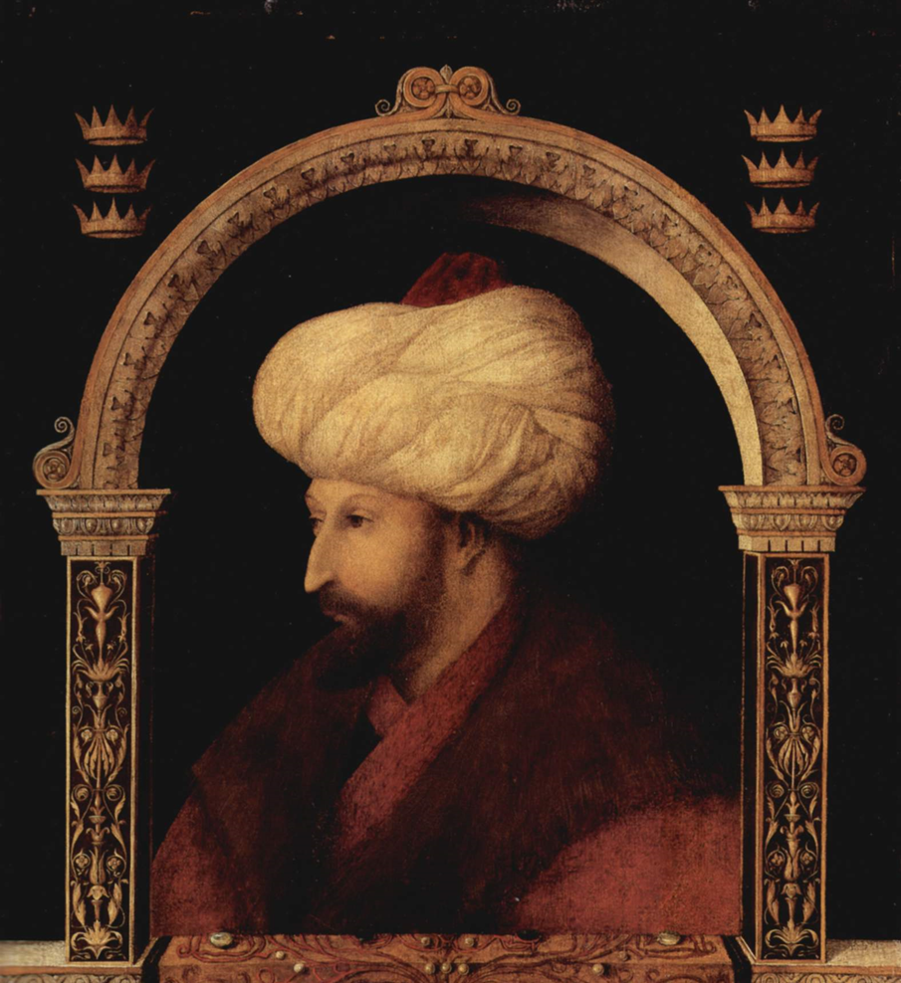
THE FINAL FALL
1453 MEHMED II (TURKISH SULTAN) BRINGS A POWERFUL ARMY, EQUIPPPED WITH ARTILLERY CAPTURES CONSTANTINOPLE
BY 1461 THE EMPIRE IS UNDER MUSLIM CONTROL FOR GOOD (TURKS)

Slide 22
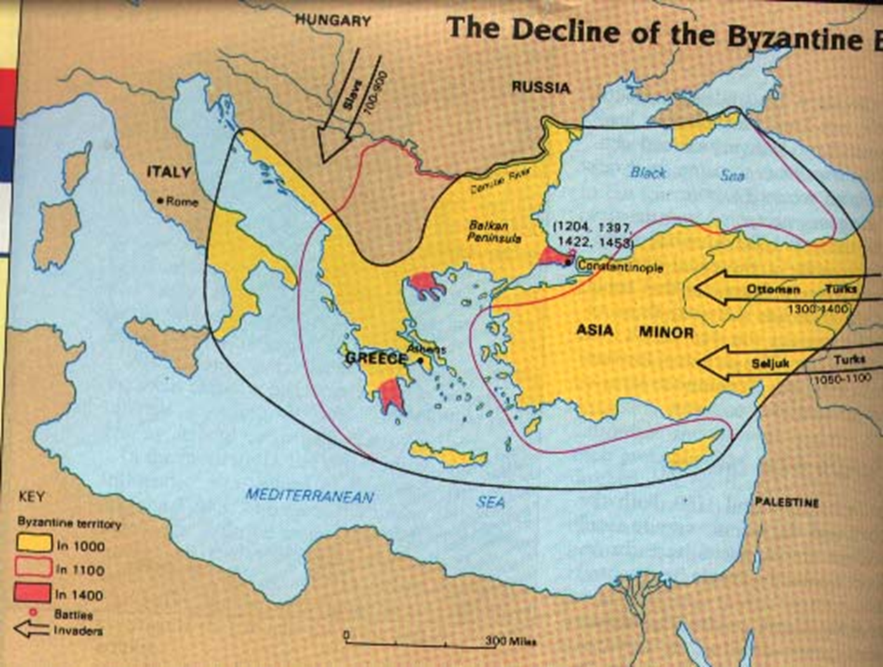
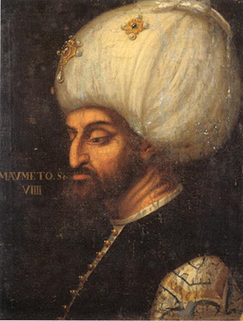
THE FALL OF THE BYZANTINE EMPIRE ENDED CHRISTIAN DOMINANCE IN THE AREA
THEY HAD MAINTAINED TRADE NETWORKS, AND CLASSICAL MEDITERRANEAN LEARNING
NOW THE OTTOMANS WOULD BE SUPREME IN THE AREA

Slide 24
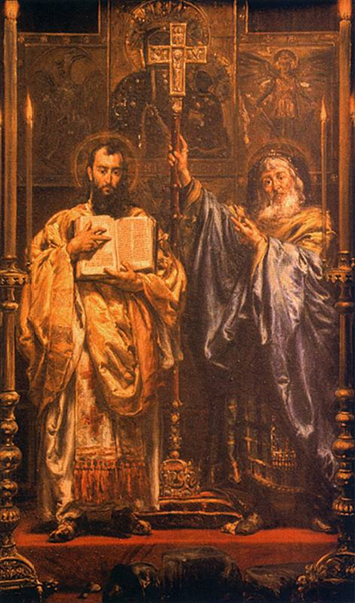
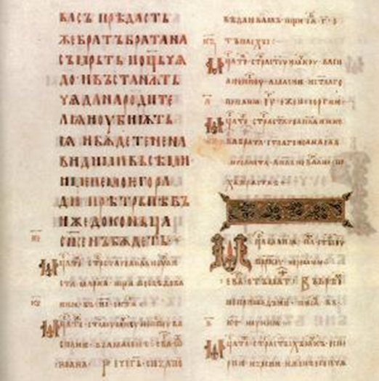
The Spread of Civilization and Christianity in Eastern Europe
11th century – Byzantine empire had been the source of a new northward surge of Christianity
Converted most people in the Balkans to Orthodox Christianity
Cyril and Methodius spread Orthodox Christianity to Russia
Developed Slavic alphabet – Cyrillic
Derived from Greek letters
Possibility of literature and some literacy in Eastern Europe

Slide 25
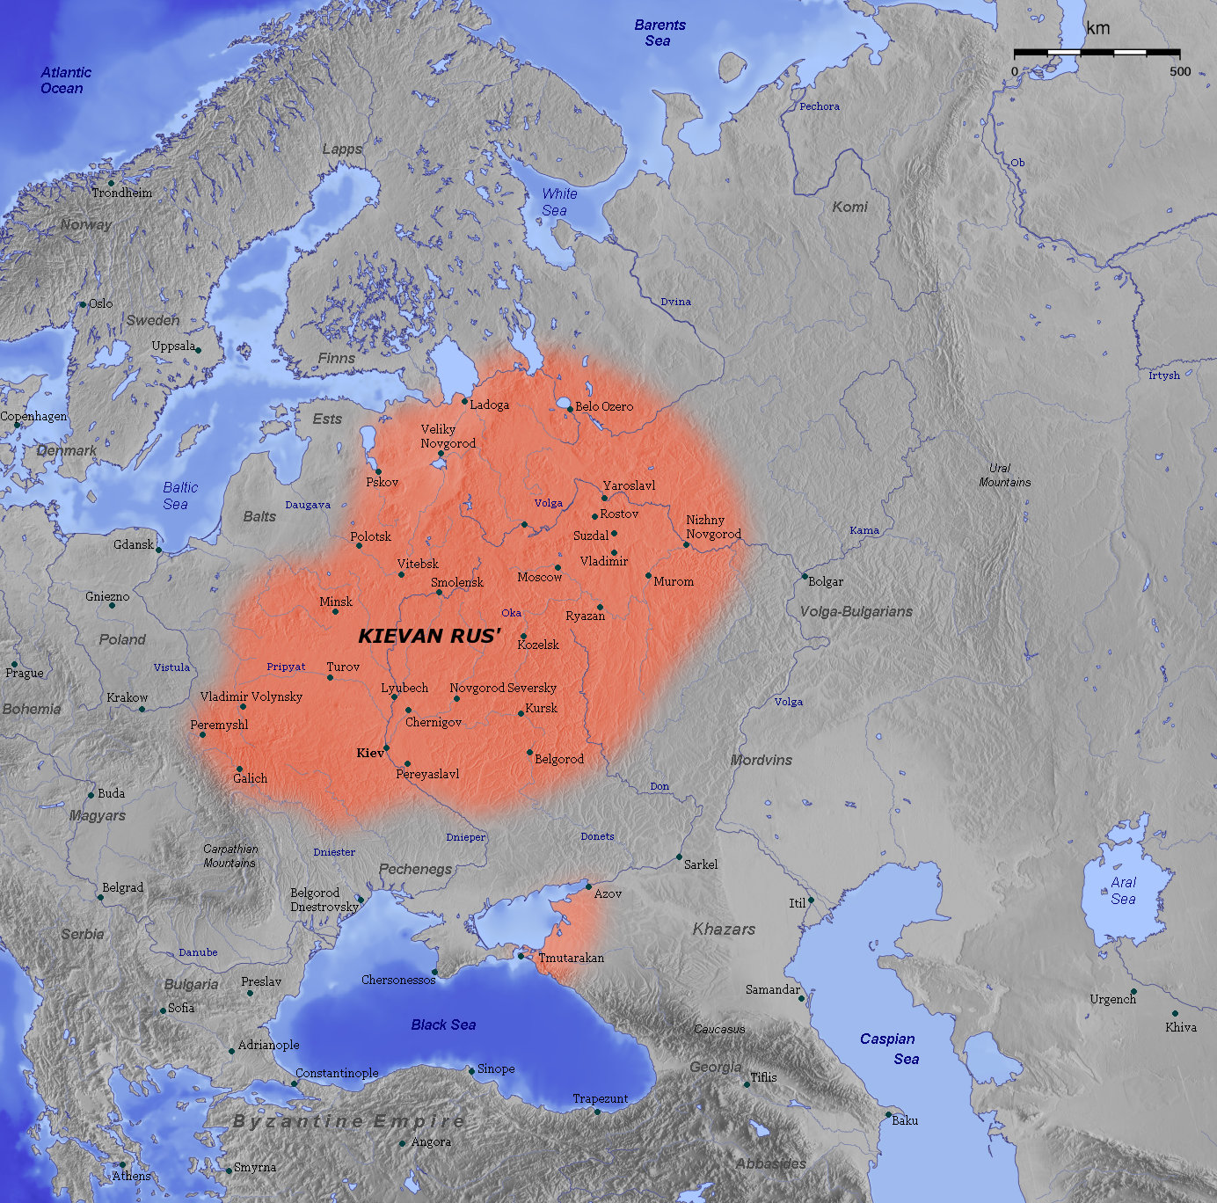
KIEVAN RUS’
SLAVIC PEOPLES HAD MOVED INTO SWEEPING PLAINS OF RUSSIA AND EASTERN EUROPE FROM AN ASIAN HOMELAND DURING THE TIME OF THE ROMAN EMPIRE
SLAVS – USED IRON; EXTENDED AGRICULTURE; ANIMIST RELIGION WITH GODS FOR THE SUN, THUNDER, WIND, AND FIRE

Slide 26
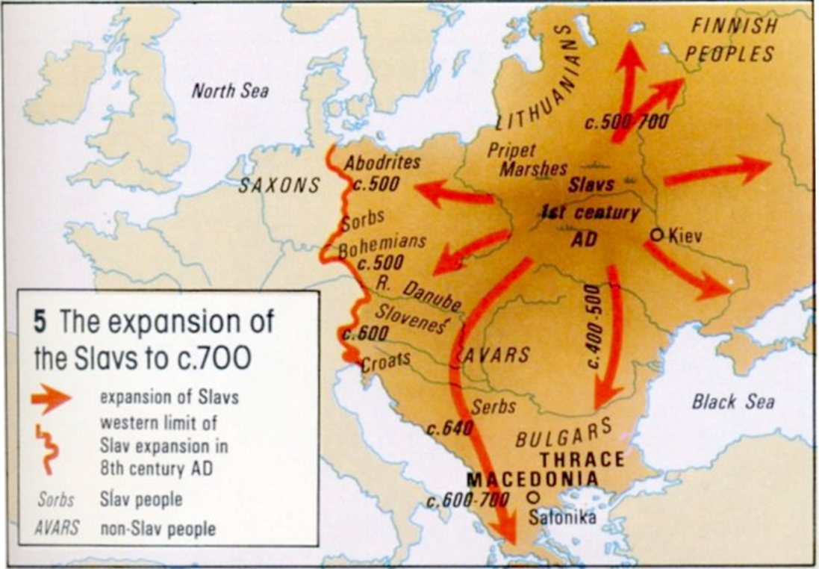

Slide 27
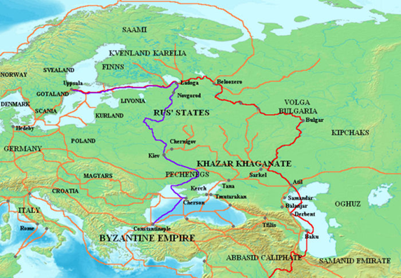
6th and 7th centuries – traders from Scandinavia (descendants of Vikings) began to work through Slavic lands
Reached Byzantine Empire and regular, flourishing trade developed between Scandinavia and Constantinople
Luxury products from Byzantium and the Arab world traveled north in return for furs and other unsophisticated products
Scandinavian traders, military superior to Slavs, gradually set up some governments along their trade route
885 – Kievan Rus’ formed
First prince – Rurik
Flourished until 12th century

Slide 28
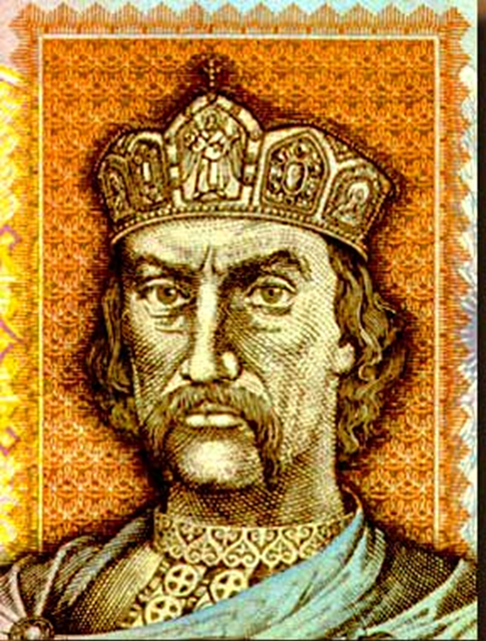
Kiev, centrally located, became a prosperous trading center
Many Russians visited Constantinople
Led to growing knowledge of Christianity
Prince Vladimir
Ruled from 980-1015
Converted to Christianity
Organized mass baptisms for his subjects, forcing conversions by military pressure

Slide 29
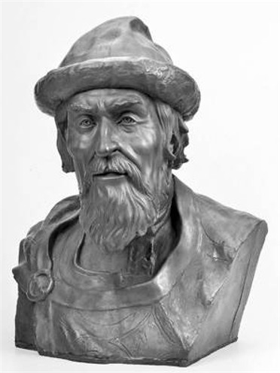
Kievan Rus
Orthodox Christian
Largest single state in Europe
Highly decentralized
Yaroslav the Wise
Issued a formal law code following Byzantine example
Reduced severity of traditional punishments
State run courts
Built many churches and arranged the translation of religious literature from Greek to Slavic

Slide 30
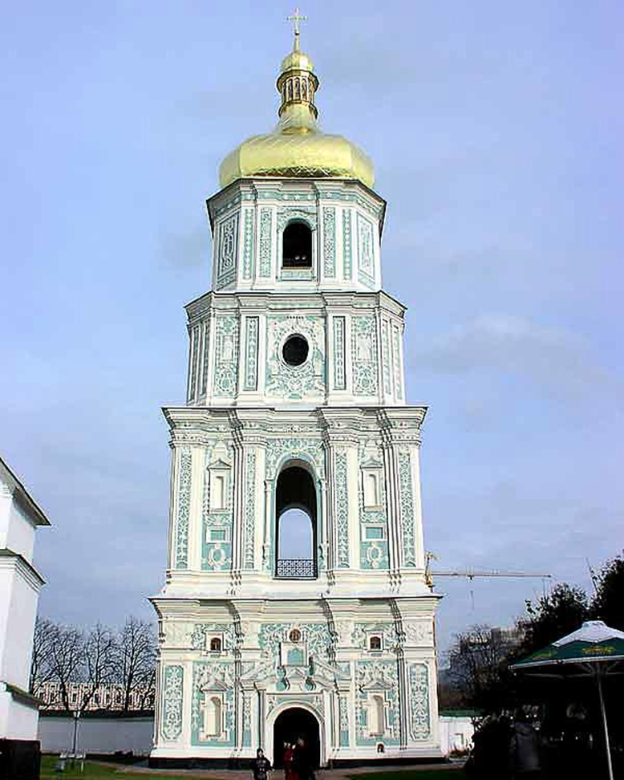
THEY COPIED A LOT FROM BYZANTIUM
THEIR ART FOCUSED ON RELIGIOUS FIGURES, DOMES STRUCTURES
PEASANTS WERE MOSTLY FREE, UNDER LOCAL CONTROL
RUSSIAN ARISTOCRATS (BOYARS ) HAD SOME POWERS, THE KIEVAN PRINCES HAD THE REST- A BALANCE OF POWER

Slide 31
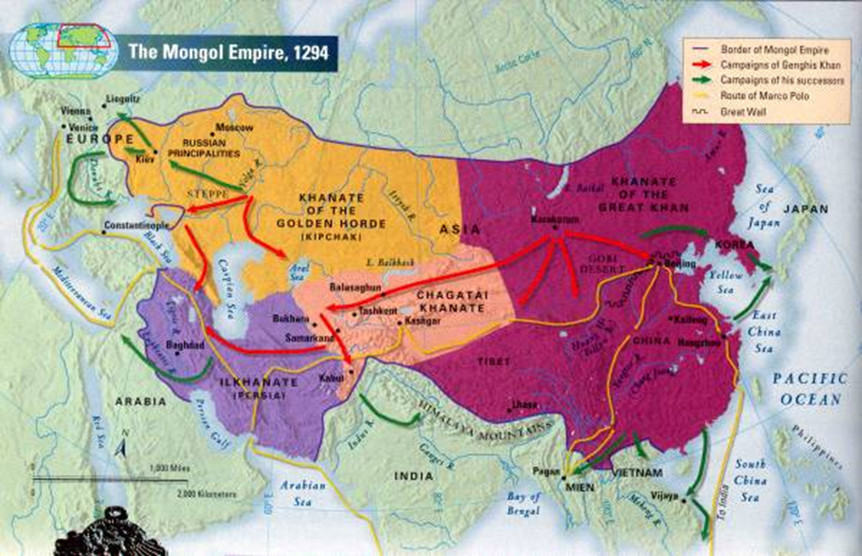
Kievan Decline
12th century – Kievan territory began to diminish
Rival princes set up regional governments
Royal family fought over succession to the throne
Rapid decline of Byzantine Empire reduced Russian trade and wealth

Slide 32
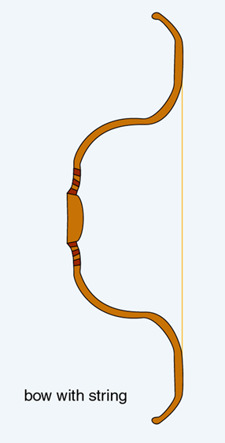
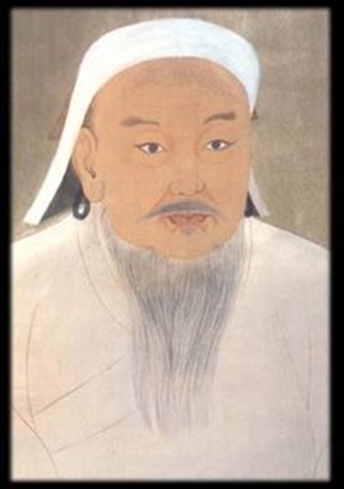
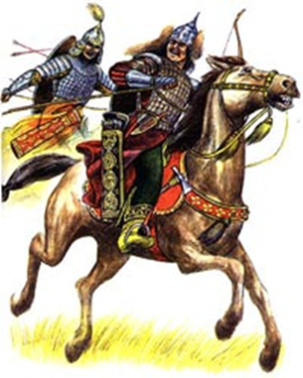
1237 – Invasion from the Mongols (Tatars)
Easily captured major Russian cities
Would control Russia for over two centuries
Tatar control did not destroy Russian Christianity or native Russian aristocratic class
As long as tribute was paid, Tatar overlords left day-to-day Russian affairs alone

Slide 33
THE LOCAL RULERS (BOYARS) STILL EXISTED
HAD TO BOW DOWN TO THE MONGOLS
PAY TAXES
WHEN THE MONGOLS WERE KICKED OUT IN 15TH CENTURY, THE LOCAL RULERS, (BOYARS) REEMERGED TO TAKE CONTROL

Slide 34
THE THIRD ROME
RUSSIAN LEADERS REMEMBERED THE GLORIES OF CONSTANTINOPLE
THEY FELT THE BURDEN OF CARRYING ON TRADITIONS HAD FALLEN TO RUSSIA
THEY CALLED THEMSELVES –
“ THE THIRD ROME”
EASTERN EUROPE FELL ON HARD TIMES FOR MANY YEARS
WESTERN EUROPE DEVELOPED WITHOUT OUTSIDE INTERFERENCE
UNLIKE ROME, OR CHINA, BYZANTINE INFLUENCE DISAPPEARED

